Slide 1
Type-safe, scalable, efficient scripting on .NET
Don Syme
MSR Cambridge
http://research.microsoft.com/fsharp
Google for “F#”, MSN for “fsharp”

Slide 2

Today…
Can we achieve a combination of paradigms? Scripting? Type-safe? Functional? OO?
Some introductory F# programming
Some F# case studies and recent language developments

Slide 3
The value of making techniques work together: .NET Generics
The JIT and NGEN code specialize where needed
Performance
List<T>
NGEN
AppDomains
Debug
Reflection
JIT
Dynamic Load
Profiling
E&C
Serialization
Intellisense
.etc.
etc
Interoperability
Usability
The feature is orthogonal and combines with to all other features on the CLR and VisualStudio
.NET Generics supports reified type parameters
Crucial around the "edges" of typed software
Safety
Safety comes from exact runtime type parameters

Slide 4
Some challenges
Type
interoperable
Functional
Imperative
OO
Type
assured
Type
free
(succinct)
Performance
Scripting
Simplicity
Scalable
Optimization
Components

Slide 5
The Context
Visual Studio
Debuggers,
Profilers etc.
.NET Common
Language
Runtime
C#
XML
Libraries
GUI Libraries,
etc.
Visual Basic
ML
F#
Languages are central, but must interoperate;
A language is judged foremost on its ability to leverage external, existing functionality;
Graphics
Libraries
System.I/O
System.Net etc.
Sockets etc.
Database
Connection
Libraries

Slide 6
Introducing F#...
A .NET language
Aims to combine much of Lisp, ML, Scheme and Haskell in the context of .NET
Functional, math-oriented, scalable
Aimed particularly at the "AdvancedScripting and Symbolic Programming" niche at Microsoft
  e.g. Static Driver Verifier, Terminator, Machine Learning, Systems Analysis and more

Slide 7
F# as a Language
Common core language
Core
ML
Core
ML
“OCaml-Objects”
and other extensions
Modules-as-
values, functors
.NET API
Access
Other
extensions
+ tools
+ tools
OCaml
F#

Slide 8
Some Simple F# (1)
NOTE: type inferred
val data: int * int * int
let data = (1,2,3)
let sqr x = x * x
let f (x,y,z) = (sqr x, sqr y, sqr z)
let sx,sy,sz = f (10,20,30)
printf "hello world"; 1+2
let surfacePoint f x y =
new Vector3(x,y,f x y)
let surfaceNormal f x y =
let dx,dy = 0.01,0.01
let pA = surfacePoint f x y
let pA_dx = surfacePoint f (x+dx) y - pA
let pA_dy = surfacePoint f x (y+dy) - pA
normalize (cross pA_dx pA_dy)
let (|>) x f = f x
val sqr: int -> int
pattern
matching
parentheses optional on application
side effects and sequencing
let pastaProducts =
productList
|> Set.filter (fun x -> x.Contains("Ravioli"))
|> Set.to_array
local binding, sequencing
pipelining operator

Slide 9
Some Simple F# (2)
let surfaceNormal f x y =
let dx,dy = 0.01,0.01 in
let pA = surfacePoint f x y in
let pA_dx = surfacePoint f (x+dx) y - pA in
let pA_dy = surfacePoint f x (y+dy) - pA in
normalize (cross pA_dx pA_dy);;
1+1;;
do printf "Hello World";;

Slide 10
Some Simple F# (2)
#light // new in F# 1.1.12.3
let surfaceNormal f x y =
let dx,dy = 0.01,0.01
let pA = surfacePoint f x y
let pA_dx = surfacePoint f (x+dx) y - pA
let pA_dy = surfacePoint f x (y+dy) - pA
normalize (cross pA_dx pA_dy)
1+1
printf "Hello World"

Slide 11
Some Sample F# Programming

Slide 12
F# as a Language
Common core language
Core
ML
Core
ML
“OCaml-Objects”
and other extensions
Modules-as-
values, functors
.NET API
Access
Other
extensions
+ tools
+ tools
OCaml
F#

Slide 13
What of OCaml does F# omit?
Modules-as-values
Labelled or default arguments
OCaml-style objects (row-polymorphism)
Variants (column-polymorphism)
Why?
  Some platform limitations (.NET CIL)
  Some features conflict too strongly with .NET objects and other related .NET idioms
  For some we plan to add something similar

Slide 14
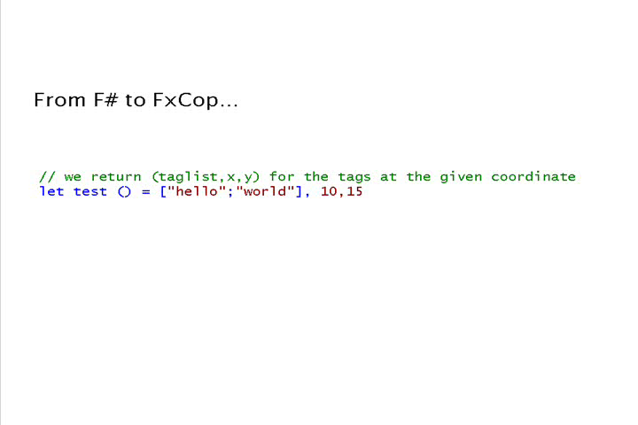
OO is fine, but...

Slide 15
Orthogonal & Unified Constructs
Type inference. The safety of C# with the succinctness of a scripting language
Let “let” simplify your life…
Bind a static value
let data = (1,2,3)
let f(a,b,c) =
let sum = a + b + c
let g(x) = sum + x*x
g(a), g(b), g(c)
Bind a static function
Bind a local value
Bind an local function

Slide 16
Orthogonal & Unified Constructs
cf. 100s of "delegate" types
in .NET
Functions: unified and simple
(fun x -> x + 1)
let f x y = x * y
let g x y = x + y
let p = (f,g)
predicate = 'a -> bool
send = 'a -> unit
threadStart = unit -> unit
comparer = 'a -> 'a -> int
hasher = 'a -> int
equality = 'a -> 'a -> bool

Slide 17
Effective abstractions
Type parameters
Discriminated unions
Pattern matching
Type inference
Recursion (Mutually-referential objects)
Map<’a,’b>
List<’a>
Set<’a>
type expr =
| Sum of expr * expr
| Prod of expr * expr
….
match expr with
| Sum(a,b) -> ...
| Prod(a,b) -> ... ….
let rec map = ...

Slide 18
The Right Defaults…
Immutability the norm…
let pi = 3.1415
pi <- 4.0
Data is immutable by default
✗!
type person =
{ Name : string;
Birth : DateTime; }
let Person(name,dob) =
{ Name = name;
Birth = dob }
let bob = Person("bob", new DateTime(1,10,1970))
do bob.Birth <- new DateTime(1,10,1969)
Values may not be changed
✗

Slide 19
In praise of immutability
Immutable objects can be relied on
Immutable objects can transfer between threads
Immutable objects can be aliased safely
Immutable objects lead to (different) optimization opportunities
  less pessimistic copying when returning values from APIs
  a sensible, efficient notion of closure

Slide 20
Case Study 1: TrueSkill
Live game ranking algorithms in F#

Slide 21
Typical F# Project Architecture
etc. etc. etc.
MATLAB
Base Tools
✓ Windows (any edition)
✓ .NET Framework 2.0
✓ F# 1.1.11
Readily Accessible Extras
✓ Visual Studio 2005
✓ SQL Server 2005
✓ Alchemi (.NET distribution framework)
✓ also many, many others
e.g. Visual C++, DirectX,
dnAnalytics, MKL,
LAPACK, MATLAB,
AJAX libraries
etc. etc. etc.
.NET Framework
libraries
Interactive
Visualization
Web
Database
Analysis
Data Access
F#
File-based
Databases
Simulation
Scripting
private
C# matrix
library
SQL
Server Database
C++ simulation
engine

Slide 22
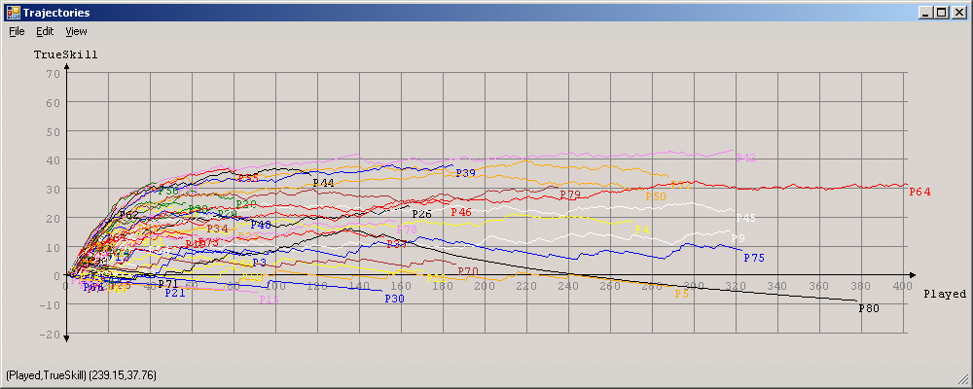
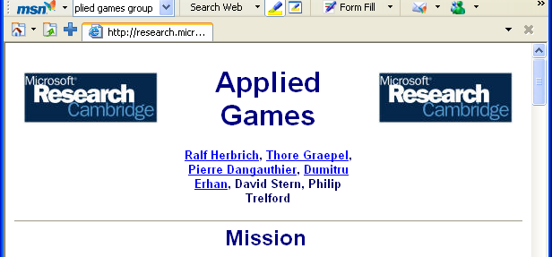
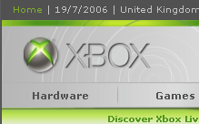
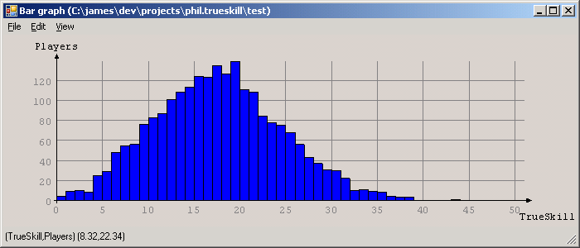

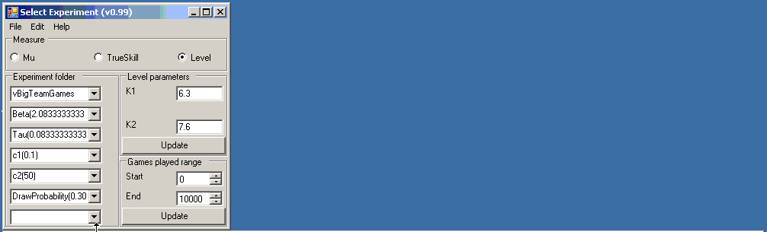
F# and Machine Learning at MSR Cambridge
MSR Cambridge's Machine learning group have the most advanced ranking algorithms in the world
They give F# binaries to the product teams for massive background server-side analysis of XBox Live game logs
All XBox Live games are ranked by similar techniques

Slide 23
MSRC/XBox: Large Scale Data Analysis
Problem:
  Analysis of 4.2 million Xbox 360 Live user feedbacks (4 months worth of data).
  Data is already in a SQL database.
Task:
  Adopt TrueSkill™ model to the user feedback problem for integration into the Xbox Live service.
Code:
  100 lines long!
Development time (code):
  3 – 4 hours.
Performance:
  10 minutes runtime for the whole dataset!

Slide 24
MSRC/XBox: Complex Scientific Modelling
Problem:
  Framework for probabilistic inference (research).
Task:
  Extensible and “thin” factor graph library.
Code:
  400 lines long (comparable C# code: ≈2000 lines)
Development time (code):
  2 weeks.
Performance:
  Excellent. Can now create and compute with > 1 Million node Factor Graphs

Slide 25
Some happy users
"We crunched 400Gb of data, scripting over smaller sets then finally running with a 15 computer cluster
New F# user (experienced OO programmer)
  “The F# code has excellent performance.”
  “F# is fun!”
  “I really enjoyed the brevity of the resulting code. It helped me focus on the ends, not the means.”
  “The F# code was easy to maintain and evolve”
Notes:
During the project I found coding in F# fun, and really enjoyed the brevity of the resultant code due to F#’s type inference and extensive collection functions.
I found the resultant F# code easy to maintain and evolve as new requirements came in, and even produced a reusable graph drawing library along the way.
The main challenges were to crunch through hundreds of gigabytes of data for 3 days using an array of 15 computers, and then to present the huge results in a usable and responsive way.
The succinctness of F# combined with the .Net framework helped me to focus on the ends and not the means.
The UI code was able to stream a 100Mb CSV file from disk in around 5 seconds, while simultaneously calculating and drawing a histogram as it loaded
Performance of the F# code was excellent.
Plus the best optimisations come from better algorithms and with F# constructs like lazy enumerations, you can focus there.

Slide 26
F# as a Multi-paradigm Language

Slide 27
The F# approach to OO programming
Type inference for .NET subtyping
  Through HM(X)-style constrained polymorphism with subtype and operator overloading constraints
Embrace the "." notation
  Can be used with regular F# types, e.g. unions and records
Permit the full .NET single-inheritance OO model
  Partly for interoperability and ".NET-style" library design
  But F# is actually a very nice OO language too
  Classes only get used where really necessary

Slide 28
Augmentation and type-directed name resolution
Type Definition
type point = { x: float; y: float }
let mkPoint x y = {x=x;y=y}
let getX p = p.x
let getY p = p.y
type point
with
static member Create(x,y) = {x=x; y=y}
static member Origin = { x=0.0; y=0.0 }
member p.Add(dx,dy) = { x=p.x+dx; y=p.y+dy }
member p.X = p.x
member p.Y = p.y
end
let p = point.Create(3.14,6.28);;
p.X;;
p.Y;;
type point = { x: float; y: float }
let mkPoint x y = {x=x;y=y}
let getX p = p.x
let getY p = p.y
type point
with
static member Create(x,y) = {x=x; y=y}
static member Origin = { x=0.0; y=0.0 }
end
type point = { x: float; y: float }
let mkPoint x y = {x=x;y=y}
let getX p = p.x
let getY p = p.y
type point
with
…
end
type point = { x: float; y: float }
type point = { x: float; y: float }
let mkPoint x y = {x=x;y=y}
let getX p = p.x
let getY p = p.y
Type Augmentation
(~instance declaration for adhoc-dot-notation)
We haven't compromised the basic way of writing code in the language
// point.mli (signature)
type point
with
static member Create : float * float -> point
static member Origin : point
member X : float
member Y : float
member Add : float * float -> point
end
Method member
Property members
(can compute)
But OO presentation techniques are available if needed
This can now be understood and used by any .NET programmer

Slide 29
Classes and interfaces
The full .NET OO model is also supported
type point = class
val x: float
val y: float
new(x,y} = { x=x;y=y }
static member Create(x,y) = {x=x; y=y}
static member Origin = { x=0.0; y=0.0 }
member p.Add(dx,dy) = { x=p.x+dx; y=p.y+dy }
member p.X = p.x
member p.Y = p.y
end
// point.mli (signature)
type point
with
static member Create : float * float -> point
static member Origin : point
member X : float
member Y : float
member Add : float * float -> point
end
This can now be understood and used by any .NET programmer

Slide 30
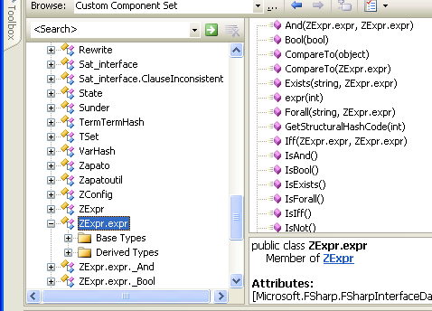
Interoperation: publishing code
Mechanism 1: All ML public types and code have accessible, reliable compiled forms
  e.g. ML type names, type representations and values have predictable, stable, public representations
Lib.expr b = Lib.expr.True;
switch (b.Tag)
{
case Lib.expr.tag_Bool:
Console.WriteLine(“B({0})“,b.Bool1);
break;
case Lib.expr.tag_Term:
Console.WriteLine(“T({0})“,b.Term1);
break;
}
type expr = Bool of bool
| Term of Term.term
| Not of expr
| And of expr * expr
| Or of expr * expr
| Iff of expr * expr
| Forall of string * expr
| Exists of string * expr
match (b) with
| Bool(b) -> ...
| Term(t) -> ...

Slide 31
Case Study: Packet Mining
MS Cambridge, Systems Group

Slide 32
The Packet Mining Problems
The Data:
  4+ TB of packet captures from a one month period (headers).
  Data spread over 9000 files of ~500Mb each.
Task:
  Study real world network usage.
  Mine data for performance and usage information.
Code:
  Packet reader and de-multiplex library in F#.
Development time (code):
  2000 lines, 1 week for beginner
Performance:
  F# reads packets at 80,000 packets / second.
  Live capture processing a possibility . . .

Slide 33
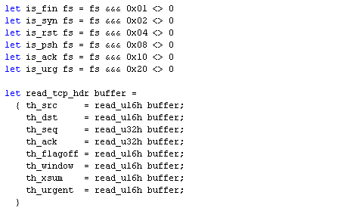
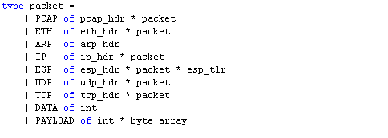
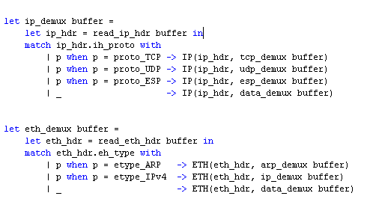
F# TCP header and packet modelling
Structural packet modelling
Packet cracking: drab, but dead simple, efficient and succinct
Notes:
During the project I found coding in F# fun, and really enjoyed the brevity of the resultant code due to F#’s type inference and extensive collection functions.
I found the resultant F# code easy to maintain and evolve as new requirements came in, and even produced a reusable graph drawing library along the way.
The main challenges were to crunch through hundreds of gigabytes of data for 3 days using an array of 15 computers, and then to present the huge results in a usable and responsive way.
The succinctness of F# combined with the .Net framework helped me to focus on the ends and not the means.
The UI code was able to stream a 100Mb CSV file from disk in around 5 seconds, while simultaneously calculating and drawing a histogram as it loaded
Performance of the F# code was excellent.
Plus the best optimisations come from better algorithms and with F# constructs like lazy enumerations, you can focus there.

Slide 34
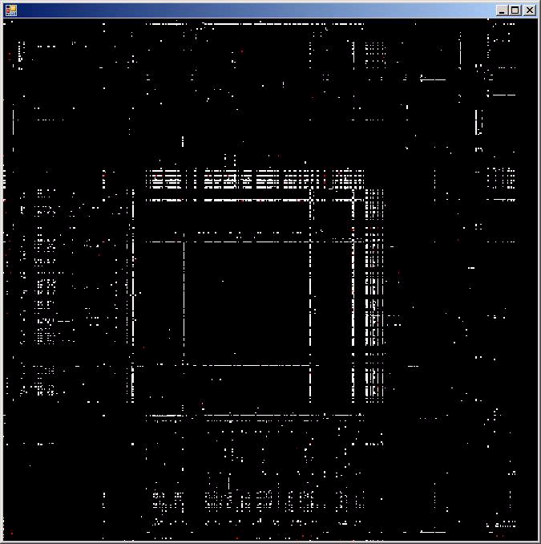
Example: who talks to who?
Connectivity:
  Packets have source and destination IP
  What is the connectivity graph?
  How does it break down by protocol?
  Summary of 500Mb capture. (10 min of traffic).
  Servers with high connectivity.
Feedback
  “Speed and Type-checking”
  “I can write terse code (like in Python) but it's fast at runtime and is type-checked."
  "Now I'm disk bound”
Dest IP
Address
Source IP Address

Slide 35
Dynamic, Static and all that

Slide 36
F# is Statically-oriented
F# originates from ML
  Traditionally a "type-safe LISP"
  Used for sophisticated interactive symbolic manipulations, where types are essential
  Easily scales to 100,000 loc+ programs
But:
  ML has traditionally been interactive
  ML has otherwise been very "non-dynamic"
  e.g. very rigid typing, no reflection, no runtime type representations, no type-rediscovery, no dynamic load, no E&C

Slide 37
F# is also surprisingly dynamic (.NET)
What is a dynamic language anyway?
 | F# | The “dynamic” languages
Dynamic Load | ✓ | ✓
Runtime Types | ✓ | ✓
Dynamic invocation | ✓ | ✓
Reflection-for-introspection | ✓ | ✓
Dynamic code generation | ✓ | ✓
Use with no compile phase | ✓ | ✓
Parse fragments at runtime | ✗ | ✓
Mutate the “type schema” | ✗ | ✓
Efficient | ✓ | ✗

Slide 38
Dynamic & Static: Looking Ahead
Trends in static typing:
  Ownership: Stronger guarantees about shapes, heaps
  Haskell et al: Type re-discovery and packaging with existential types (GADTs, wildcards)
  Scala: More uniform, extensible object models
  OCaml: More extensible structural models
  Industry: A possible move to more concurrent programming
Trends in dynamic techniques:
  Will leave the experts to talk about this ☺

Slide 39
Recent Work (1): LINQ and F# Quotations

Slide 40
Language Integrated Queries with F#/LINQ
db.Customers
|> where « fun c -> c.City = "London" »
|> select « fun c -> c.ContactName »
["Thomas Hardy"; "Victoria Ashworth";
"Elizabeth Brown"; "Ann Devon";
"Simon Crowther"; "Hari Kumar"]
SELECT [t0].[ContactName]
FROM [Customers] AS [t0]
WHERE @p0 = [t0].[City]

Slide 41

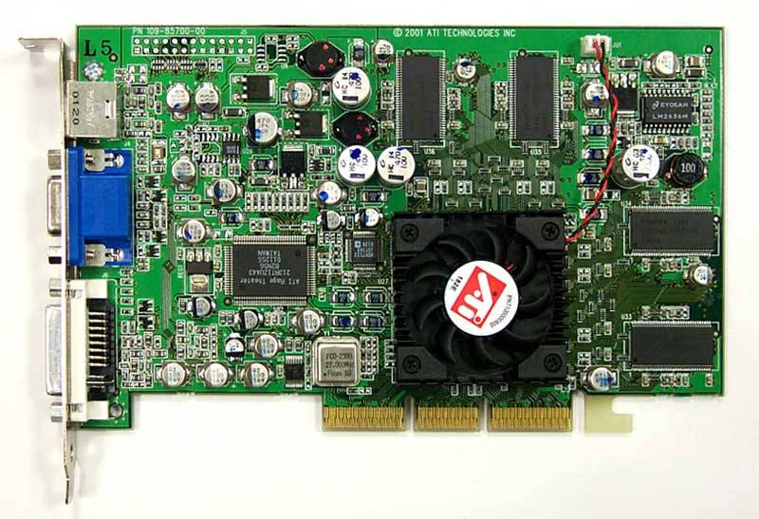
Accelerate ahead!
let nextGeneration(a) =
let sum = rot a (-1) (-1) .+ rot a (-1) 0 .+ rot a (-1) 1
.+ rot a 0 (-1) .+ rot a 0 1
.+ rot a 1 (-1) .+ rot a 1 0 .+ rot a 1 1 in
(sum .= three) .|| ((sum .= two) .&& a);;
nextGeneration a
accelerate <@ nextGeneration @> a
Accelerator.dll
Metaprogram
Program
GPU assembly code
CPU
Graphics Card

Slide 42
Recent Work (2): Active Patterns

Slide 43
Active Patterns and Views
concrete
view
type ilist =
| Empty
| Single of int
| Join of ilist * ilist
val Nil : IQuery<ilist,unit>
val Cons : IQuery<ilist,(int * ilist)>
view ilist ~> Nil | Cons
| Nil
| Cons of int * ilist
val Nil : IQuery<ilist,unit>
val Cons : IQuery<ilist,(int * ilist)>
use-site
let head js =
match js with
| Cons (x,_) -> x
| _ -> failwith "empty list"
Elements of views have IQuery type
(~=~ 'a -> 'b option)
TODO: add "views" and Okasaki run-once semantics
implementation
of view
IQuery typed-values can be used as (nested) patterns
let pattern f = { new IQuery<_,_> with get_Query () = f }
let rec Cons = pattern (function
| Single x -> Some (x, Empty)
| Join (Cons (x,xs), ys) -> Some (x, Join (xs, ys))
| Join (Nil (), Cons (y,ys)) -> Some (y, ys)
| _ -> None)
and Nil = query (function
| Empty
| Join (Nil (), Nil ()) -> Some ()
| _ -> None)
use-site (computed pattern)
Computed IQuerys
let insert x xs =
match xs with
| ?!(Member x) _ -> xs
| _ -> x :: xs
Implementing view elements

Slide 44
Active Pattern Samples
type complex = (float * float)
let Polar = pattern (fun (re, im) -> Some (sqrt (re*re + im*im), atan2 im re))
view complex ~~> Polar
type System.Type
let TyApp = …
let TyArray = …
let TyByRef = …
let TyPtr = …
view System.Type ~~> TyApp | TyArray | TyByRef | TyPtr
let Succ = query (fun n -> if n > 0 then Some (n-1) else None)
let Zero = query (fun n -> if n = 0 then Some () else None)
view int ~~> Zero | Succ

Slide 45
A Little on Performance

Slide 46
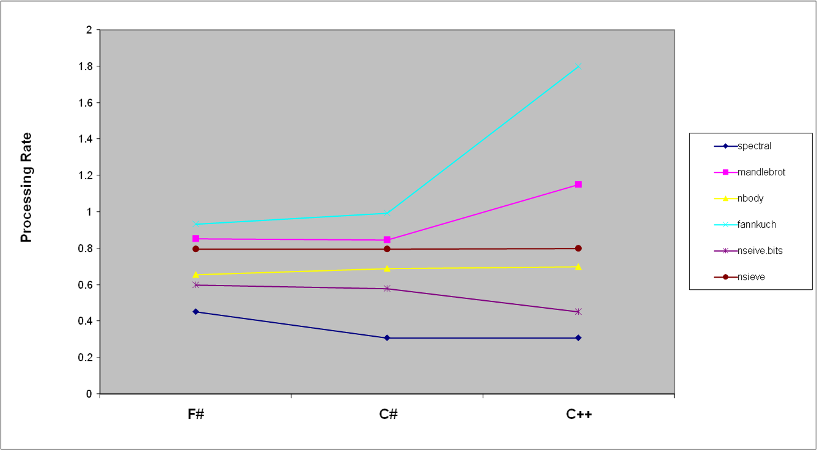
Some Micro Benchmarks by Language
P4 3GHz, 512kb cache

Slide 47
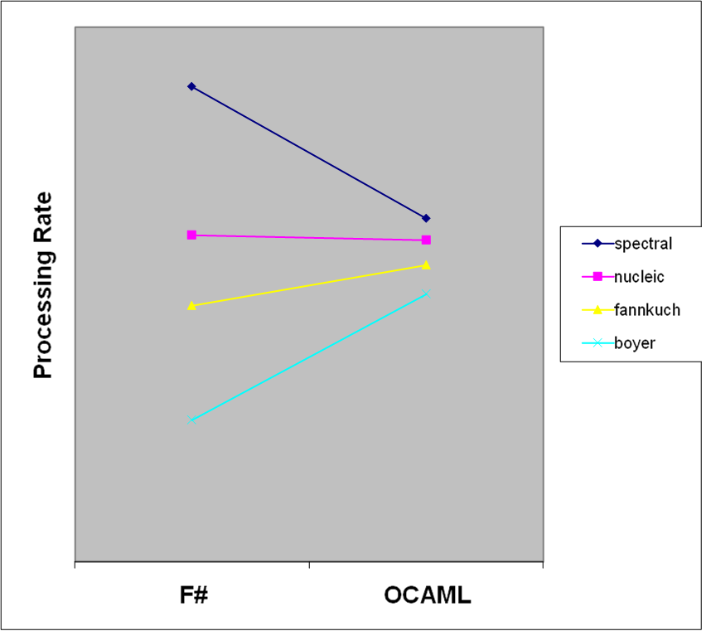
F# and OCAML benchmarks
0

Slide 48
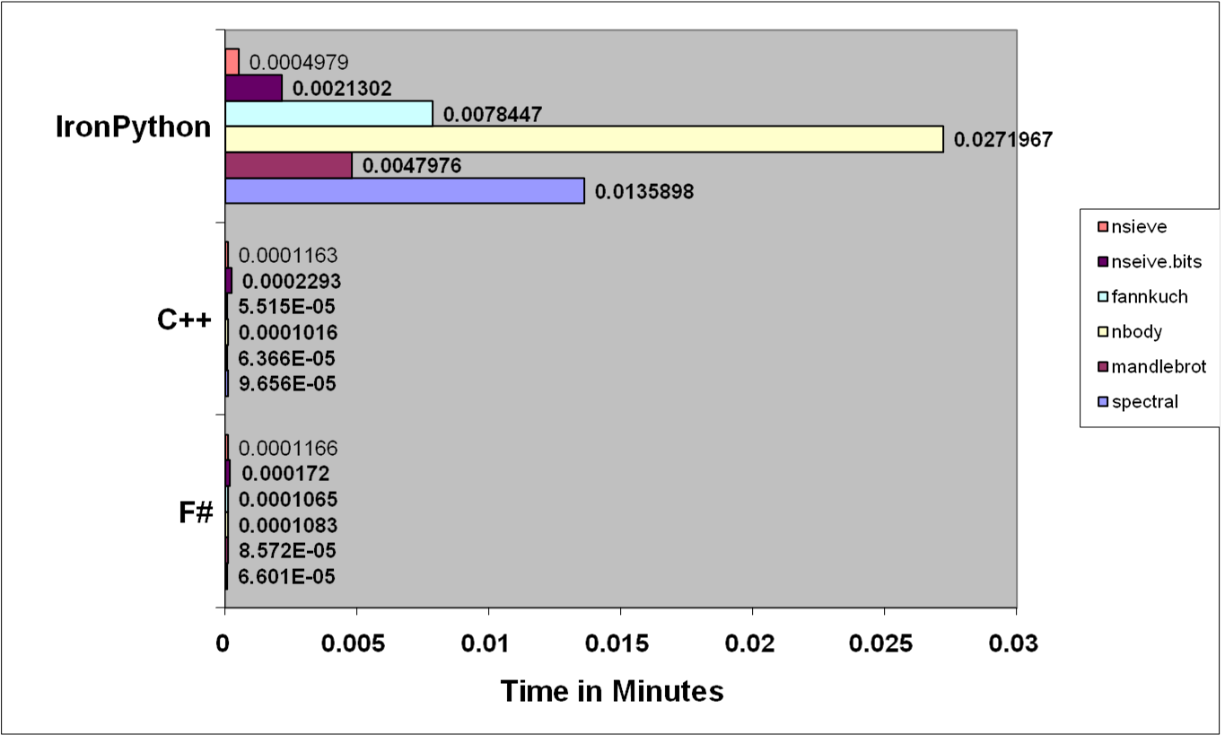
Running times for benchmarks
A sample
.NET dynamic
language

Slide 49
Summary

Slide 50
Some challenges for F#
F# is a function-oriented multi-paradigm language
Interoperable
Functional
Imperative
OO
Type
assured
Succinct
F# code is largely type-inferred, hence succinct
Scripting
F# Interactive code is fully optimized (>= C# perf)
Optimization
Components

Slide 51
Challenges of modern language design
Statically typed, hence
Scalable (> 100K LOC)
It’s the
combination that counts
Succinct
Safe
Efficient
Libraries
Interactive
Interoperable
Good
Platform

Slide 52
Questions?

Slide 53
Backup

Slide 54
Quotation literals by example
<@ 1 + 2 @>;; -- : int expr
<@ x + 1 @>;; -- "not closed"
<@ fun x -> x + 1 @>;; -- : (int -> int) expr
<@ _ + 1 @>;; -- : int expr -> int expr
<@| _ + _ + 1 |@>;; -- : int expr -> int expr option
let (<@| |@>) t = match1 t -- can redefine operators
let (<@. .@>) t = matchHO t -- can define new operators
A phantom-typed "AST template with holes" indicating holes and their types.

Slide 55
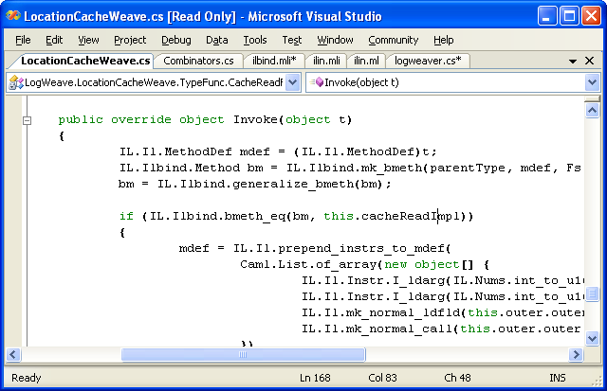
Calling F# from C#
LogWeave (Office XAF Optimization Tool)
4000 lines C#, using Abstract IL library
Using types defined in F#
Using functions defined in F#
il.mli/ilbind.mli
type Method
type MethodDef
val bmeth_hash : Method -> int
val bmeth_eq : Method -> Method -> bool
val bmeth_compare : Method -> Method -> int
val mk_bmeth : Type * MethodDef * Types -> Method
val mk_generalized_bmeth : Type * MethodDef -> Method
val generalize_bmeth : Method -> Method

Slide 56
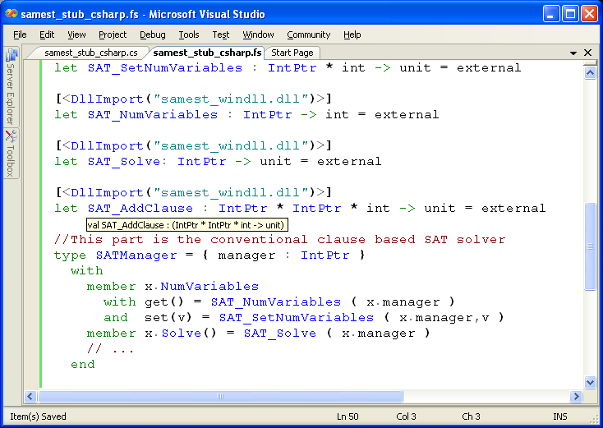
Calling C/C++
C SAT Solver
Accessed from F#
Type-safe F# wrapper

Slide 57
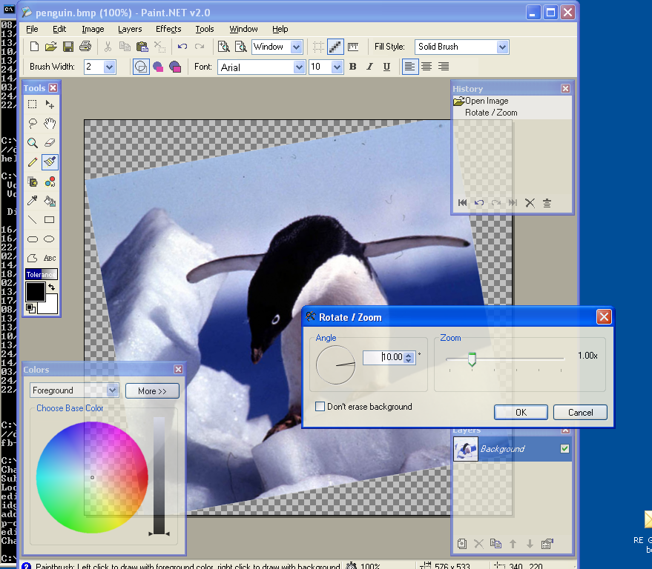
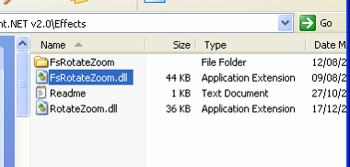
#3: Paint.NET & Plugins
Plugin written in F#
Here is the DLL

Slide 58
The Vision: Heterogeneous Execution
Today languages use homogeneous execution:
  The CPU
The natural extension of the LINQ vision is heterogeneous execution, leveraging
  The database
  The server
  The GPU
  The web browser (ala AJAX)
  Symbolic execution
Write your code in one language, execute it in many completely different ways

Slide 59
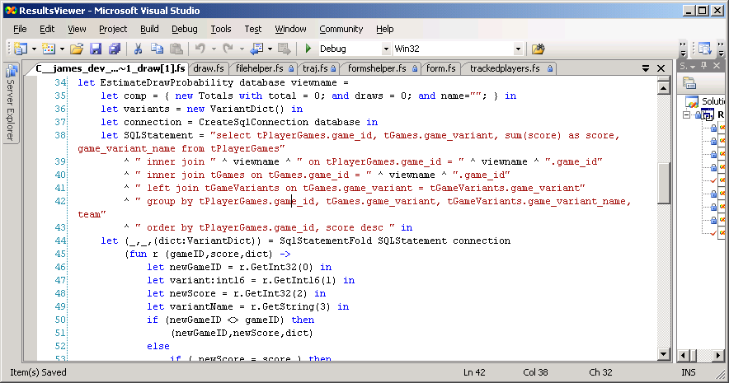
F# code - data processing

Slide 60
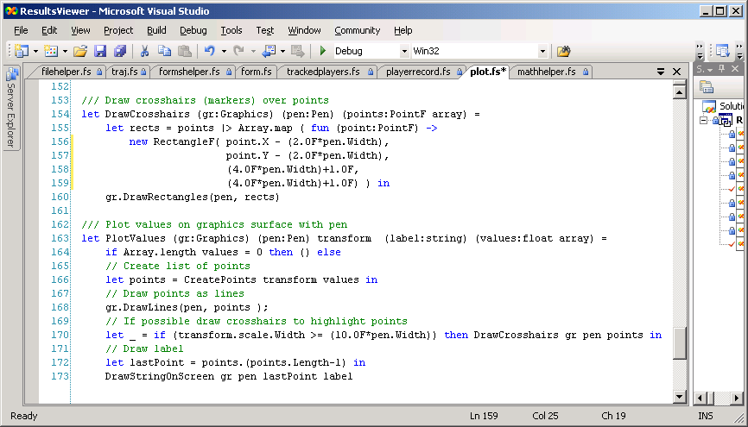
Code – plotting v. TrueSkill

Slide 61
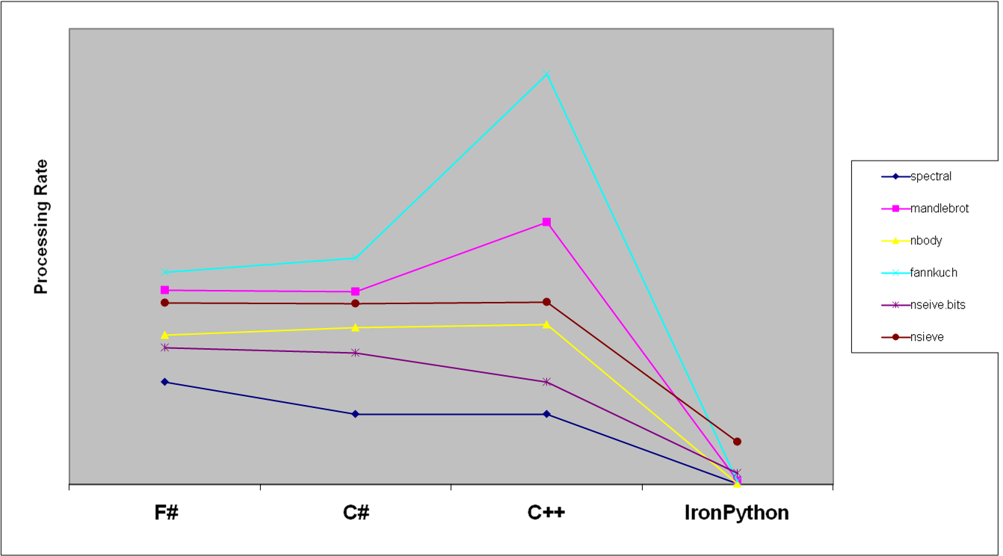
Benchmark Performance by Language

