Slide 1
Introducing F# 1.1
Don Syme
Thanks to the Programming Principles and Tools group
Special thanks to James Margetson

Slide 2
The Programme
Prelude
The functional heart of F#
Interlude
What’s new in F# 1.1
Interlude
Related Work & Summary

Slide 3
Prelude:
A Modern Hello World

Slide 4
Part 1 – The functional heart of F#

Slide 5
F# as a Language
Powerful but simple programming language
Core
ML
Core
ML
“OCaml-Objects”
and other extensions
Modules-as-
values, functors
.NET API
Access
Other
extensions
+ tools
+ tools
OCaml
F#

Slide 6

Orthogonal & Unified Constructs
Type inference. The safety of C# with the succinctness of a scripting language
Let “let” simplify your life…
Bind a static value
let data = (1,2,3)
let f(a,b,c) =
let sum = a + b + c in
let g(x) = sum + x*x in
g(a), g(b), g(c)
Bind a static function
Bind a local value
Bind an local function

Slide 7
Orthogonal & Unified Constructs
“let” + “capture”: sophisticated operations in sophisticated contexts…
Context
Operation in
context
let readBinary(inputStream) =
let read () = inputStream.ReadByte() in
let smallFormat = (read() == 0x2) in
…
let readOneRecord() =
…
if (smallFormat) then read()
else … in
…
readOneRecord();
readOneRecord();
Operation in
richer context
Use operations in
rich context

Slide 8
Orthogonal & Unified Constructs
Immutability the norm…
All F# data is immutable by default
let data = 3
do data := 4
type data =
{ Name: string;
Size: int;
Items: Map<string,string> }
let NewData(name,items) =
{ Name=name;
Size=Map.size items;
Items=items }
Simple values may not be changed

Slide 9
Orthogonal & Unified Constructs
Mutability allowed if needed…
Mutability explicit
type table =
{ Name: string;
mutable Items: string[] }
Mutation
let data =
{ Name= “Don”;
Items= [| “x”;”y”;”z” |]
do data.Items <- [| “a”;”b” |]
Used well, this isolates and controls complexity

Slide 10
In praise of immutability
Immutable objects can be relied on
Immutable objects can transfer between threads
Immutable objects can be aliased safely
Immutable objects can be optimized

Slide 11
Orthogonal & Unified Constructs
Function values simplify and unify
…iteration
val List.map: (‘a → ‘b) → list<‘a> → list<‘b>
val List.foreach: list<‘a> → (‘a -> unit) → unit
val IEnumerable.map: (‘a → ‘b) → IEnumerable<‘a> → IEnumerable<‘b>
val IEnumerable.foreach: IEnumerable<‘a> → (‘a -> unit) → unit
Structural and Logical transformations made easy
Imperative and functional versions encouraged

Slide 12
Orthogonal & Unified Constructs
Function values simplify and unify
…extension
“Virtual methods”
(extension points)
type UnaryOperator =
{ evaluate: (float → float); // evaulation function
differentiate: (expr → expr); // symbolic differentiation function
name: string } // identity
let sinop = { evaluate=sin;
differentiate=Cos;
name="sin" }
Subclass? What subclass?

Slide 13
Orthogonal & Unified Constructs
Type parameters
Discriminated unions
Pattern matching
Type inference
Recursion (Mutually-referential objects)
Map<’a,’b>
List<’a>
Set<’a>
type expr =
| Sum of expr * expr
| Prod of expr * expr
….
match expr with
| Sum(a,b) -> ...
| Prod(a,b) -> ... ….
let rec map = ...

Slide 14
Less is More?
Fewer concepts = Less time in class design
Far fewer null pointers
Far fewer classes and other type definitions
Less OO weirdness: constructors-calling-virtual-methods and other OO dangers

Slide 15
Access to .NET
.NET access through adhoc overloading
Nb. For L-R inference order matters. Seems to be reasonable in practice
Operator overloading
Very weak type-class-like traits
Method overloading
Based on l-r inference of argument types
LConstraints |- arg-type
Name resolution
Based on l-r inference
of head type
LConstraints |- e : type
expr + expr
expr * expr
Type.Property
Type.MethodName
expr.MethodName
expr.Property
expr.MethodName(args)
expr.IndexerProperty(args)

Slide 16
Interlude:
A perf taster

Slide 17
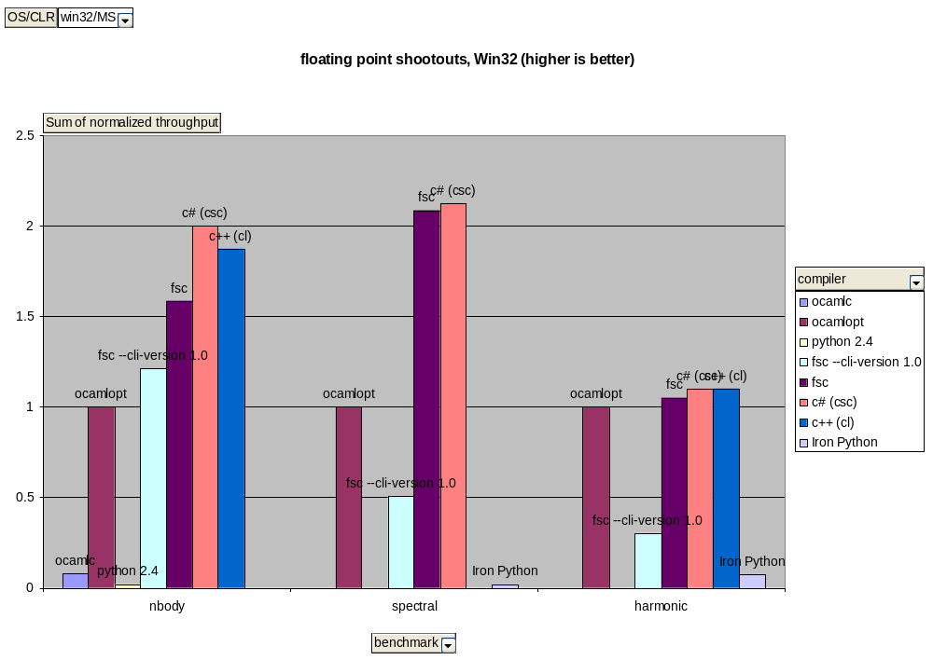
Floating point performance
and Python is the future of computational science!??

Slide 18
F# & OCaml Perf
F# is often faster for floating point and matrix computations
OCamlopt is typically faster for “term crunching”
But F# consistently beats the interactive/dynamic OCamlc.exe

Slide 19
Part 2 – F# 1.1

Slide 20
F# 1.1 - Two Big Ticket Items
F# Interactive (fsi.exe)
The F# Object and Encapsulation Model
Also
  Operator overloading according to .NET standards
  bignum, bigint
  XMLDocs
  Optimizations and other bits and pieces

Slide 21
F# 1.1: Objects and Encapsulation
Functional programming is excellent in the small
  i.e. the majority of your code
Objects and Encapsulation are for:
  Publish
  Design-for-Discoverability
  Large-scale library design
  Large recursive scopes

Slide 22
Objects and Encapsulation by Example
Type Definition
type point = { x: float; y: float }
let mkPoint x y = {x=x;y=y}
let getX p = p.x
let getY p = p.y
type point
with
static member Create(x,y) = {x=x; y=y}
static member Origin = { x=0.0; y=0.0 }
member p.Add(dx,dy) = { x=p.x+dx; y=p.y+dy }
member p.X = p.x
member p.Y = p.y
end
let p = point.Create(3.14,6.28);;
p.X;;
p.Y;;
type point = { x: float; y: float }
let mkPoint x y = {x=x;y=y}
let getX p = p.x
let getY p = p.y
type point
with
static member Create(x,y) = {x=x; y=y}
static member Origin = { x=0.0; y=0.0 }
end
type point = { x: float; y: float }
let mkPoint x y = {x=x;y=y}
let getX p = p.x
let getY p = p.y
type point
with
…
end
type point = { x: float; y: float }
type point = { x: float; y: float }
let mkPoint x y = {x=x;y=y}
let getX p = p.x
let getY p = p.y
Type Augmentation
// point.mli (signature)
type point
with
static member Create : float * float -> point
static member Origin : point
member X : float
member Y : float
member Add : float * float -> point
end
Method member
Property members
(can compute)

Slide 23
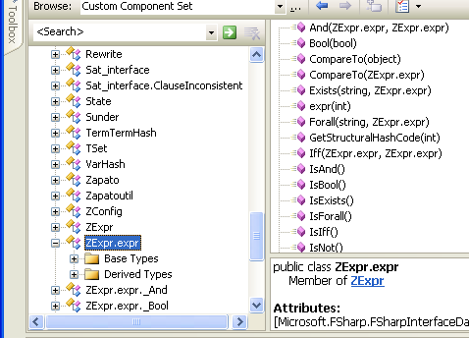
F# 1.1: Publishing F# Code
Mechanism 1: All ML public types and code have accessible, reliable compiled forms
  e.g. ML type names, type representations and values have predictable, stable, public representations
Lib.expr b = Lib.expr.True;
switch (b.Tag)
{
case Lib.expr.tag_Bool:
Console.WriteLine(“B({0})“,b.Bool1);
break;
case Lib.expr.tag_Term:
Console.WriteLine(“T({0})“,b.Term1);
break;
}
type expr = Bool of bool
| Term of Term.term
| Not of expr
| And of expr * expr
| Or of expr * expr
| Iff of expr * expr
| Forall of string * expr
| Exists of string * expr
match (b) with
| Bool(b) -> ...
| Term(t) -> ...

Slide 24
F# 1.1: Publishing F# Code
Mechanism 2: Using the Encapsulation extensions
Publishing F# Code:
  Expect high “sophistication : surface” ratio. e.g. 2000 lines ML, then publish to .NET
  Not particularly expanding the language of component description
Mechanism /= Policy
  .NET library design guidelines are good
type BigInt
with
static member (+) : z * z -> z
static member (*) : z * z -> z
static member (-) : z * z -> z
static member (/) : z * z -> z
interface System.IComparable
interface IStructuralHash
end
Remember, members can be used without classes!
type BigInt
= { sign : int; v : N.n }
with
interface System.IComparable with
...
end
interface IStructuralHash with
...
end
end

Slide 25
F# 1.1: Subtyping and Subtype Constraints
The basic mechanism:
This function accepts any thing that is a subtype of “Stream”
val f : (_ :> Stream) -> StreamWriter
val f: 'a -> StreamWriter when 'a :> StreamWriter
Equivalent to this more verbose form

Slide 26
F# 1.1: Subtyping and Subtype Constraints
Refactoring works:
StreamWriter(_ :> Stream)
let x1 = new StreamWriter(new FileStream(“abc.txt”))
let x2 = new StreamWriter(new MemoryStream(bytes))
let f s = new StreamWriter(s)
let x1 = f(new FileStream(“abc.txt”)
let x2 = f(new MemoryStream(bytes)
Refactor to a function, no type error

Slide 27
F# 1.1 – Library
fslib.dll
  Microsoft.FSharp.Math.BigInt
  Microsoft.FSharp.Math.BigNum
  Microsoft.FSharp.Idioms
  Microsoft.FSharp.Experimental.Reflection
  Microsoft.FSharp.Experimental.SharpCollections
  Microsoft.FSharp.Math.MatrixF (next release)
  Microsoft.FSharp.Math.Matrix (next release)

Slide 28
Interlude:
5 F# Screen Shots

Slide 29
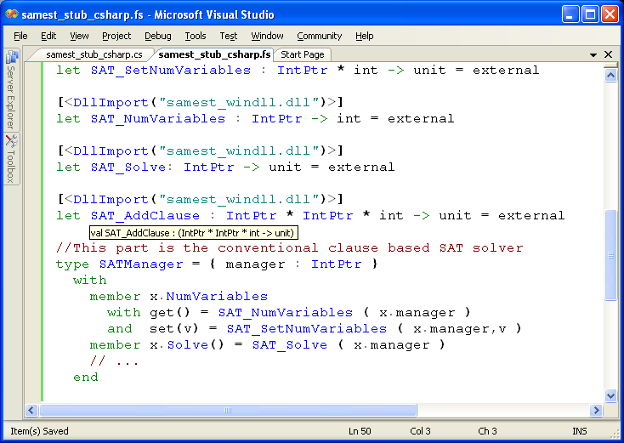
#1: Calling C/C++
World-class SAT Solver
Easily made available in F#
Wrapped as an augmented
F# type

Slide 30
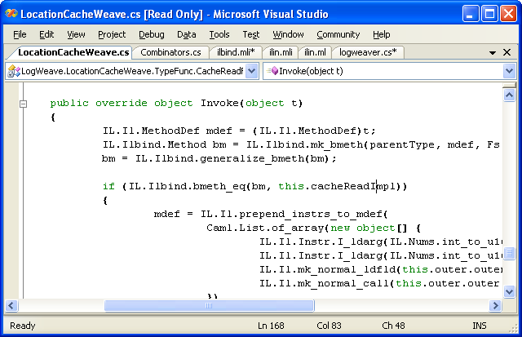
#2: Calling F# from C#
LogWeave (Office XAF Optimization Tool)
4000 lines C#, using Abstract IL library
Using types defined in F#
Using functions defined in F#
ilbind.mli
type Method
val bmeth_hash : Method -> int
val bmeth_eq : Method -> Method -> bool
val bmeth_compare : Method -> Method -> int
val mk_bmeth : Type * MethodDef * Types -> Method
val mk_generalized_bmeth : Type * MethodDef -> Method
val generalize_bmeth : Method -> Method

Slide 31
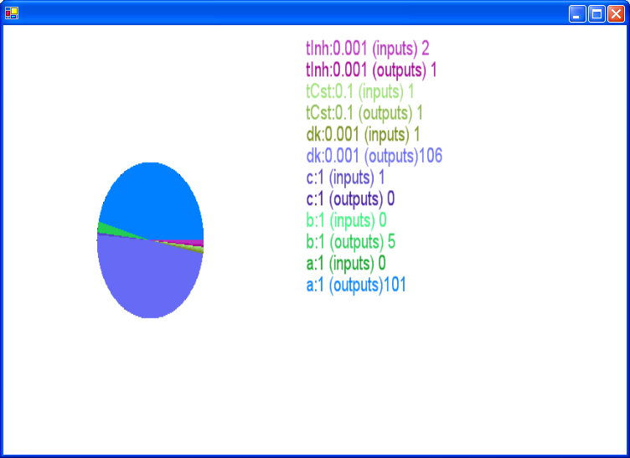


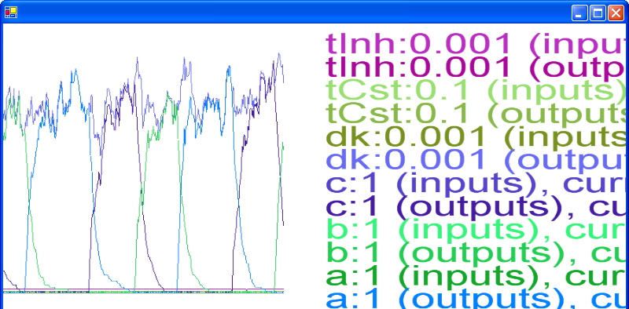
#3: SPiM: Biological Simulation and Visualization

Slide 32
#4: Running on Mono (provided by external user)

Slide 33
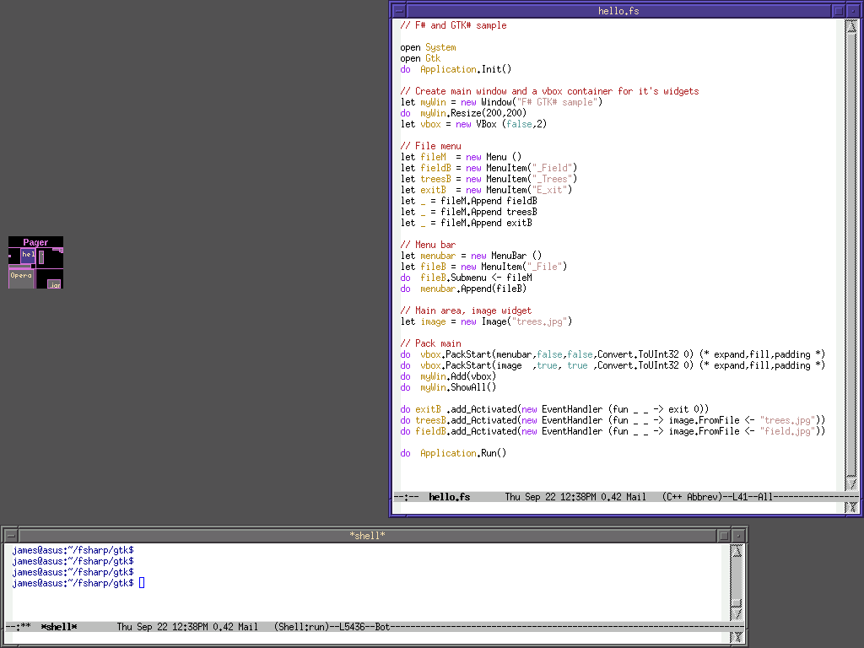
Code Shot 4: …

Slide 34
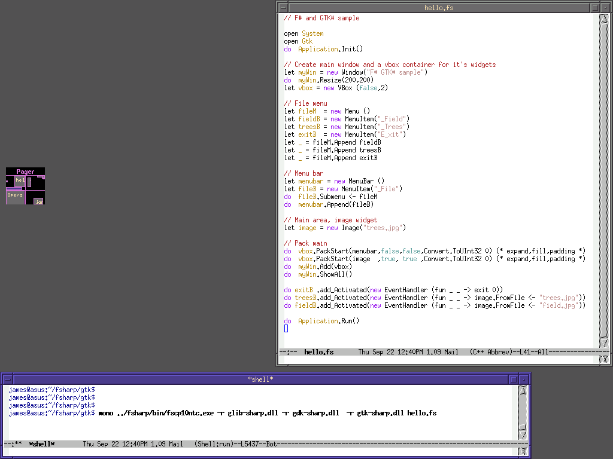
Code Shot 4: …

Slide 35
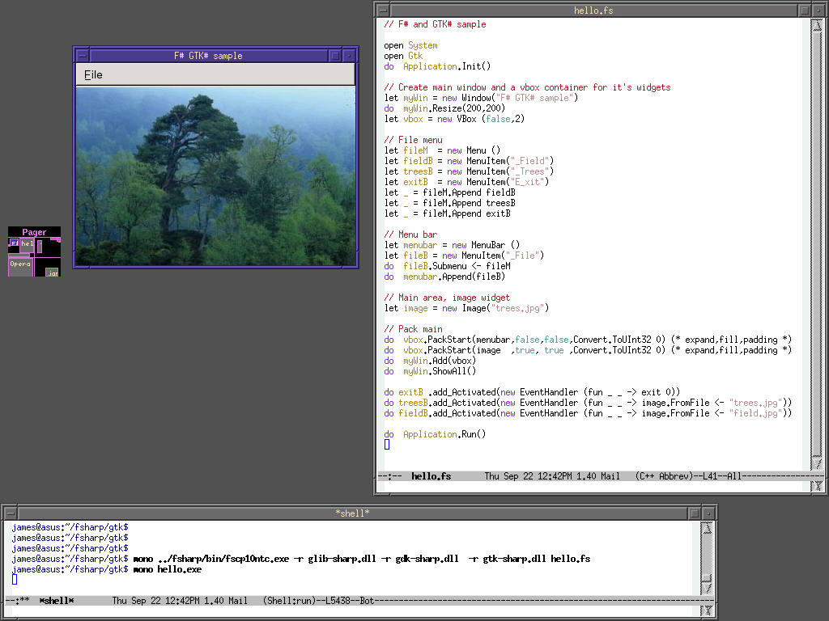

Slide 36


Slide 37
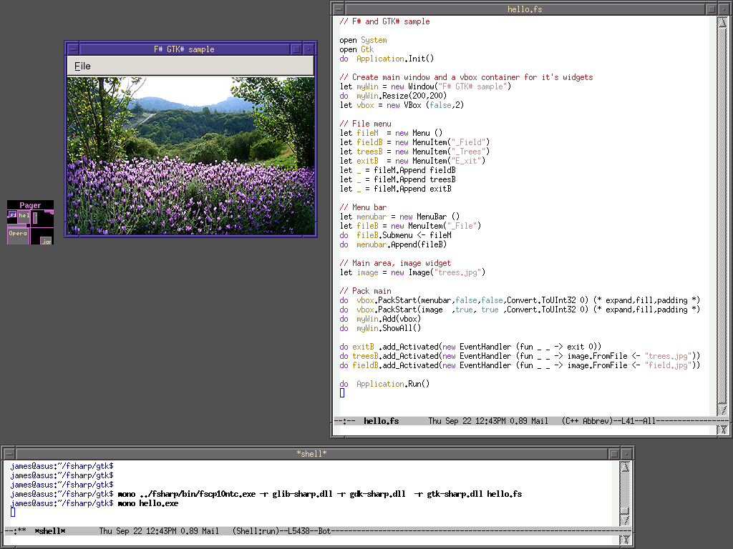

Slide 38
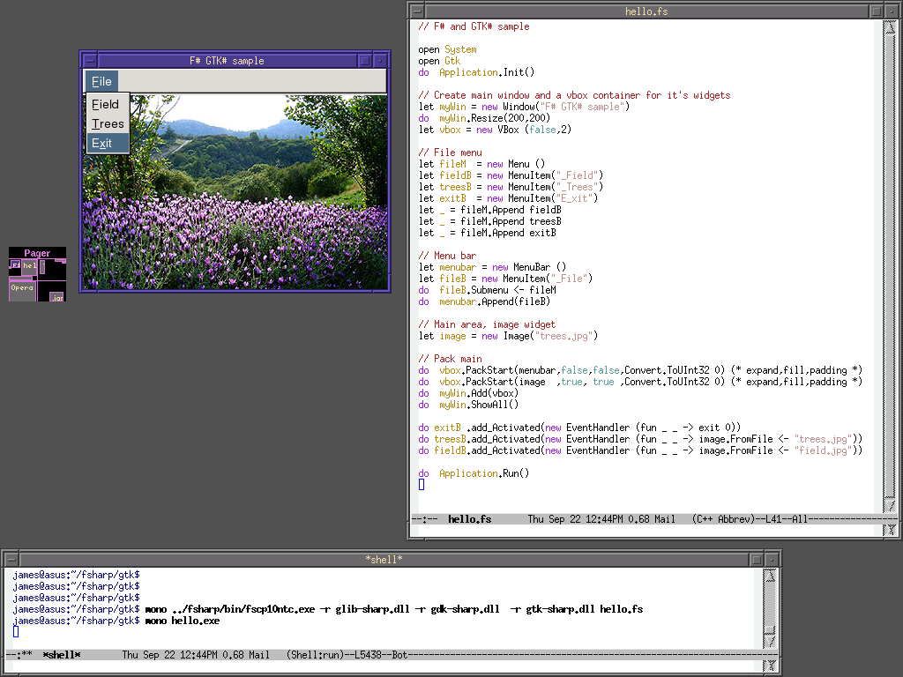

Slide 39
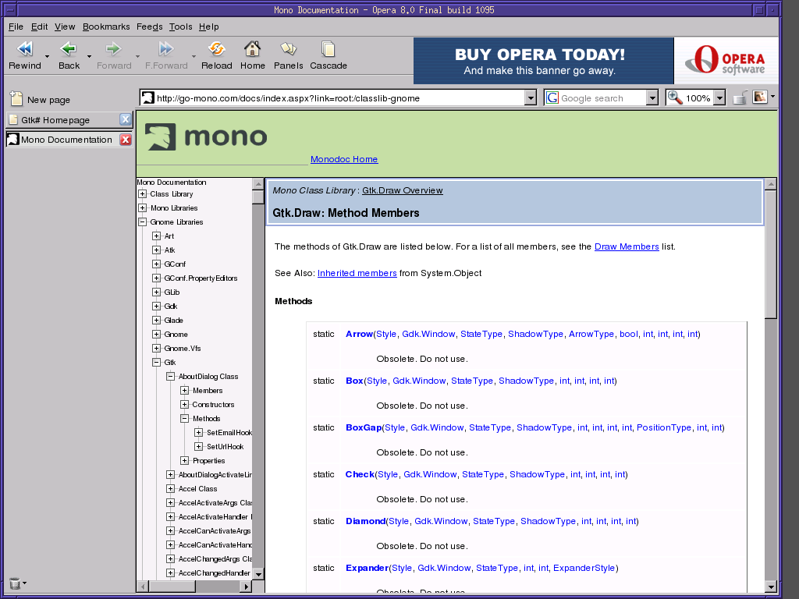

Slide 40
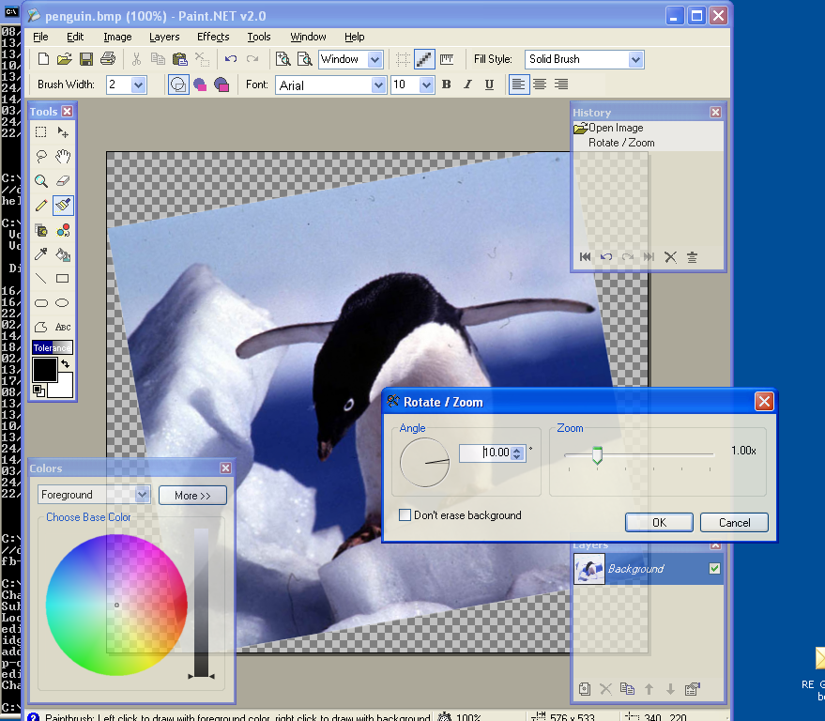
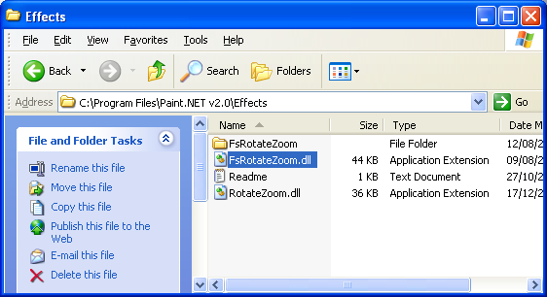
#5: Paint.NET & Plugins
Plugin written in F#
Here is the DLL

Slide 41
F# in Context

Slide 42
F# and Flexible Architectures
OCaml and F# have a common core
i.e. F# gives migration and
cross-compilation possibilities
No .NET
F# for GUIs, Avalon, Networking, Win32 and much, much more
C#, VB
for tools
C#, VB
for GUIs etc.
Application
Components in F#
Application
Components in F#
Core
Algorithms
in C#, C++
Core Sophisticated
Algorithms written
in F#
Core Sophisticated
Algorithms written
in F#
Core Sophisticated
Algorithms written
in OCaml
C#, VB
for testing
Application
Components in F#
Standard .NET
components

Slide 43
F# and Some Other Languages
MLj/SML.NET
  First decent language on JVM
  Good language
  VS Mode acted as prototype for F# VS mode
  Excellent while-program optimizing compiler
  Not quite hitting the niche I’m aiming for (scalable, typesafe scripting)
  And (like many) I “moved on” to OCaml 10 years ago
C#
  Lesson: Syntax matters
  Lesson: OO programming is a tool, not an ideology
  Becoming more functional
  Will be good for F#
Haskell
  Haskell is the most beautiful functional language
  I did a prototype Haskell.NET in 2001
  By .NET standards Haskell does not interoperate well with other languages
  But I am very interested in enabling Haskell-like programming on .NET
Nemerle
  new language vaguely reminiscent of OCaml
  Lesson: “functional in the small, OO in the big”

Slide 44
Example: Static Driver Verifier: SLAM
Developing using:
Pointer analysis
Weakest pre-conditions
A “symbolic” first-order logic theorem prover with uninterpreted functions
Implemented in OCaml
Rule
Driver passes rule
SLAM
Abstract
Step
Driver
sources
Instrument
Step
Check
Step
Developed using:
A lazy first-order logic theorem prover with uninterpreted functions based on a propositional satisfiability solver (SAT)
Implemented in OCaml
Refine
Step
Developed using:
CFL-reachability
Boolean decision diagrams (BDDs)
Implemented in C, OCaml
OS model
Rule violation found

Slide 45
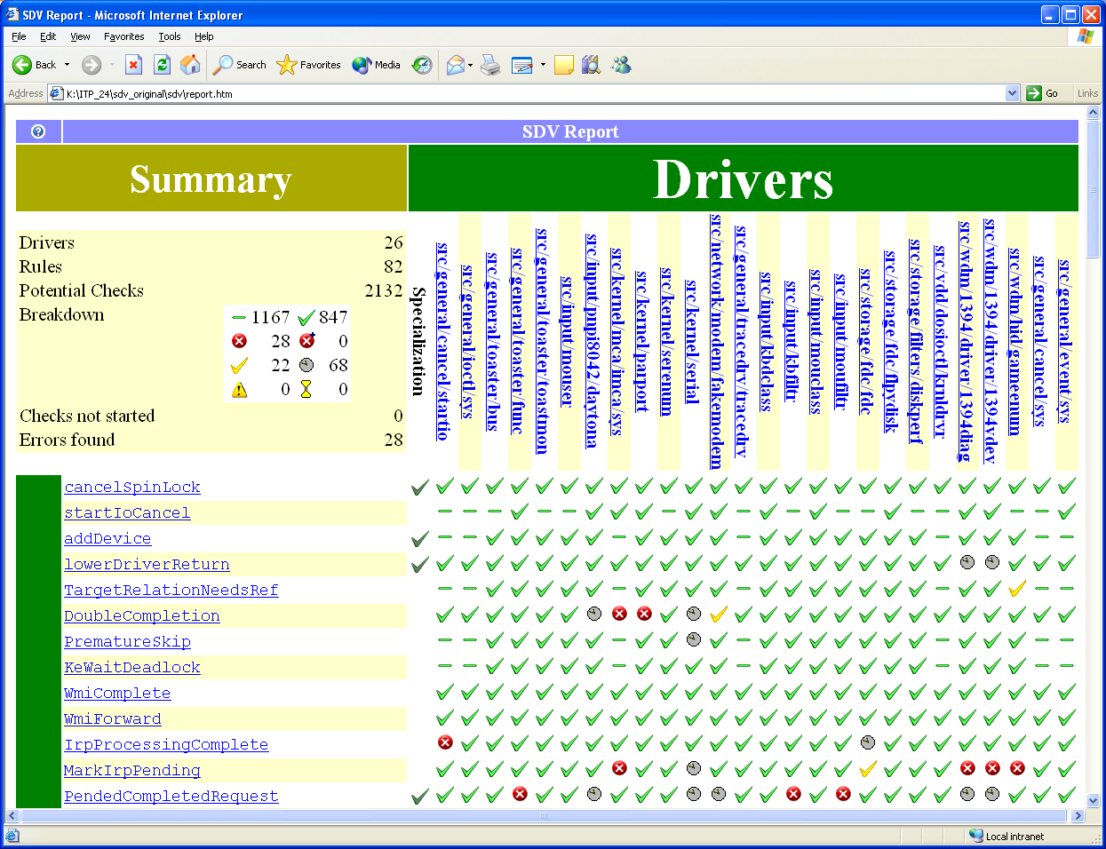
Static Driver Verifier

Slide 46
Summary
Do you like
  Scripting with rich libraries?
  A mathematical/functional style to your programming?
  OO when you need it?
  A host of libraries?
  Performance that rivals C#?
  Language interoperability?
If so, F# might be a good tool for you

Slide 47
Thanks & Questions!
http://research.microsoft.com/projects/fsharp
Or:
Google/MSN for “F#”

Slide 48
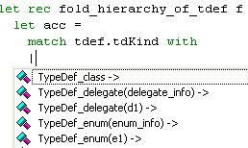
Practicalities
fsc.exe, fsyacc.exe, fslex.exe
fslib.dll: Core FP constructs, some idioms
mllib.dll: OCaml-compatible basic library
Separate compilation to DLLs or EXEs. Static Linking available if necessary
Cross-module optimization
.NET v1.0, v1.1 or v2.0
Robust, fast Visual Studio mode integration
F# Code
F# Code
F# DLL
F# Code
C# DLL
F# EXE
fslib.dll
F# Code
C# Code
F# DLL
C# DLL
F# DLL
fslib.dll
mllib.dll
mllib.dll

Slide 49
Usability Validation
Formal Verification: 50K line SDV application cross-compiled and passing major tests
  2.2X slower than OCamlopt
  But much easier to profiler, debug, develop
Simulation and Visualization: SPiM biological/chemical/functional simulator cross-compiled and augmented with dynamic loading GUI plugins
Image Processing: Experimental Paint.NET plugin
Compilers: 20kloc bootstrapped compiler, regularly edited with Visual Studio, passes all tests and is efficient
Term Libraries: Abstract IL library cross-compiles, usable from C#
Underway:
  F# for Numerics (matrix libraries, also as a client of Infer.NET)
Externals: F# Wiki, F# for ASP.NET, F# for Avalon

Slide 50
Object Expressions
inner classes w/- interface mappings
Build a .NET imperative iterator for an F# collection
let get_IEnumerator (s: Set<'a>) =
let i = ref (mkIterator s) in
{ new IEnumerator<'a>
with get_Current() = current !i
interface System.Collections.IEnumerator
with get_Current() = box (current !i)
and MoveNext() = moveNext !i
and Reset() = i := mkIterator s
interface System.IDisposable
with Dispose() = ()}

Slide 51
Implementing indirect calls efficiently
Efficient curried indirect calls without allocation
.NET generics give us “automatic” good unboxed calling
public abstract class FastFunc<T,U>
{
public abstract U Invoke(T t);
public static V InvokeFast2<V>(FastFunc<T,FastFunc<U,V>> f, T t, U u)
{
FastFunc2<T,U,V> f2 = (f as FastFunc2<T,U,V>);
if (f2 != null)
return f2.Invoke(t,u);
return f.Invoke(t).Invoke(u);
} }
public abstract class FastFunc2<T,U,V> : FastFunc<T,FastFunc<U,V>>
{
public override FastFunc<U,V> Invoke(T t)
{ return new Delayed(this, t); }
public abstract V Invoke(T t,U u); }
.NET type test to discover fast entry point

Slide 52
Implementing type functions
Arise from first-class polymorphism
Also currently some poor compilation of some inner polymorphism
type AbstractSetFactory<'a> =
{
empty: Set<'a>;
add: 'a -> Set<'a> -> Set<'a>;
map: 'b. ('a -> 'b) -> Set<'a> -> Set<'b>;
}
Remy style ∀ polymorphism
Caller casts result to expected type
public abstract class TyFunc
{
public abstract object Specialize<T>();
}
class AbstractSetFactoryMap : TyFunc { ... }

Slide 53
F# Observations
“An ML I can use without hurting other people in my team”
F# is:
  excellent for using .NET libraries
  excellent for writing ML libraries
  ok at making ML libraries usable from .NET
So the niche seems to be for writing sophisticated applications
  probably making use of the .NET components
  probably with a symbolic processing component
  probably with some components written in C# etc.

Slide 54
F# v1.0
Very stable core language and compiler
Being used by Microsoft Research
Being adopted internally and externally
VisualStudio integration
ML compatibility library
Samples etc.
Tools: Lexer, Parser Generators
But: a research project, not a product

Slide 55
How F# is implemented
F# = Compiler + Library + VS Mode + Yacc + Lex
Compiler = Parse + Import + Typecheck + Optimize + ILX-Generate + ILX-Erasure
Typecheck = identifier status and the “dot” notation resolved during type-checking
Optimize = Cross-module optimization focused on inlining, constant folding and representation choices
ILX-Generate = A scriptable compiler engine (constructs for IL assembly code, type-directed static optimizations)
ILX-Erasure =
  Erase Closures to classes
  Erase Discriminated Unions to classes
  Optionally erase generics to “object” (ala GJ)
VS-Mode =
  implement a simple COM interface that calls the lexer, importer and typechecker interactively and caches the results
  copy a sample that implements a “project system”

Slide 56
Languages, the CLR & .NET Generics
...and here.
VB
VC++
C#
...
F#
also here...
Common IL
F# is a related project
that works with or
without generics
We’ve added support for
generics/polymorphism...
Common Language Runtime
Loader
JIT
Verifier
...
GC
Native
Code

