Slide 1
Towards Interoperable Heterogeneous Execution with F#
Initial Investigations
Don Syme
TAB 2006

Slide 2

Today
Quick F# Update
Very much work in progress.
  Paper submitted to ML Workshop, but raised many questions
  In some ways it feels like we're still at the beginning.
Mostly Background and Motivation
Quick overview of two applications (SQL, GPU)
Related work and the many, many challenges in this area

Slide 3
F# update
Much of my time is spent making F# a viable long-term option for Microsoft and the Developer Division
  Recent work: .NET Objects, "F# Interactive", Optimizations
  Incubated a group of active viral users, internal and external
  ~15000 downloads/year (~8000 last year)
  Major talks to DevDiv management ("first functional language I might be tempted to use" – Craig Symonds, head of VS)
  F# seen as a viable candidate for a Microsoft scientific/engineering programming language
  F# a key tool for MSR Applied Games Group, among others
However, today is not about F# ☺

Slide 4
The Context
Visual Studio
Debuggers,
Profilers etc.
.NET Common
Language
Runtime
C#
XML
Libraries
GUI Libraries,
etc.
Visual Basic
F#
Languages are central, but must interoperate;
A language is judged foremost on its ability to leverage external, existing functionality;
Graphics
Libraries
System.I/O
System.Net etc.
Sockets etc.
Common type system
Common tools
Common libraries
Database
Connection
Libraries

Slide 5
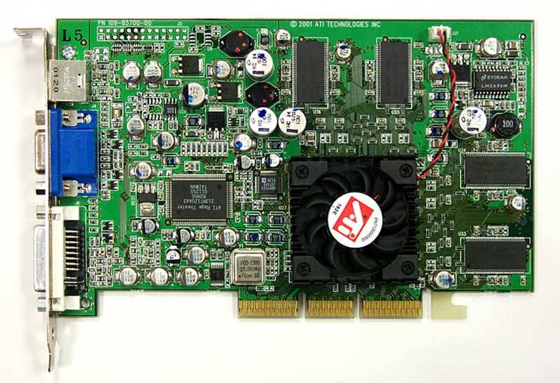
The Context
Visual Studio
Debuggers,
Profilers etc.
.NET Common
Language
Runtime
C#
"JavaScript
Programs"
Server-side
Browser
Library
GUI Libraries,
etc.
Visual Basic
Many very useful libraries now accept programs as part of their runtime input
These "little languages" are increasingly very large
They are now being "mapped" to subsets of C#, in terms of .NET library primitives and combinators
F#
"Pixel Shader
Programs"
Graphics
Library
System.I/O
System.Net etc.
Sockets etc.
"SQL Programs"
Database
Library

Slide 6
The Trend: Heterogeneous Execution
Today languages use homogeneous execution:
  The CPU
The natural extension of the LINQ vision is heterogeneous execution, leveraging
  The database
  The server
  The GPU
  The web browser (e.g. AJAX)
  Symbolic execution
Write your code in "one" language, execute it in many completely different ways

Slide 7
Background: LINQ
LINQ is a set of features and libraries for C# and Visual Basic, due out in 2007
The primary aim is "Language Integrated Queries", e.g.:
Closed.
Type-checked.
IQueryable<Contact>
IQueryable<T> -> Func<T,bool> -> IQueryable<T>
var results =
myDatabase.Contacts
.Select(x => x.Name, row.Street)
.Where(x => x.Town="Brisbane")
Runtime errors if "not in the SQL subset"
let query =
...
let command = "select top "
+ Int32.to_string nbGames +" game_id from tGames order by game_id" in
let sqlCommand = new SqlCommand (command, connection) in
...
var results =
from x in myDatabase
select (x.Name,x.Street)
where x.Town=Brisbane
Reified C# expressions building on .NET library primitives
Runtime checked subset, stitched together with combinators
Currently SQL is hacked as strings in nearly all applications

Slide 8
Hacking SQL as strings is a disaster..
…as has long been recognized
  Programmer productivity suffers
  Robustness suffers
  Security suffers
  e.g. see enormous amount of OO database work, Ruby on Rails etc.
The funny thing is…
  From F#'s perspective we don't have much control about what to do about it…
  … as Microsoft have decided what they will do!
  The investment to do anything else is very, very, big
  Therefore the "how to leverage" question is a very real one (also for Scala!)

Slide 9
For our purposes LINQ is..
SQLMetal
  generates object/relational mapping
C# Extensions
  expression quotation to the LINQ Expression type
Two libraries to
  translate a subset closed C# expressions to SQL
  compile/eval a subset of closed C# expressions
Assume there will be many more such libraries

Slide 10
Linq’s System.Expressions
Types:
  Expression
  Expression.Expression<T>
  Func<A,B>
  Func<A,B,C>
  Expression.LambdaExpression<Func<A,B>>
  Expression.LambdaExpression<Func<A,B,C>>
Constructors:
  Expression.And(…) -- overloaded
  Expression.LT(…)
  Expression.EQ(…)
  etc.
  Expression.Property(…)
  Expression.MethodCall(…)
  Expression.LambdaExpression(…)
  Expression.LambdaExpression<T>
Comments
Intended semantics of nodes a little unclear, but not too bad
No primitives like substitution, beta-reduction etc.
Bound (variables point directly back to the binding site)
C# does partial evaluation of constant expressions (lifts them out of expression and splices reified result back in). This seems like a mistake for many applications (e.g. mobile code)
Nested quotations look difficult in C#
At least one obvious nodes missing in early releases (conditionals, also “let”)
val projE : exprSpec -> Expression
val projExpr : 'a expr -> Expression<'a>
val projFunc2 : ('a -> 'b) expr -> Expression<Func<'a,'b> >
val projFunc3 : ('a -> 'b -> 'c) expr -> Expression<Func<'a,'b,'c> >
From F# Quoted Expressions to System.Expression

Slide 11
Our project aims...
Can we take advantage of the LINQ components?
  Start with a form of runtime meta-programming
  Something I've seen used very effectively in other pragmatic functional language implementations (e.g. ForteFL)
Along the way we aim to
  rationally reconstruct LINQ
  partially validate the design
  identify the limitations of the techniques
  make helpful suggestions
Then ask the really hard questions
  Can this be done better? (yes, but how exactly?)
  Can we apply more disciplined approaches (e.g. staged computation)?

Slide 12
Project Plan
Enable experiments by adding runtime meta-programming to F#
  LISP-style quotations, but typed
  Initially with closed (hence hygienic) literals
  Useful for other reasons (e.g. theorem proving – see TulaFale, Reflect et al.)
Develop applications to motivate further research and F# investments

Slide 13
F# Quotations by Example

Slide 14
Quoted Expressions
Much like LISP’s `(1 + 2), with holes, hygienic names and types
‘eval’ provided via LINQ's Expression.Compile
No type generalization (inner polymorphism) inside quoted expressions
Currently mapped to name carrying terms
Closed “up to top-level, public definitions”
Piggy-back of the assembly/namespace/type structure of .NET and F# for model of linking/references
May reference object model (some incompletenesses here)
« 1 + 2 »;;
« 1 + _ »;;
« _ + _ »;;
« _ + _ »;;
type exprSpec =
| ConstExpr of constSpec * typeSpec list
| VarExpr of varName
| LambdaExpr of varSpec * exprSpec
| AppExpr of exprSpec * exprSpec
| QuoteExpr of exprSpec
| HoleExpr of typeSpec
and typeSpec =
| VarType of tyvarIdx
| AppType of tyconstSpec * typeSpec list
type 'a expr = Expr of exprSpec
Runtime
Compile
F# Internal
Compiler Trees
Linq’s
System.Expression
Pickle to bytes
bytes
Unpickle from bytes
SQL
etc.

Slide 15
Quoted Expressions: Top Environments
Top Definitions are polymorphic constants:
  (assembly * path) → ΛX. expr
Saved only if --quotation-data flag on
On for standard libraries
Currently only save “immediately closed” definitions
  Could save whole module expressions, including representing type privacy (existentials in term structure)
  Nb. System.Reflection gives a way to invoke any top defn. as code (or fetch its value)
foo.ml
foo.mli
let f x = x + 1
let g1 y = f y + 1
let g2 y = y + 2
module X : sig
val g1 : int -> int // defn. saved
val g2 : int -> int // defn. not saved
end

Slide 16
Quoted Expressions: Intrinsics
No pattern matching (becomes test/project/conditional/equality)
A bunch of mostly standard intrinsics matching the F# language primitives
New intrinsics can usually be ‘faked’ by using a failing definition
| CondOp
| TopDefOp of topDefData
| RecOp
| RecdMkOp of recdMkOpData
| RecdGetOp of recdGetOpData
| UnionMkOp of unionMkOpData
| UnionGetOp of unionGetOpData
| UnionTestOp of unionTestOpData
| TupleMkOp of tupleMkOpData
| TupleGetOp of tupleGetOpData
| EqualityOp
| UnitOp
| BoolOp of bool
| StringOp of string
| SingleOp of float32
| DoubleOp of float
| CharOp of unichar
| SByteOp of sbyte
| ByteOp of byte
| Int16Op of int16
| UInt16Op of uint16
| Int32Op of int32
| UInt32Op of uint32
| Int64Op of int64
| UInt64Op of uint64
(* Object Model Goop! *)
| PropGetOp of propGetOpData
| CtorCallOp of ctorSpec
| MethodCallOp of methSpec
| CoerceOp
| ArrayMkOp
| DelegateMkOp
(* Unclean/imperative! *)
| GetAddrOp
| SeqOp
| ForLoopOp
| WhileLoopOp

Slide 17
Working with Quoted Expressions
Expression Families
  Projection/Injection pairs
  Avoids pattern matching directly on expressions
  Construct nested pattern matches using combinators
A range of primitives is/will be provided
  Substitution
  Renaming
  Rewriting
  Etc.
efQuery
type 'a exprFamily =
{ efMake: ('a -> exprSpec);
efQuery: (exprSpec -> 'a option); }
efMake

Slide 18
Queries with F#/Linq

Slide 19
Queries with F#/LINQ
db.Customers
|> where « fun c -> c.City = "London" »
|> select « fun c -> c.ContactName »
["Thomas Hardy"; "Victoria Ashworth";
"Elizabeth Brown"; "Ann Devon";
"Simon Crowther"; "Hari Kumar"]
SELECT [t0].[ContactName]
FROM [Customers] AS [t0]
WHERE @p0 = [t0].[City]

Slide 20
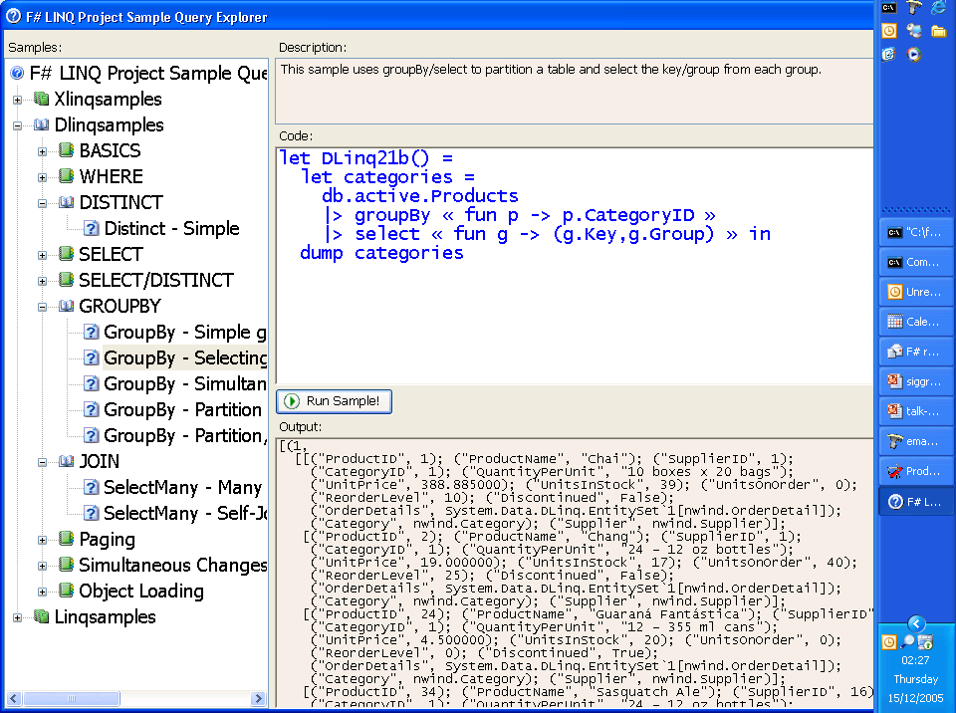

Slide 21
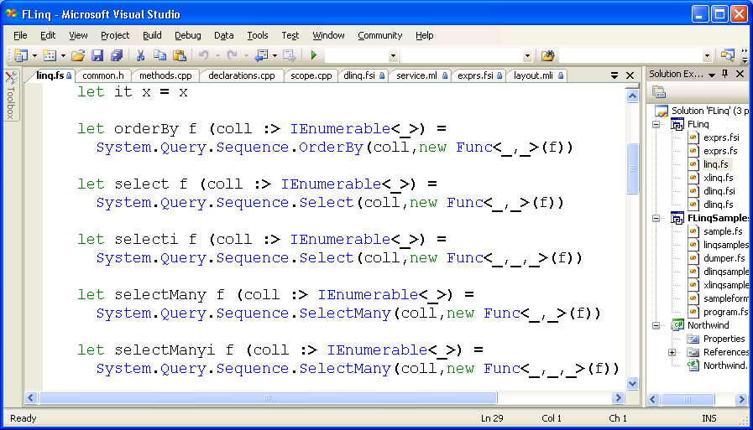

Slide 22
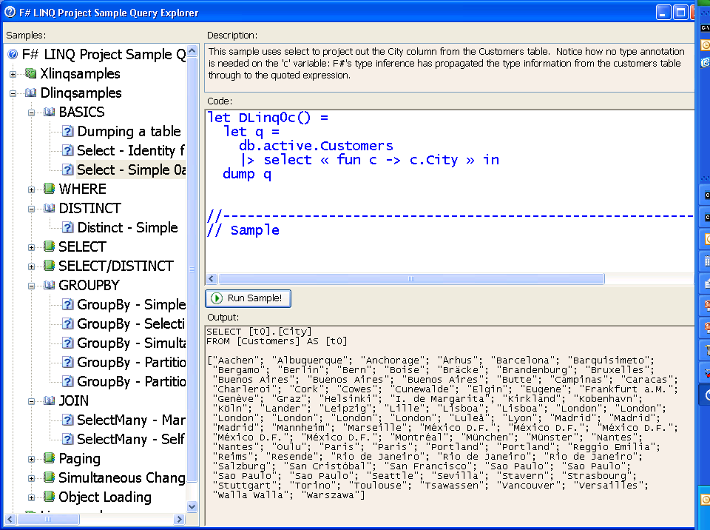

Slide 23
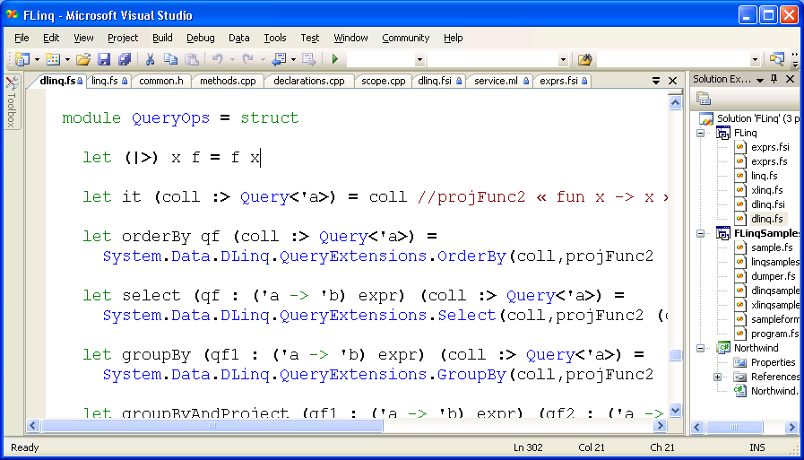

Slide 24
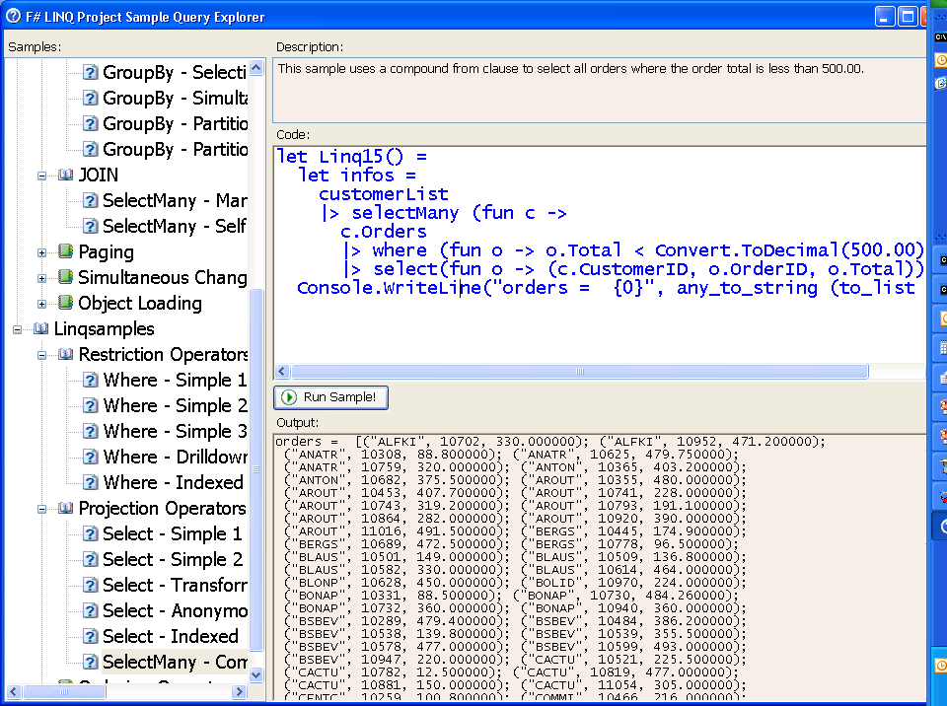

Slide 25
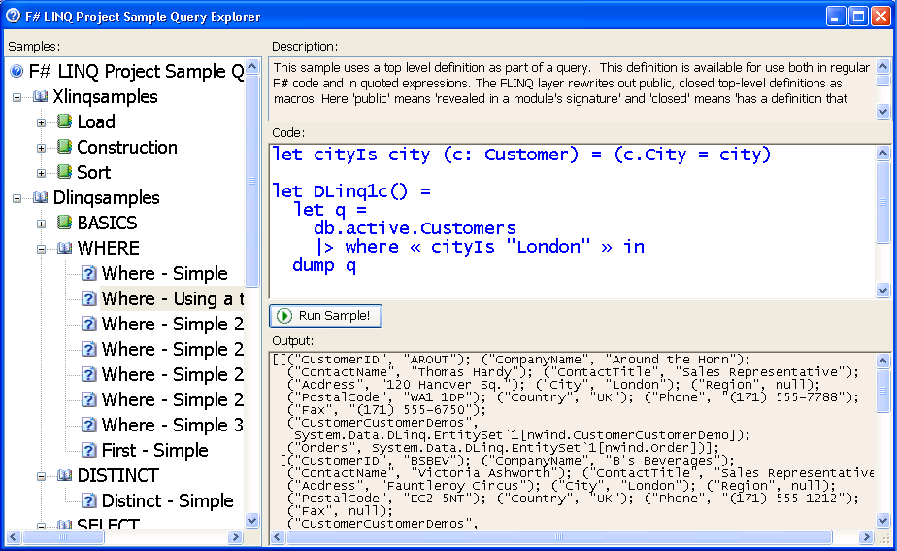
Quotations can refer to top level definitions. Quotation processors may expanded these as “macros” in the expression tree
This allows factoring of common fragments of quoted expressions

Slide 26
Joins, GroupBy, OrderBy need a change in plan
Linq involves many fudges, one of which is…
The F# version currently reveals this
A Ha! First layer of comprehension translation uses IQueryable, inner layers use IEnumerable
db.Customers
|> IQueryable.selectMany(« fun c1 ->
db.Customers
|> IEnumerable.selectMany(fun c2 ->
db.Customers
|> IEnumerable.select(fun c3 ->
c1,c2,c3) »)
Note that inner portions of queries are not quoted! Different types?
db.Customers.SelectMany(« fun c1 ->
db.Customers.SelectMany(fun c2 ->
db.Customers.Select(fun c3 ->
c1,c2,c3) »)
So to avoid this we also offer a "whole query" version
Only one set of operators needed
val SQL : ('db -> seq<'a>) expr -> 'db -> seq<'a>
SQL « fun db ->
db.Customers
|> groupBy (fun c -> c.City)
|> selectMany (fun (key,group) ->
group |> where (fun c -> c.SecondCity = City) »)

Slide 27

Accelerator and F# Quotations
let nextGeneration(a) =
let sum = rot a (-1) (-1) .+ rot a (-1) 0 .+ rot a (-1) 1
.+ rot a 0 (-1) .+ rot a 0 1
.+ rot a 1 (-1) .+ rot a 1 0 .+ rot a 1 1 in
(sum .= three) .|| ((sum .= two) .&& a);;
nextGeneration a
accelerate <@ nextGeneration @> a
Accelerator.dll
Metaprogram
Program
GPU assembly code
CPU
Graphics Card

Slide 28
Conclusion

Slide 29
Huge related literature
Partial evaluation and staged computation
  disciplined generation of programs within the same language at runtime
  can we apply the techniques to generation of these DSL languages?
Domain Specific Languages
  a mixed bag of research, often very hard to follow
  often types and APIs ("object models") to build programs at runtime
Related systems: LISP, Meta-OCaml, ReFLect, MetaML, Template Haskell
(Of course, no one asks C# if an equational theory holds for quoted "SQL" programs… ☺)

Slide 30
Is C# 3.0/LINQ a huge leap forward?
By our standards, yes:
  Type-checking quoted programs is better than string hacking
  SQL is well-formed and more secure once generated
By our standards, no:
  Generative programs are

Slide 31
Is C# 3.0/LINQ a semantic disaster?
By our standards, yes:
  No guarantee that quoted SQL programs are well-formed
  Documented semantic inconsistencies exist between quoted expressions and SQL interpretation
  Runtime failure if outside subset
  A huge amount of complexity for a very limited meta-programming framework
  Potential for bugs/incompletenesses/inconsistencies in LINQ libraries

Slide 32
Is Runtime Term-style Meta Programming worth it (if we tame it)?
Pragmatic, industry deployed functional languages often feature some form of runtime meta-programming
e.g. same techniques are used to embed H.O.L theorem proving in Intel’s ForteFL.
  For hardware verification
  So (clearly) the techniques are very general
So some obvious "alternative forms of execution" we could support in a LINQ-like way are:
  Proof and Logic, BDDs, OLAP Cube Queries, GPU, JavaScript/AJAX on the browser, Probabilistic modelling, Runtime Code Generation, Avalon without XAML, Fran.
Slogan: `Evaluation Jim, but not as we know it’

Slide 33
Challenges?
General Meta-programming Challenges
  Finding a simple, general, effective IR
    e.g. some F# language constructs not reified
  Slippery Slope towards
    ‘hygenic macros’
    ‘eval’ (nb. Reflection.Emit exists anyway)
    The Reflective Tower
  Exposing library definitions as macros brings fragility
  Increasing static feedback
Meta-evaluation Challenges
  Ensuring semantic consistency between multiple evaluation techniques

Slide 34
Discussion

