Slide 1
Introducing F#
Don Syme
MSR Cambridge

Slide 2

Outline
F#: a quick orientation via a demo
F#: orthogonal, simple features
F#: co-operates in the context of .NET

Slide 3
An ML-F# Orientation
DEMO
1. Write a symbolic differentiator
2. Write an evaluation function
3. Make it extensible with new operators
4. Display sample plots on a form
5. Use the differentiator from C#

Slide 4
Part 2. The ML-F# approach to language design

Slide 5
The ML-F# Sweet Spot
Static analysis of programs
Program transformation
Compilers
Verification, model checking, theorem proving

Slide 6
ML in Microsoft
Static Driver Verifier (Core OS)
High-level model of FRS (Core File Services)
Zap theorem prover (MSR)
KIS race condition finder (MSR)

Slide 7
F# within .NET
C#
CLR GC,
JIT, NGEN etc.
Profilers,
Optimizers etc.
VB
System.Windows.Forms
Avalon etc.
ML
F#
Debuggers
System.I/O
System.Net etc.
Sockets etc.
ASP.NET

Slide 8
F# as a Language
Powerful, simple programming language
Core
ML
Core
ML
“OCaml-Objects”
and other rarely
used extensions
Modules-as-
values
(hard to understand,
rarely used)
.NET API
Access
Other
extensions
+ tools
+ tools
OCaml
F#

Slide 9
Orthogonal & Unified Constructs
Tuples = multiple arguments = multiple returns
Tuples
as Data
let args = (1,2,3)
let f (a,b,c) = (a+b , b+c, a+b)
let x,y,z = f(f(f args))
do printf “res =%d,%d,%d” x y z
res = 17,16,15”
Multiple
Returns
Multiple Args

Slide 10
Orthogonal & Unified Constructs
Let “let” simplify your life…
Bind a static value
let data = (1,2,3)
let f(a,b,c) =
let sum = a + b + c in
let g(x) = sum + x*x in
g(a), g(b), g(c)
Bind a static function
Bind a local value
Bind an local function

Slide 11
Orthogonal & Unified Constructs
“let” + “capture”: sophisticated operations in sophisticated contexts…
Context
Operation in
context
let readBinary(inputStream) =
let read () = inputStream.ReadByte in
let smallFormat = (read() == 0x2) in
…
let readOneRecord() =
…
if (smallFormat) then read()
else … in
…
readOneRecord();
readOneRecord();

Slide 12
Orthogonal & Unified Constructs
“let” + “capture”: sophisticated operations in sophisticated contexts…
Context
Operation in
context
let readBinary(inputStream) =
let read () = inputStream.ReadByte() in
let smallFormat = (read() == 0x2) in
…
let readOneRecord() =
…
if (smallFormat) then read()
else … in
…
readOneRecord();
readOneRecord();
Operation in
richer context
Use operations in
rich context

Slide 13
Orthogonal & Unified Constructs
Immutability the norm…
All F# data is immutable by default
let data = 3
do data := 4
type data =
{ Name: string;
Size: int;
Items: Map<string,string> }
let NewData(name,items) =
{ Name=name;
Size=Map.size items;
Items=items }
Simple values may not be changed

Slide 14
In praise of immutability
Immutable objects can be relied on
Immutable objects can transfer between threads
Immutable objects can be aliased safely
Immutable objects can be optimized

Slide 15
Orthogonal & Unified Constructs
Mutability encouraged if needed…
Mutability explicit
type table =
{ Name: string;
mutable Items: string[] }
Mutation
let data =
{ Name= “Don”;
Items= [| “x”;”y”;”z” |]
do data.Items <- [| “a”;”b” |]
Used well, this isolates and controls complexity

Slide 16
Orthogonal & Unified Constructs
F# is a functional language
F# is an imperative language
F# is a mixed functional/imperative language
F# is not Haskell. Loops encouraged.

Slide 17
Orthogonal & Unified Constructs
Function values simplify and unify
…iteration
val List.map: (‘a → ‘b) → list<‘a> → list<‘b>
val List.foreach: list<‘a> → (‘a -> unit) → unit
val IEnumerable.map: (‘a → ‘b) → IEnumerable<‘a> → IEnumerable<‘b>
val IEnumerable.foreach: IEnumerable<‘a> → (‘a -> unit) → unit
Structural and Logical transformations made easy
Imperative and functional versions encouraged

Slide 18
Orthogonal & Unified Constructs
Function values simplify and unify
…extension
“Virtual methods”
(extension points)
type UnaryOperator =
{ evaluate: (float → float); // evaulation function
differentiate: (expr → expr); // symbolic differentiation function
name: string } // identity
let sinop = { evaluate=sin;
differentiate=Cos;
name="sin" }
Caveat: Extensible extension is still hard
Subclass? What subclass?

Slide 19
Orthogonal & Unified Constructs
Type parameters
Discriminated unions
Pattern matching
Type inference
Recursion (Mutually-referential objects)
Map<’a,’b>
List<’a>
Set<’a>
type expr =
| Sum of expr * expr
| Prod of expr * expr
….
match expr with
| Sum(a,b) -> ...
| Prod(a,b) -> ... ….
let rec map = ...

Slide 20
Less is More?
Fewer concepts = Less time in class design
No null pointers¹
Far fewer classes and other type definitions
No constructors-calling-virtual-methods and other OO dangers
1. except leaking across from .NET APIs

Slide 21
Problems are problems
Unmanaged resources (IDisposable)
Exceptions
I/O, avoiding blocking, concurrency
API design
Complex software is, well, complex…

Slide 22
F# Observations
F# gives you the tools to concentrate on the algorithmic complexities of symbolic processing
F# is:
  excellent for using .NET libraries
  excellent for writing ML libraries
  ok at making ML libraries usable from .NET
So the niche seems to be for writing sophisticated applications
  probably with some use of .NET components
  probably with some symbolic processing
  probably with some components written in C#

Slide 23
Part 2. F# Co-operates
The F# challenge: make it fit with .NET in a deeply practical way without losing the essential goodness of ML programming

Slide 24
Connecting F# to .NET
C#
CLR GC,
JIT, NGEN etc.
Profilers,
Optimizers etc.
Outward interop
VB
System.Windows.Forms
etc.
ML
F#
Debuggers
System.I/O
System.Net etc.
Sockets etc.
ASP.NET

Slide 25
Outward Interop
A very nice “.” notation
Quite similar to C#
Delegates created using function values
System.Console.WriteLine(“abc”);
form.SetStyle(ControlStyles.AllPaintingInWmPaint,true);
form.ClientSize <- new System.Drawing.Size(292, 266);

Slide 26
Outward Interop
Object expressions == closures for objects
Overriding only
Orthogonal: type inference, capture, mutually recursive, nested
let myForm title n =
{ new System.Windows.Forms.Form() as base
with OnPaint(args) =
base.OnPaint(args);
Console.WriteLine (“OnPaint\n“)
and OnResize(args) =
base.OnResize(args);
Console.WriteLine (“OnResize, args = {0}\n“, args)
}

Slide 27
Connecting F# to .NET
C#
CLR GC,
JIT, NGEN etc.
Profilers,
Optimizers etc.
Inward interop
VB
System.Windows.Forms
etc.
ML
F#
Debuggers
System.I/O
System.Net etc.
Sockets etc.
ASP.NET

Slide 28
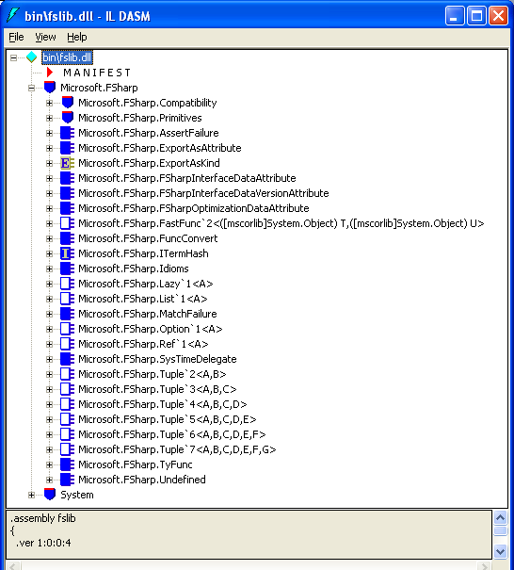
Inward Interop
Inward interop == predictable, stable compiled forms
e.g. F# types have predictable compiled forms as classes

Slide 29
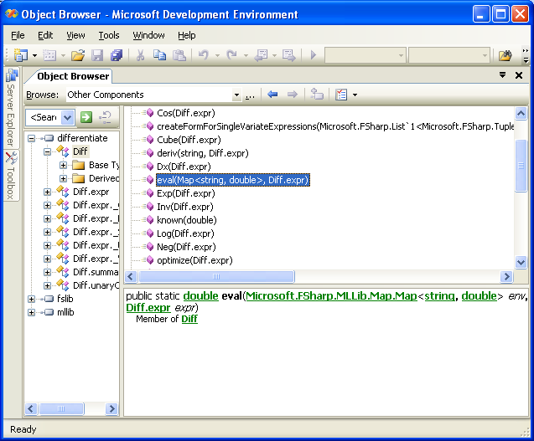
Inward Interop
F# values compile to static functions and/or static fields.

Slide 30
Inward Interop
Inward Interop is essential for many reasons, e.g. componentization, testing, profiling
No other ML implementation in the world has it
Inward interop gives you full access, but is sometimes a little awkward from C#
Room for extensions to what is there

Slide 31
What else does F# offer? ☺
Libraries galore
  GUIs, Network, Speech, Graphics
Tools galore
  CPU Profiling, Memory Profiling, Debugging, Visual Studio integration
C# next door
  Fantastic interop with C and COM
Components
  Can build versionable, binary compatible DLLs
Multi-threading that works
  Even OCaml has problems here
No significant runtime components
  GC etc. is not part of the package
ML in .NET heaven! ☺

Slide 32
F#, the CLR & .NET Generics
...and here.
VB
VC++
C#
...
F#
also here...
MS-IL
F# is a related project
that works with or
without generics
We’ve added support for
generics/polymorphism...
Common Language Runtime
Loader
JIT
Verifier
...
GC
Native
Code

Slide 33
F# v1.0
Very stable core language and compiler
  Some interesting language work will go on around the edges, e.g. ML-modules-without-ML-modules
Being used by Zapato & SDV & many others
~6000 downloads/year
VisualStudio 2005 Beta 1 integration
ML compatibility library
Samples etc.
Tools: Lexer, Parser Generators

Slide 34
F# & Research
Practical programming in ML still raises many interesting language design questions
e.g. mutually recursive initialization that compensate correctly when failure occurs half-way through
F# is a great place to conduct this research
  easy to code examples of real-world practical programming
  a simple clean language to extend

Slide 35
Questions? http://research.microsoft.com/projects/fsharp
http://research.microsoft.com/projects/fsharp
autogroup: mailto:fsharp
\\cam-01-srv\dfsroot\projects\fcom\releases

Slide 36
What does F# lack?
Omitted Language Features
  No OCaml-style “objects”.
  No functors.
  No modules-as-values
Some loss of raw performance

Slide 37
Some useful things to know
ML idioms used today:
  let x = … in -- let-binding
  match x with … -- pattern matching
  let rec … and … in … -- a set of recusrive bindings
  ignore(a) -- discard value
  let f x y z = … -- currying and partial application
  let f () = … -- unit == “()” == void
  (fun x y -> …) -- lambda expressions
  Data(data1,…,dataN) -- allocate a value
  let x = ref 0 -- allocate a reference cell
  Some(x) or None -- optional values
  let x = ref (Lazy(fun () -> expr)) -- laziness by data + explicit holes
  lazy expr, force expr -- syntactic sugar
F# extensions used today:
  let x = new MyCSharpClass(…) -- making an object
  let x = new MyCSharpDelegate(fun x y ->…) -- making a delegate (~a function)
  MyCSharpClass.StaticMethod(…) -- calling a method
  x.Method(…) -- calling a method
  x.Property -- getting a property
  x.Property <- value -- setting a propery

Slide 38
An F# sample
Game Of Life, computed on a worked thread
Controlled using semaphores
User Input
The GUI
Thread
GUI Output
Worker
Thread
Forms,
Menus etc.
Forms,
Menus etc.
Worker
Automaton
Game
State
Updates sent via callbacks & message loop
Created using WinForms
Specified using data

