Slide 1
F#: ML Reloaded
Don Syme
MSR Cambridge
Principles of Programming Group

Slide 2

Overview
The .NET Platform is a stable, efficient execution environment
Here’s some of the innovation that’s happened or is happening
Concurrency
and Scalability
Generics
Versioning and
Deployment
The Compilation
Hierarchy
The .NET Framework
& the Common
Language Runtime
Reliability under
Resource Starvation
Native
Interoperability
Resource
Management
Database
Integration and
Interoperability
Isolation
XML
Integration
Languages

Slide 3
Overview
The .NET Platform is a stable, efficient execution environment
Here’s some of the innovation that’s happened or is happening
Concurrency
and Scalability
Generics
Versioning and
Deployment
The Compilation
Hierarchy
The .NET Framework
& the Common
Language Runtime
Reliability under
Resource Starvation
Native
Interoperability
Resource
Management
Database
Integration and
Interoperability
Isolation
XML
Integration
F#

Slide 4
Today
Compilation Reloaded
  Pre-compilation
Generics Reloaded
  C# Generics
Functional Programming Reloaded
  F# (also SML.NET!)
Isolation Reloaded
  Application domains

Slide 5
Languages, the CLR & .NET Generics
...and here.
VB
VC++
C#
...
F#
also here...
Common IL
F# is a related project
that works with or
without generics
We’ve added support for
generics/polymorphism...
Common Language Runtime
Loader
JIT
Verifier
...
GC
Native
Code

Slide 6
The aim: The goodness of ML within .NET
C#
CLR GC,
JIT, NGEN etc.
Profilers,
Optimizers etc.
VB
System.Windows.Forms
Avalon etc.
ML
ML
Debuggers
System.I/O
System.Net etc.
Sockets etc.
ASP.NET

Slide 7
Example: The Symbolic Programming Niche
Software designs, hardware designs and analyses of these designs
Transformation, decomposition, verification, and analysis
  (not just hacking on an object graph!)
1K-200K LOC – not just scripting
Small, smart teams generating high-value apps. Part of the flow from research to industry

Slide 8
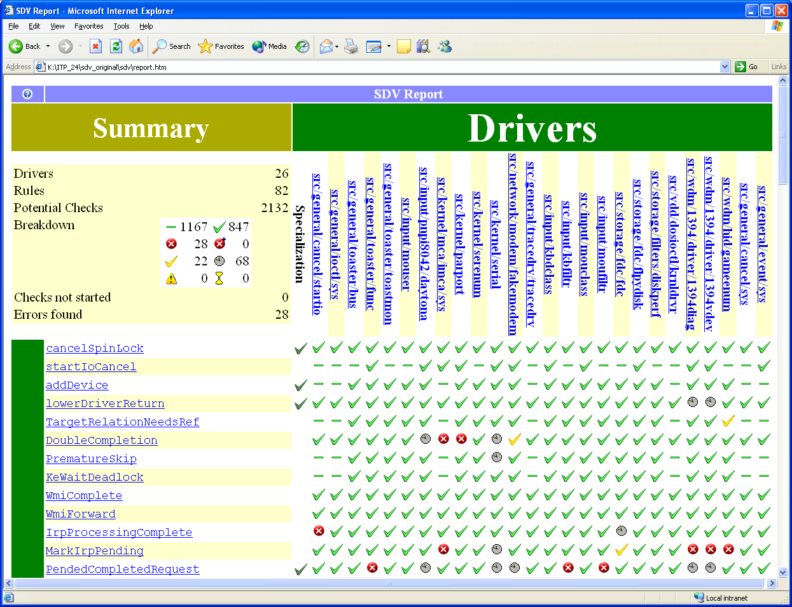
Static Driver Verifier

Slide 9
Example: Static Driver Verifier: SLAM
Developing using:
Pointer analysis
Weakest pre-conditions
A “symbolic” first-order logic theorem prover with uninterpreted functions
Implemented in OCaml
Rule
Driver passes rule
SLAM
Abstract
Step
Driver
sources
Instrument
Step
Check
Step
Developed using:
A lazy first-order logic theorem prover with uninterpreted functions based on a propositional satisfiability solver (SAT)
Implemented in OCaml
Refine
Step
Developed using:
CFL-reachability
Boolean decision diagrams (BDDs)
Implemented in C, OCaml
OS model
Rule violation found

Slide 10
Is there really a productivity gain?
Type inference?
Tuples, lists?
Discriminated unions?
Inner definitions?
Functions as first-class values?
Simple but powerful optimization story?
Explicit mutual dependencies and self-reference (e.g. no ‘this’ pointer by default)?
Immutability the norm?
However still require the same “basic model”, e.g. w.r.t I/O, concurrency, effects, exceptions
= Core ML (of course)

Slide 11
Orthogonal & Unified Constructs
“let” + “capture”: sophisticated operations in sophisticated contexts…
Context
Operation in
context
let readBinary(inputStream) =
let read () = inputStream.ReadByte() in
let smallFormat = (read() == 0x2) in
…
let readOneRecord() =
…
if (smallFormat) then read()
else … in
…
readOneRecord();
readOneRecord();
Operation in
richer context
Use operations in
rich context

Slide 12
Less is More?
Fewer concepts = Less time in class design
No null pointers¹
Far fewer classes and other type definitions
No constructors-calling-virtual-methods and other OO dangers
1. except leaking across from .NET APIs

Slide 13
The Great ML Tragedy
ML is the world’s best language, almost:
  “Type inference just makes programs cryptic and unreadable”
  “Over-use of combinator-style is really hard to follow”
  “ML APIs are cryptic and hard to understand. I never know where to look or what to expect.”
  “Pattern matching only works on concrete data, so you are encouraged to break abstractions”
  “You can’t write GUIs in a declarative way”
  “Where are my objects?”
  “Functors are hard to understand and use properly”
  “OO-style extensibility is really hard”

Slide 14
The Great ML Tragedy
Some ML implementations have been quite good, but even then…
  “No libraries”
  “No debuggers”
  “No visual editing environments”
  “Threads can’t execute concurrently, if at all”
  “You can’t use your code from any other language”
  “You can’t compile as a DLL, or if you can you have to statically link the entire ML runtime”
  “No binary compatibility – you have to recompile the world when you upgrade your ML compiler”
  Wadler: “Libraries, Portability, Availability, Packagability, Tools, Training and Popularity”

Slide 15
The Great ML Tragedy
Students leave with the impression that ML is “not for real”
Many who struggle with lambda calculus think it must be really slow
  If it took them so long to do that beta-reduction exercise, then surely the computer must be slow as well!

Slide 16
The F# Experiment
The question:
  ML is appealing. But is it really any good?
  In a certain sense “obviously” (see SLAM), but that’s not the end of the story
  One test of “is it any good” is whether it attract and keep programmers, “all things being equal”
The project:
  Build an ML-like language that controls for many variables
    is “as good as possible” in the context of .NET
    .NET: same libraries, same runtime
  Focus on end-to-end “developer experience”, i.e. making life happy for programmers, without losing the essentials of ML
  Focus on finding appropriate niches for ML-like programming
The evaluation:
  Informal: watch how many bees come to the honey pot, watch what they do, and learn.

Slide 17
Framework Thinking
A Core Language exists to provide conceptual unity to the vast majority of programming tasks. It should be almost entirely independent of the wider framework
But even a core language can be affected by a framework
  Is the framework typed?
  Do types control exceptions?
  Do types control effects?
A framework oriented language questions ignored by a core language
  How code appear to other languages?
  Can we consume components in the framework?
  Can we author components in the framework?
  Can we author the “patterns” of the framework?
    e.g. Resource disposal on the .NET platform
    e.g. Component = DLL with attributed public class

Slide 18
Understanding .NET: The role of types and Common IL
The Common IL is:
  Simple enough for compiler writers who don’t want to think
  High-level enough for versioning and interface stability (binary compatibility)
  Only a part of the “true language”, which encompasses basic types, Reflection and much more (1000 types?)
Types are:
  For safety (with optimizations)
  For developers (API metadata, API organization and API exploration)
  For components (API contract description)
  For exploration (service discovery, ala COM)
  API = Application Programming Interface = Library Interface

Slide 19
F# as a Language
Powerful, simple programming language
Core
ML
Core
ML
“OCaml-Objects”
and other rarely
used extensions
Modules-as-
values
(hard to understand,
rarely used)
.NET API
Access
Other
extensions
+ tools
+ tools
OCaml
F#

Slide 20
What does F# omit?
Omitted Language Features:
  No OCaml-style “objects” (row-polymorphism)
  No higher-kinded polymorphism
  No modules-as-values
  No labelled or default arguments
  No variants (column-polymorphism)

Slide 21
F# is Connected to .NET
C#
CLR GC,
JIT, NGEN etc.
Profilers,
Optimizers etc.
Outward interop
VB
System.Windows.Forms
etc.
ML
F#
Debuggers
System.I/O
System.Net etc.
Sockets etc.
ASP.NET

Slide 22
Some useful things to know
ML’s notion of an “object” is really a value which owns/manages/hides some state (i.e. a handle)
  Much more like C than C++
  Forget all about virtual methods, inheritance etc. You don’t need them.
ML idioms used today:
  “let x = … in” -- let-binding
  “match x with …” -- pattern matching
  “let rec … and … in …” -- a set of recusrive bindings
  “ignore(a)” -- discard value
  “let f x y z = …” -- currying and partial application
  “let f () = …” -- unit == “()” == void
  “(fun x y -> …)” -- lambda expressions
  “Data(data1,…,dataN)” -- allocate a value
  “let x = ref 0” -- allocate a reference cell
  “Some(x)” or “None” -- optional values
  “let x = ref (Lazy(fun () -> expr))” -- laziness by data + explicit delays + holes
  “lazy expr” and “force expr” -- syntactic sugar
F# extensions used today:
  “let x = new MyCSharpClass(…)” -- making an object
  “let x = new MyCSharpDelegate(fun x y ->…)” -- making a delegate (a named function type)
  “MyCSharpClass.StaticMethod(…)” -- calling a method
  “x.Method(…)” -- calling a method
  “x.Property” -- getting a property
  “x.Property <- value” -- setting a propery
  “(x :> MyCSharpBaseType)” -- upcast coercion

Slide 23
Samples
  Sample: Symbolic Differentiation
  Sample: Concurrent Life
  Sample: Biological Simulation
  Sample: Application Plug-ins

Slide 24
F# is Connected to .NET
C#
CLR GC,
JIT, NGEN etc.
Profilers,
Optimizers etc.
Inward interop
VB
System.Windows.Forms
etc.
ML
F#
Debuggers
System.I/O
System.Net etc.
Sockets etc.
ASP.NET

Slide 25
Samples
  Sample: Symbolic Differentiation
  Sample: Biological Simulation
  Sample: Application Plug-ins
  Sample: Concurrent Life

Slide 26
What else does F# offer? ☺
Libraries galore
  GUIs, Network, Speech, Graphics
Tools galore
  CPU Profiling, Memory Profiling, Debugging, Visual Studio integration
C# next door
  Fantastic interop with C and COM
Can build versionable, binary compatible components
Multi-threading that works
No significant runtime components
ML in .NET heaven! ☺

Slide 27
Samples
  Sample: Symbolic Differentiation
  Sample: Biological Simulation
  Sample: Application Plug-ins
  Sample: Concurrent Life

Slide 28
An F# sample
Controlled using semaphores
User Input
The GUI
Thread
GUI Output
Worker
Thread
Forms,
Menus etc.
Forms,
Menus etc.
Worker
Automaton
Game
State
Updates sent via callbacks & message loop
Created using WinForms
Finite state control

Slide 29
How F# is implemented
F# = Compiler + Library + VS Mode + Yacc + Lex
Compiler = Parse + Import + Typecheck + Optimize + ILX-Generate + ILX-Erasure
Typecheck = identifier status and the “dot” notation resolved during type-checking
Optimize = Cross-module optimization focused on inlining, constant folding and representation choices
ILX-Generate = A scriptable compiler engine (constructs for IL assembly code, type-directed static optimizations)
ILX-Erasure =
  Erase Closures to classes
  Erase Discriminated Unions to classes
  Optionally erase generics to “object” (ala GJ)
VS-Mode =
  implement a simple COM interface that calls the lexer, importer and typechecker interactively and caches the results
  copy a sample that implements a “project system”

Slide 30
An Extension: .NET method and property calls

Slide 31
Interop: F# calling C#
Basically, teach ML how to understand .NET APIs, based on
  Type-based static resolution
  Type annotations where needed
Seen of examples already

Slide 32
Interop: C# calling F#
Not covered today
Basically, all public ML types and values are immediately available for use from C# and other .NET languages
e.g. “List<T>”, “List.map”, “MyCode.MyType”, “MyCode.MyFunction” etc.
Incredibly useful in practice, e.g. if a theorem prover is written in F#

Slide 33
An Extension: Object expressions

Slide 34
Object Expressions Design
Expressions
  { new ClassType(args) with override and … and override }
  { new InterfaceType with override and … and override }
  Also classes + explicit interface implementations
  Closure = inner classes
e.g.
let to_ICollection s =
{ new ICollection<'a>
with Add(x) = raise (new System.NotSupportedException("ReadOnlyCollection"));
and Clear() = raise (new System.NotSupportedException("ReadOnlyCollection"));
and Remove(x) = raise (new System.NotSupportedException("ReadOnlyCollection"));
and Contains(x) = mem x s
and CopyTo(arr,i) = copy_to_array s arr i
and get_IsReadOnly() = true
and get_Count() = cardinal s
interface IEnumerable<'a>
with GetEnumerator() = get_IEnumerator s
interface System.Collections.IEnumerable
with GetEnumerator() = get_old_IEnumerator s }

Slide 35
Object Expressions Design
Another example (closing over private state)
let get_IEnumerator s =
let i = ref (mkIterator s) in
{ new IEnumerator<_>
with get_Current() = current !i
interface System.Collections.IEnumerator
with get_Current() = box (current !i)
and MoveNext() = moveNext !i
and Reset() = i := mkIterator s
interface System.IDisposable
with Dispose() = ()}

Slide 36
An Extension: Constrained Polymorphism in ML

Slide 37
Constrained Polymorphism Design (1)
Constraints of the form
  'a :> System.IDisposable
  'a :> System.IComparable<'a>
  _ :> System.IDisposable -- implicit variable
  others solved to this form -- ala limited Haskell type classes
  But not 'a :> 'b -- except arising from some .NET calls
Constraints arise from
  signatures: val v : ty when constraints
  calls to .NET APIs:
  new System.IO.StreamWriter(s) → typeof(s) :> Stream
  uses of (ty :> System.IDisposable) etc. in types
  uses of (expr :> System.IDisposable) “upcast” expressions
  uses of (pat :> System.IDisposable) “subtype of” patterns
ty :> obj holds for all types
e :> ty need not preserve identity, e.g. may repackage, apart from mutable values.

Slide 38
Constrained Polymorphism Examples
ML definitions don’t lead to rigid types:
Another subsumption example:
val stream_to_stream_writer : (_ :> Stream) -> StreamWriter
let stream_to_stream_writer (s :> Stream) =
new StreamWriter(s)
val of_ICollection: (_ :> ICollection<'a>) -> Set<'a>
let of_ICollection (c :> ICollection<'a>) : Set<'a> =
let e = c.GetEnumerator in
let rec add s =
if e.MoveNext() then
add (setAdd (e.Current) s)
else empty in
add empty

Slide 39
Constrained Polymorphism Design (2)
Constraints of the form
  $a when $a.op_Addition($a,$b)
  $a when $a.op_Multiplication($a,$b)
  etc
Used only for adhoc type-directed overloading of operators
$a indicates “a type variable that cannot be generalized, except if the binding is implemented by inlining”. Combines well with a “static optimization” construct.
A statically-resolved constraint call.
let inline op_OverloadedAddition (x: $a) (y: $b) : $a =
$a.op_Addition(x,y)
when $a = int32 and $b = int32 = (# "add" x y : int32 )
when $a = float and $b = float = (# "add" x y : float )
when $a = float32 and $b = float32 = (# "add" x y : float32 )
when $a = int64 and $b = int64 = (# "add" x y : int64 )
when $a = uint64 and $b = uint64 = (# "add" x y : uint64 )
when $a = uint32 and $b = uint32 = (# "add" x y : uint32 )
when $a = int16 and $b = int16 = (# "add" x y : int16 )
when $a = uint16 and $b = uint16 = (# "add" x y : uint16 )
when $a = nativeint and $b = nativeint = (# "add" x y : nativeint )
when $a = unativeint and $b = unativeint = (# "add" x y : unativeint )
when $a = sbyte and $b = sbyte = (# "add" x y : sbyte )
when $a = byte and $b = byte = (# "add" x y : byte )
let (+) x y = op_OverloadedAddition x y

Slide 40
An Extension: Mutually Dependent Reactive Values

Slide 41
Recursive functions v. Mutually referential values
✓
let rec f x = if x < 2 then 1 else f (x-1) + f (x-2)
✓
let rec f(x) = if x < 2 then 1 else g(x-1) + g(x-2)
and g(x) = if x < 2 then 3 else f(x-1)
However we’re talking about mutually referential VALUES. I’ll call these objects, especially if they have internal state.
Mutually referential non-stateful objects are not common. Mutually referential stateful objects are very common
    GUIs
    Automaton and other reactive machines

Slide 42
GUI elements are highly self-referential reactive machines
A specification:
form
form = Form(menu)
menu = Menu(menuItemA,menuItemB)
menuItemA = MenuItem(“A”, {menuItemB.Activate} )
menuItemB = MenuItem(“B”, {menuItemA.Activate} )
✓
menu
This smells like a “small” knot. However another huge source of self-referentiality is that messages from worker threads must be pumped via a message loop accessed via a reference to the form.
menuItemA
menuItemB
workerThread

Slide 43
Approaches to Describing Mutually Referential Objects
Scripting
  forward references to undefined names
OO
  null pointers, “create and configure”
Strict Functional
  explicit encodings of nulls, filled in later via mutation, also APIs use and configure” extensively
Lazy Functional
  use “bottom” as an initialization-hole

Slide 44
Reactive v. Immediate Dependencies
form = Form(menu)
menu = Menu(menuItemA,menuItemB)
menuItemA = MenuItem(“A”, {menuItemB.Activate} )
menuItemB = MenuItem(“B”, {menuItemA.Activate} )
form
menu
The goal: support value recursion for reactive machines
menuItemA
These are REACTIVE (delayed) references, hence OK
!! But we cannot statically check this without knowing a lot about the MenuItem constructor code !!
menuItemB

Slide 45
“Create and configure” in F#
form
// Create
let form = new Form() in
let menu = new Menu() in
let menuItemA = new MenuItem(“A”) in
let menuItemB = new MenuItem(“B”) in
...
// Configure
form.AddMenu(menu);
menu.AddMenuItem(menuItemA);
menu.AddMenuItem(menuItemB);
menuItemA.add_OnClick(new EventHandler(fun x y -> …))
menuItemB.add_OnClick(new EventHandler(fun x y -> …))
menu
menuItemA
✗ Lack of locality for large specifications
✗In reality a mishmash – some configuration
mixed with creation.
menuItemB

Slide 46
“Create and configure” in C#
Nb. Anonymous delegates really required
class C
{ Form form;
Menu menu;
MenuItem menuItemA;
MenuItem menuItemB;
C() {
// Create
form = new Form();
menu = new Menu();
menuItemA = new MenuItem(“A”);
menuItemB = new MenuItem(“B”);
// Configure
form.AddMenu(menu);
menu.AddMenuItem(menuItemA);
menu.AddMenuItem(menuItemB);
menuItemA.OnClick +=
delegate(Sender object,EventArgs x)
{ … };
menuItemB.OnClick += … ;
// etc.
}
}
Rough C# code,
if well written:
✗Null pointer exceptions possible
(Some help from compiler)
form
✗Lack of locality
✗In reality a mishmash – some configuration
mixed with creation.
menu
✗Need to use classes
menuItemA
✗Easy to get lost in OO fairyland
(e.g. virtuals, inheritance, mixins)
✓Programmers understand null pointers
✓ Programmers always have a path to work around problems.
menuItemB

Slide 47
“Create and configure” in F#
Often library design permits/forces configuration to be
mixed with creation. If so it ends up a mishmash.
form
We manually build “holes” to fill in later to cope with the value-recursion
// Create
let form = new Form() in
let menu = new Menu() in
let menuItemB = ref None in
let menuItemA =
new MenuItem(“A”,
(fun () -> (the !menuItemB).Activate()) in
menuItemB := Some(new MenuItem(“B”, ...));
…
menu
menuItemA
✓Programmers understand ref, Some, None.
✗ Programmers normally hand-minimize the number of “ref options”, so the structure of their code depends on solving a recursive puzzle.
menuItemB

Slide 48
An alternative: Initialization Graphs
let rec form = new Form(menu)
and menu = new Menu(menuItemA, menuItemB)
and menuItemB =
new MenuItem(“B”,
(fun () -> menuItemA.Activate())
and menuItemA =
new MenuItem(“A”,
(fun () -> menuItemB.Activate())
in
...
form
The solution: Runtime check these “reactive” uses
menu
The initialization graph is NON-ESCAPING. No runtime checks can fail after this point.
A set of recursive value bindings specifies the EAGER evaluation of nodes in a graph of LAZY computations
Runtime initialization errors will occur if the creating the objects causes a self-reference during initialization
menuItemA
menuItemB

Slide 49
Initialization Graphs: Static Checks
Most direct (eager) recursion loops are detected
Optional warnings where runtime checks are used
let rec x = y
and y = x
mistake.ml(3,8): error: Value ‘x’ will be evaluated as part of its own definition. Value 'x' will evaluate 'y' will evaluate 'x'
let rec x = new MenuItem("X", new EventHandler(fun sender e -> x.Enabled <- false))
ok.ml(13,63): warning: This recursive use will be checked for initialization-soundness at runtime.

Slide 50
Self-referential objects without “self”
let rec obj = {new Object() with
GetHashCode() = obj.ToString().Length }
obj
But reactive recursion means reactive uses of “Self” drop out for free!
(with a runtime check)
This is an object expression, used to implement/extend .NET classes.
Note: there is no this or self keyword. My belief is that this/self is an broken, limited form of recursive reference.

Slide 51
Observations about the F# mechanism
It is incredibly useful
  Immediately helped me “scale up” samples
  GUIs correspond to their specification
  Unsophisticated programmers appear able to use it
It has its dangers
  Evaluation order is well-defined, but forward-references force evaluations earlier than expected
  Problem: how do we evaluate language features like this?
It can be optimized
  Neither references nor laziness escape in any “real” sense, hence scope for optimization

Slide 52
Issues with Initialization Graphs
Concurrency:
  Need to prevent leaks to other threads during initialization (or else lock)
  Raises broader issues for a language
Continuations:
  Initialization can be halted. Leads to major problems
What to do to make things a bit more explicit?
  My thought: annotate each binding with “lazy”
  One suggestion: annotate each binding with “eager”
  Interesting, but too verbose
let rec eager form = new Form(menu)
and eager menu = new Menu(menuItemA, menuItemB)
and eager menuItemB =
new MenuItem(“B”,
(fun () -> menuItemA.Activate())
and eager menuItemA =
new MenuItem(“A”,
(fun () -> menuItemB.Activate())

Slide 53
Observations about Initialization Graphs
It works well as an augmentation of ML’s existing “let rec”
Each binding can be an arbitrary computation. This allows configuration to be co-located with creation.
let rec form = new Form()
and do form.Add(menu)
and menu = new Menu()
and do menu.Add(menuItemA)
and do menu.Add(menuItemB)
and menuItemB = ...
and menuItemA = ...
Finally the goal is reached!
Localized codifications that match a semi-formal specification, despite using a creat-and-configure API!

Slide 54
Aside: F# is actually a lot more
Type inference means terseness and clarity.
Looks good for general programming
May help to slightly taming thread-based concurrency
Looks good for games
    (caveat: once games move to managed code, e.g. 3 years)
Looks good for math-oriented markets
  e.g. symbolic physics & chemistry
  e.g. computational scientists, given the right libraries
Because F# feels like a scripted math language.
“We might well have a use for F#, since it’s a terse, expressive type safe .NET language that can be used for both game scripting and game engines”
Jack Palevich, XBox
Far fewer null pointers.
Nothing really new, but F# promotes immutable data and the promotes the abstraction of control

Slide 55
Summary

Slide 56
F# Observations
“An ML I can use without hurting other people in my team”
Surprisingly F# is:
  excellent for using .NET libraries
  excellent for writing ML libraries
  ok at making ML libraries usable from .NET
So the niche seems to be for writing sophisticated applications
  probably making use of the .NET components
  probably with a symbolic processing component
  probably with some components written in C# etc.

Slide 57
F# v1.0
Very stable core language and compiler
Being used by Microsoft Research
SDV adopting it internally
VisualStudio integration
ML compatibility library
Samples etc.
Tools: Lexer, Parser Generators
But: a research project, not a product

Slide 58
Summary
F# is “ML in situ” in .NET
Embrace Core ML
Embrace .NET
A core application area in symbolic programming
Lots of interesting directions for possible extension
Do lots of “real world” .NET programming and see what problems arise

Slide 59
Questions?
http://research.microsoft.com/projects/fsharp
Or:
Google for “F#”
MSN Search for “FSharp” ☺

Slide 60
The Challenges of the Modern Compilation Hierarchy
Source
C#, C++
Interpretation
Server Side
Source & JIT
Compilation
Compile
Abstract machine
interpreter
IL
Ship-time
compilation
Pre-compilation
JIT
compilation
Native
x86
Native compilation
Develop
Ship to CD/Web
Install
Run
Time
1 machine

Slide 61
Some Challenges of the Modern Compilation Hierarchy
Multiple
Components
C
B
Source
e.g. C#, C++
A
Interpretation
Binding/Linking/Optimizing
always has versioning
ramifications
IL
Native
x86
Native compilation
Develop
Pre-Compilation
Ship
JIT Compilation
Install
Time
Run

Slide 62
Compilation and Dependencies
What dependencies does my code take?
  When I write my source?
  When I compile to bytecode?
  When I compile to native code?
  When I turn on/off optimizations?
How deep are these dependencies?
  Header files (signatures)?
  Inlined functions?
  Data formats and representations? Which ones?
  Deeply optimized code?
What would I have to do to “patch” my source?
  Would I have to recompile?
  Would I have to recompile components that depend on me?

Slide 63
Challenges...
Ensuring patching and versioning “just works”
Managed compilation, not manual compilation
Combine multiple techniques
  .NET Windows DLLs pre-compiled
  .NET User DLLs install-compiled
  .NET Applications JIT-compiled

Slide 64
Pre-compilation in the .NET Framework
Client-side pre-compilation (all versions)
  ngen myProgram.exe
  Compiling 1 assembly:
  Compiling assembly C:\fsharpv2\src\samples\fsharp\ConcurrentLife\life.exe ..
Client-side pre-compilation service (VS 2005 onwards)
  ngen /install myProgram.exe
  ngen /uninstall myProgram.exe
  ngen /update myProgram.exe
Build-time pre-compilation with very few cross-image dependencies (> VS 2005)
  ngen /noDependencies myProgram.exe

Slide 65
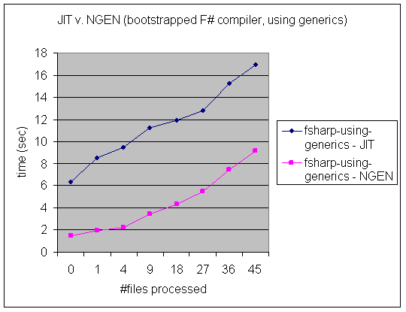
Typical Results of Pre-compilation
5X startup time improvement!!

Slide 66
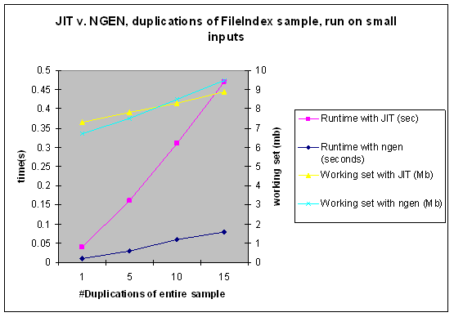
Typical Results of Pre-compilation

Slide 67
Part B: Generics Reloaded
.NET Generics and F#

Slide 68
Generics: Introduction
For:
Collection Classes,
Algorithms
Benefits:
Code Reuse,
Faster Code,
Safer Programming
Generic Classes,
Generic Interfaces,
Generic Structs,
Generic Code
Not a new idea...
public class Stack<T>
{
public Stack() { nitems = 0; items = new T[10]; }
public T Pop() { return items[--nitems]; }
public void Push(T x) { ... ; items[nitems++] = x; }
public bool IsEmpty() { ... }
private T[] items;
private int nitems;
}
C++
Ada
Stack<int> st;
..
switch (oper)
{
case ‘*’ :
st.Push (st.Pop() * st.Pop());
break;
case ‘*’ :
...
}
ML
Eiffel
Haskell
C#
Mercury
Java
Using a Generic Class

Slide 69
Languages, the CLR & .NET Generics
...and here.
VB
VC++
C#
...
F#
also here...
Common IL
F# is a related project
that works with or
without generics
We’ve added support for
generics/polymorphism...
Common Language Runtime
Loader
JIT
Verifier
...
GC
Native
Code

Slide 70
Generics are simple to use… (C#)
Without:
  class IntList { int x[]; int size; }
  class StringList { string x[]; int size; }
With:
  class List<T> { T x[]; int size; }
Main uses are collections, algorithms and control structures

Slide 71
But lots of real-world problems...
Interactions with:
  dynamic inspection of software objects/components
  dynamic linking
  exact runtime types
  on-the-fly code generation
  performance expectations of the user

Slide 72
Generics: Design Comparison
 | C++ | Java with Generics (GJ) | C# with Generics
Dynamic Load | ✗ | ✓ | ✓
Runtime Types | ✓ | ✗ | ✓
List<int> Stack<Date> | ✓ | ✗ | ✓
Efficient Execution | ✓ | ✗ | ✓
Code Sharing | ✗ | ✓ | ✓
Errors at compile time | ✗ Link time | ✓ | ✓
Ship without source | ✗ | ✓ | ✓
Easy debug | ✗ Name mangling | ✗ No type info | ✓

Slide 73
.NET Generics
MSR Cambridge “proof-of-concept” in 2002
MSR Cambridge and Microsoft have worked together since then
Generics for C#, VB, C++ is in VisualStudio 2005

Slide 74
Part D: Isolation and Resources Reloaded
Resource management
Software-based processes
Light-weight code generation

Slide 75
Design space for Software Isolated Processes
Excellent overview paper “Techniques for the design of Java operating systems” (Back, Tullmann, Stoller, Hsieh, Lepreau, 2000)
Process model
Protection/Security
  e.g. each application domain may have a different security policy
Resource management
  e.g. place hard limits on memory usage
  e.g. track processor usage per-application-domain
Communication

Slide 76
Reclaiming resources in long-running code: Lightweight code generation
Regular Expression.: (a|b)*(ba)+
Fast FSM (native code!)
Program generates an IL blob
Has control over resolution of bindings
Accessed via a single delegate object
FSM
“abba”
Slave
Delegate
RE
A
true
= app domain
= component
= set of class defs
App Domain
= .NET object

Slide 77
Reclaiming resources in long-running code: Application Domains
.NET supports “software isolated processes”.
Contain components, running code, descriptors, objects etc.
Transient
Resources reclaimed
One software-isolated process
VM
HOST
1
Typical uses:
Long running services
VM hosted inside database
User shell/browser
3
2
One component used by a process
hardware-isolated process
e.g. sqlserver.exe
= app domain
= software isolated process
= component
= set of class defs

Slide 78
What are they for? (computation)
Fast FSM
Regular Expression.: (a|b)*(ba)+
s1
Cl
“abba”
FSM
f: string -> bool
App Domain 2
RE
s2
A
true
App Domain 1
Communication (remoting) between “isolated” domains is possible
= app domain
= component
= set of class defs
Class
= descriptor/code
= C# object

Slide 79
What are they for? (plugins)
Website plugin (?)
VM
HOST
1
3
2
Website plug-in
Avalon GUI (?)
hardware-isolated process
e.g. explorer.exe
= app domain
= software isolated process
= component
= set of class defs

Slide 80
Sharing between AppDomains
Compiled code, descriptors and other resources may be shared between all domains.
We can configure which components are “domain neutral”
For this talk assume all basic components are shared
A
D
A
D
A
App Domain 3
App Domain 1
Cl
B
= app domain
A
C
= component
= set of class defs
App Domain 2
Class
= descriptor/code

Slide 81
Communication between AppDomains
As a baseline all communications can be implemented by marshalling & unmarshalling
Many communications can be implemented exceptionally efficiently (e.g. passing strings)
A
D
A
App Domain 3
App Domain 1
Cl
B
= app domain
A
C
= component
= set of class defs
App Domain 2
Class
= descriptor/code

Slide 82
AppDomains and static fields
int *xa = &(GetThreadLocalStore()->AppDomainState[2][0])
xa = (*xa)+1
static int x;
...
x++;
...
int *xa = 0x02376580
xa = (*xa)+1
B
A
D
App Domain 1
App Domain 2

Slide 83
Today
Compilation Reloaded
  Pre-compilation
Generics Reloaded
  C# Generics
Functional Programming Reloaded
  F#
Isolation Reloaded
  Application domains

Slide 84
Orthogonal & Unified Constructs
Type inference. The safety of C# with the succinctness of a scripting language
Let “let” simplify your life…
Bind a static value
let data = (1,2,3)
let f(a,b,c) =
let sum = a + b + c in
let g(x) = sum + x*x in
g(a), g(b), g(c)
Bind a static function
Bind a local value
Bind an local function

Slide 85
Orthogonal & Unified Constructs
Function values simplify and unify
…iteration and control
val List.map: (‘a → ‘b) → list<‘a> → list<‘b>
val List.foreach: list<‘a> → (‘a -> unit) → unit
val IEnumerable.map: (‘a → ‘b) → IEnumerable<‘a> → IEnumerable<‘b>
val IEnumerable.foreach: IEnumerable<‘a> → (‘a -> unit) → unit
Structural and Logical transformations made easy
Imperative and functional versions encouraged

Slide 86
Orthogonal & Unified Constructs
Function values simplify and unify
…extension
“Virtual methods”
(extension points)
type UnaryOperator =
{ evaluate: (float → float); // evaulation function
differentiate: (expr → expr); // symbolic differentiation function
name: string } // identity
let sinop = { evaluate=sin;
differentiate=Cos;
name="sin" }
This approach covers the majority of extensibility scenarios
Subclass? What subclass?

Slide 87
Orthogonal & Unified Constructs
Type parameters
Discriminated unions
Pattern matching
Type inference
Recursion (Mutually-referential objects)
Map<’a,’b>
List<’a>
Set<’a>
type expr =
| Sum of expr * expr
| Prod of expr * expr
….
match expr with
| Sum(a,b) -> ...
| Prod(a,b) -> ... ….
let rec map = ...

