Slide 1
F#
Combining Functional Programming, Objects and Meta-Programming in the context of .NET 2.0
Don Syme
Microsoft Research, Cambridge
http://research.microsoft.com/projects/fsharp
Google/MSN for “F#”

Slide 2

Today
Not a formal talk (no type inference rules)
But everything in the talk has a background in formal computer science
  .NET generics and type parameterization
  Types and type soundness
  Type inference through constrained polymorphism
  ML, Haskell
  HOL, Isabelle, ReFLect logic/meta-programming
If you like, read it as "applied language theory"
  or a vain attempt to bridge functional programming and the "real" (Microsoft-oriented) world

Slide 3
Which functional language:
Has 100s of Microsoft and open source developers working on its runtime systems, JIT compilers and libraries?
Has concurrent GC and SMP support?
Has CPU profilers, memory profilers, debuggers, test, doc tools?
Has companies like NAG building its numerics libraries?
Lets you publish types and code accessible by 100,000s of developers?
Consists of only ~25K LOC

Slide 4
A Modern Hello World

Slide 5
Introducing F#...
A .NET language
Aims to combine the best of Lisp, ML, Scheme, Haskell, in the context of .NET
Functional, math-oriented, scalable
Aimed particularly at the "Symbolic Programming" niche at Microsoft
  e.g. Static Driver Verifier, Terminator and more

Slide 6
F# as a Language
Common core language
Core
ML
Core
ML
“OCaml-Objects”
and other extensions
Modules-as-
values, functors
.NET API
Access
Other
extensions
+ tools
+ tools
OCaml
F#

Slide 7
What does F# omit?
Omitted Language Features:
  No OCaml-style “objects” (row-polymorphism)
  No higher-kinded polymorphism
  No modules-as-values
  No labelled or default arguments
  No variants (column-polymorphism)

Slide 8
Core ML (as if you didn't know)
Type inference. The safety of C# with the succinctness of a scripting language
Bind a static value
let data = (1,2,3)
let f(a,b,c) =
let sum = a + b + c in
let g(x) = sum + x*x in
g(a), g(b), g(c)
Bind a static function
Bind a local value
Bind an local function

Slide 9
Core ML (as if you didn't know)
Functions: like C# delegates, but simpler
Anonymous
Function value
(fun x -> x + 1)
let f x = x + 1
(f,f)
val f : int -> int
Declare a
function value
Pass around a pair
of function values
A function type

Slide 10
Core ML (as if you didn't know)
Type parameters
Discriminated unions
Pattern matching
Type inference
Recursion (Mutually-referential objects)
Map<’a,’b>
List<’a>
Set<’a>
type expr =
| Sum of expr * expr
| Prod of expr * expr
….
match expr with
| Sum(a,b) -> ...
| Prod(a,b) -> ... ….
let rec map = ...

Slide 11
Less is More?
Far fewer classes and other type definitions than in OO programming
Fewer classes, concepts = less up-front time in class design
Essentially no null pointers
No constructors-calling-virtual-methods and other OO weirdness

Slide 12
Interlude:
Some F# Screen Shots

Slide 13
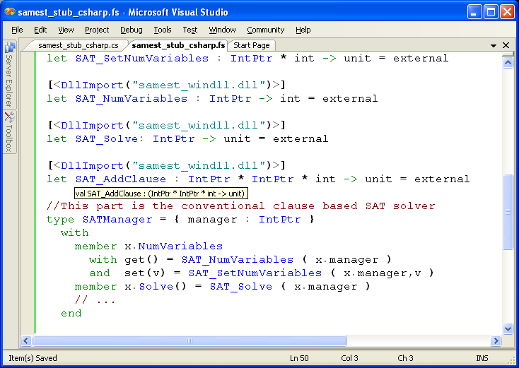
#1: Calling C/C++
World-class SAT Solver
Easily made available in F#
Wrapped as an
F# type

Slide 14
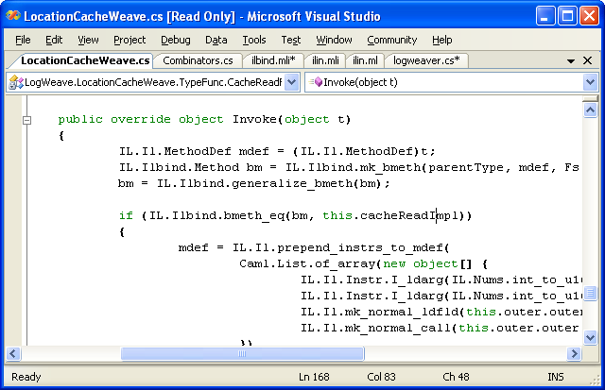
#2: Calling F# from C#
LogWeave (Office XAF Optimization Tool)
4000 lines C#, using Abstract IL library
Using types defined in F#
Using functions defined in F#
il.mli/ilbind.mli
type Method
type MethodDef
val bmeth_hash : Method -> int
val bmeth_eq : Method -> Method -> bool
val bmeth_compare : Method -> Method -> int
val mk_bmeth : Type * MethodDef * Types -> Method
val mk_generalized_bmeth : Type * MethodDef -> Method
val generalize_bmeth : Method -> Method

Slide 15
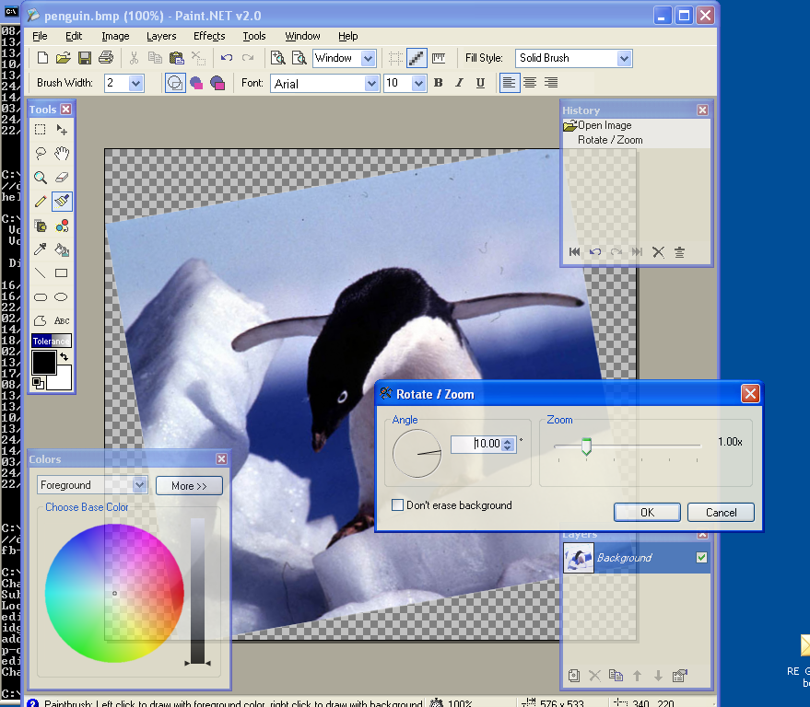
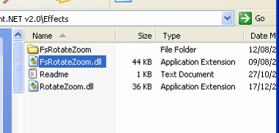
#3: Paint.NET & Plugins
Plugin written in F#
Here is the DLL

Slide 16
F# for language geeks…

Slide 17
F# is not "just" ML...
Mutually referential objects and initialization graphs
Embracing the best of OO in the context of ML
Leveraging .NET Generics
Quoted Expressions and LINQ

Slide 18
Restrictions in Core ML
Only recursive functions:
  "let rec" can only bind lambda expressions
  also recursive data in OCaml
No polymorphic recursion
  "let rec" bindings must be recursively used at uniform polymorphic instantiations
Value restriction
  limits on the generalization of polymorphic bindings that involve computation

Slide 19
Recursive definitions in ML
Core ML
let rec f x = if x > 0 then x*f(x) else 1
Recursive function
OCaml
let rec ones = 1 :: ones
Recursive data
✗ ✗
let cons x y = x :: y
let rec ones = cons 1 ones
Immediate dependency
✗
type widget
let rec widget = MkWidget (fun ... -> widget)
Possibly delayed dependency

Slide 20
Example 1: Typical GUI toolkits
Widgets
Evolving behaviour
A specification:
form
form = Form(menu)
menu = Menu(menuItemA,menuItemB)
menuItemA = MenuItem(“A”, {menuItemB.Activate} )
menuItemB = MenuItem(“B”, {menuItemA.Activate} )
✓
menu
Assume this
abstract API
Assume:
menuItemA
type Form, Menu, MenuItem
val MkForm : unit -> Form
val MkMenu : unit -> Menu
val MkMenuItem : string * (unit -> unit) -> MenuItem
val activate : MenuItem -> unit
…
menuItemB

Slide 21
Example 1: The Obvious Is Not Allowed
✗ Construction computations
on r.h.s of let rec
The obvious code isn't allowed:
let rec
form = MkForm()
and menu = MkMenu()
and menuItemA = MkMenuItem(“A”, (fun () -> activate menuItemB)
and menuItemB = MkMenuItem(“B”, (fun () -> activate menuItemA)
…
nb. Delayed self-references

Slide 22
Example 1: Explicit Initialization Holes in ML
VR Mitigation Technique 1
Manually build
“initialization-holes”
and fill in later
So we end up writing:
let form = MkForm()
let menu = MkMenu()
let menuItemB = ref None
let menuItemA = MkMenuItem(“A”, (fun () -> activate (the(!menuItemB))
menuItemB := Some(MkMenuItem(“B”, (fun () -> activate menuItemA))
…
✓ML programmers understand ref, Some, None.
✗ Most programmers hate this. Why bother using ML if you end up doing this?
✗ The use of explicit mutation is deeply disturbing.

Slide 23
Example 1: Imperative Wiring in ML
VR Mitigation Technique 2
Create then use mutation to
configure
form
// Create
let form = MkForm() in
let menu = MkMenu() in
let menuItemA = MkMenuItem(“A”) in
let menuItemB = MkMenuItem(“B”) in
...
// Configure
form.AddMenu(menu);
menu.AddMenuItem(menuItemA);
menu.AddMenuItem(menuItemB);
menuItemA.add_OnClick(fun () -> activate menuItemB))
menuItemB.add_OnClick(fun () -> activate menuItemA))
menu
menuItemA
✗ Lack of locality for large specifications
✗In reality a mishmash – some configuration
mixed with creation.
menuItemB

Slide 24
Example 1: It Gets Worse
A specification:
form
form = Form(menu)
menu = Menu(menuItemA,menuItemB)
menuItemA = MenuItem(“A”, {menuItemB.Activate} )
menuItemB = MenuItem(“B”, {menuItemA.Activate} )
✓
menu
Aside: this smells like a “small” knot. However another huge source of self-referentiality is that messages from worker threads must be pumped via a message loop accessed via a reference to the form.
menuItemA
menuItemB
workerThread

Slide 25
Example 2: Caches
Given:
val cache : (int -> 'a) -> (int -> 'a)
We might wish to write:
let rec compute = cache (fun x -> ...(compute(x-1)))
Alternatives don’t address the fundamental problem:
But have to write:
val mkCache : unit -> (int -> 'a) -> (int -> 'a)
let computeCache = mkCache()
let rec computeCached x = computeCache computeUncached x
and computeUncached x = ...(computeCached(x-1))
✗ Construction computations
on r.h.s of let rec
✗ Broken abstraction boundaries
let computeCache = Hashtbl.create ...
let rec computeCached x =
match Hashtbl.find computeCache x with
| None ->
let res = computeUncached x in
Hashtbl.add computeCache x res;
res
| Some x -> x
and computeUncached x = ...(computeCached(x-1))
✗ No reuse
✗ Non local
VR Mitigation Technique 3
Lift the effects out of let-recs, provide possibly-rec-bound information later, eta-expand functions

Slide 26
Example 2: Caches cont.
But what if given:
type 'a cache
val stats: 'a cache -> string
val apply: 'a cache -> int -> 'a
val cache : (int -> 'a) -> 'a cache
Want to write
let rec computeCache = cache (fun x -> ...(compute(x-1)))
and compute x = apply computeCache x
Mitigation Technique 3 doesn't work
(can't eta-expand abstract objects)
Have to resort to mutation: i.e. "option ref" or "create/configure"
Summary
The let-rec restriction discourages abstraction, discourages code re-use, encourages mutation

Slide 27
Further Examples
Picklers
  Mini-objects: pairs of functions once again
  Again, abstract types make things worse
Automata
  Recursive references to pre-existing states
Streams (lazy lists)
  Very natural to recursively refer to existing stream objects in lazy specifications
Just about any other behavioural/co-inductive structure

Slide 28
Example 1 in Scheme
values are initially nil
form
(letrec
((mi1 (createMenuItem("Item1",
(lambda () (activate(mi2)))))
(mi2 (createMenuItem("Item2",
(lambda () (activate(mi1)))))
(f (createForm("Form", (m))))
(m (createMenu("File", (mi1, mi2))))
...)
menu
menuItemA
runtime error: nil value
menuItemB

Slide 29
Example 1: Create and Configure in Java/C#
Nb. Anonymous delegates really required
class C
{ Form form;
Menu menu;
MenuItem menuItemA;
MenuItem menuItemB;
C() {
// Create
form = new Form();
menu = new Menu();
menuItemA = new MenuItem(“A”);
menuItemB = new MenuItem(“B”);
// Configure
form.AddMenu(menu);
menu.AddMenuItem(menuItemA);
menu.AddMenuItem(menuItemB);
menuItemA.OnClick +=
delegate(Sender object,EventArgs x)
{ … };
menuItemB.OnClick += … ;
// etc.
}
}
Rough C# code,
if well written:
✗Null pointer exceptions possible
(Some help from compiler)
form
✗Lack of locality
✗In reality a mishmash – some configuration
mixed with creation.
menu
✗Need to use classes
menuItemA
✗Easy to get lost in OO fairyland
(e.g. throw in virtuals, inheritance)
✓Programmers understand null pointers
✓ Programmers always have a path to work around problems.
menuItemB

Slide 30
Are we missing a point in the design space?
Initialization soundness
guarantees ("no nulls")
ML
The question: could it better to check some initialization conditions at runtime, if we encourage abstraction and use less mutation?
???
Dynamically
typed
scripting
languages
Correspondence of
code to spec

Slide 31

An alternative: Initialization Graphs
let rec form = MkForm(menu)
and menu = MkMenu(menuItemA,
menuItemB)
and menuItemA =
MkMenuItem(“A”,
(fun () -> activate menuItemB)
and menuItemB =
MkMenuItem(“B”,
(fun () -> activate menuItemA)
in
...
Write the code the obvious way, but interpret the "let rec" differently
Caveat: this mechanism has problems. I know.
From a language-purist perspective consider it a "cheap and cheerful" mechanism to explore the issues and allow us to move forward.

Slide 32
Initialization Graphs: Compiler Transformation
let rec form = lazy (MkForm(menu))
and menu = lazy (MkMenu(menuItemA,
menuItemB))
and menuItemA =
lazy (MkMenuItem(“A”,
(fun () -> activate menuItemB))
and menuItemB =
lazy (MkMenuItem(“B”,
(fun () -> activate menuItemA))
in
...
All “let rec” blocks now represent graphs of lazy computations called an initialization graph
Recursive uses within a graph become eager forces.

Slide 33
Initialization Graphs: Compiler Transformation
let rec form = lazy (MkForm(force(menu)))
and menu = lazy (MkMenu(force(menuItemA),
force(menuItemB)))
and menuItemA =
lazy (MkMenuItem(“A”,
(fun () -> force(menuItemB).Toggle()))
and menuItemB =
lazy (MkMenuItem(“B”,
(fun () -> force(menuItemA).Toggle()))
in
...
All “let rec” blocks now represent graphs of lazy computations called an initialization graph
Recursive uses within a graph become eager forces.

Slide 34
Initialization Graphs: Compiler Transformation
let rec form = lazy (MkForm(force(menu)))
and menu = lazy (MkMenu(force(menuItemA),
force(menuItemB)))
and menuItemA =
lazy (MkMenuItem(“A”,
(fun () -> force(menuItemB).Toggle()))
and menuItemB =
lazy (MkMenuItem(“B”,
(fun () -> force(menuItemA).Toggle()))
in
let form = force(form)
and menu = force(menu)
and menuItemA = force(menuItemA)
and menuItemB = force(menuItemB)
form
With some caveats, the initialization graph is NON ESCAPING. No “invalid recursion” errors beyond this point
menu
All “let rec” blocks now represent graphs of lazy computations called an initialization graph
Recursive uses within a graph become eager forces.
Explore the graph left-to-right
The lazy computations are now exhausted
menuItemA
menuItemB

Slide 35
Example 1: GUIs
This is the natural way to write the program
// Create
let rec form = MkForm()
and menu = MkMenu()
and menuItemA = MkMenuItem(“A”, (fun () -> activate menuItemB)
and menuItemB = MkMenuItem(“B”, (fun () -> activate menuItemA)
…

Slide 36
Example 2: Caches
This is the natural way to write the program
let rec compute = cache (fun x -> ...(compute(x-1)))
let rec compute = apply computeCache
and computeCache = cache (fun x -> ...(compute(x-1)))
Note IGs cope with immediate dependencies

Slide 37
Example 3: Lazy lists
val Stream.consf : 'a * (unit -> 'a stream) -> 'a stream
val threes: int stream
let rec threes3 = consf 3 (fun () -> threes3)
// not: let rec threes3 = cons 3 threes3
This is the almost the natural way to write the program
All references must be delayed
Or use a "delay" operator
val Stream.cons : 'a -> 'a stream -> 'a stream
val Stream.delayed : (unit -> 'a stream) -> 'a stream
let rec threes3 = cons 3 (delayed (fun () -> threes3))

Slide 38
Performance
Take a worst-case (streams)
  OCamlopt: Hand-translation of IGs
Results (ocamlopt – F#'s fsc.exe gives even greater difference):
Notes:
  Introducing initialization graphs can give huge performance gains
  Further measurements indicate that adding additional lazy indirections doesn't appear to hurt performance
This uses an IG to create a single object wired to itself
let rec threes = Stream.consf 3 (fun () -> threes)
suck threes 10000000;;
0.52s
let rec threes () = Stream.consf 3 threes
suck (threes()) 10000000;;
4.05s

Slide 39
Initialization Graphs: Static Checks
Simple static analyses allow most direct (eager) recursion loops to be detected
Optional warnings where runtime checks are used
let rec x = y
and y = x
mistake.ml(3,8): error: Value ‘x’ will be evaluated as part of its own definition. Value 'x' will evaluate 'y' will evaluate 'x'
ok.ml(13,63): warning: This recursive use will be checked for initialization-soundness at runtime.
let rec menuItem =
MkMenuItem("X", (fun () -> activate menuItem))

Slide 40
Issues with Initialization Graphs
No generalization at bindings with effects (of course)
Compensation (try-finally)
Concurrency
  Need to prevent leaks to other threads during initialization (or else lock)
  Raises broader issues for a language
Continuations:
  Initialization can be halted. Leads to major problems
What to do to make things a bit more explicit?
  My thought: annotate each binding with “lazy”
  One suggestion: annotate each binding with “eager”
let rec eager form = MkForm(menu)
and eager menu = MkMenu(menuItemA, menuItemB)
and eager menuItemB = ...
and eager menuItemA = ...

Slide 41
Initialization graphs: related theory
Monadic techniques
  Launchbury/Erkok
  Multiple mfix operators (one per monad)
  Recursion & monads (Friedman, Sabry)
  Benton's "Traced Pre-monoidal categories"
Operational Techniques
  Russo's recursive modules
  Haskell's mrec
  Scheme's let rec
  Units for Scheme
  Boudol, Hirschowitz
Denotational Techniques
  Co-inductive models of objects (Jakobs et al.)

Slide 42
F#, OOP and VOP

Slide 43
Untying the OO puzzle
Type-directed name resolution
Type-directed XYZ resolution
Mutation and identity
Encapsulated mutation
Existentials
Large recursive scopes
Initialization holes everywhere
Default parameters
Classification
Dynamic discovery of typed services ("casting")

Slide 44
Accessing OO
1. Type-Directed Name Resolution
A mix of type-directed adhoc overloading and constrained monomorphism
Inference order matters, type annotations may be needed. Seems to work well in practice
Adhoc, based on all H-M inferred type information, outside-in, left-to-right
Type.Property
Type.MethodName
expr.MethodName
expr.Property
Name resolution
new Type(args)
expr.MethodName(args)
expr.IndexerProperty(args)
Method overloading

Slide 45
Accessing OO
2. Subtyping, inference and constraints
The basic mechanism:
This function accepts any thing that is a subtype of “Stream”
val f : (_ :> Stream) -> StreamWriter
val f: 'a -> StreamWriter when 'a :> Stream
StreamWriter(_ :> Stream)
Equivalent to this more verbose form
let x1 = new StreamWriter(new FileStream(“abc.txt”))
let x2 = new StreamWriter(new MemoryStream(bytes))
let f s = new StreamWriter(s)
let x1 = f(new FileStream(“abc.txt”)
let x2 = f(new MemoryStream(bytes)
Refactor to a function, no type error

Slide 46
Accessing OO
2. Subtyping, inference and constraints
From .NET we get constraints of the form
  'a :> System.IDisposable
  'a :> System.IComparable<'a>
  _ :> System.IDisposable -- implicit variable
  #System.IDisposable -- implicit variable
  others solved to this form -- ala limited Haskell type classes
  But we eagerly solve 'a :> 'b to 'a = 'b -- arise rarely
ty :> obj holds for all types
e :> ty need not preserve identity, e.g. may box/repackage
This is the primary technical limitation

Slide 47
Augmentation and type-directed name resolution
Type Definition
type point = { x: float; y: float }
let mkPoint x y = {x=x;y=y}
let getX p = p.x
let getY p = p.y
type point
with
static member Create(x,y) = {x=x; y=y}
static member Origin = { x=0.0; y=0.0 }
member p.Add(dx,dy) = { x=p.x+dx; y=p.y+dy }
member p.X = p.x
member p.Y = p.y
end
let p = point.Create(3.14,6.28);;
p.X;;
p.Y;;
type point = { x: float; y: float }
let mkPoint x y = {x=x;y=y}
let getX p = p.x
let getY p = p.y
type point
with
static member Create(x,y) = {x=x; y=y}
static member Origin = { x=0.0; y=0.0 }
end
type point = { x: float; y: float }
let mkPoint x y = {x=x;y=y}
let getX p = p.x
let getY p = p.y
type point
with
…
end
type point = { x: float; y: float }
type point = { x: float; y: float }
let mkPoint x y = {x=x;y=y}
let getX p = p.x
let getY p = p.y
Type Augmentation
(~instance declaration for adhoc-dot-notation)
We haven't compromised the basic way of writing code in the language
// point.mli (signature)
type point
with
static member Create : float * float -> point
static member Origin : point
member X : float
member Y : float
member Add : float * float -> point
end
Method member
Property members
(can compute)
But OO presentation techniques are available if needed
This can now be understood and used by any .NET programmer

Slide 48
Classes and interfaces
The full .NET OO model is also supported
type point = class
val x: float
val y: float
new(x,y} = { x=x;y=y }
static member Create(x,y) = {x=x; y=y}
static member Origin = { x=0.0; y=0.0 }
member p.Add(dx,dy) = { x=p.x+dx; y=p.y+dy }
member p.X = p.x
member p.Y = p.y
end
// point.mli (signature)
type point
with
static member Create : float * float -> point
static member Origin : point
member X : float
member Y : float
member Add : float * float -> point
end
This can now be understood and used by any .NET programmer

Slide 49
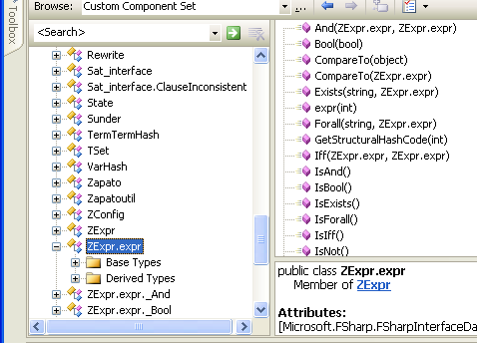
Interoperation: publishing code
Mechanism 1: All ML public types and code have accessible, reliable compiled forms
  e.g. ML type names, type representations and values have predictable, stable, public representations
Lib.expr b = Lib.expr.True;
switch (b.Tag)
{
case Lib.expr.tag_Bool:
Console.WriteLine(“B({0})“,b.Bool1);
break;
case Lib.expr.tag_Term:
Console.WriteLine(“T({0})“,b.Term1);
break;
}
type expr = Bool of bool
| Term of Term.term
| Not of expr
| And of expr * expr
| Or of expr * expr
| Iff of expr * expr
| Forall of string * expr
| Exists of string * expr
match (b) with
| Bool(b) -> ...
| Term(t) -> ...
Lesson
Do everything you can to allow other languages call you.

Slide 50
Interoperation: publishing code
LogWeave (Office XAF Optimization Tool)
4000 lines C#, using Abstract IL library
Using types defined in F#
Using functions defined in F#
ilbind.mli
type Method
val bmeth_hash : Method -> int
val bmeth_eq : Method -> Method -> bool
val bmeth_compare : Method -> Method -> int
val mk_bmeth : Type * MethodDef * Types -> Method
val mk_generalized_bmeth : Type * MethodDef -> Method
val generalize_bmeth : Method -> Method

Slide 51
LINQ: Data Integration through meta-programming

Slide 52
Language Integrated Queries with LINQ
db.Customers
|> where « fun c -> c.City = "London" »
|> select « fun c -> c.ContactName »
["Thomas Hardy"; "Victoria Ashworth";
"Elizabeth Brown"; "Ann Devon";
"Simon Crowther"; "Hari Kumar"]
SELECT [t0].[ContactName]
FROM [Customers] AS [t0]
WHERE @p0 = [t0].[City]

Slide 53
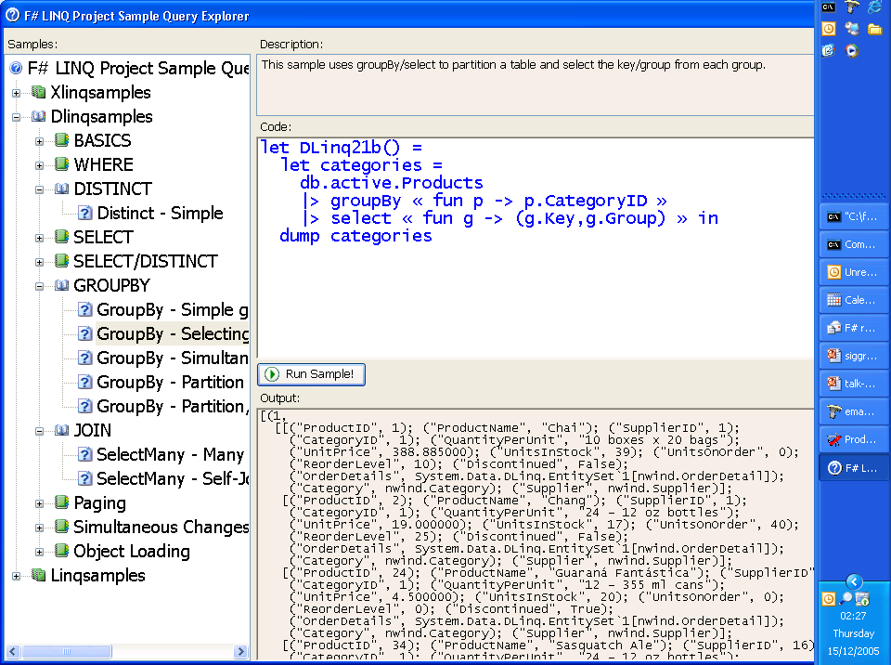

Slide 54
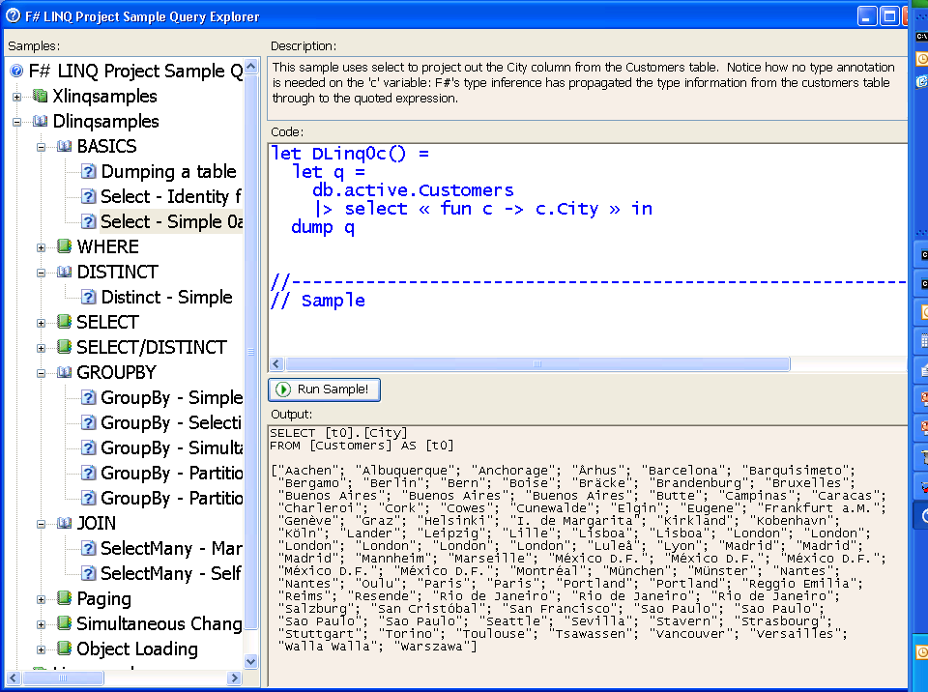

Slide 55
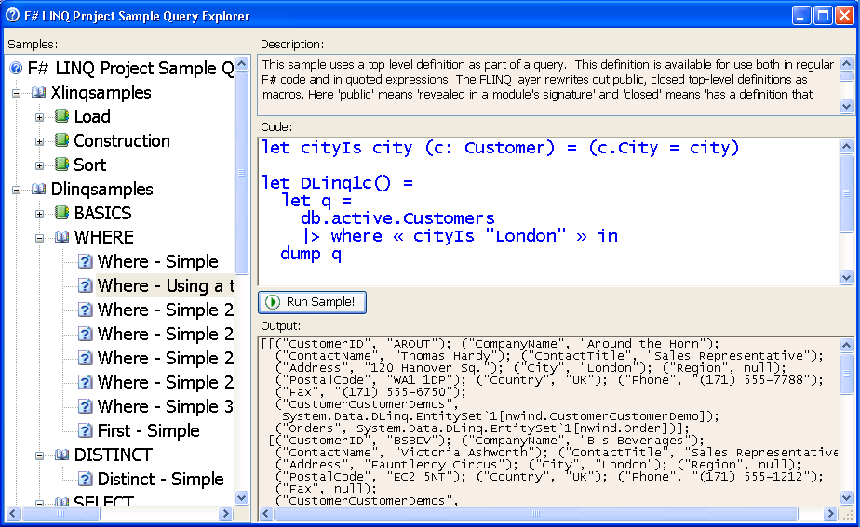
This allows definitions to be shared between meta-language and object-language
Quotations can refer to top level definitions

Slide 56
Quoted Expressions
Much like LISP’s `(1 + 2), with holes, interior binding and types
No ‘eval’ provided
No type generalization (inner polymorphism) inside quoted expressions
Currently mapped to name carrying terms
Closed “up to top-level, public definitions”
Piggy-back of the assembly/namespace/type structure of .NET and F# for model of linking/references
May reference object model goop (some incompletenesses here)
« 1 + 2 »;;
« 1 + _ »;;
« _ + _ »;;
« _ + _ »;;
Runtime
type exprSpec =
| ConstExpr of constSpec * typeSpec list
| VarExpr of varName
| LambdaExpr of varSpec * exprSpec
| AppExpr of exprSpec * exprSpec
| QuoteExpr of exprSpec
| HoleExpr of typeSpec
and typeSpec =
| VarType of tyvarIdx
| AppType of tyconstSpec * typeSpec list
type 'a expr = Expr of exprSpec
Compile
F# Internal
Compiler Trees
Linq’s
System.Expression
Pickle to bytes
bytes
Unpickle from bytes
SQL
etc.

Slide 57
FLINQ: Overall Results?
Surprisingly different to C# Linq
  No syntax extensions
  Can use top definitions as macros (i.e. can factor common fragments of queries)
  F# makes quotation, splicing and lifting explicit but relatively painless
LINQ has some of the world’s first multi-language meta-programming components
  Gives meta-programming a much less ‘introverted’ feel
  Indeed interoperability at this layer is much easier than at the IL layer (it’s just programming and transformation)

Slide 58
Opportunities?
Essentially the same techniques are used to embed H.O.L theorem proving in Intel’s ForteFL.
  For hardware verification
  So (clearly) the techniques are very, very general
So some obvious targets are:
  Proof and Logic: e.g. embed H.O.L. theorem proving
  Symbolic Programming: An interface to BDDs, SAT solving and decision procedures
  Data: OLAP Cube Queries
  Hardware: Running code on GPUs (Accelerator)
  Distributed computing: A subset of F# ‘code’ becomes JavaScript on the browser, probably via a Linq-like standard library
  Probabilistic modelling: Is FP code a good basis for expressing a class of graphical models?
  Runtime Code Generation: The dreaded ‘Eval’ returns
  Avalon without XAML
  Fran: Optimizing Reactive Animation Descriptions
Slogan: `Evaluation by Other Means’

Slide 59
Summary

Slide 60
Languages, the CLR & .NET Generics
...and here.
VB
VC++
C#
...
F#
also here...
Common IL
F# is a related project
that works with or
without generics
We’ve added support for
generics/polymorphism...
Common Language Runtime
Loader
JIT
Verifier
...
GC
Native
Code

Slide 61
F# and Some Other Languages
MLj/SML.NET
  First decent language on JVM
  VS Mode acted as prototype for F# VS mode
  Excellent whole-program optimizing compiler
  Not quite hitting the niche I’m aiming for (scalable, typesafe scripting)
Haskell
  Haskell is the most beautiful functional language
  I did a prototype Haskell.NET in 2001
  By .NET standards Haskell doesn't interoperate well
  But I'm very interested in enabling Haskell-like programming on .NET
Nemerle
  new language vaguely reminiscent of OCaml
  Lesson: “functional in the small, OO in the big”

Slide 62
Summary
F#: Scalable, type-safe, efficient, .NET-interoperable scripting
Some related aspects of language design
  Combining FP & OOP
  Initialization graphs
  A modicum of meta-programming

Slide 63
Practicalities
Getting it:
  http://research.microsoft.com/downloads
  MSN Search for “fsharp”
  Google for “F#”
Learning it:
  http://research.microsoft.com/projects/fsharp
  http://blogs.msdn.com/dsyme
Participating:
  http://research.microsoft.com/projects/ilx/fsharp-community.aspx

Slide 64
Questions?

Slide 65
Backup Slides

Slide 66
F# 1.1 - Three Big Ticket Items
F# Interactive
The F# Object and Encapsulation Model
F# LINQ
Also:
Operator overloading according to .NET standards
bignum, bigint, matrix, vector, complex
XMLDocs
Optimizations

Slide 67
F# 1.1 - Three Big Ticket Items
F# Interactive
  Traditional command-line execution meets .NET
  A wonderful tool for interactive, investigative computations and visualizations
The F# Object and Encapsulation Model
F# LINQ

Slide 68
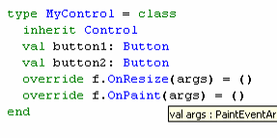
F# 1.1 - Three Big Ticket Items
F# Interactive
The F# Object and Encapsulation Model
  The .NET object model with succinct notation, type inference
  OO for scalability and multi-paradigm programming
  Integrated elegantly with functional programming
F# LINQ

Slide 69
F# 1.1 - Three Big Ticket Items
F# Interactive
The F# Object and Encapsulation Model
F# LINQ
  Microsoft says: the future of data integration in languages
  Academics say: interesting combination of functional-programming and meta-programming
  Regardless,
    F# is now a beautiful LINQ language
    Exploring future application areas

Slide 70
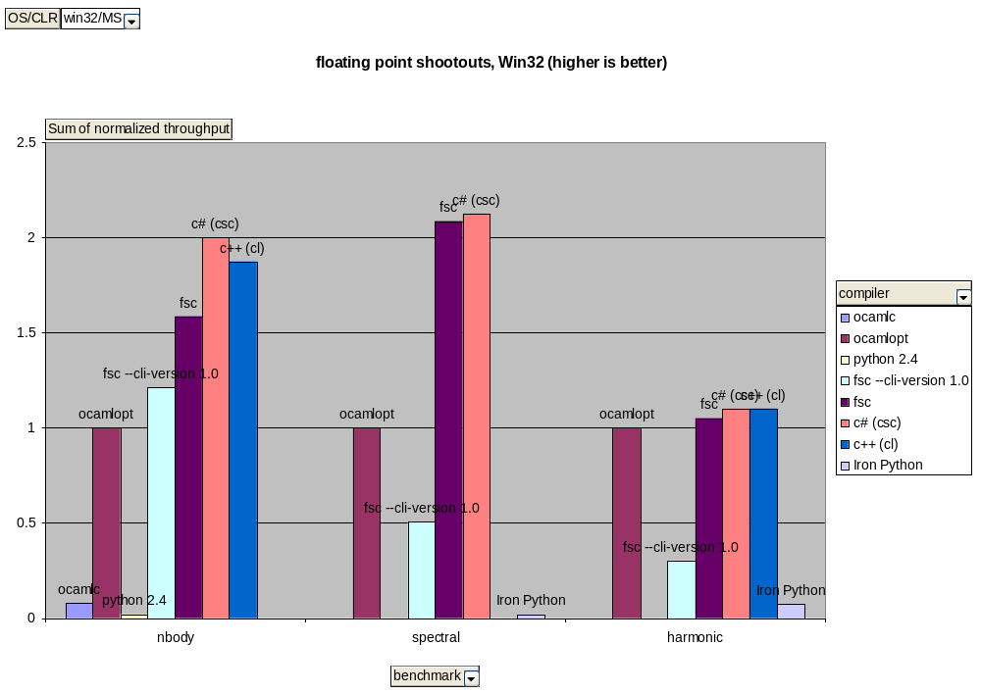
Floating point performance

Slide 71
F# and Research
Some F#-related Research
  Value recursion and mixins in safe programming languages
  Generics for C# and .NET
  Interoperability for .NET languages

Slide 72
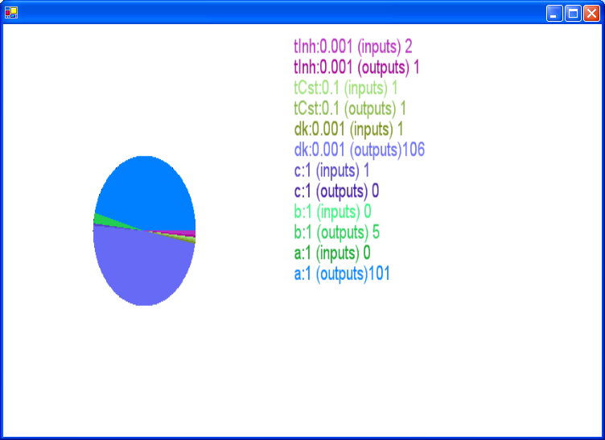
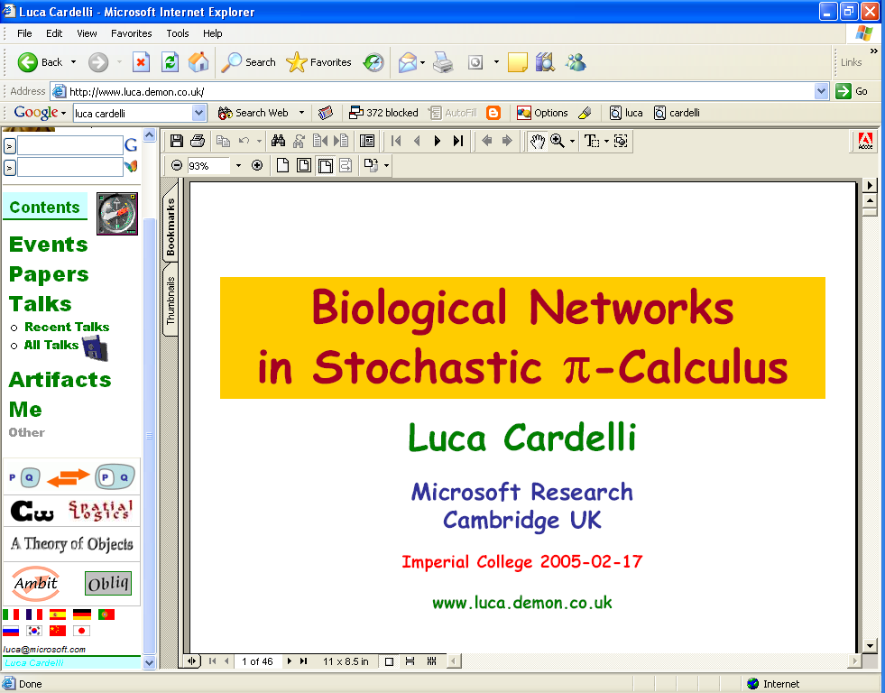

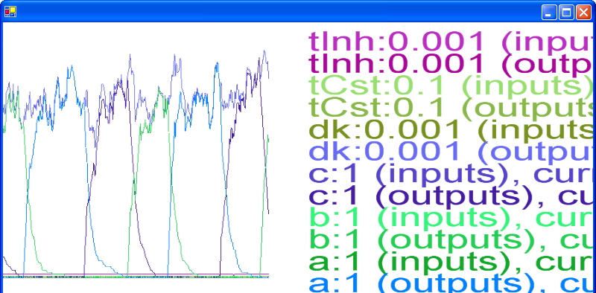
#3: SPiM: Biological Simulation and Visualization

Slide 73
#4: Running on Mono

Slide 74
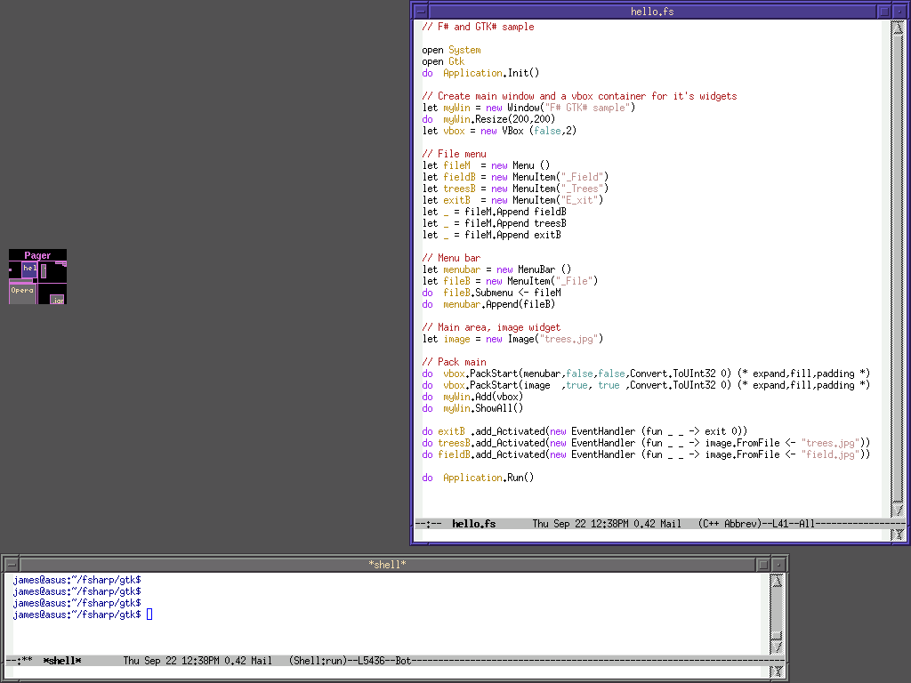
Code Shot 4: …

Slide 75
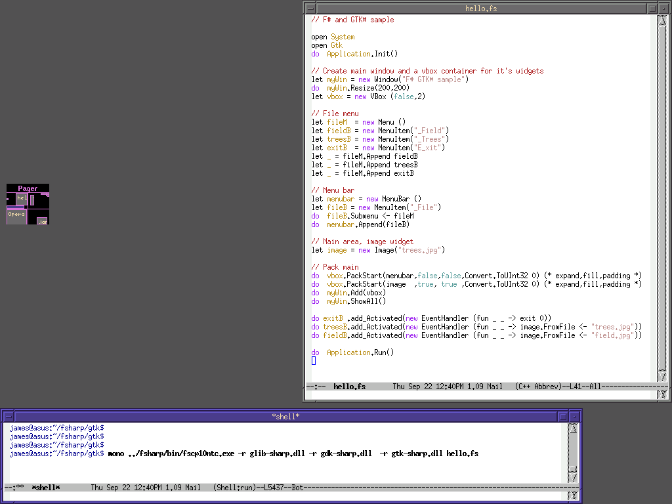
Code Shot 4: …

Slide 76
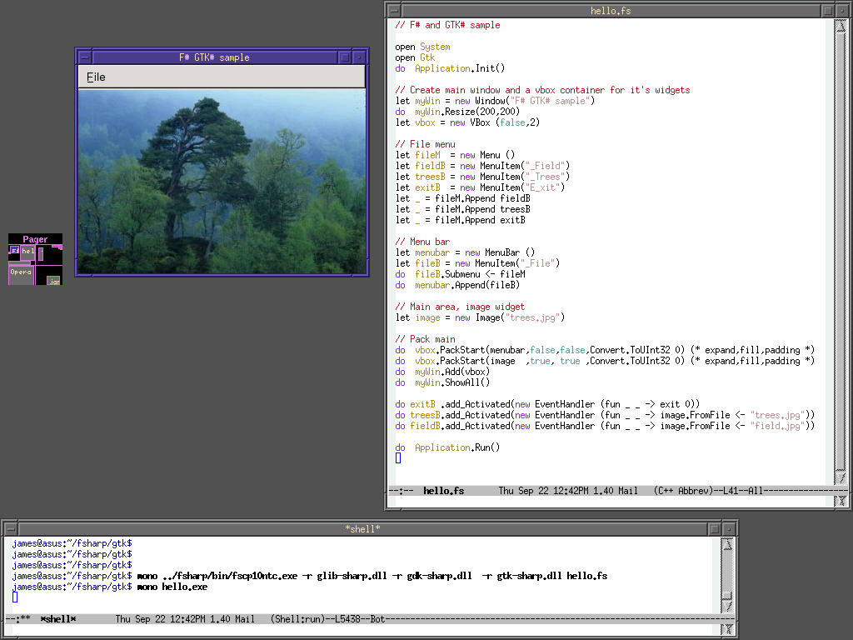

Slide 77


Slide 78
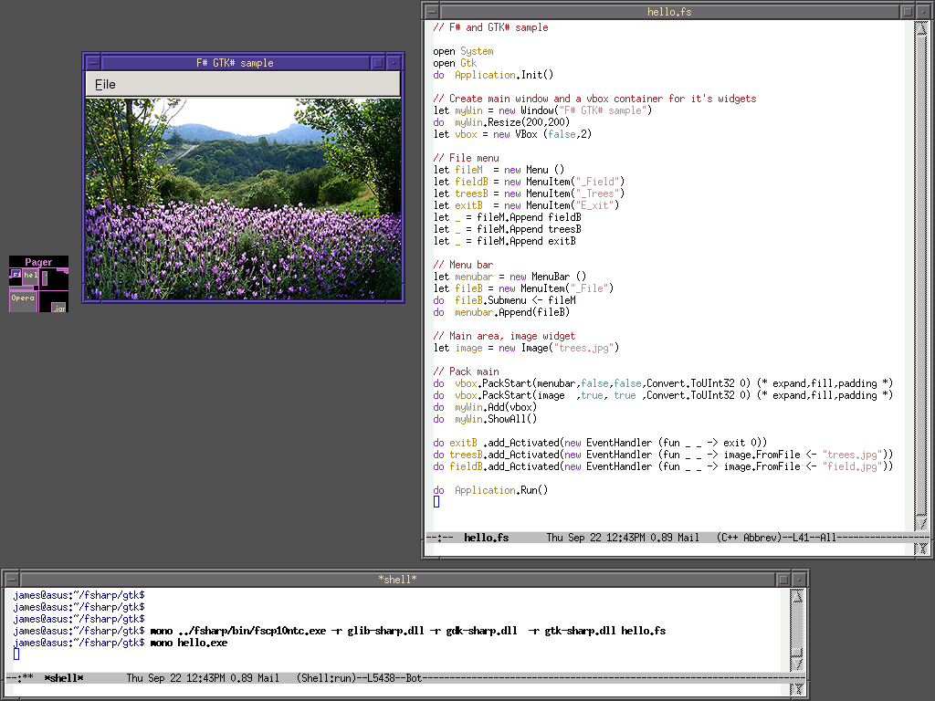

Slide 79
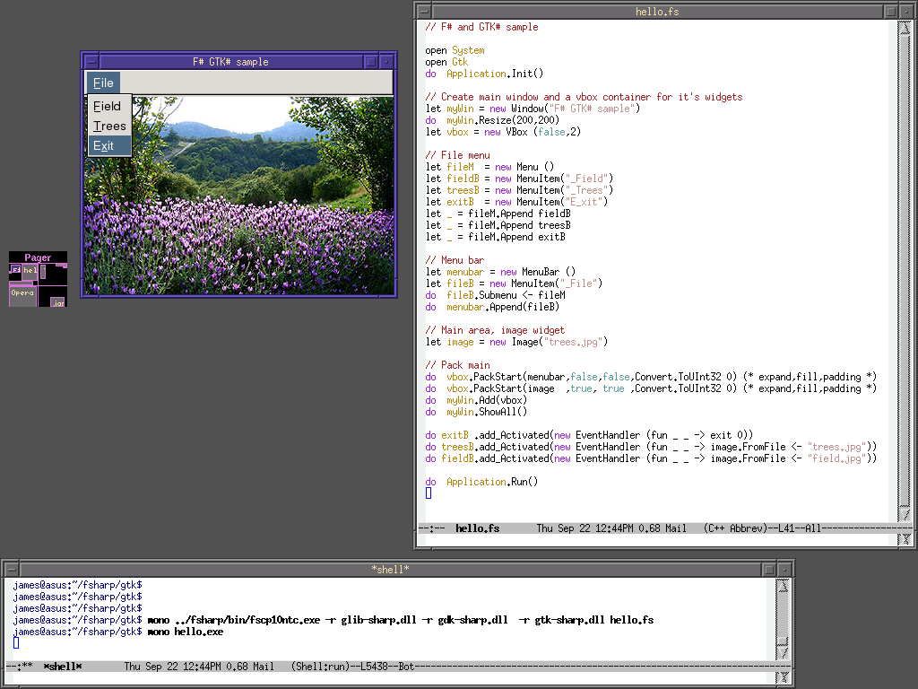

Slide 80
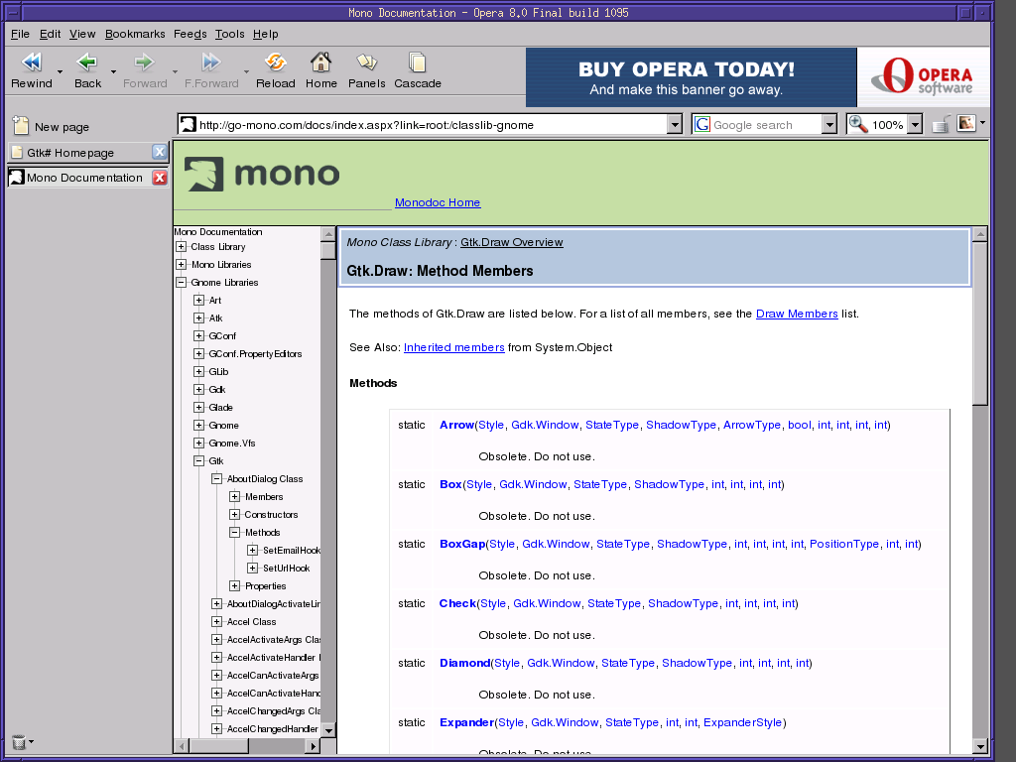

Slide 81
.NET
VB
C++
C#
...
F#
Common IL
Common Language Runtime
Loader
JIT
Verifier
...
GC
Native
Code

Slide 82
Challenges of modern language design
It’s the
combination that counts
Scalable
Succinct
Type-safe
Efficient
Libraries
Interactive
Interoperable
Good
Platform

Slide 83
The Great ML Tragedy
ML is the world’s best language, almost:
  “Type inference makes programs cryptic and unreadable”
  “ML APIs are cryptic. I never know where to look or what to expect.”
  “Pattern matching only works on concrete data, so you are encouraged to break abstractions”
  “You can’t write GUIs in a declarative way”
  “Where are my objects?”
  “Functors are hard to understand and use properly”
  “OO-style extensibility is really hard”

Slide 84
The Great ML Tragedy
Some ML implementations have been quite good, but even then…
  No libraries
  No debuggers
  No visual editing environments
  “Threads can’t execute concurrently, if at all”
  “You can’t use your code from any other language”
  “You can’t compile as a DLL, or if you can you have to statically link the entire ML runtime”
  “No binary compatibility – you have to recompile the world when you upgrade your ML compiler”
  Wadler: “Libraries, Portability, Availability, Packagability, Tools, Training and Popularity”

Slide 85
The Great ML Tragedy
Students leave with the impression that ML is “not for real”
Many who struggle with lambda calculus think it must be really slow
  If it took them so long to do that beta-reduction exercise, then surely the language must be slow as well?

Slide 86
Reactive v. Immediate Dependencies
form = Form(menu)
menu = Menu(menuItemA,menuItemB)
menuItemA = MenuItem(“A”, {menuItemB.Activate} )
menuItemB = MenuItem(“B”, {menuItemA.Activate} )
form
menu
The goal: support value recursion for reactive machines
menuItemA
But we cannot statically check this without knowing a lot about the MenuItem constructor code
Often infeasible and technically extremely challenging
These are REACTIVE (delayed) references, hence "OK"
menuItemB

Slide 87
Challenges?
General Meta-programming Challenges
  Some language constructs not reified
  Slippery Slope towards
    ‘hygenic macros’
    ‘eval’ (nb. Reflection.Emit exists anyway)
    The Reflective Tower
  Exposing library definitions brings real fragility
  Increasing static feedback
Meta-evaluation Challenges
  Ensuring semantic consistency between multiple evaluation techniques
Meta-logic Challenges
  Won’t cover these today

Slide 88
Linq’s System.Expressions
Types:
  Expression
  Expression.Expression<T>
  Func<A,B>
  Func<A,B,C>
  Expression.LambdaExpression<Func<A,B>>
  Expression.LambdaExpression<Func<A,B,C>>
Constructors:
  Expression.And(…) -- overloaded
  Expression.LT(…)
  Expression.EQ(…)
  etc.
  Expression.Property(…)
  Expression.MethodCall(…)
  Expression.LambdaExpression(…)
  Expression.LambdaExpression<T>
Comments
Intended semantics of nodes a little unclear, but not too bad
No primitives like substitution, beta-reduction etc.
Bound (variables point directly back to the binding site)
C# does partial evaluation of constant expressions (lifts them out of expression and splices reified result back in). This seems like a mistake for many applications (e.g. mobile code)
Nested quotations look difficult in C#
At least one obvious nodes missing in early releases (conditionals, also “let”)
val projE : exprSpec -> Expression
val projExpr : 'a expr -> Expression<'a>
val projFunc2 : ('a -> 'b) expr -> Expression<Func<'a,'b> >
val projFunc3 : ('a -> 'b -> 'c) expr -> Expression<Func<'a,'b,'c> >
From F# Quoted Expressions to System.Expression

Slide 89
Observations?
A funny kind of meta-programming
  Translation, not Staging
  Parameterize very heavy lifters like SQL by very simple expressions
    The program fragments can easily be analyzed at runtime to be effect and recursion free
The following feel potentially irritating, but are unlikely to be killers to LINQ techniques in practice:
  Effects
  Non-termination
  Semantic inconsistencies
  Potential for bugs/incompletenesses/inconsistencies in LINQ libraries
F# seems a perfect environment to author and experiment with LINQ libraries
I strongly prefer having the quotation explicit, at least when learning

Slide 90
Futures
We’re happy to continue to ship F# through MSR
  Short release cycle, quick bug fixes
F# is also ready for real-world trial
  Great for exploring and testing .NET components interactively
  Great for scalable data-driven, math-oriented programming like QF, or simulation
  Also in technical computing
  Looking for collaborators
Lot's more fun to come!

Slide 91
Is F# a Dynamic Language?
What is a dynamic language anyway?
 | F# | The “dynamic” languages
Dynamic Load | ✓ | ✓
Runtime Types | ✓ | ✓
Dynamic invocation | ✓ | ✓
Reflection-for-introspection | ✓ | ✓
Dynamic code generations | ✓ | ✓
Can use without compile/link phase | ✓ | ✓
Mutate the “type schema” (if any) at runtime | ✗ | ✓
Efficient | ✓ | ✗

Slide 92
Quoted Expressions: Top Environments
Top Definitions are polymorphic constants:
  (assembly * path) → ΛX. expr
Saved only if --quotation-data flag on
On for standard libraries
Currently only save “immediately closed” definitions
  Could save whole module expressions, including representing type privacy (existentials)
  Nb. System.Reflection gives a way to invoke any top defn. as code (or fetch its value)
foo.ml
foo.mli
let f x = x + 1
let g1 y = f y + 1
let g2 y = y + 2
module X : sig
val g1 : int -> int // defn. saved
val g2 : int -> int // defn. not saved
end

Slide 93
Working with Quoted Expressions
Expression Families
  Projection/Injection pairs
  Avoids pattern matching directly on expressions
  Construct nested pattern matches using combinators
A range of primitives is/will be provided
  Substitution
  Renaming
  Rewriting
  Etc.
efQuery
type 'a exprFamily =
{ efMake: ('a -> exprSpec);
efQuery: (exprSpec -> 'a option); }
efMake

