Slide 1
Type-safe, scalable, efficient scripting with F# and .NET
Don Syme
MSR Cambridge
http://research.microsoft.com/fsharp
Google for “F#”, MSN for “fsharp”

Slide 2
Today
What do we do at Microsoft Research?
Why F#?
A Quick Start guide to F# programming

Slide 3
MSR: Making Ideas Work
Take great ideas from programming languages
(e.g. generics, templates, polymorphism, List<T> )
High-value .NET technologies
(e.g. C#, VB, C++ generics in .NET 2.0)
Potential Value
Discard the things that don’t work
Simplify the ideas simpler and make them more accessible
Real Value
Solve problems with innovative research
Add value by integrating
(code, designs, technologies, platforms and schedules)

Slide 4
The value of making techniques work together: .NET Generics
.NET JITs and precompiles specialize code where needed
Performance
List<T>
NGEN
AppDomains
Debug
Reflection
JIT
Dynamic Load
Profiling
E&C
Serialization
Intellisense
.etc.
etc
Interoperability
Usability
The feature is combines with to all other features on the CLR and Visual Studio
.NET Generics supports runtime type parameters
Crucial around the "edges" of software
Safety
Safety comes from exact type parameters

Slide 5
.NET Generics started by us in 1999, implemented here 1999-2004.
Generics shipped in Visual Studio 2005
The "research pipeline" in action
Without generics LINQ and all C# 3.0 features would be impossible. We knew what counted.

Slide 6
What comes next?
Our aim: do the same thing for sophisticated symbolic programming
Momentarily think Lisp, ML, Scheme
But lets make the goodness of these languages work in practice

Slide 7
Prelude
Which functional language:
  Has 100s of devs on its runtime system, libraries and JIT(s)?
  Can be used seamlessly with all new Microsoft foundation technologies?
  Has concurrent GC and SMP support?
  Has CPU profilers, memory profilers, debuggers, testing, documentation tools?
  Has companies like NAG building its computational libraries?
  Lets you to publish types and code ready to use by 100,000s of developers?
  Consists of just ~30Kloc of code?

Slide 8
The .NET Context
Visual Studio
Debuggers,
Profilers etc.
.NET Common
Language
Runtime
C#
XML
Libraries
GUI Libraries,
etc.
Visual Basic
ML
F#
Languages are central, but must interoperate;
A language is judged foremost on its ability to leverage external, existing functionality;
Graphics
Libraries
System.I/O
System.Net etc.
Sockets etc.
Database
Connection
Libraries

Slide 9
Introducing F#...
A .NET research language (not a product)
Aims to combine much of Lisp, ML, Scheme and Haskell in the context of .NET
Functional, math-oriented, scalable
Aimed particularly at the "Advanced Scripting and Symbolic Programming" niche at Microsoft
  e.g. Static Driver Verifier, Machine Learning, Systems Analysis and more

Slide 10
F# as a Language
Common core language
Core
ML
Core
ML
“OCaml-Objects”
and other extensions
Modules-as-
values, functors
.NET API
Access
Other
extensions
+ tools
+ tools
OCaml
F#

Slide 11
Some Simple F# (1)
NOTE: type inferred
val data: int * int * int
let data = (1,2,3)
let sqr x = x * x
let f (x,y,z) = (sqr x, sqr y, sqr z)
let sx,sy,sz = f (10,20,30)
printf "hello world"; 1+2
let surfacePoint f x y =
new Vector3(x,y,f x y)
let surfaceNormal f x y =
let dx,dy = 0.01,0.01
let pA = surfacePoint f x y
let pA_dx = surfacePoint f (x+dx) y - pA
let pA_dy = surfacePoint f x (y+dy) - pA
normalize (cross pA_dx pA_dy)
let (|>) x f = f x
val sqr: int -> int
pattern
matching
parentheses optional on application
side effects and sequencing
local binding, sequencing
pipelining operator

Slide 12
Some Simple F# (2)
let surfaceNormal f x y =
let dx,dy = 0.01,0.01 in
let pA = surfacePoint f x y in
let pA_dx = surfacePoint f (x+dx) y - pA in
let pA_dy = surfacePoint f x (y+dy) - pA in
normalize (cross pA_dx pA_dy);;
1+1;;
do printf "Hello World";;

Slide 13
Some Simple F# (2)
#light
let surfaceNormal f x y =
let dx,dy = 0.01,0.01
let pA = surfacePoint f x y
let pA_dx = surfacePoint f (x+dx) y - pA
let pA_dy = surfacePoint f x (y+dy) - pA
normalize (cross pA_dx pA_dy)
1+1
printf "Hello World"

Slide 14
Let's hit the web…

Slide 15
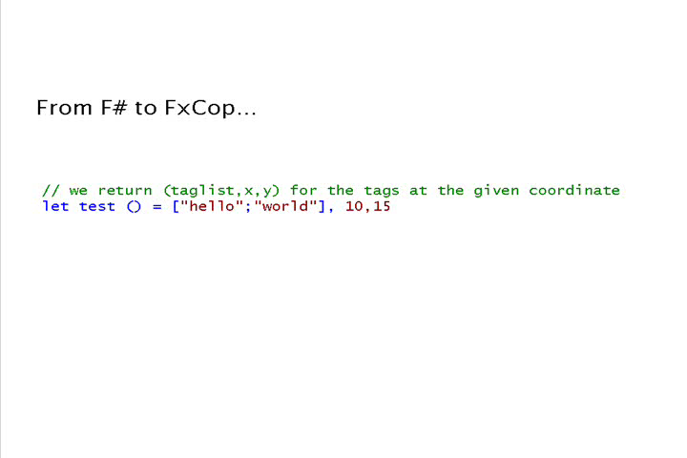
OO is fine, but...

Slide 16
Quick start: let
Type inference. The safety of C# with the succinctness of a scripting language
Let “let” simplify your life…
Bind a static value
let data = (1,2,3)
let f(a,b,c) =
let sum = a + b + c
let g(x) = sum + x*x
g(a), g(b), g(c)
Bind a static function
Bind a local value
Bind a local function

Slide 17
Quick Start: Patterns
matching and binding values
Take this value
let urlFilter url agent =
match (url,agent) with
| ("http://www.control.org", 99) -> true
| ("http://www.kaos.org" , _ ) -> false
| (_, 86) -> true
| _ -> false
And match against these cases…

Slide 18
Quick Start: Structured Data
Lists, tuples and options:
let people = [ ("Adam", None);
("Eve" , None);
("Cain", Some("Adam","Eve"));
("Abel", Some("Adam","Eve")) ]
let showParents (nm,parents) =
match parents with
| Some(dad,mum) ->
printf "%s, dad %s, mum %s\n" nm dad mum
| None ->
printf "%s has no parents!\n" nm

Slide 19
Quick Start: .NET Collections
e.g. using dictionaries…
open System.Collections.Generic
let capitals = new Dictionary<string, string>()
capitals.["Great Britain"] <- "London"
capitals.["France"] <- "Paris"
capitals.ContainsKey("France")
capitals.ContainsKey("Sweden")
capitals.["France"]
capitals.Keys |> show

Slide 20
Typical F# Project Architecture
etc. etc. etc.
MATLAB
Base Tools
✓ Windows (any edition)
✓ .NET Framework 2.0
✓ F# 1.1.11
Readily Accessible Extras
✓ Visual Studio 2005
✓ SQL Server 2005
✓ Alchemi (.NET distribution framework)
✓ also many, many others
e.g. Visual C++, DirectX,
dnAnalytics, MKL,
LAPACK, MATLAB,
AJAX libraries
etc. etc. etc.
.NET Framework
libraries
Interactive
Visualization
Web
Database
Analysis
Data Access
F#
File-based
Databases
Simulation
Scripting
private
C# matrix
library
SQL
Server Database
C++ simulation
engine

Slide 21
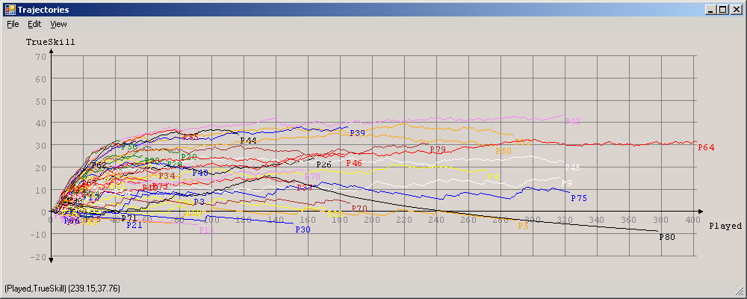
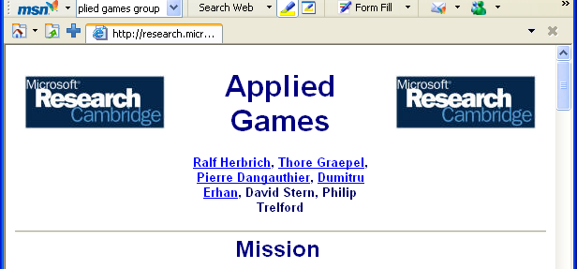
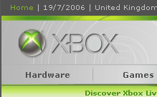
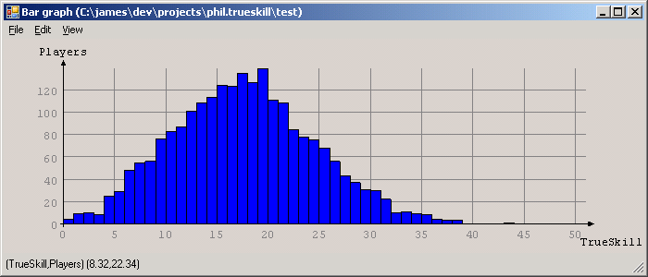

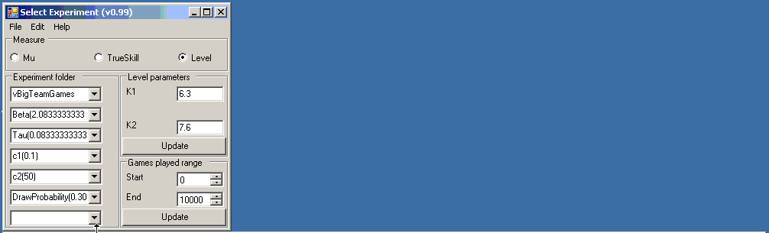
F# and Machine Learning
MSR Cambridge's Machine learning group have the most advanced ranking algorithms in the world
They give F# binaries to the product teams for massive background server-side analysis of XBox Live game logs
All XBox Live games are ranked by similar techniques

Slide 22
MSRC/XBox: Large Scale Data Analysis
Problem:
  Analysis of 4.2 million Xbox 360 Live user feedbacks (4 months worth of data).
  Data is already in a SQL database.
Task:
  Adopt TrueSkill™ model to the user feedback problem for integration into the Xbox Live service.
Code:
  100 lines
Development time (code):
  3 – 4 hours.
Performance:
  10 minutes runtime for the whole dataset

Slide 23
MSRC/XBox: Complex Scientific Modelling
Problem:
  Framework for probabilistic inference (research).
Task:
  Extensible and “thin” factor graph library.
Code:
  400 lines long (comparable C# code: ≈2000 lines)
Development time (code):
  2 weeks.
Performance:
  Excellent. Can now create and compute with > 1 Million node Factor Graphs

Slide 24
Some happy users
"We crunched 400Gb of data, scripting over smaller sets then finally running with a 15 computer cluster
  “The F# code has excellent performance.”
  “F# is fun!”
  “I really enjoyed the brevity of the resulting code. It helped me focus on the ends, not the means.”
  “The F# code was easy to maintain and evolve”
Notes:
During the project I found coding in F# fun, and really enjoyed the brevity of the resultant code due to F#’s type inference and extensive collection functions.
I found the resultant F# code easy to maintain and evolve as new requirements came in, and even produced a reusable graph drawing library along the way.
The main challenges were to crunch through hundreds of gigabytes of data for 3 days using an array of 15 computers, and then to present the huge results in a usable and responsive way.
The succinctness of F# combined with the .Net framework helped me to focus on the ends and not the means.
The UI code was able to stream a 100Mb CSV file from disk in around 5 seconds, while simultaneously calculating and drawing a histogram as it loaded
Performance of the F# code was excellent.
Plus the best optimisations come from better algorithms and with F# constructs like lazy enumerations, you can focus there.

Slide 25
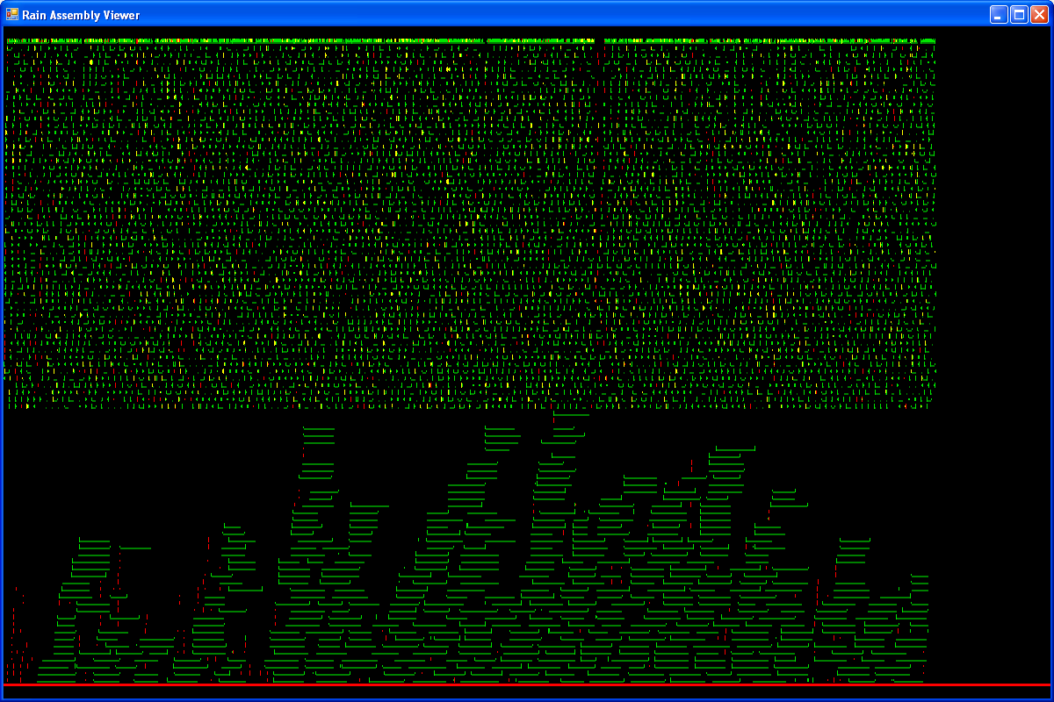
Genomics viewer (Head of IT, US DOE, 20% of worlds DNA sequencing)
"Still pretty crude, but starting to become useful. This is my first test project in F# and I've been pleasantly surprised how quickly it has come together."

Slide 26
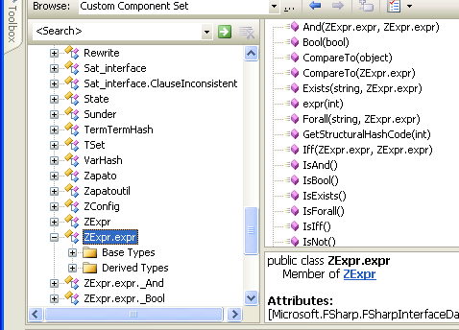
Interoperation: publishing code
Mechanism 1: All ML public types and code have accessible, reliable compiled forms
  e.g. ML type names, type representations and values have predictable, stable, public representations
Lib.expr b = Lib.expr.True;
switch (b.Tag)
{
case Lib.expr.tag_Bool:
Console.WriteLine(“B({0})“,b.Bool1);
break;
case Lib.expr.tag_Term:
Console.WriteLine(“T({0})“,b.Term1);
break;
}
type expr = Bool of bool
| Term of Term.term
| Not of expr
| And of expr * expr
| Or of expr * expr
| Iff of expr * expr
| Forall of string * expr
| Exists of string * expr
match (b) with
| Bool(b) -> ...
| Term(t) -> ...

Slide 27
F# is Statically-oriented
Originates from ML, traditionally a "type-safe LISP"
Used for sophisticated interactive symbolic manipulations, where types are essential
Often write 1000s of LOC with few mistakes
High Performance
Easily scales to 100,000 loc+ programs
But:
  ML has traditionally been very "non-dynamic"
  e.g. very rigid typing, no reflection, no runtime type representations, no type-rediscovery, no dynamic load, no E&C

Slide 28
F# is also Dynamic
What is a dynamic language anyway?
 | F# | The “dynamic” languages
Dynamic Load | ✓ | ✓
Runtime Types | ✓ | ✓
Dynamic invocation | ✓ | ✓
Reflection-for-introspection | ✓ | ✓
Dynamic code generation | ✓ | ✓
Use with no compile phase | ✓ | ✓
Efficient | ✓ | ✗
Mutate the “type schema” | ✗ | ✓

Slide 29
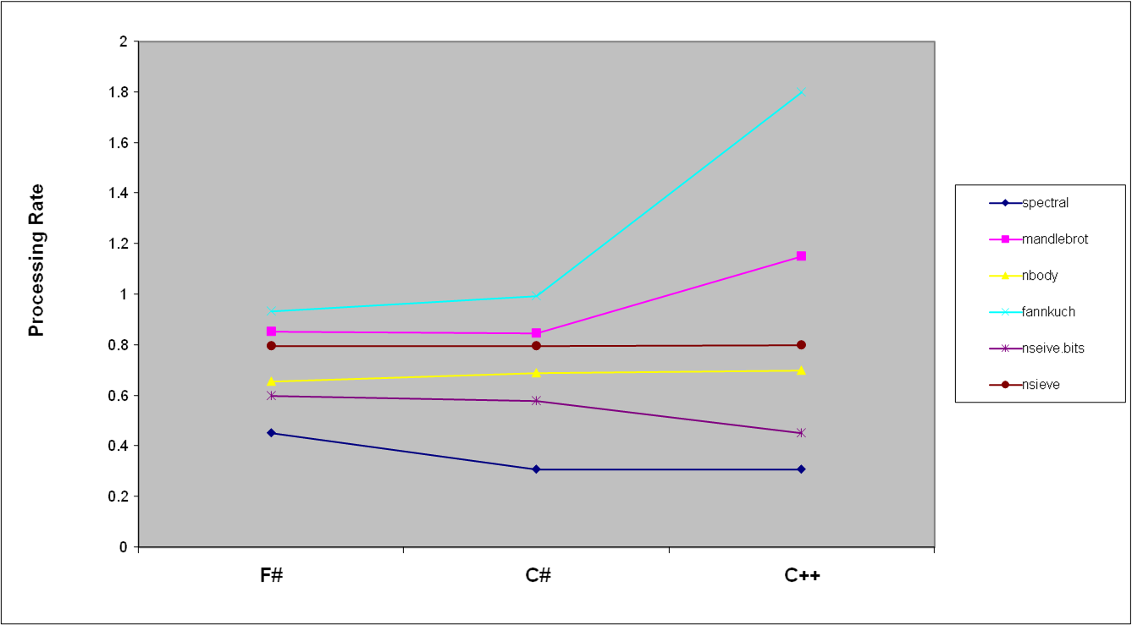
Some Micro Benchmarks by Language
P4 3GHz, 512kb cache

Slide 30
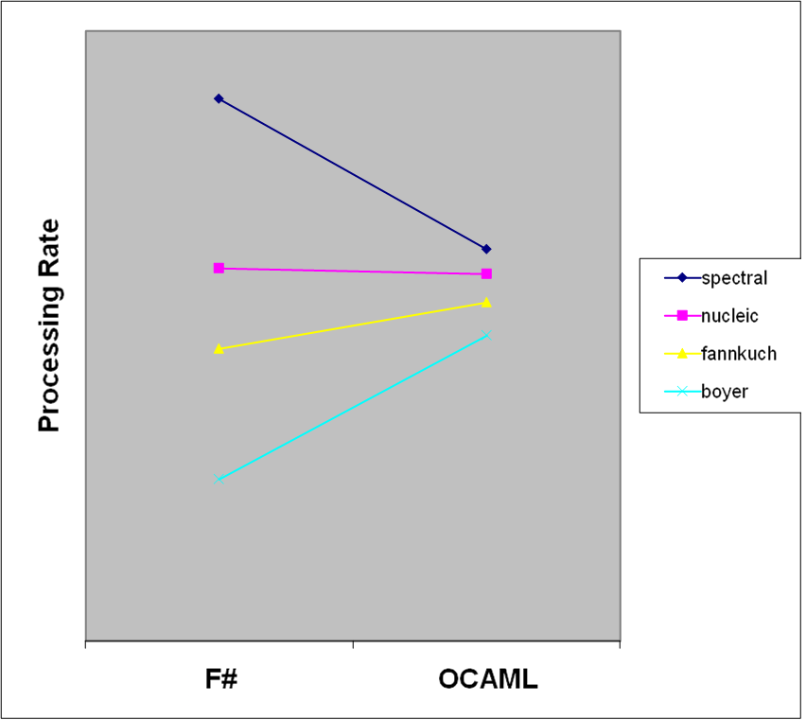
F# and OCAML benchmarks
0

Slide 31
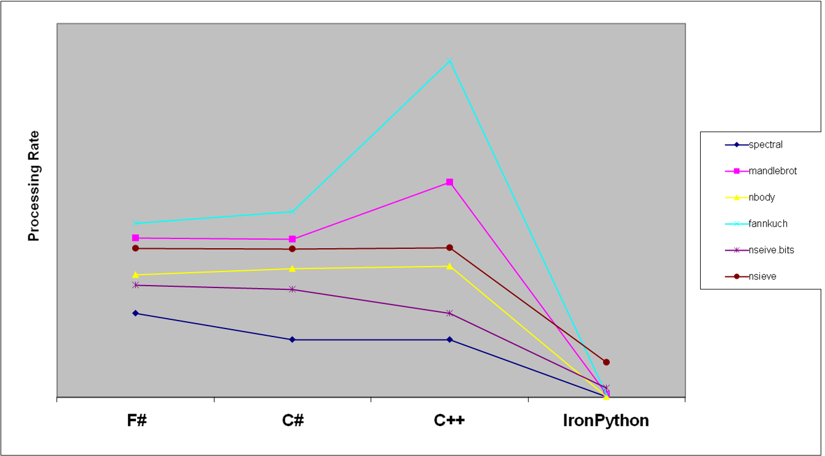
Benchmark Performance by Language

Slide 32
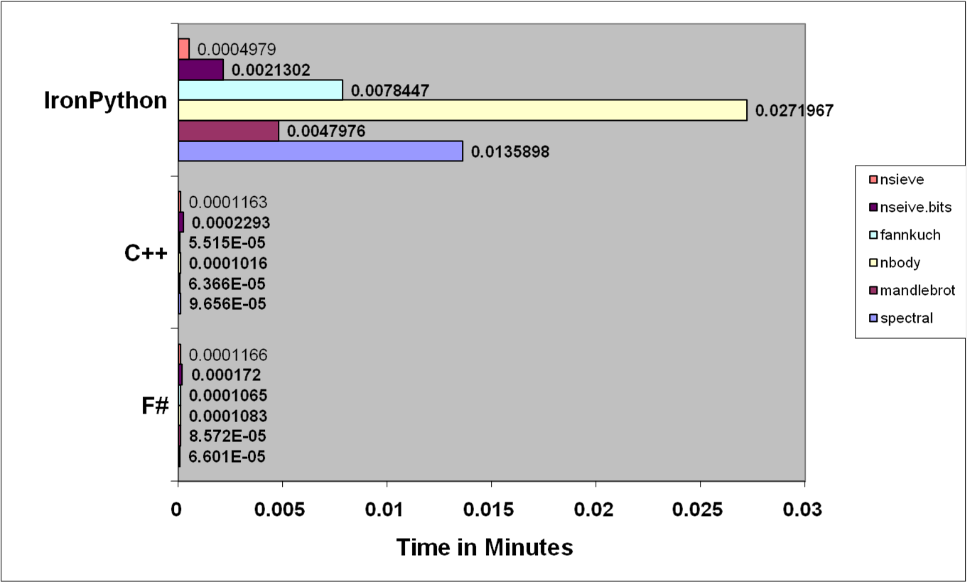
Running times for benchmarks
Iron Python

Slide 33
The Vision: Heterogeneous Execution
Today languages use homogeneous execution:
  The CPU
The natural extension of the LINQ vision is heterogeneous execution, leveraging
  The database
  The server
  The GPU
  The web browser (ala AJAX)
  Symbolic execution
Write your code in one language, execute it in many completely different ways

Slide 34
Language Integrated Queries with F#/LINQ
db.Customers
|> where « fun c -> c.City = "London" »
|> select « fun c -> c.ContactName »
["Thomas Hardy"; "Victoria Ashworth";
"Elizabeth Brown"; "Ann Devon";
"Simon Crowther"; "Hari Kumar"]
SELECT [t0].[ContactName]
FROM [Customers] AS [t0]
WHERE @p0 = [t0].[City]

Slide 35

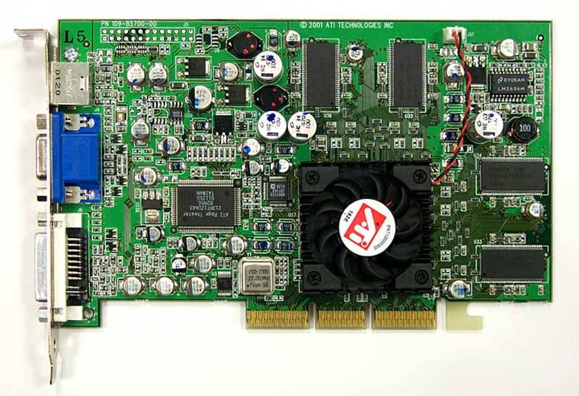
Accelerate ahead!
let nextGeneration(a) =
let sum = rot a (-1) (-1) .+ rot a (-1) 0 .+ rot a (-1) 1
.+ rot a 0 (-1) .+ rot a 0 1
.+ rot a 1 (-1) .+ rot a 1 0 .+ rot a 1 1 in
(sum .= three) .|| ((sum .= two) .&& a);;
nextGeneration a
accelerate <@ nextGeneration @> a
Accelerator.dll
Metaprogram
Program
GPU assembly code
Graphics Card
CPU

Slide 36
Discussion & Opportunities

Slide 37
Challenges of modern language design
Statically typed, hence
Scalable (> 100K LOC)
It’s the
combination that counts
Succinct
Safe
Efficient
Libraries
Interactive
Interoperable
Good
Platform

Slide 38
Discussion
Claim: F# has the potential to rival (also complement) Matlab, Python and Ruby combined
  The other are good, but fail big-time on one or more of scalability, performance, and interoperability
Strategy: What role can F# play in Microsoft strategy?
  especially in the scientific and server markets

Slide 39
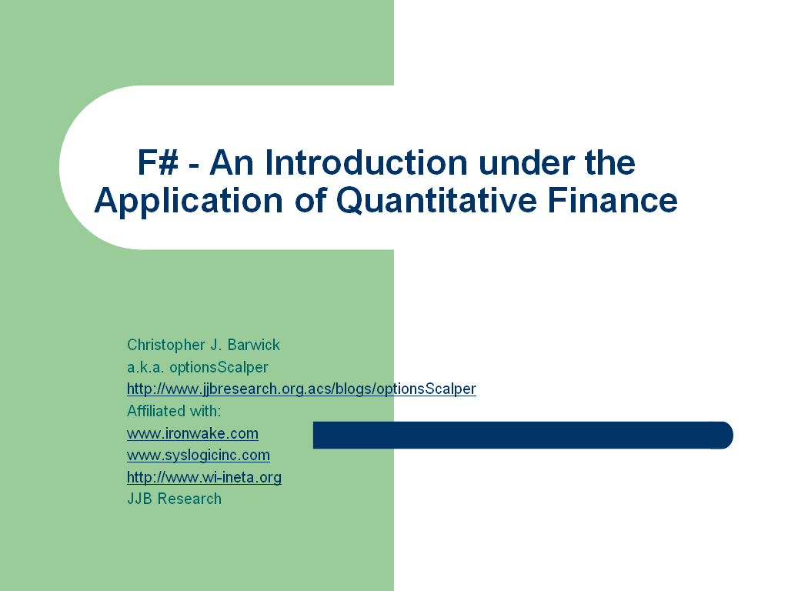
Discussion
Market: What markets are attracted by math-oriented programming?
  Quantitative finance
  Simulation
  "Sophisticated symbolic analysis"
Partners and Community: F# is also an opportunity for co-operation with partners:
  .NET and F#-friendly bindings to major libraries (e.g. NAG, Dundas, MATLAB, other visualization libraries)
  Academics (INRIA could probably also be convinced to get involved)
nb. some potential "MVPs" are getting excited

Slide 40
Discussion
I'm happy to continue to ship F# itself through MSR
  The dev div wouldn't be able to ship it for years, even if they accepted it
  I can put out a bug fix in 24 hours
But F# is also ready for real-world trial
  especially in data-driven, math-oriented programming like QF, or simulation
  also in technical computing
  need some product team sponsorship for this

Slide 41
Resources
Draft chapters of "Expert F#" available on the Web
Books are Coming!!
  F# for Scientists, by Jon Harrop, December 2006
  Foundations of F#, by Robert Pickering, Apress, April 2007
  Expert F#, by Syme, Granicz and Cisternino, Apress, July 2007
F#: http://research.microsoft.com/fsharp
My blog: http://blogs.msdn.com/dsyme
Join the Community: http://www.hubfs.net

Slide 42
Thanks!
Disclaimer: F# is a research project, and not a product
F#: http://research.microsoft.com/fsharp
My blog: http://blogs.msdn.com/dsyme
Join the Community: http://www.hubfs.net

Slide 43
Active Patterns and Views
concrete
view
type ilist =
| Empty
| Single of int
| Join of ilist * ilist
val Nil : IQuery<ilist,unit>
val Cons : IQuery<ilist,(int * ilist)>
view ilist ~> Nil | Cons
| Nil
| Cons of int * ilist
val Nil : IQuery<ilist,unit>
val Cons : IQuery<ilist,(int * ilist)>
use-site
let head js =
match js with
| Cons (x,_) -> x
| _ -> failwith "empty list"
Elements of views have IQuery type
(~=~ 'a -> 'b option)
TODO: add "views" and Okasaki run-once semantics
implementation
of view
IQuery typed-values can be used as (nested) patterns
let pattern f = { new IQuery<_,_> with get_Query () = f }
let rec Cons = pattern (function
| Single x -> Some (x, Empty)
| Join (Cons (x,xs), ys) -> Some (x, Join (xs, ys))
| Join (Nil (), Cons (y,ys)) -> Some (y, ys)
| _ -> None)
and Nil = query (function
| Empty
| Join (Nil (), Nil ()) -> Some ()
| _ -> None)
use-site (computed pattern)
Computed IQuerys
let insert x xs =
match xs with
| ?!(Member x) _ -> xs
| _ -> x :: xs
Implementing view elements

Slide 44
Active Pattern Samples
type complex = (float * float)
let Polar = pattern (fun (re, im) -> Some (sqrt (re*re + im*im), atan2 im re))
view complex ~~> Polar
type System.Type
let TyApp = …
let TyArray = …
let TyByRef = …
let TyPtr = …
view System.Type ~~> TyApp | TyArray | TyByRef | TyPtr
let Succ = query (fun n -> if n > 0 then Some (n-1) else None)
let Zero = query (fun n -> if n = 0 then Some () else None)
view int ~~> Zero | Succ

Slide 45
Quotation literals by example
<@ 1 + 2 @>;; -- : int expr
<@ x + 1 @>;; -- "not closed"
<@ fun x -> x + 1 @>;; -- : (int -> int) expr
<@ _ + 1 @>;; -- : int expr -> int expr
<@| _ + _ + 1 |@>;; -- : int expr -> int expr option
let (<@| |@>) t = match1 t -- can redefine operators
let (<@. .@>) t = matchHO t -- can define new operators
A phantom-typed "AST template with holes" indicating holes and their types.

Slide 46
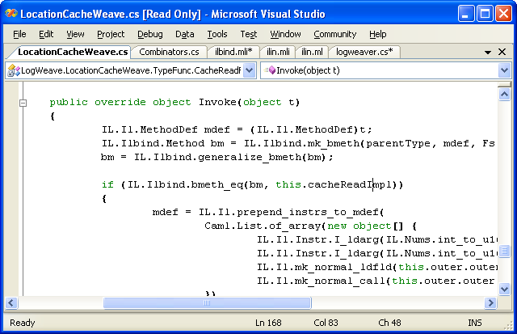
Calling F# from C#
LogWeave (Office XAF Optimization Tool)
4000 lines C#, using Abstract IL library
Using types defined in F#
Using functions defined in F#
il.mli/ilbind.mli
type Method
type MethodDef
val bmeth_hash : Method -> int
val bmeth_eq : Method -> Method -> bool
val bmeth_compare : Method -> Method -> int
val mk_bmeth : Type * MethodDef * Types -> Method
val mk_generalized_bmeth : Type * MethodDef -> Method
val generalize_bmeth : Method -> Method

Slide 47
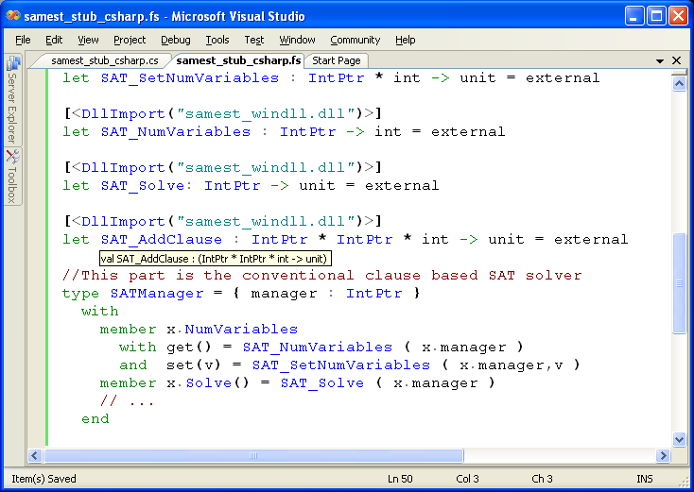
Calling C/C++
C SAT Solver
Accessed from F#
Type-safe F# wrapper

Slide 48
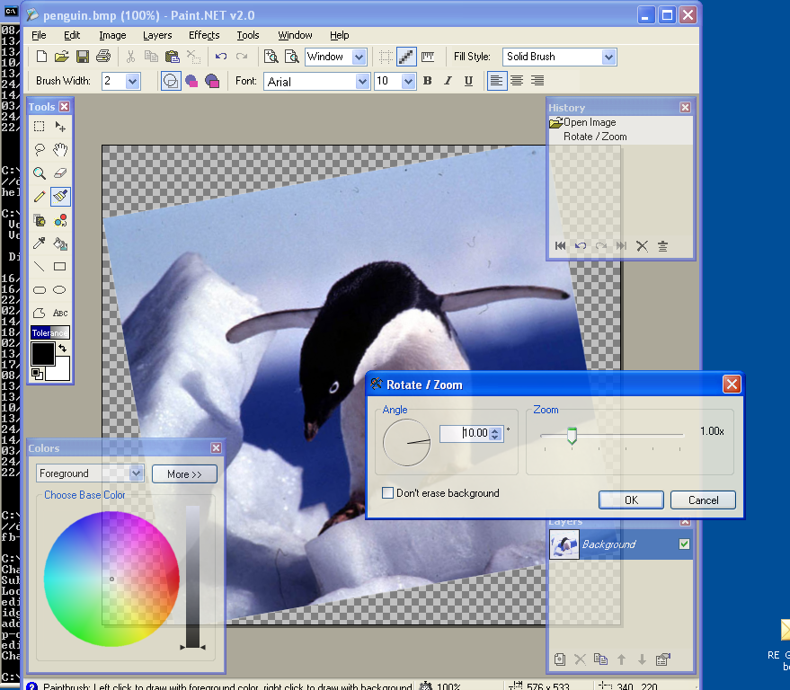
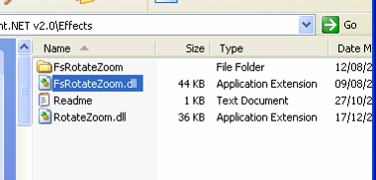
#3: Paint.NET & Plugins
Plugin written in F#
Here is the DLL

Slide 49
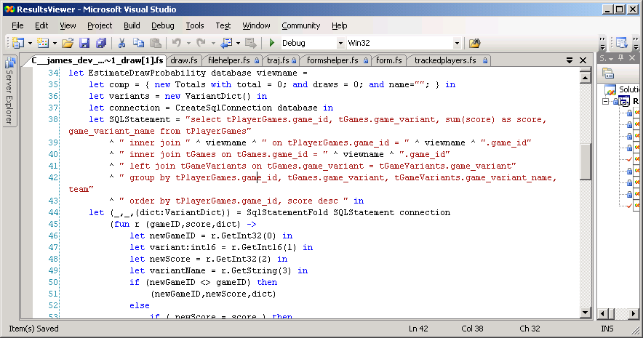
F# code - data processing

Slide 50
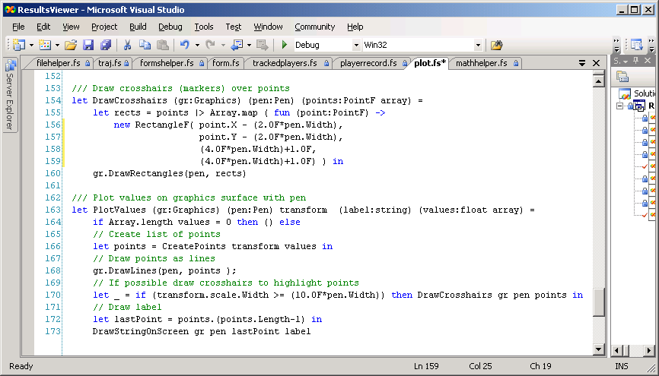
Code – plotting v. TrueSkill

Slide 51
The Right Defaults…
Immutability the norm…
let pi = 3.1415
pi <- 4.0
Data is immutable by default
✗!
type person =
{ Name : string;
Birth : DateTime; }
let Person(name,dob) =
{ Name = name;
Birth = dob }
let bob = Person("bob", new DateTime(1,10,1970))
do bob.Birth <- new DateTime(1,10,1969)
Values may not be changed
✗

Slide 52
In praise of immutability
Immutable objects can be relied on
Immutable objects can transfer between threads
Immutable objects can be aliased safely
Immutable objects lead to (different) optimization opportunities
  less pessimistic copying when returning values from APIs
  a sensible, efficient notion of closure

Slide 53
The F# approach to OO programming
Type inference for .NET subtyping
  Through HM(X)-style constrained polymorphism with subtype and operator overloading constraints
Embrace the "." notation
  Can be used with regular F# types, e.g. unions and records
Permit the full .NET single-inheritance OO model
  Partly for interoperability and ".NET-style" library design
  But F# is actually a very nice OO language too
  Classes only get used where really necessary

Slide 54
Augmentation and type-directed name resolution
Type Definition
type point = { x: float; y: float }
let mkPoint x y = {x=x;y=y}
let getX p = p.x
let getY p = p.y
type point
with
static member Create(x,y) = {x=x; y=y}
static member Origin = { x=0.0; y=0.0 }
member p.Add(dx,dy) = { x=p.x+dx; y=p.y+dy }
member p.X = p.x
member p.Y = p.y
end
let p = point.Create(3.14,6.28);;
p.X;;
p.Y;;
type point = { x: float; y: float }
let mkPoint x y = {x=x;y=y}
let getX p = p.x
let getY p = p.y
type point
with
static member Create(x,y) = {x=x; y=y}
static member Origin = { x=0.0; y=0.0 }
end
type point = { x: float; y: float }
let mkPoint x y = {x=x;y=y}
let getX p = p.x
let getY p = p.y
type point
with
…
end
type point = { x: float; y: float }
type point = { x: float; y: float }
let mkPoint x y = {x=x;y=y}
let getX p = p.x
let getY p = p.y
Type Augmentation
(~instance declaration for adhoc-dot-notation)
We haven't compromised the basic way of writing code in the language
// point.mli (signature)
type point
with
static member Create : float * float -> point
static member Origin : point
member X : float
member Y : float
member Add : float * float -> point
end
Method member
Property members
(can compute)
But OO presentation techniques are available if needed
This can now be understood and used by any .NET programmer

Slide 55
Hands on: .NET Collections

Slide 56
Quick Start: Nested functions
Map between coordinate systems…
Compute the scaling factors
open System.Drawing
let remap (r1: Rectangle) (r2: Rectangle) =
let scalex = float r2.Width / float r1.Width
let scaley = float r2.Height / float r1.Height
let scale s i = truncate (float i * s)
let mapx x = r2.Left + scale scalex (x - r1.Left)
let mapy y = r2.Top + scale scaley (y - r1.Top)
let mapp (p: Point) = new Point(mapx p.X, mapy p.Y)
mapx, mapy, mapp
Compute the scaling
functions
Return the final scaling functions

Slide 57
Hand on: Nested Functions

Slide 58
Quick Start: Abstracting Control with Functions
Abstracting Imperative Control patterns
open System
let time f =
let start = DateTime.Now
let res = f()
let finish = DateTime.Now
(res, finish - start)

Slide 59
Quick Start: Functions as Abstract Values
cf. 100s of "delegate" types
in .NET
Functions: unified and simple
(fun x -> x + 1)
let f x y = x * y
let g x y = x + y
let p = (f,g)
predicate = 'a -> bool
send = 'a -> unit
threadStart = unit -> unit
comparer = 'a -> 'a -> int
hasher = 'a -> int
equality = 'a -> 'a -> bool

Slide 60
Quick Start: IEnumerables and Comprehensions
IEnumerable<int>
(1 .. 10)
let checkerboardCoordinates n =
(for row in (1 .. n)
for col in (1 .. n)
when (row+col) % 2 = 0
-> (row,col))
IEnumerable<(int * int)>

Slide 61
Quick Start: IEnumerables and Comprehensions
Basic comprehension syntax:
(for ... in ...
for ... in ...
when ...
-> ... )

Slide 62
Hands On: Working with IEnumerables and Comprehensions

Slide 63
Quick Start: Lazy I/O with IEnumerables
e.g. Read subdirectory hierarchy on demand…
open System.IO
let rec allFiles dir =
IEnumerable.append
(for file in Directory.GetFiles(dir) -> file)
(for subdir in Directory.GetDirectories(dir)
for file in allFiles subdir -> file)
allFiles @"C:\"
allFiles @"C:\WINDOWS"

Slide 64
Quick Start: Lazy I/O with Enumerables
Alternative: use aggregate operators like "map" and "map_concat"
open System.IO
let rec allFiles dir =
IEnumerable.append
(Directory.GetFiles(dir))
(Directory.GetDirectories(dir)
|> IEnumerable.map_concat allFiles)
allFiles @"C:\"
allFiles @"C:\WINDOWS"

Slide 65
Demo: Lazy I/O with IEnumerables

Slide 66
Quick Start: Making things Generic
e.g. Euclid's algorithm for highest common factor…
let rec hcf a b =
if a=0 then b
elif a<b then hcf a (b-a)
else hcf (a-b) b

Slide 67
Quick Start: Making things Generic
parameters
e.g. Euclid's algorithm for highest common factor…
let hcfGeneric (zero,(-),(<)) =
let rec hcf a b =
if a=zero then b
elif a<b then hcf a (b-a)
else hcf (a-b) b
hcf
automatically
generalized
inner implementation in the scope
of the parameters
some
specializations

Slide 68
Quick Start: Making things Generic
parameters
e.g. Euclid's algorithm for highest common factor…
type NumericOps<'a> =
{ Zero: 'a;
Subtract: 'a -> 'a -> 'a;
LessThan: 'a -> 'a -> bool; }
let hcfGeneric (ops : NumericOps<'a>) =
let zero = ops.Zero
let (-) = ops.Subtract
let (<) = ops.LessThan
let rec hcf a b =
if a= zero then b
elif a < b then hcf a (b-a)
else hcf (a-b) b
hcf

Slide 69
Hands On: making things generic

Slide 70
Many Other Effective abstractions
Map<’a,’b>
List<’a>
Set<’a>
Type parameters
Discriminated unions
Pattern matching
Classes and Objects
Recursion (Mutually-referential objects)
type expr =
| Sum of expr * expr
| Prod of expr * expr
….
match expr with
| Sum(a,b) -> ...
| Prod(a,b) -> ... ….
let rec map = ...

Slide 71
Classes and interfaces
The full .NET OO model is also supported
type point = class
val x: float
val y: float
new(x,y} = { x=x;y=y }
static member Create(x,y) = {x=x; y=y}
static member Origin = { x=0.0; y=0.0 }
member p.Add(dx,dy) = { x=p.x+dx; y=p.y+dy }
member p.X = p.x
member p.Y = p.y
end
// point.mli (signature)
type point
with
static member Create : float * float -> point
static member Origin : point
member X : float
member Y : float
member Add : float * float -> point
end
This can now be understood and used by any .NET programmer

