Slide 2
DEV304
A Taste of F#
Today & Future
Don Syme,
Principal Researcher/Partner Architect
Microsoft Research/Microsoft

Slide 3
Which talk?
F#
Today?
F# Advanced?
F# Tomorrow?

Slide 4
Which talk?
F#
Today!
F# Advanced?
F# Tomorrow!

Slide 5
Which talk?
F#
Today!

Slide 6
F# is…
a programming language…

Slide 7
F# is…
...a programming language that allows you to write simple code to solve complex problems.

Slide 8
F# is…
...a productive, supported, functional programming language that allows you to write simple code to solve complex problems.

Slide 9
F# Fundamentals
Succinct, Expressive, Functional Language
Parallel, Explorative, Data-rich, Algorithmic
Industry/Platform-Leading
  Note: F# is not a replacement for C#/VB/C++
  Augments and builds on .NET as multi-lang platform

Slide 10
Why Functional?

Slide 11
Simplicity

Slide 12
Parallel

Slide 13
Simplicity

Slide 14
Simplicity: Functions as Values
abstract class Command {
public virtual void Execute();
}
abstract class RoverCommand : Command {
protected Rover Rover { get; private set; }
public RoverCommand(MarsRover rover) {
this.Rover = rover;
}
}
class BreakCommand : RoverCommand {
public BreakCommand(Rover rover)
: base(rover) { }
public override void Execute() {
Rover.Rotate(-5.0);
}
}
class TurnLeftCommand : RoverCommand
{
public TurnLeftCommand(Rover rover)
: base(rover) {
}
public override void Execute() {
Rover.Rotate(-5.0);
}
}
OO
F#
type Command = Command of (Rover -> unit)
let BreakCommand =
Command(fun rover -> rover.Accelerate(-1.0))
let TurnLeftCommand =
Command(fun rover -> rover.Rotate(-5.0<degs>))

Slide 15
Simplicity: Functional Data
C#
let swap (x, y) = (y, x)
let rotations (x, y, z) =
[ (x, y, z);
(z, x, y);
(y, z, x) ]
let reduce f (x, y, z) =
f x + f y + f z
Tuple<U,T> Swap<T,U>(Tuple<T,U> t)
{
return new Tuple<U,T>(t.Item2, t.Item1)
}
ReadOnlyCollection<Tuple<T,T,T>> Rotations<T>(Tuple<T,T,T> t)
{
new ReadOnlyCollection<int>
(new Tuple<T,T,T>[]
{ new Tuple<T,T,T>(t.Item1,t.Item2,t.Item3);
new Tuple<T,T,T>(t.Item3,t.Item1,t.Item2);
new Tuple<T,T,T>(t.Item2,t.Item3,t.Item1); });
}
int Reduce<T>(Func<T,int> f,Tuple<T,T,T> t)
{
return f(t.Item1) + f(t.Item2) + f (t.Item3);
}
F#

Slide 16
Parallel

Slide 17
Async.Parallel [ httpAsync "www.google.com"; httpAsync "www.bing.com"; httpAsync "www.yahoo.com"; ]
|> Async.RunSynchronously

Slide 18
Async.Parallel [ for i in 0 .. 200 -> computeTask i ]
|> Async.RunSynchronously

Slide 19
F#: Influences
OCaml
C#/.NET
F#
Similar core
language
Similar object
model

Slide 20
Event Processing
Demo
Notes:
If you would like to host your demo on the Virtual Server, please use the myVPC demo slide, not this slide.

Slide 21
Example #1 : Methodology
I've been coding in F# lately, for a production task.
F# allows you to move smoothly in your programming style... I start with pure functional code, shift slightly towards an object-oriented style, and in production code, I sometimes have to do some imperative programming.
I can start with a pure idea, and still finish my project with realistic code. You're never disappointed in any phase of the project!
Julien Laugel, Chief Software Architect, www.eurostocks.com

Slide 22
Example #2 (power company)
I have written an application to balance the national power generation schedule … for an energy company.
...the calculation engine was written in F#.
The use of F# to address the complexity at the heart of this application clearly demonstrates a sweet spot for the language … algorithmically complex analysis of large data sets.
Simon Cousins (power company)

Slide 23
Example #2 (power company)
Interoperation
Units of measure
Exploratory programming
Unit testing
Parallelism
Code reduction …
.
Lack of bugs

Slide 24
Example #2 (power company)
Interoperation ... Seamless. The C# programmer need never know.
Units of measure … a huge time saver...it eradicates a whole class of errors…
Exploratory programming …Working with F# Interactive allowed me to explore the solution space more effectively.
Unit testing …a joy to test. There are no complex time-dependent interactions to screw things up….
Parallelism …The functional purity ... makes it ripe for exploiting the inherent parallelism in processing vectors of data.
Code reduction… … vectors and matrices…higher order functions eat these for breakfast with minimal fuss, minimal code. Beautiful.
Lack of bugs… Functional programming can feel strange. .. once the type checker is satisfied that’s often it, it works.

Slide 25

Example #3: Grange Insurance

Slide 26

Example #4: “Finance Company”
Source: http://whitepapers.techrepublic.com

Slide 27
Some Basics
topic
Notes:
If you would like to host your demo on the Virtual Server, please use the myVPC demo slide, not this slide.

Slide 28
Fundamentals - Whitespace Matters
let computeDerivative f x =
let p1 = f (x - 0.05)
let p2 = f (x + 0.05)
(p2 – p1) / 0.1
Offside (bad indentation)

Slide 29
Fundamentals - Whitespace Matters
let computeDerivative f x =
let p1 = f (x - 0.05)
let p2 = f (x + 0.05)
(p2 – p1) / 0.1

Slide 30
Your First F# Application
printfn "Hello World"
C:\test> fsc test.fs
C:\test> test.exe
Hello World
C:\test>

Slide 31
Your Second F# Application
open System.Windows.Form
let form = new Form (Visible=true)
form.Click.Add (fun _ -> printfn "click")
Application.Run form

Slide 32
Fundamentals: Let
Let “let” simplify your life…
Type inference. The safety of C# with the succinctness of a scripting language
Bind a static value
let data = (1, 2, 3)
let f (a, b, c) =
let sum = a + b + c
let g x = sum + x*x
(g a, g b, g c)
Bind a static function
Bind a local value
Bind a local function

Slide 33
Functional– Pipelines
x |> f
The pipeline operator

Slide 34
Functional– Pipelines
x |> f1
|> f2
|> f3
Successive stages
in a pipeline

Slide 35
F# - Objects + Functional
type Vector2D (dx:double, dy:double) =
let d2 = dx*dx+dy*dy
member v.DX = dx
member v.DY = dy
member v.Length = sqrt d2
member v.Scale(k) = Vector2D (dx*k,dy*k)
Inputs to object
construction
Object internals
Exported properties
Exported method

Slide 36
Resource: F# Object Oriented Quick Guide
Source: F# Object-Oriented Quick Guide

Slide 37
Objects
Class Types
type ObjectType(args) =
let internalValue = expr
let internalFunction args = expr
let mutable internalState = expr
member x.Prop1 = expr
member x.Meth2 args = expr
Interface Types
type IObject =
interface ISimpleObject
abstract Prop1 : type
abstract Meth2 : type -> type
Constructing Objects
new FileInfo(@"c:\misc\test.fs")

Slide 38
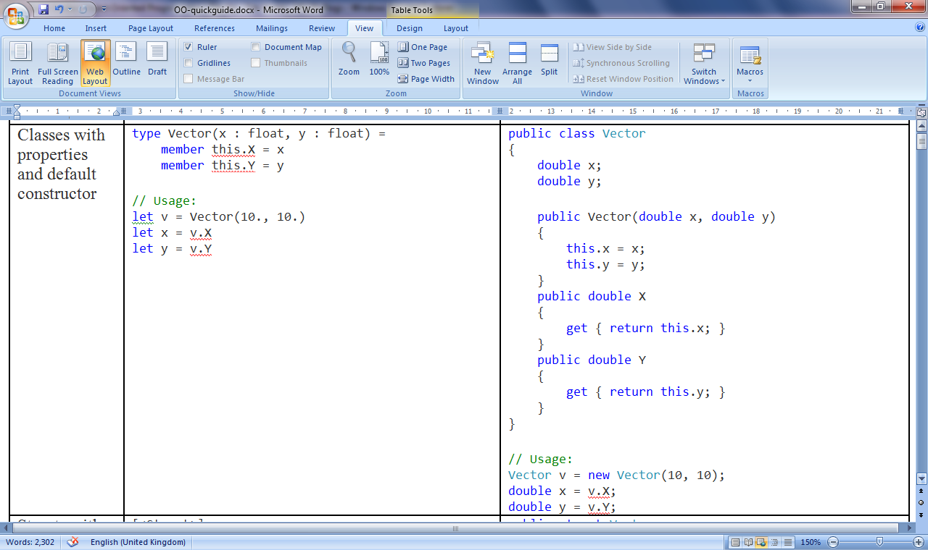
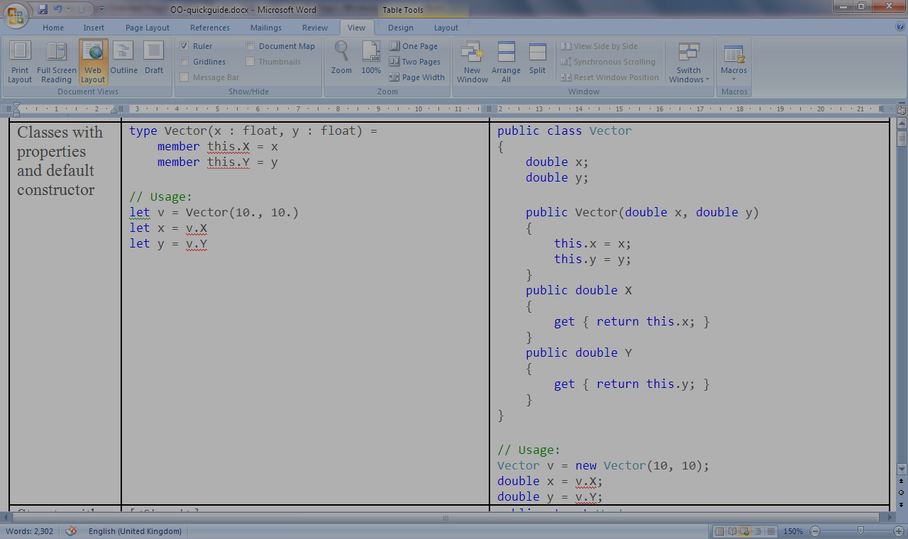
Class with Properties

Slide 39
Async/Parallel
topic
Notes:
If you would like to host your demo on the Virtual Server, please use the myVPC demo slide, not this slide.

Slide 40
C# is joining us too!
let! ≈ await
async { let! res = <async-event>
... }
React to a GUI Event
React to a Timer Callback
React to a Query Response
React to a HTTP Response
React to a Web Service Response
React to a Disk I/O Completion
Agent reacts to Message

Slide 41
F# async + immutable
Parallel
Server
Agents

Slide 42
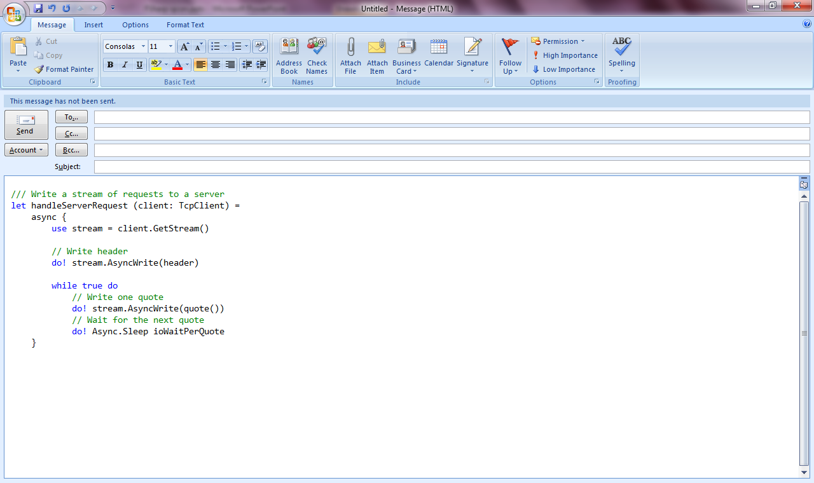
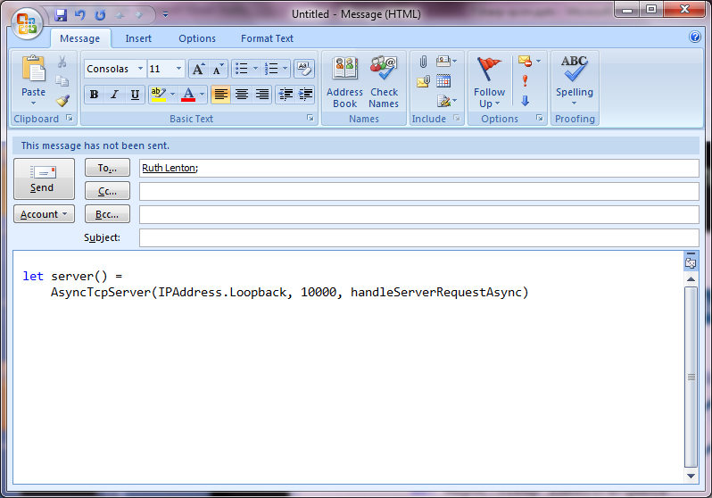
F# example: Serving 50,000+ simultaneous TCP connections with ~10 threads
Await!
Await!
Await!

Slide 43
Async on the Phone, Today
demo

Slide 44
The Future of F#
Data and Services, At Your Fingertips, Strongly Typed

Slide 45
Caveat: No CTP today

Slide 46
Fact #1
The world is information-rich

Slide 47
Fact #2
Languages are information-sparse

Slide 48
To fix this we will use magic

Slide 49
The magic is called Type Providers

Slide 50
Language Integrated Web Data
demo

Slide 51
The Magic: Type Providers
F#
Web Data
Cloud Data
Enterprise
Data
Local Data
Web Services
Your Data

Slide 52
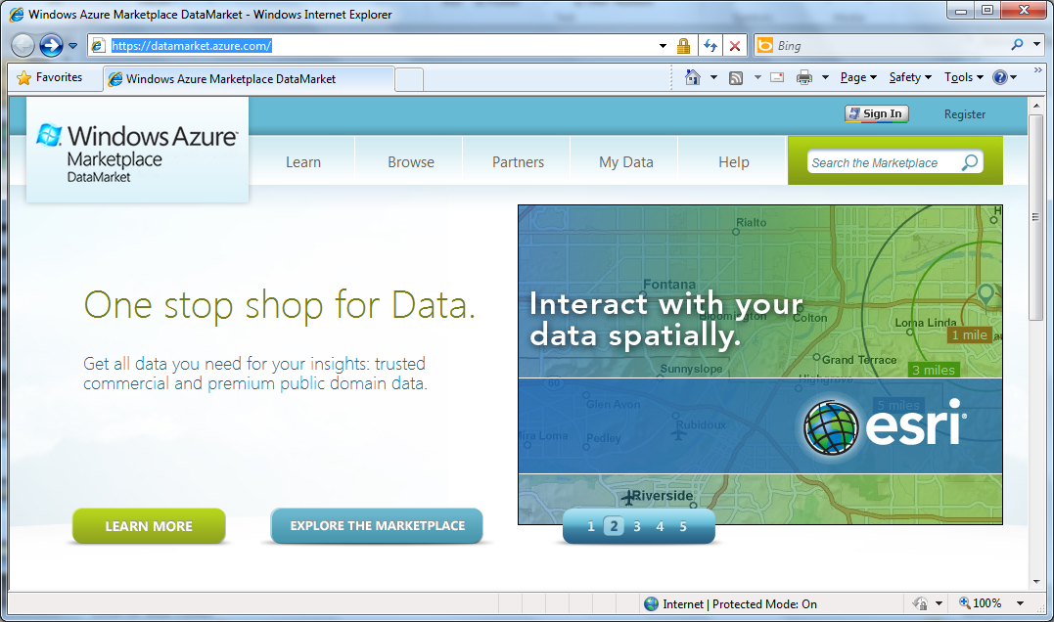

Slide 53
Language Integrated Data Market Directory
demo

Slide 54
Summary: Just imagine if we could access….
…web data
…data markets
…WMI & active directory
…a spreadsheet
…web services
…CRM data
…social data
…SQL data
…XML data
...
strongly typed
without explicit codegen
extensible, open

Slide 55
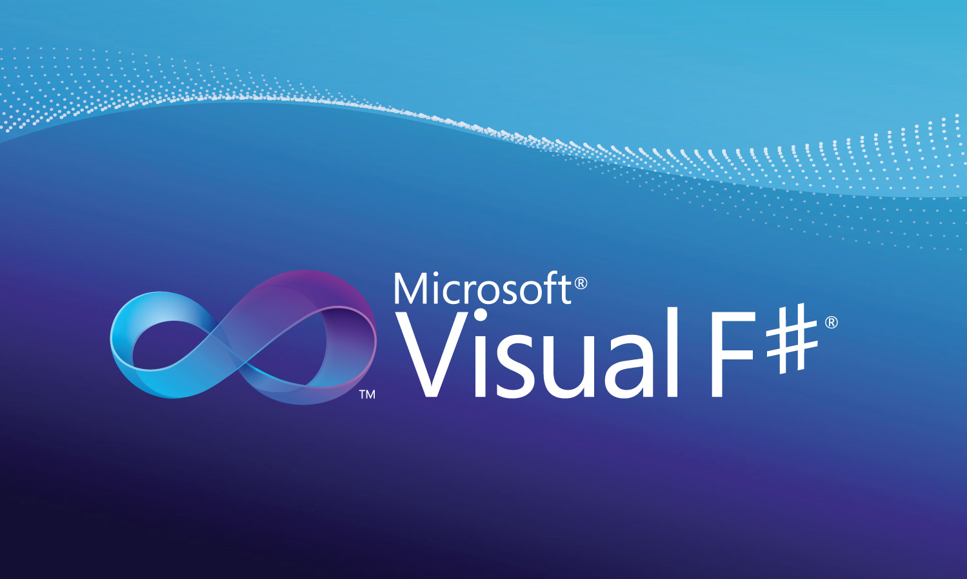
Professional Tools

Slide 56
F# and Source
F# Compiler and Library is now available
  fsharppowerpack.codeplex.com
  Apache 2.0 License
Why?
  Tools, tools, tools (e.g. Visual Studio tools, editing aids, optimizers, evaluators)
  Increase reach of a Microsoft-sponsored language to academia and education

Slide 57
In Summary
F#
Ready for supported use in VS2010
F# greatly simplifies parallelism
An amazing data-rich future ahead
Simple, expressive, productive addition to .NET

Slide 58
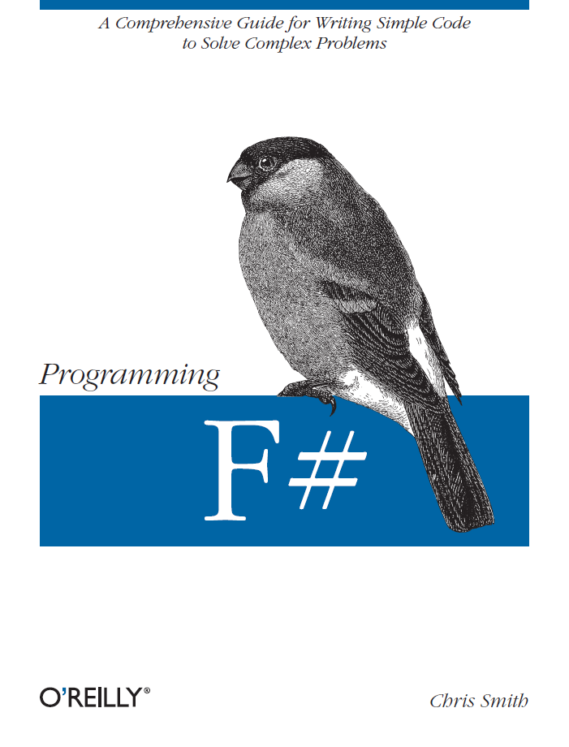
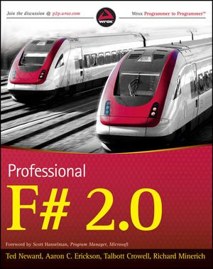
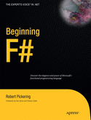
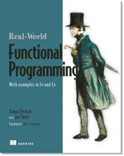

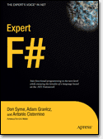
Latest Books about F#
Visit www.fsharp.net

Slide 59
Questions http://fsharp.net

Slide 60

Session Evaluations
Tell us what you think, and you could win!
All evaluations submitted are automatically entered into a daily prize draw*
Sign-in to the Schedule Builder at http://europe.msteched.com/topic/list/
* Details of prize draw rules can be obtained from the Information Desk.

Slide 61

© 2010 Microsoft Corporation. All rights reserved. Microsoft, Windows, Windows Vista and other product names are or may be registered trademarks and/or trademarks in the U.S. and/or other countries.
The information herein is for informational purposes only and represents the current view of Microsoft Corporation as of the date of this presentation. Because Microsoft must respond to changing market conditions, it should not be interpreted to be a commitment
on the part of Microsoft, and Microsoft cannot guarantee the accuracy of any information provided after the date of this presentation. MICROSOFT MAKES NO WARRANTIES, EXPRESS, IMPLIED OR STATUTORY, AS TO THE INFORMATION IN THIS PRESENTATION.

