Slide 1
F# Asynchronous Programming
Don Syme, Tomas Petricek, Dmitry Lomov + the F# team
Microsoft, Microsoft Research

Slide 2
Two F#-related talks today
F# 2.0 async
  It’s part of F# , and “real world”
“Joinads”
  A research experiment/idea/observation
  Part of “Variations in F#” research project
  It’s not for prime time yet ☺

Slide 3
Terminology
In this talk
  “Asynchronous”
  = “Overlapping”
  = “Non-blocking”
  = “Programming with callbacks”
  = “Reacting to events”
e.g. “make a non-blocking read to a file”
This is standard terminology for professional developers

Slide 4
Outline
A Little About F#
The Big Picture for F# Async
The Essence of F# Async
Related Work, Summary

Slide 5
Outline
A Little About F#
The Big Picture for F# Async
  A standard part of F# 2.0
  Solves a serious industry problem
  Is coming to C# 5.0 (“await”)
The Essence of F# Async
Related Work, Summary

Slide 6
Outline
A Little About F#
The Big Picture for F# Async
The Essence of F# Async:
  Localized CPS transformation
  Syntax is a modality, i.e. reuses the syntax of the host language
  Library gives fork-join, futures/promises, agents
Related Work, Summary

Slide 7
A Little About F#

Slide 8
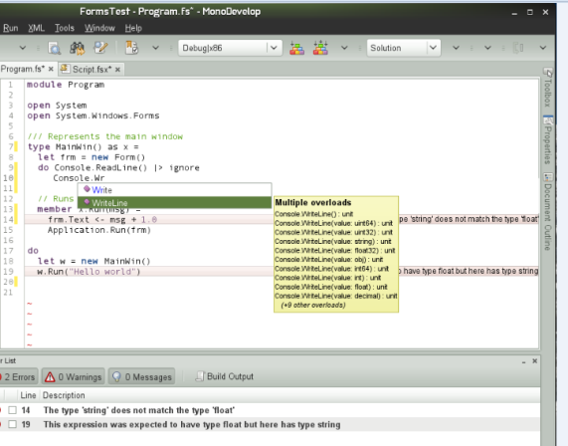

What is F#?
Strict, Strongly Typed Functional Language
Focus on Interop, Parallel, Explorative, Data
Augments .NET/CLI as multi-language platform
OSS/Mono/
Linux/Mac
+Phone
+Xbox
+Cloud
+HTML5
…
Visual Studio
F# is Open Source!!

Slide 9
What is F# For?
Applied Functional ≈ Core Engines
e.g. application to balance the national power generation schedule for an energy company.
“...the calculation engine was written in F#.”
“… a sweet spot within enterprise software - algorithmically complex analysis of large data sets. “

Slide 10
F# Open Source
F# 2.0 Compiler and Library is Open Source
  Released Feb/Nov 2010
  Apache 2.0 OSS licence
F# Power Pack is Open Source
  Released Feb/Nov 2010
  Apache 2.0 OSS licence

Slide 11
F# Async – OVERVIEW

Slide 12
F# is a Parallel Language
(Multiple active computations)
F# is a Reactive Language
(Multiple pending reactions)
e.g.
GUI Event
Page Load
Timer Callback
Query Response
HTTP Response
Web Service Response
Disk I/O Completion
Agent Gets Message

Slide 13
React!
async { let! res = <async-event>
... }
React to a GUI Event
React to a Timer Callback
React to a Query Response
React to a HTTP Response
…

Slide 14
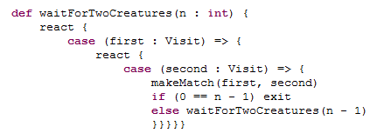
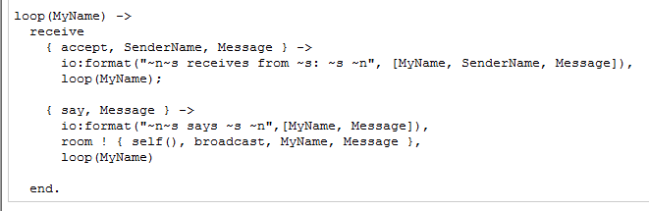
Scala
Erlang
F#
async { let! image = ReadAsync "cat.jpg"
let image2 = f image
do! WriteAsync image2 "dog.jpg"
do printfn "done!"
return image2 }

Slide 15
Types
Async<T> ≈ a future-generator
unit -> Future<T>
or, equivalently, a runnable value w.r.t. a continuation
(T -> unit) -> unit

Slide 16
Types
Async<T> ≈ a runnable value + exceptions + cooperative cancellation
CancellationContext *
(exn -> unit) *
(cancelMessage -> unit) *
(T -> unit)
-> unit
Async<unit> ≈ a co-routine as a first-class value
T → Async<U> ≈ an asynchronous function/method as a first-class value
StartImmediate : Async<unit> -> unit
RunSynchronously : Async<T> -> T

Slide 17
Hot v. Cold
F# Async is a “cold” model of tasks
  async { … } gives a new task when you call “run”
  Compositional - a proper monad
Note: C# Async will use a “hot” model of tasks

Slide 18
async { ... }
Asynchronous "non-blocking" action
async { let! image = ReadAsync "cat.jpg"
let image2 = f image
do! WriteAsync image2 "dog.jpg"
do printfn "done!"
return image2 }
Continuation/
Event callback/
Task residue
You're actually writing this (approximately):
async.Delay(fun () ->
async.Bind(ReadAsync "cat.jpg", (fun image ->
let image2 = f image
async.Bind(writeAsync "dog.jpg",(fun () ->
printfn "done!"
async.Return())))))

Slide 19
F# async
Parallel
Agents
Server

Slide 20
Some uses of F# async { ... }
Sequencing I/O requests
Sequencing CPU computations and I/O requests
async { let! lang = detectLanguageAsync text
let! text2 = translateAsync (lang,"da",text)
return text2 }
async { let! lang = detectLanguageAsync text
let! text2 = translateAsync (lang,"da",text)
let text3 = postProcess text2
return text3 }

Slide 21
Some uses of F# async { ... }
Parallel CPU computations
Parallel I/O requests
Async.Parallel [ async { return (fib 39) };
async { return (fib 40) }; ]
Async.Parallel
[ for target in langs ->
translateAsync (lang,target,text) ]

Slide 22
Taming Parallel/Asynchronous I/O
public static void ReadInImageCallback(IAsyncResult asyncResult)
{
ImageStateObject state = (ImageStateObject)asyncResult.AsyncState;
Stream stream = state.fs;
int bytesRead = stream.EndRead(asyncResult);
if (bytesRead != numPixels)
throw new Exception(String.Format
("In ReadInImageCallback, got the wrong number of " +
"bytes from the image: {0}.", bytesRead));
ProcessImage(state.pixels, state.imageNum);
stream.Close();
// Now write out the image.
// Using asynchronous I/O here appears not to be best practice.
// It ends up swamping the threadpool, because the threadpool
// threads are blocked on I/O requests that were just queued to
// the threadpool.
FileStream fs = new FileStream(ImageBaseName + state.imageNum +
".done", FileMode.Create, FileAccess.Write, FileShare.None,
4096, false);
fs.Write(state.pixels, 0, numPixels);
fs.Close();
// This application model uses too much memory.
// Releasing memory as soon as possible is a good idea,
// especially global state.
state.pixels = null;
fs = null;
// Record that an image is finished now.
lock (NumImagesMutex)
{
NumImagesToFinish--;
if (NumImagesToFinish == 0)
{
Monitor.Enter(WaitObject);
Monitor.Pulse(WaitObject);
Monitor.Exit(WaitObject);
}
}
}
using System;
using System.IO;
using System.Threading;
public class BulkImageProcAsync
{
public const String ImageBaseName = "tmpImage-";
public const int numImages = 200;
public const int numPixels = 512 * 512;
// ProcessImage has a simple O(N) loop, and you can vary the number
// of times you repeat that loop to make the application more CPU-
// bound or more IO-bound.
public static int processImageRepeats = 20;
// Threads must decrement NumImagesToFinish, and protect
// their access to it through a mutex.
public static int NumImagesToFinish = numImages;
public static Object[] NumImagesMutex = new Object[0];
// WaitObject is signalled when all image processing is done.
public static Object[] WaitObject = new Object[0];
public class ImageStateObject
{
public byte[] pixels;
public int imageNum;
public FileStream fs;
}
public static void ProcessImagesInBulk()
{
Console.WriteLine("Processing images... ");
long t0 = Environment.TickCount;
NumImagesToFinish = numImages;
AsyncCallback readImageCallback = new
AsyncCallback(ReadInImageCallback);
for (int i = 0; i < numImages; i++)
{
ImageStateObject state = new ImageStateObject();
state.pixels = new byte[numPixels];
state.imageNum = i;
// Very large items are read only once, so you can make the
// buffer on the FileStream very small to save memory.
FileStream fs = new FileStream(ImageBaseName + i + ".tmp",
FileMode.Open, FileAccess.Read, FileShare.Read, 1, true);
state.fs = fs;
fs.BeginRead(state.pixels, 0, numPixels, readImageCallback,
state);
}
// Determine whether all images are done being processed.
// If not, block until all are finished.
bool mustBlock = false;
lock (NumImagesMutex)
{
if (NumImagesToFinish > 0)
mustBlock = true;
}
if (mustBlock)
{
Console.WriteLine("All worker threads are queued. " +
" Blocking until they complete. numLeft: {0}",
NumImagesToFinish);
Monitor.Enter(WaitObject);
Monitor.Wait(WaitObject);
Monitor.Exit(WaitObject);
}
long t1 = Environment.TickCount;
Console.WriteLine("Total time processing images: {0}ms",
(t1 - t0));
}
}
let ProcessImageAsync () =
async { use inStream = File.OpenRead(sprintf "Image%d.tmp" i)
use! pixels = inStream.ReadAsync(numPixels)
let pixels' = TransformImage(pixels,i)
use outStream = File.OpenWrite(sprintf "Image%d.done" i)
do! outStream.WriteAsync(pixels') }
let ProcessImagesAsyncWorkflow() =
Async.Run (Async.Parallel
[ for i in 1 .. numImages -> ProcessImageAsync i ])
Processing 200 images in parallel
Equivalent F#, more robust

Slide 23
F# async
Parallel
Agents
Server

Slide 24
F# async
Parallel
Server
Agents

Slide 25
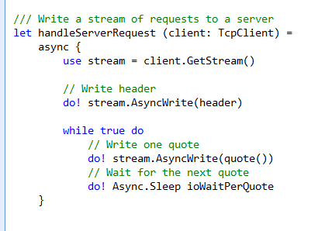
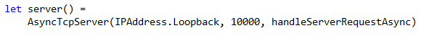
F# example: 20,000+ simultaneous TCP connections with ~10 threads
React!
React!
React!

Slide 26
F# async
Parallel
Server
Agents

Slide 27
F# async
Parallel
Server
Agents

Slide 28
Some uses of F# async { ... }
Repeating tasks/agents
State machines/agents
Repeating tasks with immutable state
async { let state = ...
while true do
let! msg = queue.ReadMessage()
<process message> }
let rec loop count =
async { let! msg = queue.ReadMessage()
printfn "got a message"
return! loop (count + msg) }
loop 0

Slide 29
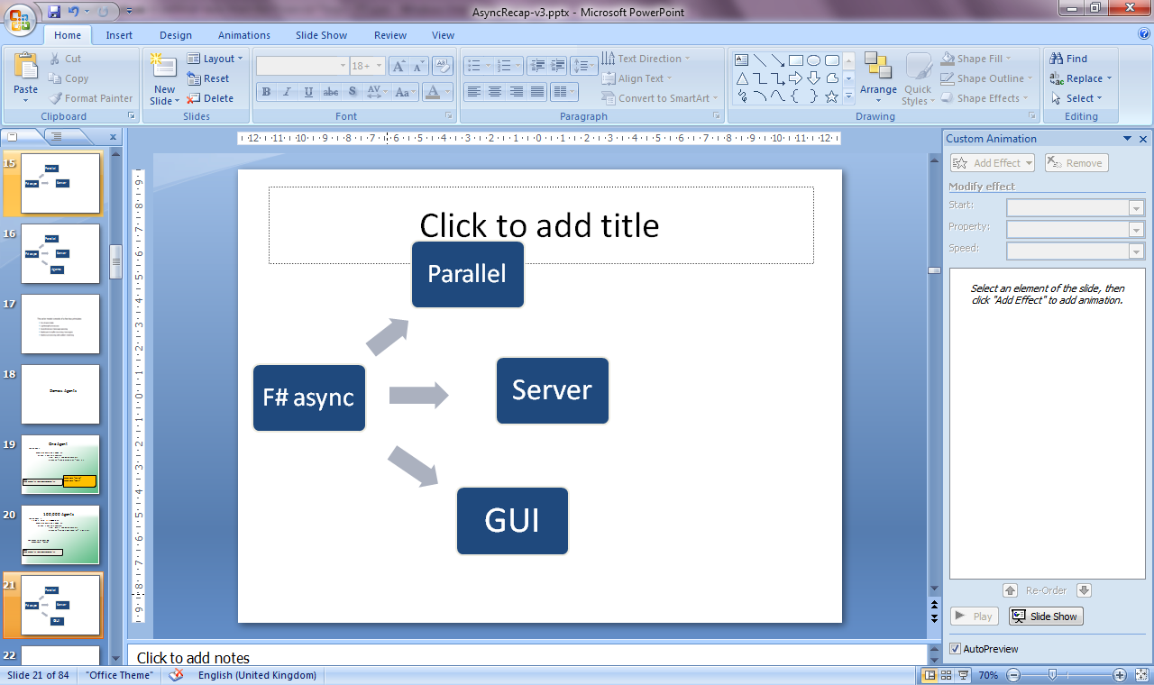
F# async
Parallel
Server
Agents

Slide 30
Part 3: The Essence of F# Async
Adding “async” to a language

Slide 31
The Basic Recipe
1. Add an asynchronous modality to your language
  Reuse and augment control-flow syntax
  Give asynchronous interpretation to control flow
2. Add library primitives
  According to richness of computational environment
3. Compile via Local CPS Transform/State Machines
  According to taste

Slide 32
Assumptions
Making all code “async” is not feasible
  Performance: Fast code needs fast stack
  Semantics: Some must be non-blocking (Javascript)
  Interop: Must interop with OS threads
  Engineering: A modal split gives nice properties
The .NET/JVM threading model is not lightweight
  e.g. 1MB stack/thread + other overheads

Slide 33
MiniAsync
expr =
| ...
Core expression/statement
language

Slide 34
MiniAsync
expr =
| ...
| async { aexpr }
aexpr =
| let! pat = expr in aexpr
| return expr
| return! expr
library +=
Async.StartImmediate
Async.Sleep
modality
await/bind
return
tailcall
primitives

Slide 35
MiniAsync
expr =
| ...
| async { aexpr }
aexpr =
| let! pat = expr in aexpr
| return expr
| return! expr
library +=
Async.StartImmediate
Async.Sleep
: Async<T>
: Async<T> * (T -> Async<U>) -> Async<U>
: Async<unit> -> unit
(start as co-routine)
: int -> Async<unit>
(Primitive to sleep)

Slide 36
MiniAsync
expr =
| ...
| async { aexpr }
aexpr =
| let! pat = expr in aexpr
| return expr
| return! expr
| try aexpr with pat -> aexpr
| try aexpr finally expr
| while expr do aexpr
| let pat = expr in aexpr
| match expr with pat -> aexpr
| expr
library +=
Async.StartImmediate
Async.Sleep
Async control syntax
= Sync control syntax

Slide 37
MiniAsync (reactive)
expr =
| ...
| async { aexpr }
aexpr =
| let! pat = expr in aexpr
| return expr
| try aexpr with pat -> aexpr
| try aexpr finally expr
| while expr do aexpr
| let pat = expr in aexpr
| match expr with pat -> aexpr
| return! expr
| expr
library +=
Async.StartImmediate
Async.Sleep
webRequest.AsyncGetResponse() : Async<unit>
Primitive to
await web response

Slide 38
Computational Model Example
✰ (e.g. Click)
Single Threaded GUI
Pending
Reactions
!
✰
(e.g. I/O
response)
...
!
!
!
...
Handlers (callbacks)

Slide 39
MiniAsync (multicore)
expr =
| ...
| async { aexpr }
aexpr =
| let! pat = expr in aexpr
| return expr
| try aexpr with pat -> aexpr
| try aexpr finally expr
| while expr do aexpr
| let pat = expr in aexpr
| match expr with pat -> aexpr
| return! expr
| expr
library +=
Async.StartImmediate
Async.Sleep
Async.RunSynchronously
Async.Parallel
Async.StartChild + I/O, affinity, cancellation primitives...
Blocking wait
Fork join
Queue in thread pool &
return promise

Slide 40
The Computational Model
(Multicore Java/C#/F#/...)
✰ (e.g. Click)
Single Threaded GUI
(separated state)
Background
Work Item
Queue(s)
Pending
Reactions
!
✰
(e.g. I/O
response)
...
!
!
!
...
Thread Pool
Handlers (callbacks)

Slide 41
Related Work + Summary

Slide 42
Caveats
Async is just a building block
  lightweight user-threads/co-routines in languages where it feels “impossible”
Isolation is not enforced
  but language constructs encourage it
Data races not prohibited
  but functional language constructs greatly reduce reliance on mutation

Slide 43
Related Work
Lots of languages with lightweight user-level threads
Lisp/Scheme Community (~1920-…)
  lots of real-world continuation-based programming
OCaml Community (~2002-2004)
  continuation-based asynchronous programming, no syntax support
C# Iterators (~2004)
  a syntactic modality for imperative streams
F# Async (~2007)
Kilim (~2008)
  a localized CPS rewrite of Java bytecode
Axum (~2008)
  a variation of C# with asynchrony and localized CPS rewrite
Scala Delimited Continuations (~2010)

Slide 44
Summary
F# “async” finalized in F# 2.0 (2010)
  Basic idea published in “Expert F#”, 2007
  No proper academic paper before this
Applicable to many “real-world” languages
C# adopting “async” modality in C# 5.0
  Some technical differences

Slide 45
Questions?

Slide 46
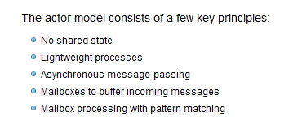

Slide 47
One Agent
let agent =
Agent.Start(fun inbox ->
async { while true do
let! msg = inbox.Receive()
printfn "got message %s" msg } )
agent.Post "three"
agent.Post "four"
Note:
type Agent<'T> = MailboxProcessor<'T>

Slide 48
100,000 Agents
let agents =
[ for i in 0 .. 100000 ->
Agent.Start(fun inbox ->
async { while true do
let! msg = inbox.Receive()
printfn "%d got message %s" i msg })]
for agent in agents do
agent.Post "hello"
Note:
type Agent<'T> = MailboxProcessor<'T>

Slide 49
The Computational Model
(Multicore Java/C#/F#/...)
✰ (e.g. Click)
Single Threaded GUI
(separated state)
Background
Work Item
Queue(s)
Pending
Reactions
!
✰
(e.g. I/O
response)
...
!
!
!
...
Thread Pool
Handlers (callbacks)

Slide 50
Computational Model #1 (Javascript)
✰ (e.g. Click)
Single Threaded GUI
Pending
Reactions
!
✰
(e.g. I/O
response)
...
!
!
!
...
Handlers (callbacks)

Slide 51
  “async expressions” (F#)
  “async methods” (C#/Axum)
  “await” (C# 5.0)
  “asyncerators” (fantasy language X)

Slide 52
Demos: Web Translation

Slide 53
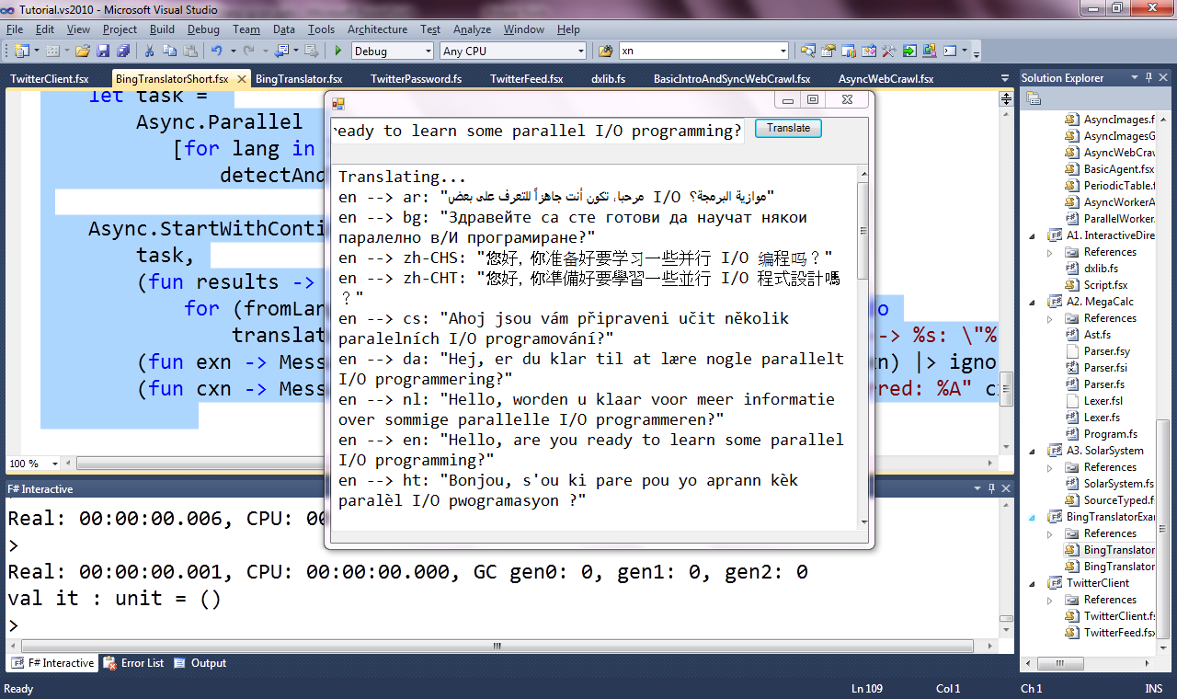

Slide 54
Background: F# Computation Expressions
Very general monadic/monoidal syntax
  In a strict language
  Haskell monadic syntax now looks very “bare”. Time for a rethink?
Applicable to any functional language which aspires to have multi-paradigm elements
  Including pure languages

Slide 55
Possible Future Directions
Formalize MiniAsync
  give language variations in C#, Java, Javascript, Haskell, etc.
  give library variations for different domains
  compare & contrast to the huge related literature
Variations
  Pure core language?
  Impure core language without data races? (c.f. F#/Axum agent language)
Splitting code into sync/async is a variation on the pure/IO split of Haskell.
i.e. there is more than one choice about where to split, even for a “safe” language.

Slide 56
use - background
open System.IO
open System.Collections.Generic
let readAllLines(file) =
use inp = File.OpenText file
let res = new List<_>()
while not(inp.EndOfStream) do
res.Add(inp.ReadLine())
res.ToArray()
“use” =
C# “using”

Slide 57
use
open System.IO
open System.Collections.Generic
let readAllLines(file) =
let inp = File.OpenText file
try
let res = new List<_>()
while not(inp.EndOfStream) do
res.Add(inp.ReadLine())
res.ToArray()
finally inp.Close()
use is sugar for try/finally

Slide 58
use
open System.IO
open System.Collections.Generic
let readAllLines(file) =
async { let! inp = File.AsyncOpenText file
try
let res = new List<_>()
while not(inp.EndOfStream) do
let! line = inp.AsyncReadLine()
res.Add(line)
res.ToArray()
finally inp.Close() }
we can use the same sugar here

Slide 59
use
open System.IO
open System.Collections.Generic
let readAllLines(file) =
async { use inp = File.OpenText file
let res = new List<_>()
while not(inp.EndOfStream) do
let! line = inp.AsyncReadLine()
res.Add(line)
res.ToArray() }

Slide 60
A Popular Question
Today’s multi-paradigm languages all tend to include embedded, richer computational sub-languages
Scala
  Extensible Monadic Generator Expressions
C#
  Iterators for generated sequences
  LINQ for extensible data queries
  C# 5.0 async programming
Haskell
  List Comprehensions
  Monadic Syntax
  Arrow Syntax
Python
  Generators/Consumers

Slide 61
Examples
Same control language, very different computational interpretation (on-demand, state-machine)
C# generators/iterators
public IEnumerator<string> GetEnumerator()
{
yield return "New York";
yield return "Paris";
yield return "London";
}
// Method that takes an iterable input (possibly an array)
// and returns all even numbers.
public static IEnumerable<int> GetEven(IEnumerable<int> numbers)
{
foreach (int i in numbers)
if ((i % 2) == 0)
yield return i;
}

Slide 62
Full F# Syntax & Translation
expr = ...
| expr { cexpr } -- let v = expr in v.Delay(fun () -> «cexpr»)
| { cexpr }
| [| cexpr |]
| [ cexpr ]
cexpr = let! pat = expr in cexpr -- v.Bind(expr,(fun pat -> «cexpr»))
| use pat = expr in cexpr -- v.Using(expr,(fun pat -> «cexpr»))
| do! cexpr1 in cexpr2 -- «let! () = cexpr1 in cexpr2»
| do expr in cexpr -- «let () = cexpr1 in cexpr2»
| for pat in expr do cexpr -- v.For(expr,(fun pat -> «cexpr»))
| while expr do cexpr -- v.While((fun () -> expr),
v.Delay(fun () -> «cexpr»))
| if expr then cexpr else cexpr -- if expr then «cexpr1» else «cexpr2»
| if expr then cexpr -- if expr then «cexpr1» else v.Zero()
| cexpr; cexpr -- v.Combine(«cexpr1», v.Delay(fun () -> «cexpr2»))
| return expr -- v.Return(expr)
| return! expr -- v.ReturnFrom(expr)
| yield expr -- v.Yield(expr)
| yield! expr -- v.YieldMany(expr)
| match expr with [pat -> cexpr]+ -- ...
| try cexpr finally cexpr -- ...
| try cexpr with pat -> cexpr -- ...

Slide 63
Recap:
Add a general mechanism for de-sugared control flow in a strict functional language
Doesn’t commit to underlying use of resumptions/continuations/co-routines/state-machines
  F# compiler knows how to optimize seq { ... } to state machines
We have made that syntax is uniform with F# control flow syntax

Slide 64
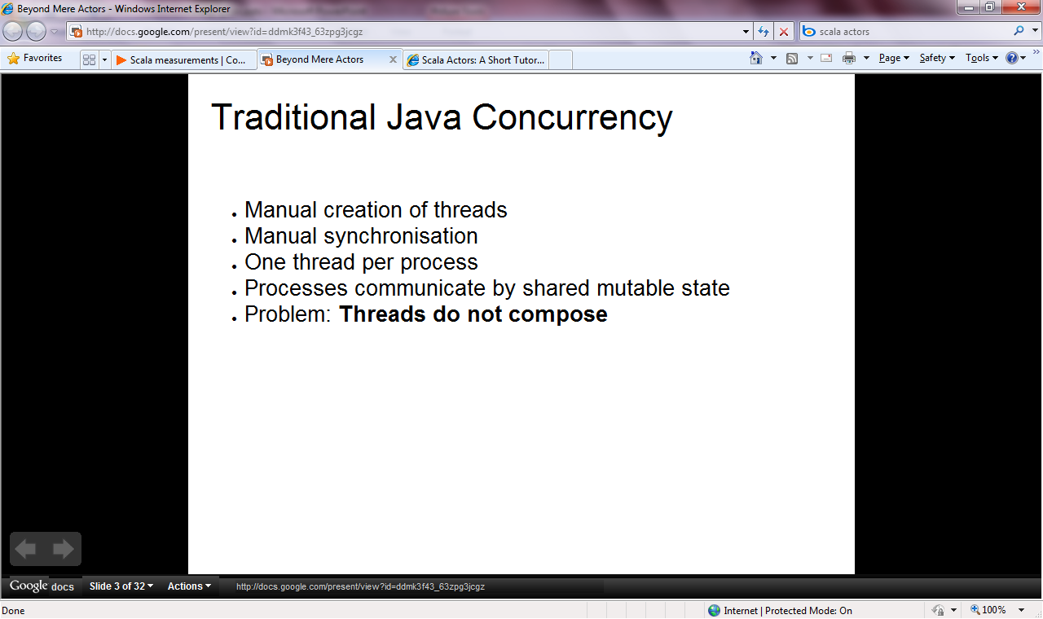

Slide 65
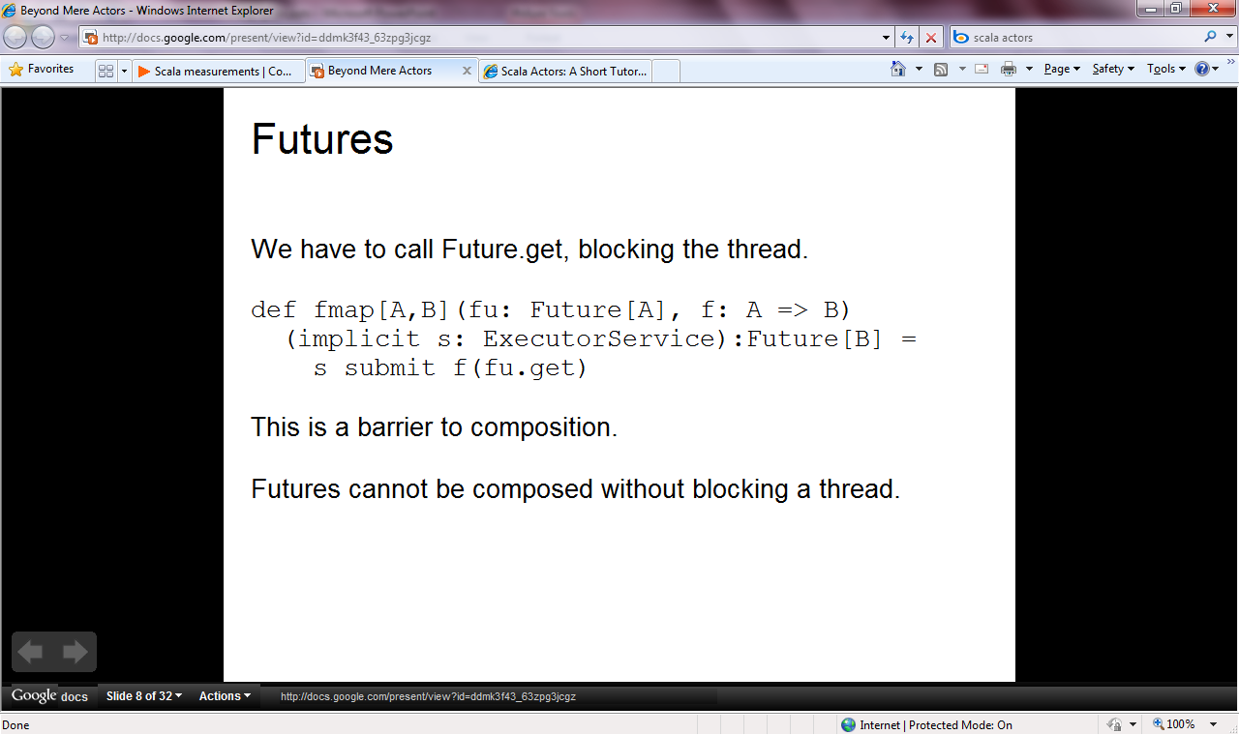

Slide 66
Uses
seq { ... }
async { ... }
asyncSeq { ... }
eventually { ... }

Slide 67
Operation | Signature | LINQ syntax (one use) | F# syntax (monad use) | F# syntax (monoid use)
return | A → M<A> | select e | return e | --
bind | M<A> → (A → M<B>) → M<B> | from x in e | let! x = e ... | --

Slide 68
Operation | Signature | LINQ syntax (one use) | F# syntax (monad use) | F# syntax (monoid use)
return | A → M<A> | select e | return e | --
bind | M<A> → (A → M<B>) → M<B> | from x in e | let! x = e ... | --
seqM | M<unit> → M<A> → M<A>) |  | ... ; ...
iterM | seq<A> → (A → M<unit>) → M<unit> |  | for x in e ... | --
whileM | (unit → bool) → M<unit> → M<unit> |  | while x do ...

Slide 69
Operation | Signature | LINQ syntax (one use) | F# syntax (monad use) | F# syntax (monoid use)
return | A → M<A> | select e | return e | --
bind | M<A> → (A → M<B>) → M<B> | from x in e | let! x = e ... | --
seqM | M<unit> → M<A> → M<A>) |  | ... ; ...
iterM | seq<A> → (A → M<unit>) → M<unit> |  | for x in e ... | --
whileM | (unit → bool) → M<unit> → M<unit> |  | while x do ...
append | M<A> → M<A> → M<A> |  |  | ... ; ...
yield | A → M<A> |  |  | yield e
appendFor | seq<A> → (A → M<B>) → M<B> |  |  | for x in e ...
appendWhile | (unit → bool) → M<A> → M<A> |  |  | while x do ...

Slide 70
Case Study: Making the F# Language Service More Reliably Reactive
Basic architecture:
  single GUI thread (VS)
  single background thread (F# compiler services)
The problem:
  The F# compiler uses enough mutable state that type-checking is single threaded.
  We can’t afford for the background worker to be unresponsive
The solution:
  Computations are “chopped and spliced” into < ~25ms.

Slide 71
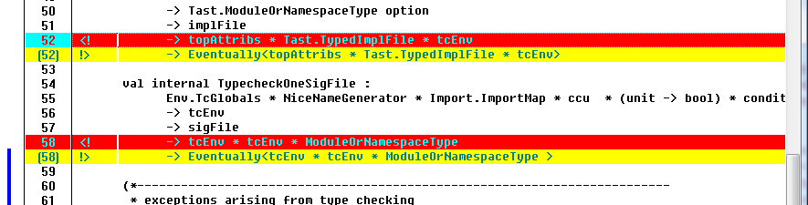

Slide 72
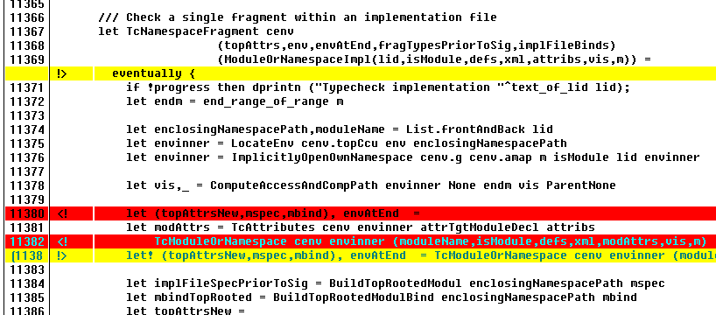

Slide 73
Generality – e.g. Type Indexed Monads
type MonadBuilder() with
member Return : 'a -> M<'a,'idx>
member Bind: M<'a,'idx> * ('a -> M<'b,'idx>) -> M<'b,'idx>
let monad = MonadBuilder()

Slide 74
About Today
F# is a practical functional-first programming language
  Industry meets academia, practice meets theory
This workshop is about exploring how F# can help an educative agenda (and other functional languages)
  In a way that is complementary and supportive of existing teaching techniques
F# comes from a tradition where teaching & using multiple languages is valuable and useful

Slide 75
F# is…
a programming language…

Slide 76
F# is…
...a programming language that allows you to write simple code to solve complex problems.

Slide 77
F# is…
...a practical, functional-first programming language that allows you to write simple code to solve complex problems.

Slide 78
Simplicity

Slide 79
Simplicity: Functions as Values
abstract class Command
{
public virtual void Execute();
}
abstract class RoverCommand : Command
{
protected Rover Rover { get; private set; }
public RoverCommand(MarsRover rover)
{
this.Rover = rover;
}
}
class BreakCommand : RoverCommand
{
public BreakCommand(Rover rover)
: base(rover)
{
}
public override void Execute()
{
Rover.Rotate(-5.0);
}
}
class TurnLeftCommand : RoverCommand
{
public TurnLeftCommand(Rover rover)
: base(rover)
{
}
public override void Execute()
{
Rover.Rotate(-5.0);
}
}
OO
F#
type Command = Command of (Rover -> unit)
let BreakCommand =
Command(fun rover -> rover.Accelerate(-1.0))
let TurnLeftCommand =
Command(fun rover -> rover.Rotate(-5.0<degs>))

Slide 80
Simplicity: Functional Data
C#
Tuple<U,T> Swap<T,U>(Tuple<T,U> t)
{
return new Tuple<U,T>(t.Item2, t.Item1)
}
ReadOnlyCollection<Tuple<T,T,T>> Rotations<T>(Tuple<T,T,T> t)
{
new ReadOnlyCollection<int>
(new Tuple<T,T,T>[]
{ new Tuple<T,T,T>(t.Item1,t.Item2,t.Item3);
new Tuple<T,T,T>(t.Item3,t.Item1,t.Item2);
new Tuple<T,T,T>(t.Item2,t.Item3,t.Item1); });
}
int Reduce<T>(Func<T,int> f,Tuple<T,T,T> t)
{
return f(t.Item1) + f(t.Item2) + f (t.Item3);
}
let swap (x, y) = (y, x)
let rotations (x, y, z) =
[ (x, y, z);
(z, x, y);
(y, z, x) ]
let reduce f (x, y, z) =
f x + f y + f z
F#

Slide 81
Simplicity: Functional Data
C#
F#
public abstract class Expr { }
public abstract class UnaryOp :Expr {
public Expr First { get; private set; }
public UnaryOp(Expr first) { this.First = first; }
}
public abstract class BinExpr : Expr
{
public Expr First { get; private set; }
public Expr Second { get; private set; }
public BinExpr(Expr first, Expr second) {
this.First = first;
this.Second = second;
}
}
public class TrueExpr : Expr { }
public class And : BinExpr {
public And(Expr first, Expr second) : base(first, second) { }
}
public class Nand : BinExpr {
public Nand(Expr first, Expr second) : base(first, second{ }
}
public class Or : BinExpr {
public Or(Expr first, Expr second) : base(first, second) { }
}
public class Xor : BinExpr {
public Xor(Expr first, Expr second) : base(first, second) { }
}
public class Not : UnaryOp {
public Not(Expr first) : base(first) { }
}
type Expr =
| True
| And of Expr * Expr
| Nand of Expr * Expr
| Or of Expr * Expr
| Xor of Expr * Expr
| Not of Expr

Slide 82
Simplicity: Functional Data
C#
public abstract class Event { }
public abstract class PriceEvent : Event
{
public Price Price { get; private set; }
public PriceEvent(Price price)
{
this.Price = price;
}
}
public abstract class SplitExpr : Event
{
public double Factor { get; private set; }
public SplitExpr(double factor)
{
this.Factor = factor;
}
}
public class DividendEvent : Event { }
...
type Event =
| Price of float
| Split of float
| Dividend of float<money>
F#

Slide 83
Parallel

Slide 84
Async.Parallel [ httpAsync "www.google.com" httpAsync "www.bing.com" httpAsync "www.yahoo.com" ]
Parallel
|> Async.RunSynchronously

Slide 85
Async.Parallel [ for i in 0 .. 200 -> computeTask i ]
Parallel
|> Async.RunSynchronously

Slide 86
F#: Influences
OCaml
C#/.NET
F#
Similar core
language
Similar object
model

Slide 87
Functional First
I've been coding in F# lately, for a production task.
F# allows you to move smoothly in your programming style... I start with pure functional code, shift slightly towards an object-oriented style, and in production code, I sometimes have to do some imperative programming.
I can start with a pure idea, and still finish my project with realistic code.
Julien Laugel, Chief Software Architect, www.eurostocks.com

Slide 88
Typed
Functional Core
Functional Data
Units of Measure
Imperative Mutation & I/O
Async/Parallel/Monads
Meta Programming
Objects

Slide 89
Applied Functional ≈ Core Engines
Units of measure The industry I work in is littered with units....Having the type system verify the correctness of the units is a huge time saver...it eradicates a whole class of errors that previous systems were prone to.
Exploratory programming Working with F# Interactive allowed me to explore the solution space more effectively before committing to an implementation ... a very natural way for a programmer to build their understanding of the problem and the design tensions in play.
Unit testing Code written using non-side effecting functions and immutable data structures is a joy to test. There are no complex time-dependent interactions to screw things up or large sets of dependencies to be mocked.
Parallelism The functional purity ... makes it ripe for exploiting the inherent parallelism in processing vectors of data.
Interoperation ... The calculation engine could be injected into any C# module that needed to use it without any concerns at all about interoperability. Seamless. The C# programmer need never know.
Code reduction Much of the data fed into the calculation engine was in the form of vectors and matrices. Higher order functions eat these for breakfast with minimal fuss, minimal code. Beautiful.
Lack of bugs Functional programming can feel strange. .. once the type checker is satisfied that’s it, it works.

Slide 90
Applied Functional ≈ Core Engines
Units of measure The industry I work in is littered with units....Having the type system verify the correctness of the units is a huge time saver...it eradicates a whole class of errors that previous systems were prone to.
Exploratory programming Working with F# Interactive allowed me to explore the solution space more effectively before committing to an implementation ... a very natural way for a programmer to build their understanding of the problem and the design tensions in play.
Unit testing Code written using non-side effecting functions and immutable data structures is a joy to test. There are no complex time-dependent interactions to screw things up or large sets of dependencies to be mocked.
Parallelism The functional purity ... makes it ripe for exploiting the inherent parallelism in processing vectors of data.
Interoperation ... The calculation engine could be injected into any C# module that needed to use it without any concerns at all about interoperability. Seamless. The C# programmer need never know.
Code reduction Much of the data fed into the calculation engine was in the form of vectors and matrices. Higher order functions eat these for breakfast with minimal fuss, minimal code. Beautiful.
Lack of bugs Functional programming can feel strange. .. once the type checker is satisfied that’s it, it works.

Slide 91
Some Basic F#
Notes:
If you would like to host your demo on the Virtual Server, please use the myVPC demo slide, not this slide.

Slide 92
Whitespace Matters
let computeDerivative f x =
let p1 = f (x - 0.05)
let p2 = f (x + 0.05)
(p2 – p1) / 0.1
Offside (bad indentation)

Slide 93
Whitespace Matters
let computeDerivative f x =
let p1 = f (x - 0.05)
let p2 = f (x + 0.05)
(p2 – p1) / 0.1

Slide 94
Functional– Pipelines
x |> f
=
f x
The pipeline operator

Slide 95
[ … ]
Generated data
let squares (n, m) =
[ for x in n .. m do
yield (x,x*x) ]
let activities children =
[ for child in children do
yield "WakeUp.fs"
yield! morningActivies child ]

Slide 96
[ … ]
Note, I/O here
This is F#, not Haskell
let rec allFiles dir =
[ for file in Directory.GetFiles dir do
yield file
for sub in Directory.GetDirectories dir do
yield! allFiles sub ]
allFiles @"C:\LogFiles"

Slide 97
seq { … }
On-demand
let rec allFiles dir =
seq { for file in Directory.GetFiles dir do
yield file
for sub in Directory.GetDirectories dir do
yield! allFiles sub }
allFiles @"C:\LogFiles"
|> Seq.take 100
|> show
Pipelines

Slide 98
seq { … }
Because it's on-demand, things can now be infinite
let rec randomWalk x =
seq { yield x
yield! randomWalk (x+rnd()) }

Slide 99
queries
seq { for i in db.Customers do
for j in db.Employees do
if i.Country = j.Country then
yield (i.FirstName, j.FirstName) }
(runs in-memory)

Slide 100
queries
<@ ... @> = quotation
query
<@ seq { for i in db.Customers do
for j in db.Employees do
if i.Country = j.Country then
yield (i.FirstName, j.FirstName) } @>
(runs as SQL on database)

Slide 101
Objects
Class Types
type ObjectType(args) =
let internalValue = expr
let internalFunction args = expr
let mutable internalState = expr
member x.Prop1 = expr
member x.Meth2 args = expr
Interface Types
type IObject =
interface ISimpleObject
abstract Prop1 : type
abstract Meth2 : type -> type
Constructing Objects
new FileInfo(@"c:\misc\test.fs")

Slide 102
Objects + Functional
type Vector2D (dx:double, dy:double) =
let d2 = dx*dx+dy*dy
member v.DX = dx
member v.DY = dy
member v.Length = sqrt d2
member v.Scale(k) = Vector2D (dx*k,dy*k)
Inputs to object
construction
Object internals
Exported properties
Exported method

Slide 103
Objects + Functional
Immutable inputs
type HuffmanEncoding(freq:seq<char*int>) =
...
< 50 lines of beautiful functional code>
...
member x.Encode(input: seq<char>) =
encode(input)
member x.Decode(input: seq<char>) =
decode(input)
Internal tables
Publish access

Slide 104
Topic: Units of Measure

Slide 105

NASA Mars Climate Orbiter, 1999

Slide 106
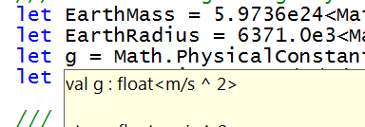
let EarthMass = 5.9736e24<kg>
// Average between pole and equator radii
let EarthRadius = 6371.0e3<m>
// Gravitational acceleration on surface of Earth
let g = PhysicalConstants.G * EarthMass / (EarthRadius * EarthRadius)

Slide 107
Units of Measure – Typical Example
[<Measure>] type money
[<Measure>] type shares
[<Measure>] type volume
[<Measure>] type rateOfReturn
let rateOfReturn (f:float) = f * 1.<rateOfReturn>
type Price = { Open: float<money>;
High: float<money>;
Low: float<money>;
Close: float<money>;
Volume: float<volume> }

Slide 108
parallel & reactive
Notes:
If you would like to host your demo on the Virtual Server, please use the myVPC demo slide, not this slide.

Slide 109
The Big Trends
THE WEB
MULTICORE

Slide 110
F# is a Parallel Language
(Multiple active computations)
F# is a Reactive Language
(Multiple pending reactions)
GUI Event
Page Load
Timer Callback
Query Response
HTTP Response
Web Service Response
Disk I/O Completion
Agent Gets Message

Slide 111
async { ... }
React!
async { let! res = <async-event>
... }
React to a GUI Event
React to a Timer Callback
React to a Query Response
React to a HTTP Response
React to a Web Service Response
React to a Disk I/O Completion
Agent reacts to Message

Slide 112
async { ... }
async { ... }
Resumptions (one shot continuations)
w/- result/exception/cancellation continuations
+ delimited exceptions and resources
+ combinators to put them together
+ syntax
+ start-task, fork-join operators

Slide 113
async { ... }
async { let! image = ReadAsync "cat.jpg"
let image2 = f image
do! writeAsync image2 "dog.jpg"
do printfn "done!"
return image2 }
Asynchronous action
Continuation/
Event callback
You're actually writing this (approximately):
async.Delay(fun () ->
async.Bind(ReadAsync "cat.jpg", (fun image ->
let image2 = f image
async.Bind(writeAsync "dog.jpg",(fun () ->
printfn "done!"
async.Return())))))

Slide 114
The many uses of async { ... }
Sequencing I/O requests
Sequencing CPU computations and I/O requests
async { let! lang = detectLanguageAsync text
let! text2 = translateAsync (lang,"da",text)
return text2 }
async { let! lang = detectLanguageAsync text
let! text2 = translateAsync (lang,"da",text)
let text3 = postProcess text2
return text3 }

Slide 115
The many uses of async { ... }
Parallel CPU computations
Parallel I/O requests
Async.Parallel [ async { return (fib 39) };
async { return (fib 40) }; ]
Async.Parallel
[ for target in langs ->
translateAsync (lang,target,text) ]

Slide 116
A First Agent
let agent =
Agent.Start(fun inbox ->
async { while true do
let! msg = inbox.Receive()
printfn "got message %s" msg } )
agent.Post "three"
agent.Post "four"
Note:
type Agent<'T> = MailboxProcessor<'T>

Slide 117
First 100,000 Agents
let agents =
[ for i in 0 .. 100000 ->
Agent.Start(fun inbox ->
async { while true do
let! msg = inbox.Receive()
printfn "%d got message %s" i msg })]
for agent in agents do
agent.Post "hello"
Note:
type Agent<'T> = MailboxProcessor<'T>

Slide 118
Demo

Slide 119
Cross-platform
Emacs
Mono-Develop,
etc. …
Emacs
Mono-Develop,
etc. …
Visual Studio
tools templates
designers
…
Visual Studio
tools templates
designers
…
Visual Studio
tools++
languages
templates
designers
…
Adv. Tools
fsc.exe
fsi.exe
libraries
fsc.exe
fsi.exe
libraries
fsc.exe
libraries
fsc.exe
fsi.exe
libraries
fsc.exe
fsi.exe
libraries
Basic Tools
Linux
(Mono…)
Mac
(Mono…)
Phone
(WP7)
Windows or
Silverlight
(free tools)
Windows or
Silverlight
VS 2010

Slide 120
Summary
F# is a general purpose, efficient, succinct, “functional-first” programming language
F# has a simple, script-like initial experience, but is strongly typed and friendly
F# has some nice features for objects, queries, async, agents, parallel and units of measure
F# is highly interoperable, and can build vanilla .NET components

Slide 121
F# and Education
What excites me is giving graduates the knowledge and tools to do great things
It feels like F# has a role here:
  Not necessarily as language #1
  Quite possibly used in conjunction with C#, Haskell, OCaml, SML, Erlang
Somehow, somewhere students need to be exposed to
  Functional programming (e.g. preparing for F#, C#, Java)
  Query programming (e.g. preparing for C#, SQL)
  Nice, simlpe objects (to avoid polluting minds)
  Parallel/async I/O (multicore + web)
  Units of measure (for numeric students)

Slide 122
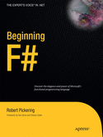
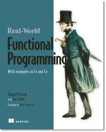
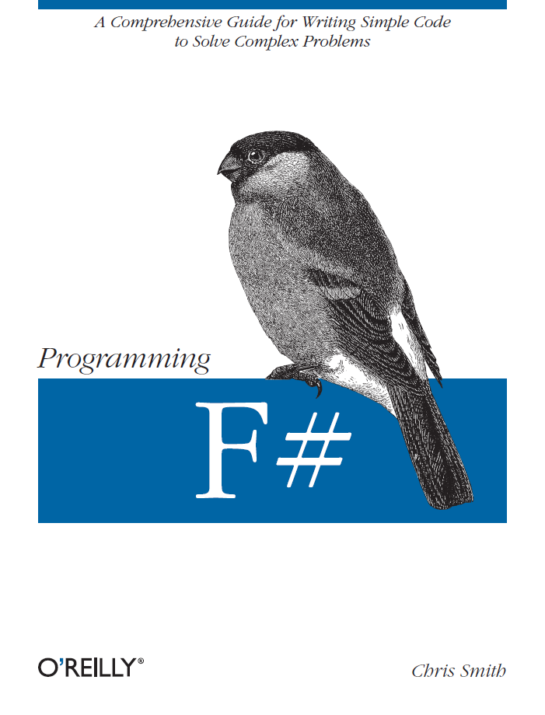
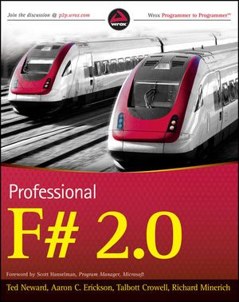

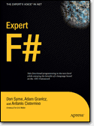
Latest Books about F#
Visit www.fsharp.net

Slide 123
q & a

Slide 124
F# - Control Flow
Control Flow
expr Sequencing
expr
if expr then expr
else expr Conditional
for id = expr to expr do Loop (1)
expr
for pat in expr do Loop (2)
expr
while expr do While loop
expr
Binding and Scoping
let pat = expr Value
let id args = expr Function
let rec id args = expr Recursive
use pat = expr Dispose

Slide 125
Quick Overview: Types
Basic Types and Literals
sbyte = System.SByte 76y
byte = System.Byte 76uy
int16 = System.Int16 76s
uint16 = System.UInt16 76us
int32 = System.Int32 76
uint32 = System.UInt32 76u
int64 = System.Int64 76L
uint64 = System.UInt64 76UL
string = System.String "abc", @"c:\etc"
single = System.Single 3.14f
double = System.Double 3.14, 3.2e5
char = System.Char '7'
nativeint = System.IntPtr 76n
unativeint = System.UIntPtr 76un
bool = System.Boolean true, false
unit = Microsoft.FSharp.Core.Unit ()
Basic Type Abbreviations
int8 = sbyte
uint8 = byte
int = int32
float32 = single
float = double
Types
ident Named type
ident<type,...,type> Type instantiation
type * ... * type Tuple type
type[] Array type
'ident Variable type
type -> type Function type
Type instantiations can be postfix:int list

Slide 126
Quick Overview: Functions
Functions
fun pat … pat -> expr Function value
function Match function
| pat -> expr
…
| pat -> expr
Application and Pipelining
f x Application
x |> g Forward pipe
f >> g Function composition

Slide 127
Quick Overview
Comments
// comment
(* comment *)
/// XML doc comment
let x = 1
Attaching Attributes
[<Obsolete("Deprecated at 1.2")>]
type Type =
…
[<Conditional("DEBUG")>]
let Function(x) =
[<assembly: Note("argument")>]
do ()

Slide 128
F# - Operators
Generic Comparison and Hashing
hash x Generic hashing
x = y Generic equality
x <> y Generic inequality
compare x y Generic comparison
x >= y, x <= y,
x > y, x < y,
min x y, max x y
Note: Records, tuples, arrays and unions
automatically implement structural equality
and hashing
Overloaded Arithmetic
x + y Addition
x - y Subtraction
x * y Multiplication
x / y Division
x % y Remainder/modulus
-x Unary negation
Overloaded Math Operators
abs, acos, atan, atan2,
ceil, cos, cosh, exp,
floor, log, log10, pow,
pown, sqrt, sin, sinh,
tan, tanh
Overloaded Conversion Operators
byte, sbyte, int16, uint16,
int, int32, uint32, int64,
uint64, float32, float, single, double, nativeint, unativeint
Mutable Locals
let mutable v = expr declare
v read
v <- expr update
Mutable Reference Cells
ref x allocate
!cell read
cell.Value read
cell := x assign
Indexed Lookup
expr.[idx] Lookup
expr.[idx] <- expr Assignment
expr.[idx..idx] Slice
expr.[idx..] Right slice
expr.[..idx] Left slice
Also multidimensional operators
Booleans
not expr Boolean negation
expr && expr Boolean “and”
expr || expr Boolean “or”

Slide 129
F#: Patterns
Patterns
_ Wildcard pattern
literal Constant pattern
ident Variable pattern
(pat, …, pat) Tuple pattern
[ pat; …; pat ] List pattern
[| pat; …; pat |] Array pattern
{ id=pat; …; id=pat } Record pattern
id(pat, …, pat) Union case pattern
pat | pat “Or” pattern
pat as id Named pattern
:? type Type test pattern
:? type as id Type cast pattern
null Null pattern
Matching
match expr with
| pat -> expr
…
| pat -> expr
Note: Rules of a match may use
| pat when expr -> expr

Slide 130
Typed Functional
Programming
Make
parallelism
sane
“Minimize Mutable
State”
Make I/O and task
parallelism more
compositional
“Purity”
Less
Mutable
State
“Transactional
State”
“Isolated
State”
Integrate declarative
engine-based parallelism
into language
e.g. Queries,
Array/matrix programs,
Constraint programs
“Immutable
Data”
Embedded
Computational
Languages
Embedded
Declarative
Languages
“combinators”
“monads”
“meta-programs”
“DSLs”
“LINQ”
task { ... }
async { ... }
Array.Parallel.map
“monoids”
Types
“generics”
query
<@ seq { for i in db.Customers do
for j in db.Employees do
if i.Country = j.Country then
yield (i.FirstName, j.FirstName) } @>
Make
programming
sane

Slide 131
F# and Parallel Challenges
Shared State
Inversion of Control
Async
I/O, Task, Agent Parallelism
Async
Implicit Parallelism
Distribution

Slide 132
The many uses of async { ... }
Repeating tasks with mutable state
Repeating tasks with immutable state
async { let state = ...
while true do
let! msg = queue.ReadMessage()
<process message> }
let rec loop count =
async { let! msg = queue.ReadMessage()
printfn "got a message"
return! loop (count + msg) }
loop 0

Slide 133
The many uses of async { ... }
Representing Agents (approximate)
let queue = new Queue()
let rec loop count =
async { let! msg = queue.ReadMessage()
printfn "got a message"
return! loop (count + msg) }
Async.Start (loop 0)
queue.Enqueue 3
queue.Enqueue 4

Slide 134
Some Micro Trends
  REST, HTML, XML, JSON, Haskell, F#, Scala, Clojure, Erlang,...
Communication With Immutable Data
Programming With Queries
Programming With Lambdas
Programming With Pattern Matching
Languages with a Lighter Syntax
Taming Side Effects
  C#, VB, F#, SQL, Kx....
  C#, F#, Javascript, Scala, Clojure, ...
  F#, Scala, ...
  Python, Ruby, F#, ...
  Erlang, Scala, F#, Haskell, ...

Slide 135
F# and Parallel Challenges
Shared State
Immutability
Inversion of Control
Async
I/O, Task, Agent Parallelism
Async
Engine Access +
Embedded
Languages
Implicit Parallelism
Distribution
Web/Cloud/MSQ/
Cluster etc.

Slide 136
F# and Parallel Challenges
Shared State
Immutability
Inversion of Control
I/O, Task, Agent Parallelism
Implicit Parallelism
Distribution

Slide 137
Immutability the norm...
Immutable Tuples
Immutable Maps
Immutable Unions
+ lots of language features to encourage immutability
Immutable Lists
Immutable Records
Immutable Sets
Immutable Objects

Slide 138
F# - Research Contributions
Active Patterns ICFP 07
Meta-programming in a typed language ML 06
Units of measure CEFP 09, Kennedy
Lightweight reactive agents on VM Expert F#
Nominal objects in a type-inferred language
Monadic programming in a strict language
Notes:
Contents are wrong – should be a summary of key F# takeaways

Slide 139
Related Work
A vast amount....
  C#
  SML (SML.NET)
  OCaml
  Scala
  Haskell
  Kennedy ‘97 – Units of Measure
  Use of resumptions for async/parallel programming has many precursors
Notes:
Contents are wrong – should be a summary of key F# takeaways

Slide 141
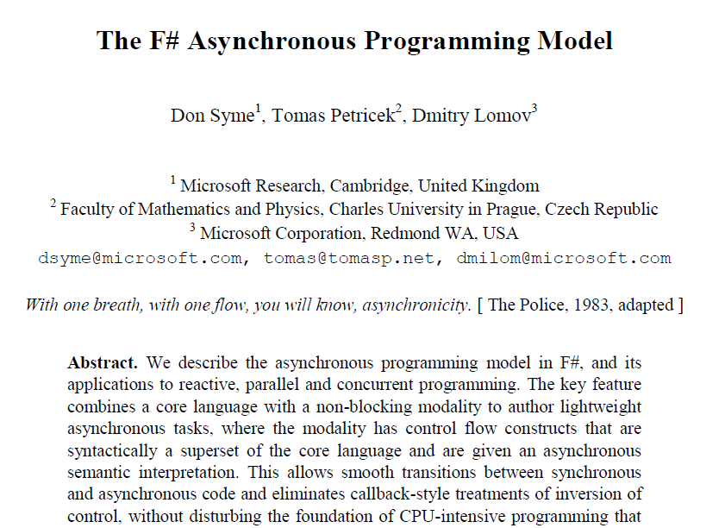
Interested in async/parallel?
Expert F# 2007
Look for it in PADL 2010!

Slide 142
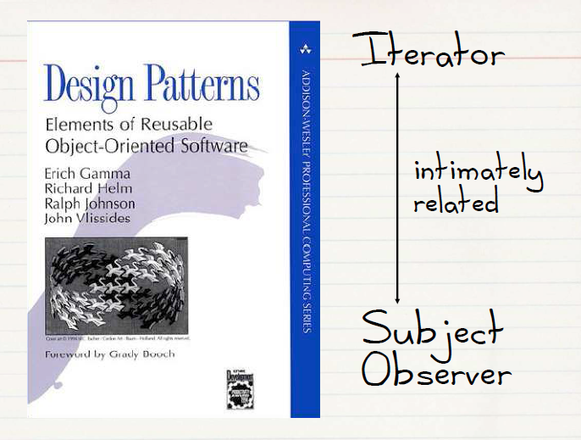
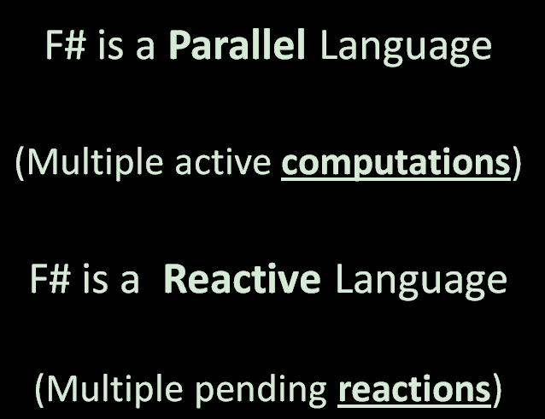
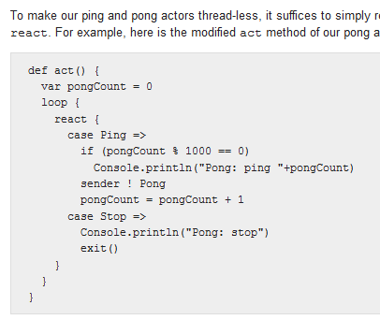
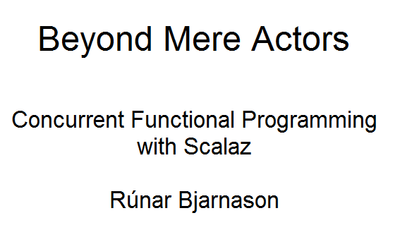

Slide 143

Multi Platform
Professional Tools
+Phone
+Xbox
+Cloud
+HTML5
(Web Sharper)
Linux/Mac

Slide 144
Computational Model Example
✰ (e.g. Click)
Single Threaded GUI
Pending
Reactions
!
✰
(e.g. I/O
response)
...
!
!
!
...
Handlers (callbacks)

