Slide 1



Scalable Integration of Heterogeneous Financial Data and Programming
A world of financial data, at your fingertips
Dr. Don Syme
Principal Researcher, Microsoft Research
F# Community Contributor, @dsyme

Slide 2
Agenda
The “Information Rich Programming” Problem
  - broadly conceived
  - and for financial data specifically
A bit about F#
Applying F# scalable data/metadata integration techniques to financial data integration

Slide 3
Proposition 1
We are living in an Information Revolution

Slide 4
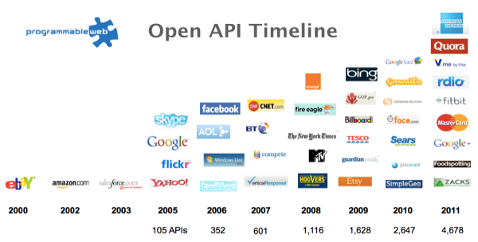
The Information Revolution
2012
2013
6,432
10,537

Slide 5
Proposition 2
Modern programming is intensely information-rich

Slide 6
Proposition 3
Our programming languages are information-sparse

Slide 7

Financial data is like water…

Slide 8
Financial data is like water…
Everyone needs it. Everyone knows where to get it. Simple.
But…
… nobody is sure where it really came from, or goes to.
… nobody really knows its true cost, or true value.
… nobody likes to pay for it, or to share it.
… nobody knows how much is wasted
… nobody knows a good plumber
… nobody knows how bad it is until after you have drunk it

Slide 9

Actually these days it’s more like a flood…

Slide 10

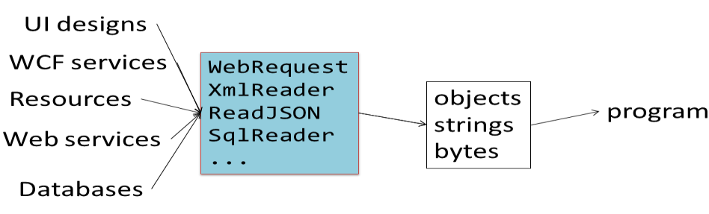
The financial data plumber’s perspective
Languages do not integrate information
  Weakly typed
  Not at scale
  Non-intuitive
  Not simple
  Disorganised
  Static
  High friction

Slide 11
We need to bring information into our
“data plumbing” languages…
At market-scale, in-cloud or on-premise, strongly tooled, strongly typed

Slide 12
This R&D is done in the context of the open language F#
But before we get into that…
Lots of good reasons for that, see our tech report
“Strongly Typed Language Support for Internet-Scale Information Spaces”

Slide 13
A bit about F#....

Slide 14
F# is a great data plumbing language

Slide 15
F# is open source, cross platform fsharp.org

Slide 16
F# has an intelligent, fun, contributing community fsharp.org fsharpforfunandprofit.com

Slide 17
F# helps address real business problems around Time to Market, Efficiency, Correctness and Tackling Complexity
See: “Succeeding with Functional-first Programming in Finance”, Don Syme

Slide 18
F# has a particularly strong following in finance, including leading London-based banks and hedge funds fsharp.org/testimonials meetup.com/FSharpLondon

Slide 19
F# is used to make lots of money fsharp.org/testimonials

Slide 20
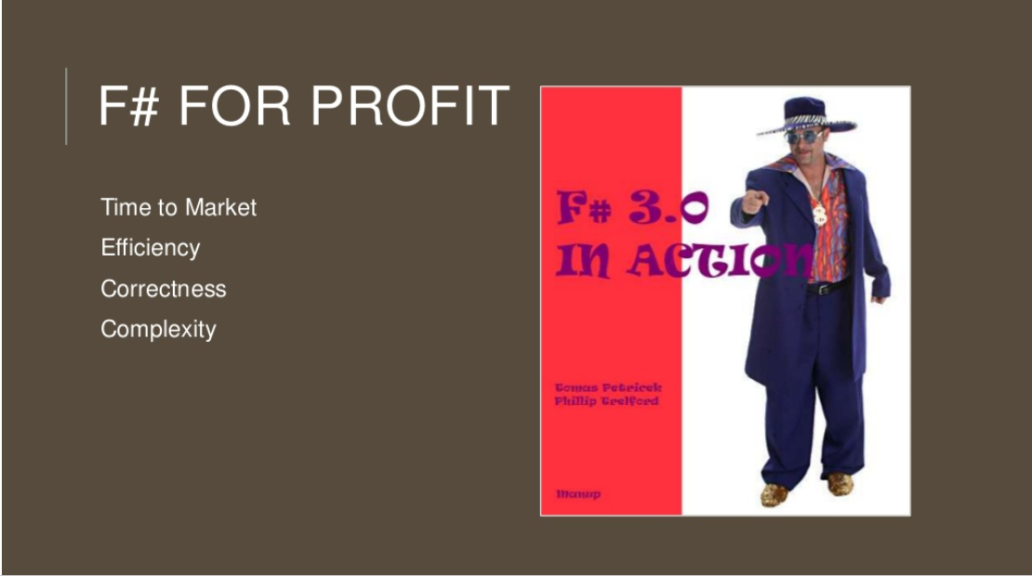

Slide 21
Example: F# for Quant Consulting
Complexity
Our bids for tendered contracts in quantitative finance are regularly half the price of competitors because of the increased productivity we get from F#.
We are regularly able to deliver correct, robust, performant solutions on-time, which is what our customers value most.
Daniel Egloff, QuantAlea Consulting, Zurich
Efficiency
Time to Market
Correctness
http://fsharp.org/testimonials

Slide 22
Microsoft recommend
F# and the Visual F# tools for your functional-first programming needs

Slide 23
Back to the main topic…

Slide 24
Typical F# Topics
F# Basics
F# for Cloud Data
F# for DSLs in Risk and Insurance
F# for GPUs
F# for Pricing
F# + R
F# for Data Science
F# Deep Data Integration

Slide 25
The Problem We’re Addressing
Our data plumbing tools are data-sparse. We need to bring financial information into the language…
At market-scale, strongly tooled, strongly typed

Slide 26
Which data?
Xenomorph Timescape is a major Microsoft partner for Financial Data in the Azure Cloud Platform
Data like this enables entire cloud-based industries in financial analytics

Slide 27
The specific questions:
Can we use F#’s unique “type provider” capabilities to integrate Xenomorph data at fine granularity?
Can we specifically tackle the quantity of instruments and the sparseness of the data in a programming language integration.

Slide 28
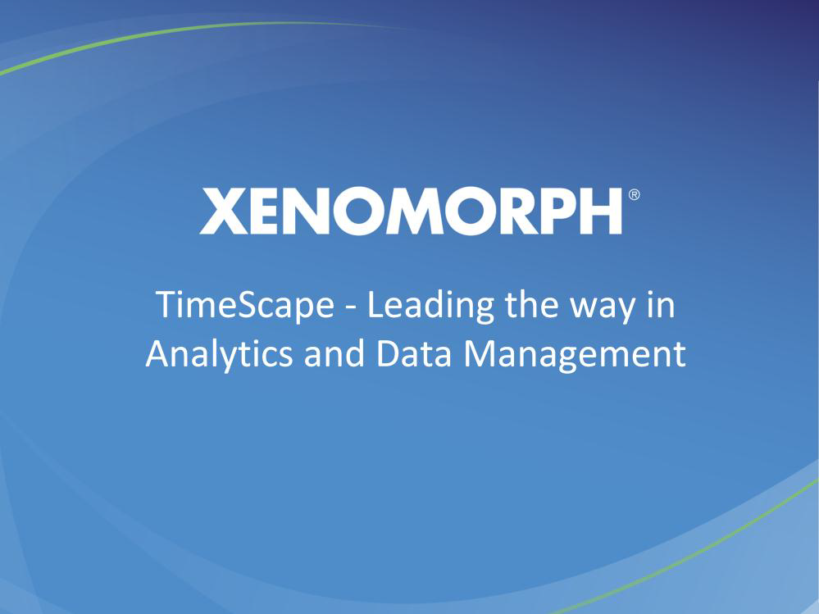

Slide 29
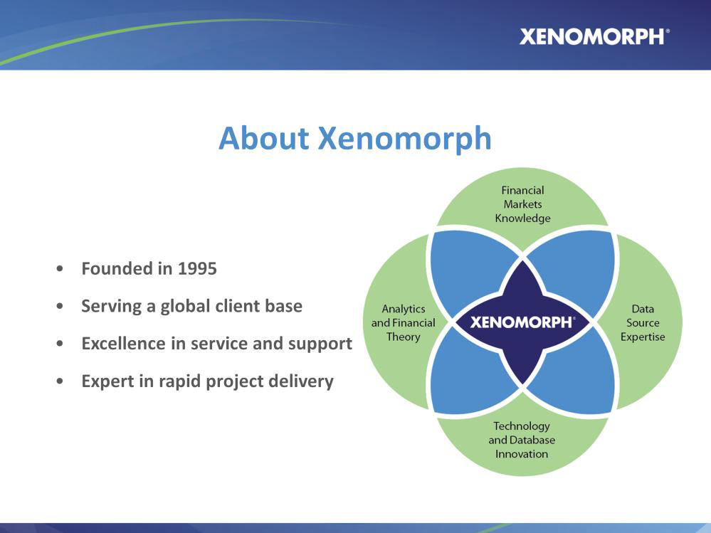

Slide 30
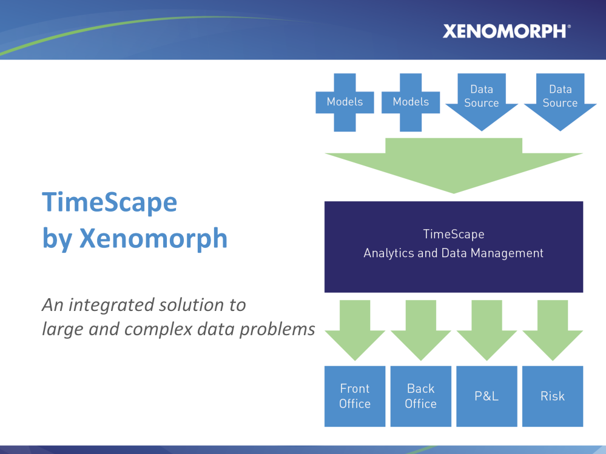

Slide 31
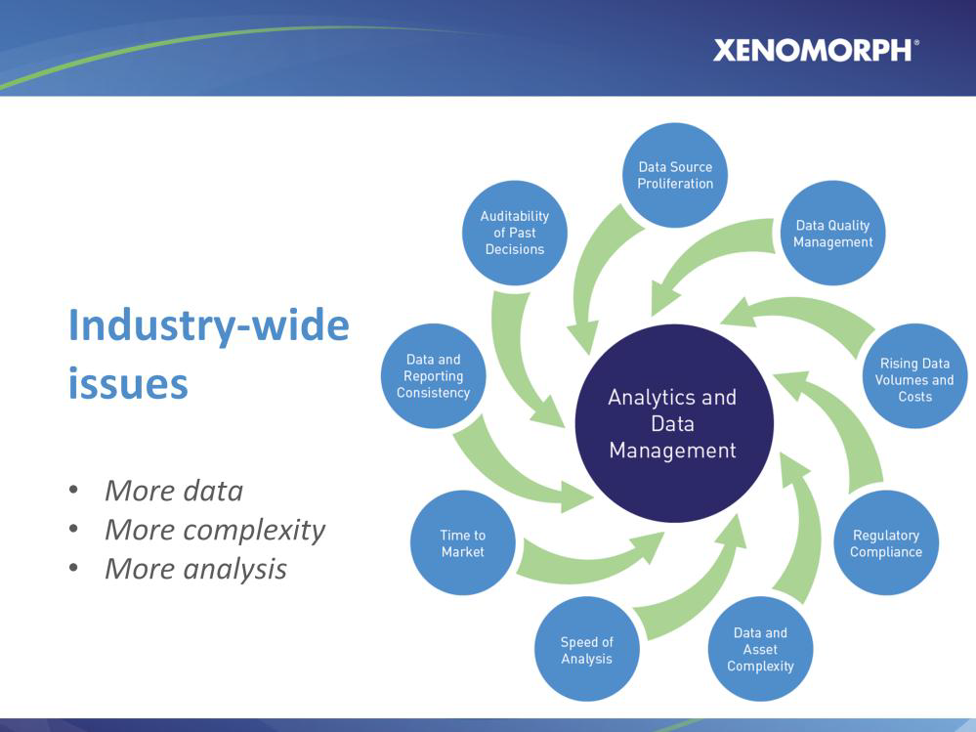

Slide 32
The problem is this: the data is still weakly integrated into our data plumbing languages

Slide 33
The Technique: “F# Type Providers”
Allow scalable, robust, deep integration

Slide 34
Similar Problem: Integrate all of freebase.com
“as if it were a library”
40M entities, 1Billion facts, 24,000 types, 65,000 properties

Slide 35
Similar Problem: Integrate all of worldbank.org/data
“as if it were a library”
10,000+ time series for hundreds of countries/regions

Slide 36
Demo
F# + Freebase
An F# type provider for deep, robust integration of web data

Slide 37
A Type Provider is….
“Just like a library”
“A design-time component that computes a space of types and methods on-demand…”
“An adaptor between data/services and the F# type system…”
“On-demand, scalable compile-time provision of type/module definitions…”

Slide 38
But what about financial data?

Slide 39
Demo
F# + Xenomorph TimeScape
An F# type provider for deep, robust integration of financial data

Slide 40
Theme #1
On-Demand Types = Internet Scalable Magic

Slide 41
On-Demand Type Provision
let data = RiskLab.GetDataContext()
1. Compiler/IDE requests metadata for symbol GetDataContext
  Provider reports return type of RiskLabDataContext
data.Categories
2. Compiler/IDE requests contents of RiskLabDataContext and property Categories
  Provider asks Freebase metadata service for top-level domains
  Provider reports top-level domains of Freebase as properties of the type
data.Categories.``GB Equities``
3. Compiler/IDE requests metadata for symbol ``GB Equities``
...

Slide 42
Theme #2
Many Data Sources, One Mechanism

Slide 43
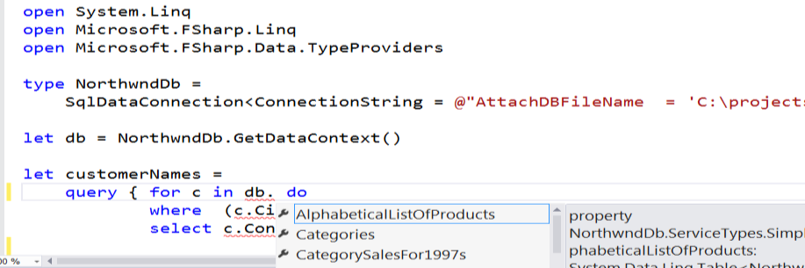
SQL

Slide 44
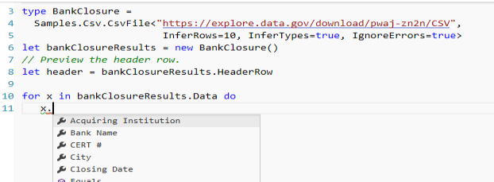
CSV

Slide 45

JSON

Slide 46
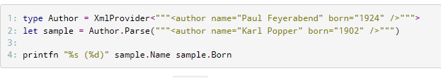
XML

Slide 47

Hadoop/Hive

Slide 48
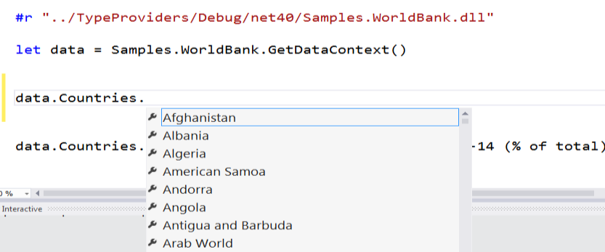
World Bank

Slide 49
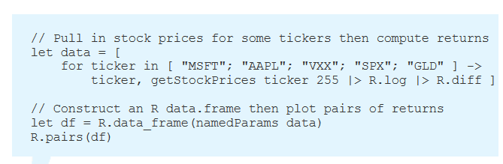
R

Slide 50
Demo
F# + R

Slide 51
Theme #3
Data and Types at Multiple Scales

Slide 52
Data at Multiple Scales
From Everything to Individuals
Data Scripters need to work with different granularities of schematization
data.AllEntites
data.Categories.``GB Equity``
data.Categories.``GB Equity``.``SAINSBURY(J) (SBRY.L, Reuters)``
…Only a language with massively scalable metadata integration can operate at all these levels
Every stable entity can get a unique type

Slide 53


Providing Units of Measure
If the metadata contains units (including currencies)…
via F#’s Units of Measure
…then these can be projected into the programming language.

Slide 54
Summary
Financial programming is ever more integrated with data
I presented applications of techniques for scalable, intuitive data/metadata integration to financial data
Integrating data+programming has many challenges
You can use these techniques for real and in production through F#

Slide 55

Questions?

Slide 56
In Summary
F#
The safe choice for functional-first
Unbeatable data integration
Visual F# - tooling you can trust from Microsoft
Open, cross-platform, strongly typed, efficient, rock-solid stable

