Slide 1



F# Code I Love
Don Syme
F# Community Contributor, Language Designer, Researcher @ Microsoft

Slide 2
A stroll through some of the F# code I love…
…and some that I love a little less :)
…and how this relates to the language features and F# 5.0+

Slide 3
Aside
The Early History of F# - HOPL IV (2021) fsharp.org/history

Slide 4

www.microsoft.com/net/

Slide 5


Slide 6






F# get started dotnet new -lang F# dotnet build
F# tools are part of the .NET SDK, available everywhere

Slide 7

F# for the backend dotnet new -i "giraffe-template::*" dotnet giraffe
A functional ASP.NET Core micro web framework for building rich web applications.
F# offers extremely high-performance functional-first server-side programming
github.com/giraffe-fsharp/Giraffe

Slide 8

F# for the frontend (JS) dotnet new -i "Fable.Template::*" dotnet new fable npm install npm start
Like Typescript, F# lives happy in the node/npm ecosystem. You can use F# as a Javascript-first language

Slide 9
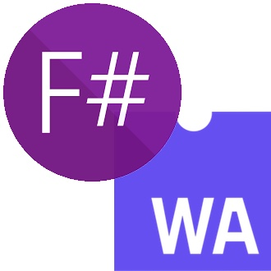
F# for the frontend (WASM) dotnet new -i Bolero.Templates dotnet new bolero-app dotnet run

Slide 10


F# for the full stack dotnet new -i SAFE.Template dotnet new SAFE dotnet tool restore dotnet fake run
=
+
This is the best thing. It powers real businesses including Norway’s NRK

Slide 11
A functional-first approach makes a huge difference in practice fsharp.org/testimonials

Slide 12

An analysis (Simon Cousins, Energy Sector)
350,000
lines of C# OO
by offshore team
30,000
lines of robust F#, with
parallel +more features
An application to evaluate the revenue due from Balancing Services contracts in the UK energy industry
http://simontcousins.azurewebsites.net/does-the-language-you-use-make-a-difference-revisited/

Slide 13


Slide 14
Simon Cousins, Energy Sector
Zero
bugs in deployed system
“F# is the safe choice for this project,
any other choice is too risky”
An application to evaluate the revenue due from Balancing Services contracts in the UK energy industry
http://simontcousins.azurewebsites.net/does-the-language-you-use-make-a-difference-revisited/

Slide 15

The Community at the Centre of the Technology fsharp.org

Slide 16
The F# Language Design Process github.com/fsharp/fslang-design github.com/fsharp/fslang-suggestions

Slide 17
F# 4.1 (2017)
✔ Optional large scope cycles
✔ Result<T,Error> in standard library
✔ Unboxed (struct) tuples
✔ Unboxed (struct) records
✔ Unboxed (struct) unions
✔ More bits and pieces
https://github.com/fsharp/fslang-design/tree/master/FSharp-4.1

Slide 18
F# 4.5 (2018)
✔ Span<T> high perf type-safe non-allocating code
✔ Improved async debugging
✔ Tooling updates
https://github.com/fsharp/fslang-design/tree/master/FSharp-4.5

Slide 19
F# 4.6 (2019)
✔ Anonymous records
✔ Tooling updates
https://github.com/fsharp/fslang-design/tree/master/FSharp-4.5

Slide 20
F# 4.7 (2019)
✔ Implicit yields
✔ /langversion
✔ indentation relaxations
https://github.com/fsharp/fslang-design/tree/master/FSharp-4.7

Slide 21
F# 5.0! (2021)
✔ #r nuget packages in scripts “#r "nuget: Newtonsoft.Json"
✔ Jupyter and .NET Interactive notebooks!
✔ string interpolation
✔ nameof
✔ applicatives syntax in computation expressions
✔ improved .NET interop
✔ improved Map/Set performance + more
https://github.com/fsharp/fslang-design/tree/master/FSharp-5.0

Slide 22
OK, I’m the language designer. I could tell you about the features.
But what code do I like and not like?

Slide 23
WARNING: Opinion!

Slide 24
Reminder:
The F# Advent Calendar
(started by F# users in Japan!)
English 2017, 2016, 2015
Japanese 2016, 2015, 2014, 2013, 2012, 2011, 2010

Slide 25
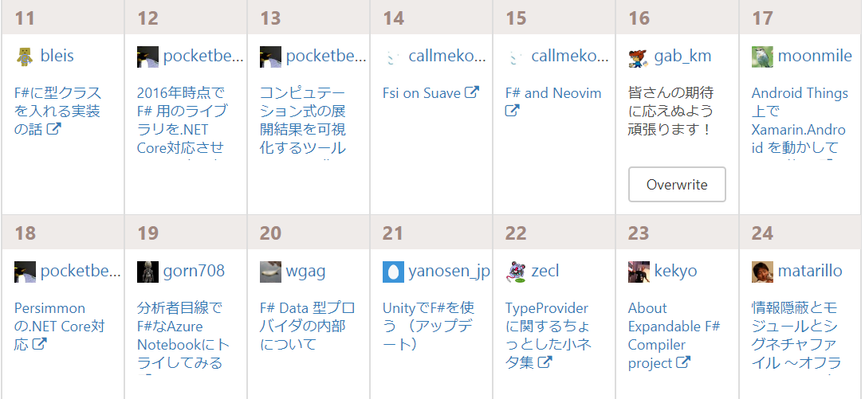
Reminder:
The F# Advent Calendar
(started by F# users in Japan!)
English 2017, 2016, 2015
Japanese 2016, 2015, 2014, 2013, 2012, 2011, 2010

Slide 26

Foundations of the F# Design (~2007)

Slide 27
From that, it’s fair to say that I love these :)
Code that is succinct
Code that is expressive
Code that interoperates
Code that is performant
Code that is accurate
Code that is well-tooled

Slide 28

Code I love!
printfn "hello world"
✓
✓
✓
✓
✓
✓

Slide 29
Code I love!
- pipelines
x |> f1
x |> f1 |> f2 |> f3 |> …..

Slide 30
Code I love!
- pipelines
let symbolUses =
symbolUses
|> Array.filter (fun symbolUse -> …)
|> Array.Parallel.map (fun symbolUse -> …)
|> Array.filter (fun … -> …)
|> Array.groupBy (fun … -> …)
|> Array.map (fun … ->….)

Slide 31
Code I love!
- pipelines
- domain modelling

Slide 32
Code I love!
- pipelines
- domain modelling
/// Represents a parsed expression
type Expr =
| True
| And of Expr * Expr
| Nand of Expr * Expr
| Or of Expr * Expr
| Xor of Expr * Expr
| Not of Expr
+ recursion, evaluation, normalization, analysis, visualization, …

Slide 33
Code I love!
- pipelines
- domain modelling
/// Represents information known about a value
type ExprValueInfo =
| UnknownValue
| ValValue of ValRef * ExprValueInfo
| TupleValue of ExprValueInfo[]
| RecdValue of TyconRef * ExprValueInfo[]
| UnionCaseValue of UnionCaseRef * ExprValueInfo[]
| ConstValue of Const * TType
| CurriedLambdaValue of Unique * Expr * TType

Slide 34

Code we love :)
- pipelines
- domain modelling
type Status =
| Online
| Unresponsive of string
| Missing of string
| NotChecked of string
| Ignored
https://lukemerrett.com/fsharp-domain-modelling/

Slide 35


Code we love :)
- pipelines
- domain modelling
https://medium.com/@odytrice
Ody Mbegbu
type Value = | Integer of int64 | String of string | Date of DateTime | Data of string | Bool of bool | Dict of list<string * Value> | Array of list<Value>

Slide 36


Code we love :)
- pipelines
- domain modelling
- domain semantics

Slide 37
Code I love :)
- data scripting + type providers
// Get the nuget stats schema
type NugetStats = HtmlProvider<"https://www.nuget.org/packages/FSharp.Data">
// Load the live package stats for FSharp.Data
let rawStats = NugetStats().Tables.``Version History``
// Group by minor version and calculate download count
let stats =
rawStats.Rows
|> Seq.groupBy (fun r -> getMinorVersion r.MinorVersion)
|> Seq.sortBy fst
|> Seq.map (fun (k, xs) -> k, xs |> Seq.sumBy (fun x -> x.Downloads))

Slide 38
Code I love :)
- model-view-update mobile UIs
- view functions!
A model-view-update mobile app
/// The view function giving updated content for the page
let view (model: Model) dispatch =
if model.Pressed then
Xaml.Label(text="I was pressed!")
else
Xaml.Button(text="Press Me!", command=(fun () -> dispatch Pressed))

Slide 39
Code I love :)
- model-view-update web UIs
- view functions!
A model-view-update web view
/// The view function giving updated content for the page
let view model dispatch =
match model.Text with
| [| |] ->
div [] [ div [] [str "Loading..."] ]
| _ ->
div [ ClassName "container" ] [
button [ OnClick (fun _ -> dispatch Faster) ] [ str "Faster" ]
div [ ClassName "theText" ] [ str model.Text.[model.Index] ]
button [ OnClick (fun _ -> dispatch Slower) ] [ str "Slower" ]
div [] [ str (sprintf "Ticks Per Update: %d" model.TicksPerUpdate) ]
]

Slide 40



Code we love :)
- composition

Slide 41
Code we love :)
- super-fast compositional
web servers
let logout : HttpHandler =
signOut AuthSchemes.cookie
>=> redirectTo false Urls.index
let webApp : HttpHandler =
choose [
GET >=>
choose [
route Urls.index >=> index
route Urls.login >=> login
route Urls.user >=> authenticate >=> user
route Urls.logout >=> logout
route Urls.googleAuth >=> googleAuth
]
notFound ]

Slide 42
But….
…not all Functional Code is Good Code…

Slide 43
curry, uncurry
nooo
curry String.Compare s1 s2
yes
String.Compare (s1, s2)
let curry f x y = f (x,y)
let uncurry f (x,y) = f x y
nooo
let ZipMap f a b =
Seq.zip a b
|> Seq.map (uncurry f)
Too indecipherable, too often
let ZipMap f a b =
Seq.zip a b
|> Seq.map (fun (x,y) -> f x y)
yes

Slide 44
<|
let testString = "Happy"
let amendedString =
testString
|> replace "H" "Cr"
|> joinWith <| "birthday"
nooo
let (<|) f x = f x
Please, never, ever use the <| operator in beginner code
let testString = "Happy"
let amendedString =
testString
|> replace "H" "Cr"
|> joinWith "birthday"
yes
Please, don’t ever put |> and <| on the same line :)

Slide 45
<||, <|||
nooo
let (<||) f x y = f x y
let (<|||) f x y z = f x y z
Please, always avoid the <|| and <||| operators. They should be deprecated

Slide 46
Point-free is not a virtue
nooo
“Point free” is code without explicit lambdas or let
Often heavy use of “>>”, “>>=“, “curry”, “uncurry”, partial application
Using and combining existing functions as values is OK
Please give explicit arguments to functions defined in modules
Please, avoid needless over-use of point-free code
let add10To x = x + 10
let doubleAndIncr x = x * 2 + 1
yes
“In rare cases there can even be point-free DSLs that are actually legible in the large. However the utility of adopting this approach always carries a big burden of proof, and should not be motivated merely out of stylistic considerations.” Eirik Tsarpalis

Slide 47
Fold considered harmful
Please, avoid needless use of fold in code if simpler alternatives are available
List/Seq/Array.sumBy
List/Seq/Array.maxBy
List/Seq/Array.choose
List/Seq/Array.tryPick
List/Seq/Array.mapFold
List/Seq/Array.reduce
….
“Data.fold” is a blunt instrument
Replace by something more simpler
Sometimes harder to understand than an imperative while loop
If you fold or mapFold, use ||>
✗
List.fold (fun state x -> new-state) state0 xs
v.
✓
(state0, xs) ||> List.fold (fun state x -> new-state)

Slide 48
Records can be bad
If your record types are not symmetric or representationally simple, then use a class
Each time we design a type, we design the external view of the type, and the internal representation.
A record is great when these are the same. Beware records when they are not.
Be prepared to make records private or convert records to classes. Can be painful.
✗
type Program =
{ initial : int
labelToNode : Map<int, string> ref
nodeToLabel : Map<string, int> ref
transitionCount : int ref
variables : Set<string> ref
... }
+ 10 files that hack on this data structure
✓
type Program (parameters) =
let mutable initial = -1
let mutable labelToNode = Map.empty
let mutable nodeToLabel = Map.empty
let mutable nodeCount = 1
let mutable transitionCount = 0
let mutable transitionsArray = …
let mutable activeTransitions = Set.empty
let mutable variables = Set.empty
...
v.

Slide 49
Objects Good, Objects Bad

Slide 50
F# - Objects + Functional
type Vector2D (dx:double, dy:double) =
let d2 = dx*dx+dy*dy
member v.DX = dx
member v.DY = dy
member v.Length = sqrt d2
member v.Scale(k) = Vector2D (dx*k, dy*k)
Inputs to object
construction
Object internals
Exported properties
Exported method

Slide 51
Objects
Constructed Class Types
type ObjectType(args) =
let internalValue = expr
let internalFunction args = expr
let mutable internalState = expr
member x.Prop1 = expr
member x.Meth2 args = expr
Object Expressions
{ new IObject with
member x.Prop1 = expr
member x.Meth1 args = expr }
{ new Object() with
member x.Prop1 = expr
interface IObject with
member x.Meth1 args = expr
interface IWidget with
member x.Meth1 args = expr }
Object Interface Types
type IObject =
interface ISimpleObject
abstract Prop1 : type
abstract Meth2 : type -> type

Slide 52
Code I love:
Functional computation of encapsulated tables and summaries
Information in
An early example (FsLexYacc):
/// Gives an index to each LR(0) kernel
type KernelTable(kernels) =
let kernelsAndIdxs = List.indexed kernels
let kernelIdxs = List.map fst kernelsAndIdxs
let toIdxMap = Map.ofList [ for i,x in kernelsAndIdxs -> x,i ]
let ofIdxMap = Array.ofList kernels
member _.Indexes = kernelIdxs
member _.Index(kernel) = toIdxMap.[kernel]
member _.Kernel(i) = ofIdxMap.[i]
Encapsualted
computation
Information out

Slide 53
Deconstructing Object Programming

Slide 54
20+ features of OO
dot notation (x.Length)
instance members
type-directed name resolution
implicit constructors
static members
indexer notation arr.[x]
named arguments
optional arguments
interface types
mutable data
defining events
defining operators on types
auto properties
IDisposable, IEnumerable
type extensions
structs
delegates
enums
implementation inheritance
nulls and Unchecked.defaultof<_>
method overloading
curried method overloads
protected members
self types
wildcard types
aspect oriented programming …
…
???

Slide 55
Some make F# a better API language
Some make F# a better implementation language
Some are part of an interop standard
Some are not needed

Slide 56
Where do we stand?
Embrace
dot notation (x.Length)
instance members
type-directed name resolution
implicit constructors
static members
indexer notation arr.[x]
named arguments
optional arguments
interface types and implementations
mutable data
operators on types
auto properties
IDisposable, IEnumerable
type extensions
events
structs
delegates
enums
type casting
large type hierarchies
implementation inheritance
nulls and Unchecked.defaultof<_>
pervasive method overloading
curried method overloads
protected members
self types
wildcard types
aspect oriented programming …
…
Down the object rabbit hole
Use where necessary, use tastefully, use respectfully, use sparingly
Not supported

Slide 57
The 20+ features of OO
Love
dot notation (x.Length)
instance members
type-directed name resolution
implicit constructors
static members
indexer notation arr.[x]
named arguments
optional arguments
interface types and implementations
mutable data
operators on types
auto properties
IDisposable, IEnumerable
type extensions
events
structs
delegates
enums
type casting
large type hierarchies
implementation inheritance
nulls and Unchecked.defaultof<_>
pervasive method overloading
curried method overloads
protected members
self types
wildcard types
aspect oriented programming …
…
Mostly Avoid
Tolerate
Forget

Slide 58
Object Programming v.
Object-Oriented Programming

Slide 59
Object Programming focuses on … succinct coding, notational convenience
API ergonomics good naming practical encapsulation sensible, small, composable abstractions expression-oriented making simple things out of (potentially complex) foundations works well with expression-oriented programming

Slide 60
In the extreme Object-Oriented Programming can be… objects as a single paradigm hierarchical classification (Animal, Cat, Dog, AbstractJellyBeanFactoryDelegator) large abstractions with many holes and failure points declarations not expressions composition through… more hierarchies

Slide 61
The F# approach is to embrace object programming, make it fit with the expression-oriented typed functional paradigm but not embrace full “object-orientation” (unless you happen to be in a project using that technique)

Slide 62
Code I love: computation expressions

Slide 63
seq { … }
[ … ]
[| … |] async { … } option { … } task { … } taskSeq { … } asyncOption { … }
….
“extensible, intuitive, friendly monadic notation on steroids”

Slide 64
seq { … }, [ … ], [| … |]
✗
let rec allSymbolsInEntities compGen (entities: FSharpEntitylist) =
List.concat [
entities;
(e.GenericParameters
|> List.filter (fun gp -> compGen || not gp.IsCompilerGenerated));
(e.MembersFunctionsAndValues
|> List.filter (fun x -> compGen || not x.IsCompilerGenerated)
|> List.collect (fun x ->
List.cons x
(x.GenericParameters
|> List.filter (fun gp -> compGen || not gp.IsCompilerGenerated))));
e.UnionCases;
(x.UnionCaseFields
|> List.filter (fun f -> compGen || not x.IsCompilerGenerated));
(x.Fields
|> List.filter (fun f -> compGen || not x.IsCompilerGenerated));
allSymbolsInEntities compGen e.NestedEntities ]
let rec allSymbolsInEntities compGen (entities: FSharpEntitylist) =
[ yield! entities
for gp in e.GenericParameters do
if compGen || not gp.IsCompilerGenerated then
yield gp
for x in e.MembersFunctionsAndValues do
if compGen || not x.IsCompilerGenerated then
yield x
for gp in x.GenericParameters do
if compGen || not gp.IsCompilerGenerated then
yield gp
yield! e.UnionCases
for f in x.UnionCaseFields do
if compGen || not f.IsCompilerGenerated then
yield f
for x in e.FSharpFields do
if compGen || not x.IsCompilerGenerated then
yield x
yield! allSymbolsInEntities compGen e.NestedEntities ]
Many examples, almost every page of code
Alternative is explicit append etc
Typically much more expressive than other comprehension notations
✓
v.

Slide 65

async { … }
One example:
v.

Slide 66
asyncSeq { … }
let withTime =
asyncSeq {
do! Async.Sleep 1000 // non-blocking sleep
yield 1
do! Async.Sleep 1000 // non-blocking sleep
yield 2
}
It’s a library
No inversion of control, you think in a “forward” way
let intervalMs (periodMs:int) =
asyncSeq {
yield DateTime.UtcNow
while true do
do! Async.Sleep periodMs
yield DateTime.UtcNow
}
v.
https://fsprojects.github.io/FSharp.Control.AsyncSeq/

Slide 67
I love…
Please, implement .ToString() and DebuggerDisplay to aid debugging
Code that can be debugged
Code that is commented
Code that is tested
Code that is performant
Code that is under CI
Code that is readable
Please, use good variable names
Please, use good method names and seek good stack traces
Please, comment your code well

Slide 68
What’s coming in F# 5.1/6.0…?
high-perf computation expressions
tasks
anonymous unions
inline-if-lambda
additional type-directed conversions for better interop

Slide 69
In Closing

Slide 70
F# Emphasises Clear Code to Solve Real-world Problems
Simple, clear code is the F# Code I Love
Object Programming
<>
Object-Oriented Programming
Not all Functional Code is Good Code

Slide 71
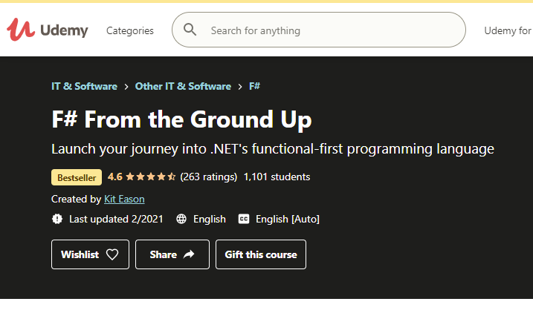

Thanks! Questions?

