Slide 1
Finite state machine (or finite-state automaton)
A FSM is a computation model that can be implemented with hardware or software and can be used to simulate sequential logic and some computer programs. Finite state automata generate regular languages. Finite state machines can be used to model problems in many fields including mathematics, artificial intelligence, games, and linguistics.

Slide 2
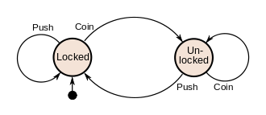

Slide 3
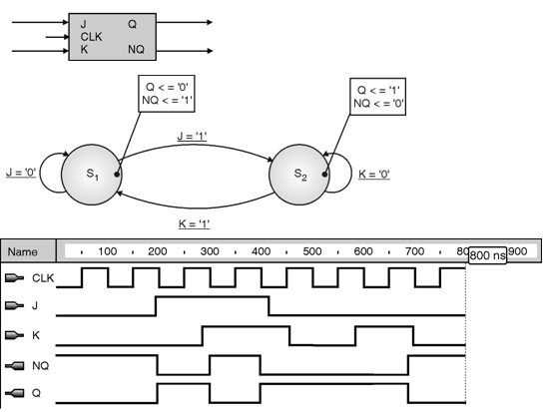

Slide 4

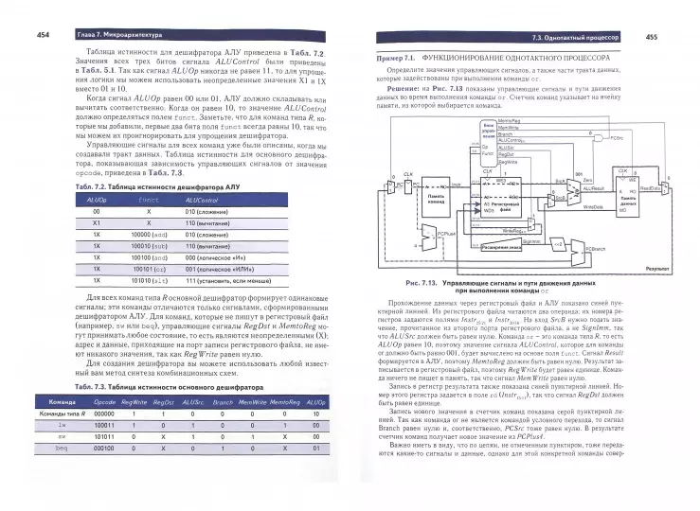
Рекламная интеграция

Slide 5
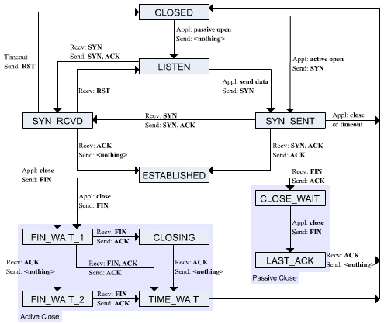
TCP

Slide 6
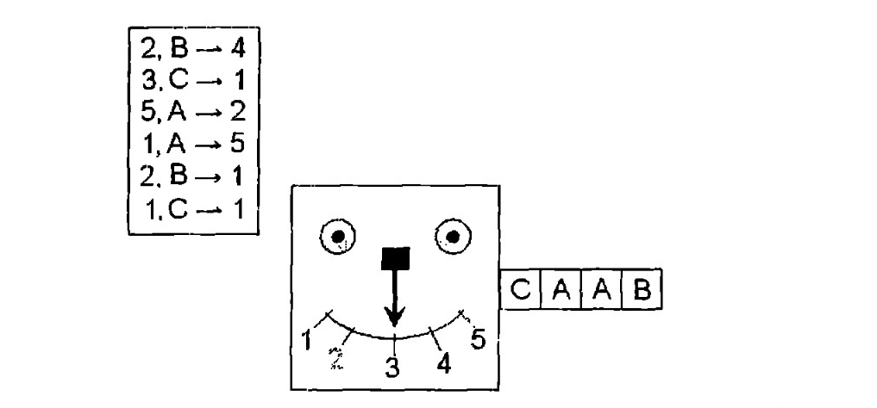
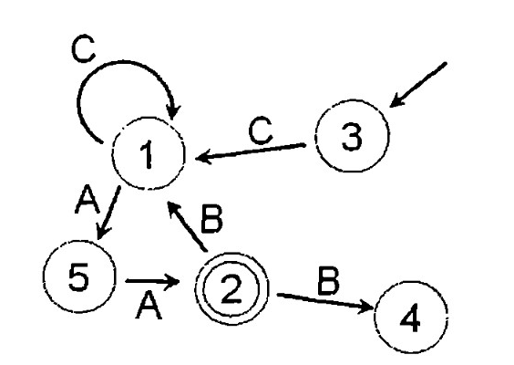

Slide 7
Formal definition of the Deterministic Finite Automata
A deterministic finite automaton (DFA) is described by a five-element tuple: (Q, Σ, δ, q0, F)
Q = a finite set of states
Σ = a finite, nonempty input alphabet
δ = a series of transition functions
q0​ = the starting state
F = the set of accepting states
There must be exactly one transition function for every input symbol
in Σ from each state.

Slide 9
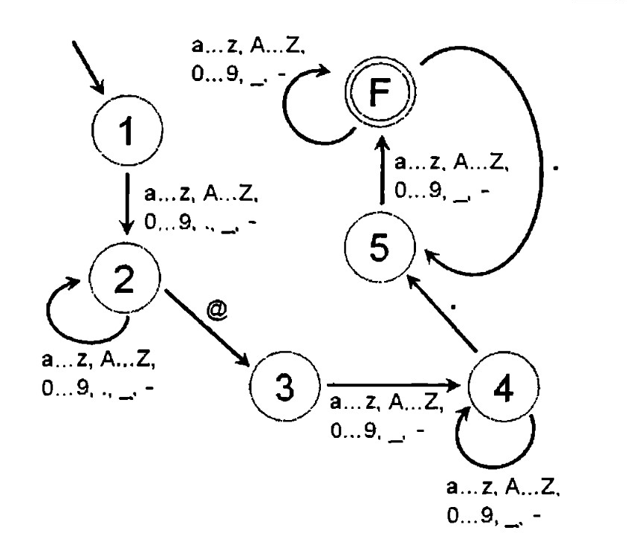



Slide 10
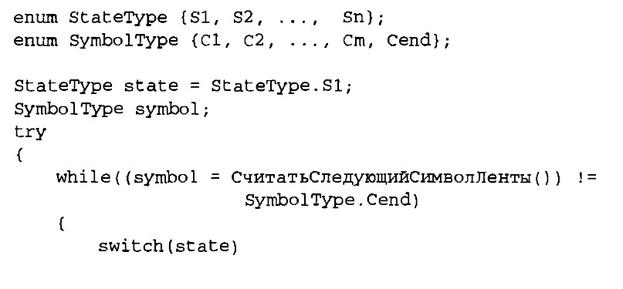
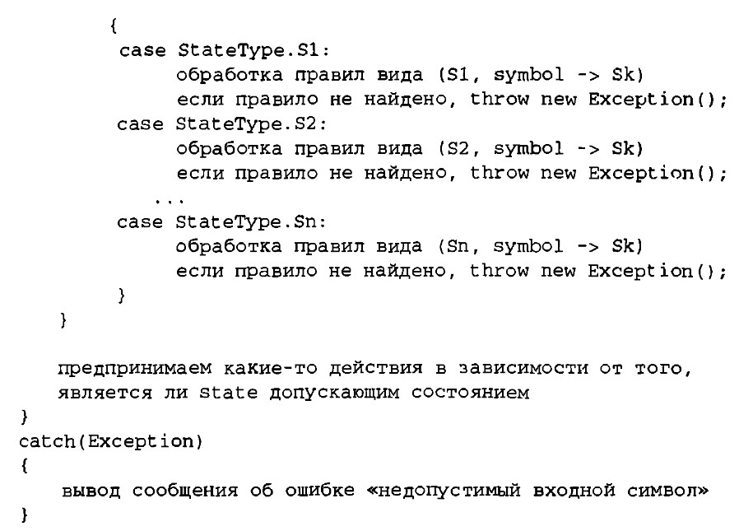

Slide 11
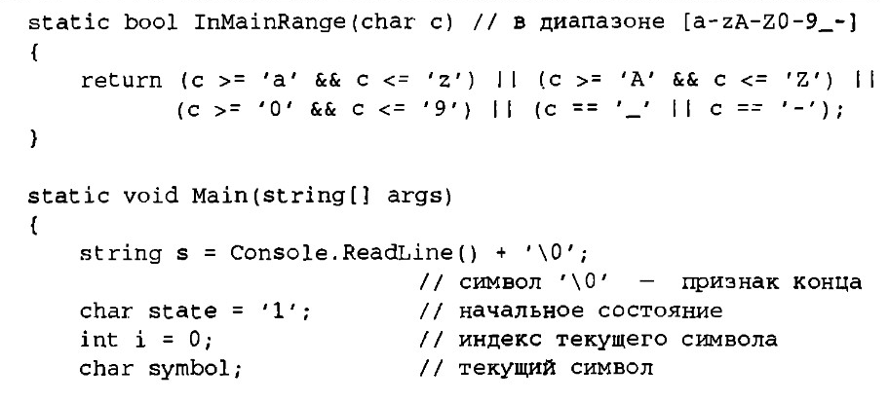
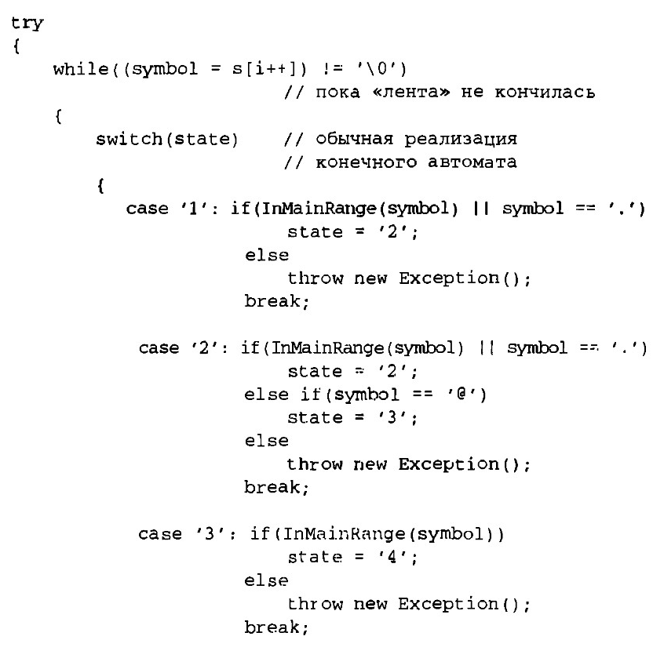

Slide 12
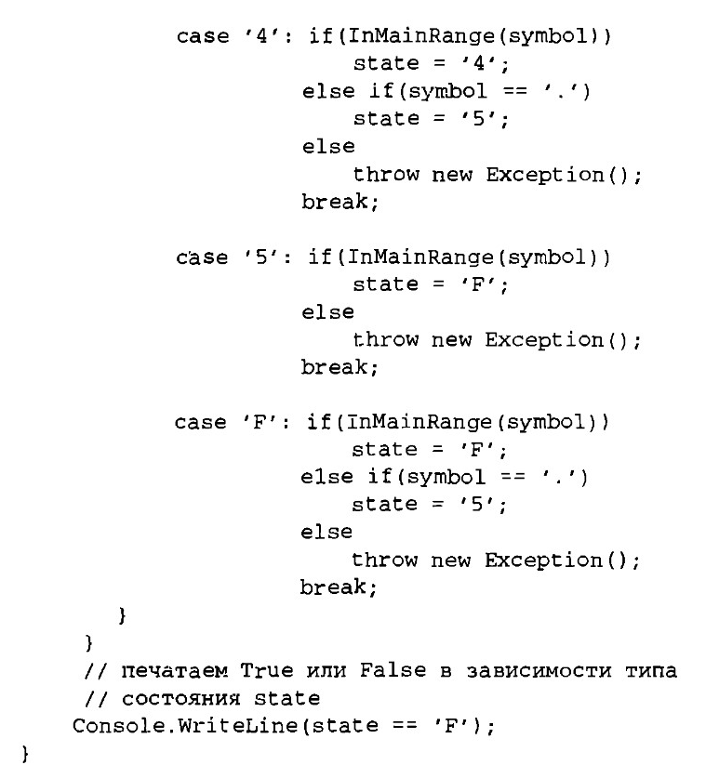
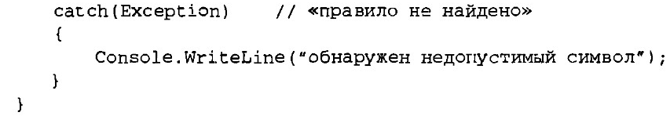

Slide 13
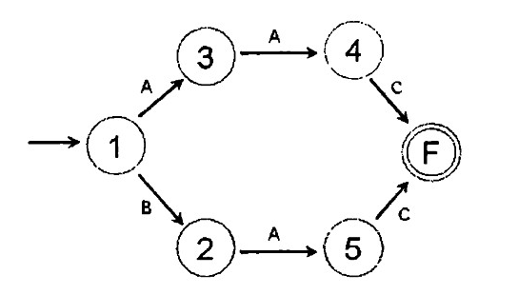
Эквивалентность состояний

Slide 14
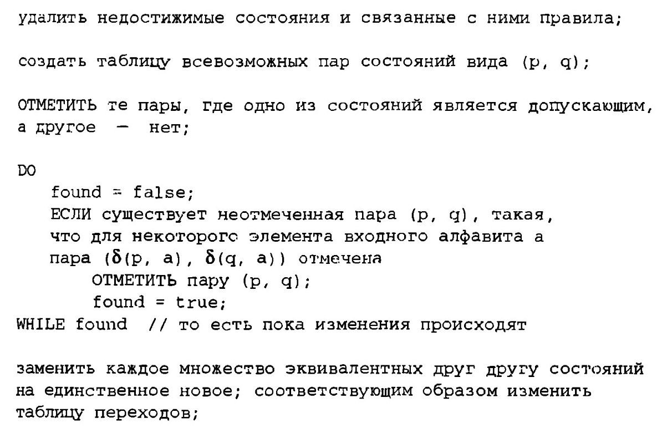
Минимизация автомата

Slide 15
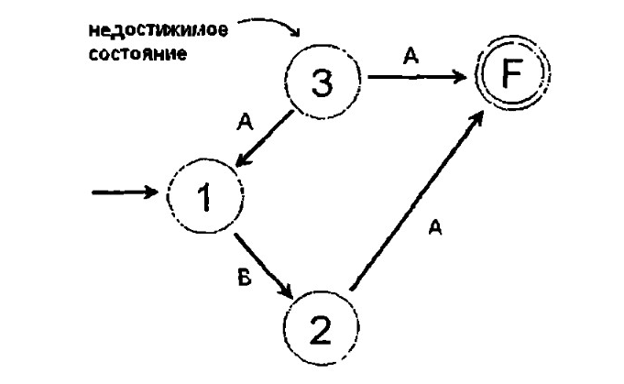

Slide 16
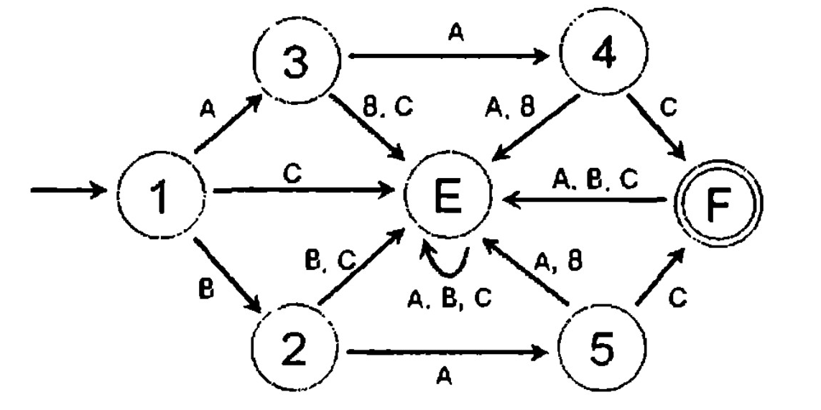

Slide 17
Минимизация автомата

Slide 18
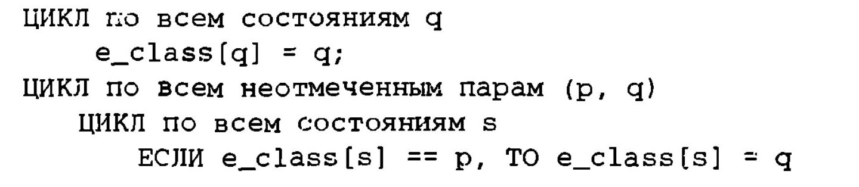

Slide 19
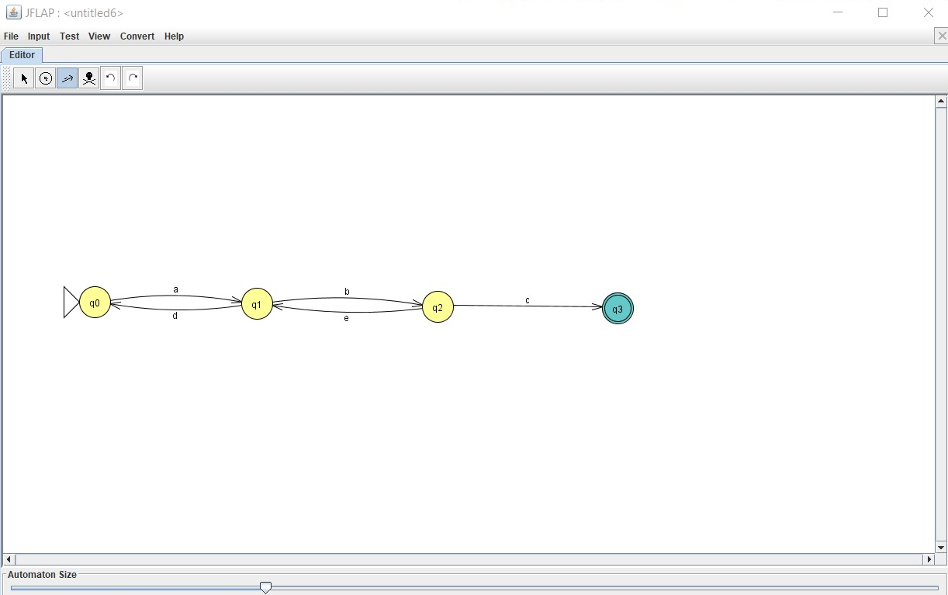

Slide 20
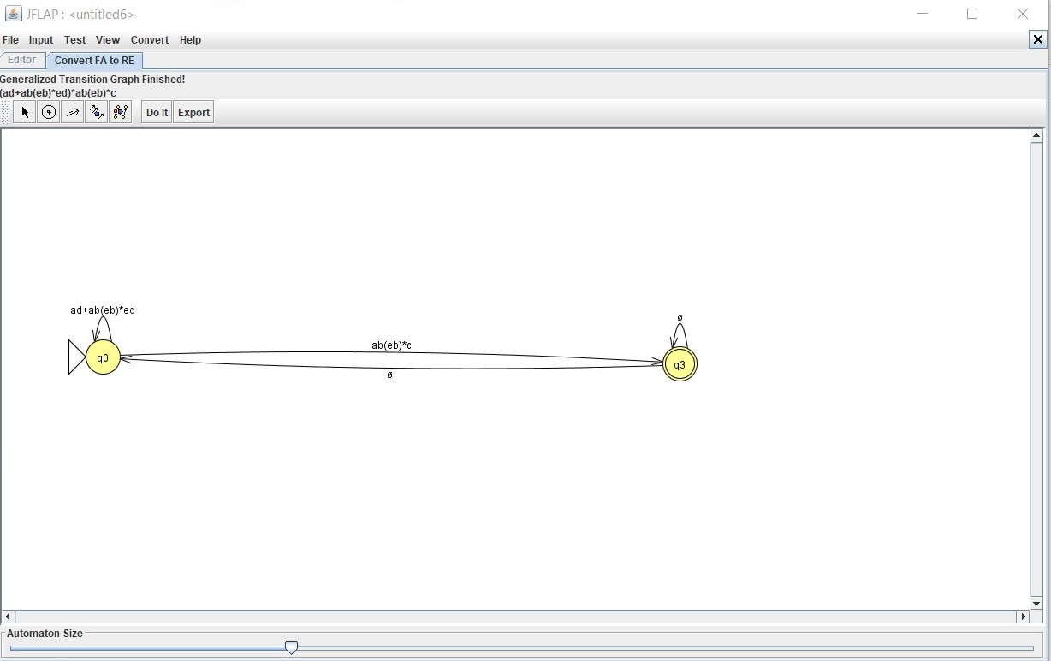
(ad+ab(eb)*ed)*ab(eb)*c

