Slide 1


CITN·AI
CHURCH IT NETWORK · WORKSHOP
AI Context Engineering
NORTHWOODS CHURCH
PEORIA, IL
Notes:
Welcome them in. Big energy. 'AI Context Engineering — that's a long title for what's actually a really practical workshop. Over the next 90 minutes we're going to get hands-on with what makes AI useful at your church versus useless at your church.'

Slide 2
PART 02 / 06
Vibe Coding vs
Context
Engineering
They are not the same!
Notes:
Section opener. Pause. Breathe. 'Most of what looks like bad AI output is actually a context problem on our end.'

Slide 3
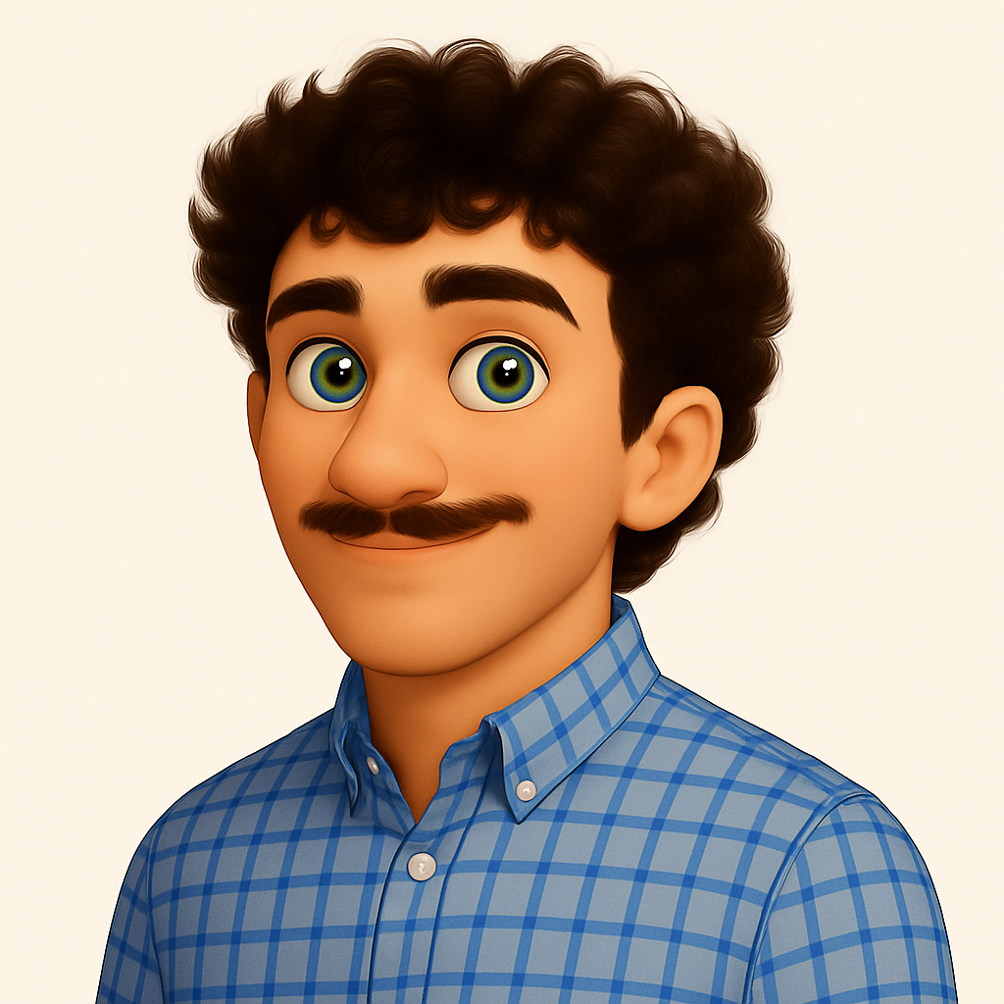
SPEAKER
Tripp Lisenby
AI Developer – ACS Technologies
Notes:
Brief intro — keep it under 60 seconds. 'I ship AI products for a living and I've been in the church tech world a while. Most of what I'm sharing today is what I wish someone had told me two years ago.'

Slide 4
PRESENTED BY · TRIPP LISENBY
10 MIN
A PERSONAL JOURNEY
Vibe Coder → Context Engineer
How I stopped one-shotting and started thinking.
// 6 STAGES · 1 SHIFT
Notes:
Alright — quick 10 minutes from me before Chris takes you into the real workshop. I want to tell you a story, because I think a lot of you are somewhere on the same path I was on. The title says it all: I started as a vibe coder, and I had to become a context engineer. Six stages, one shift. Let's go.

Slide 5
VIBE → CONTEXT
01
01 / 06
STAGE 01
The Spark.
ChatGPT had just dropped. I started one-shotting prompts to get through my classes.
NO STAKES · PURE CURIOSITY
Notes:
Stage one — the spark. ChatGPT had just dropped, and like a lot of you I was in school at the time. I wasn't building products. I was just one-shotting prompts to get through assignments. No stakes, pure curiosity. That's where it started for me, and honestly that's where it starts for almost everyone — you type something, something useful comes back, and you go 'huh, that's interesting.'

Slide 6
VIBE → CONTEXT
02
02 / 06
STAGE 02
The Hook.
Then I found Bolt. Then Replit . A short prompt, and out came a whole app.
FELT LIKE A SUPERPOWER
Notes:
Stage two — the hook. Then I found Bolt. Then Replit. And this is where it stopped being a toy. I'd type a sentence — 'build me a habit tracker' — and out came a whole app. Frontend, backend, database. It felt like a superpower. And for a while, I genuinely thought I had figured something out that other people hadn't. That's the hook.

Slide 7
VIBE → CONTEXT
03
03 / 06
STAGE 03
The Cracks.
The demos looked great. They almost never held up.
INCONSISTENT
FRAGILE
NOWHERE NEAR PRODUCTION
// HIDDEN COST: DEBT I COULDN'T SEE
Notes:
Stage three — the cracks. Here's where it got humbling. The demos looked great in the moment. They almost never held up. Inconsistent. Fragile. Nowhere near production. I'd show something off on Monday and by Wednesday it was broken in three different places. And the worst part — I couldn't see the debt I was building. The model was writing code I couldn't read, in patterns I couldn't evaluate. It looked like progress. It wasn't.

Slide 8
VIBE → CONTEXT
04
04 / 06
STAGE 04
Bigger prompts ≠ better code.
I learned "context is king," so I wrote paragraphs instead of sentences. Still one-shotting. Change one thing — the whole thing fell apart. Hours of hot-fixes.
MORE WORDS · SAME PROBLEM
Notes:
Stage four — and this is the one I want you to hear, because I bet some of you are right here. I learned the phrase 'context is king.' So I figured, okay, more context, better output. I started writing paragraphs instead of sentences. Huge prompts. And I was still one-shotting. I'd change one tiny thing and the whole thing would fall apart. I'd spend hours hot-fixing what the model had built. Bigger prompts did not equal better code. More words, same problem.

Slide 9
VIBE → CONTEXT
05
05 / 06
STAGE 05 · THE SHIFT
Planning > Prompting.
I started spending more time thinking before asking. Output got 10× better. I still couldn't read code — but I could find what works before building it.
THE SHIFT
Notes:
Stage five — this is the shift. I stopped trying to write the perfect prompt and started spending my time thinking before I asked. Planning over prompting. And the output got about ten times better — overnight. Here's the wild part: I still couldn't really read code. But I could find what works before I started building. I could pressure-test the idea on paper. The leverage moved from the prompt to the plan.

Slide 10
VIBE → CONTEXT
06
06 / 06
STAGE 06
The Engineer Era.
Now I build from a base repository . Same apps — but stronger every time. Not a different prompt every time. A system.
REPEATABLE
CONSISTENT
PRODUCTION-SHAPED
Notes:
Stage six — the engineer era. This is where I am today. I don't start from a blank prompt anymore. I start from a base repository. A foundation I trust. Same kinds of apps I was building two years ago — but stronger, every single time. It's not a different prompt every time. It's a system. Repeatable, consistent, production-shaped from day one.

Slide 11
THE CONTRAST
VIBE → CONTEXT
SIDE BY SIDE
Vibe Coder vs. Context Engineer.
BEFORE
NOW
Vibe Coder
Context Engineer
Prompt and pray
One-shot every time
Hours of hot-fixes
Looks great, breaks fast
Different bug every run
Hidden technical debt
Plan, then build
Base repo as a foundation
Hours of thinking up front
Production-shaped from day one
Repeatable, consistent
Debt visible and managed
Notes:
So if I had to put it on a single slide — this is the contrast. On the left, the vibe coder I was. Prompt and pray. One-shot every time. Hours of hot-fixes. Looks great, breaks fast. Hidden technical debt I couldn't even see. On the right, the context engineer I had to become. Plan, then build. Base repo as a foundation. Hours of thinking up front instead of hot-fixes after. Production-shaped from day one. Repeatable. Consistent. The work moved — from after the prompt, to before it.

Slide 12
THE TAKEAWAY
END · OPENING
"
The leverage isn't in the prompt . It's in the thinking before it.
— TRIPP LISENBY · ACS TECHNOLOGIES
Notes:
Here's the takeaway, and then I'll hand it to Chris. The leverage is not in the prompt. It's in the thinking before it. That's the whole shift. And that's what the next 75 minutes are about — Chris is going to walk you through how to actually do that thinking. The four pillars, the anatomy, the practical exercises. Over to you, Chris.

Slide 13
PART 02 / 06
Vibe Coding vs
Context
Engineering
They are not the same!
Notes:
Section opener. Pause. Breathe. 'Most of what looks like bad AI output is actually a context problem on our end.'

Slide 14
VIBE → CONTEXT
10
06 / 06
STAGE 06
Brownfield Work
VIBE coding dies a quick death on the vine when you need to work on existing code or legacy solutions. You need the EXPLORE steps of context engineering.
EXPLORE
DOCUMENT
WORK
Notes:
Stage six — the engineer era. This is where I am today. I don't start from a blank prompt anymore. I start from a base repository. A foundation I trust. Same kinds of apps I was building two years ago — but stronger, every single time. It's not a different prompt every time. It's a system. Repeatable, consistent, production-shaped from day one.

Slide 15
THE SHIFT
From prompt engineering to context engineering.
THEN
NOW
Prompt Engineering
Context Engineering
Find the right magic words to coax a single response out of a model.
→
Design everything the model sees — instructions, knowledge, tools, memory — before it answers.
Notes:
Set up the central pivot of the workshop. 'Prompt engineering was about magic words. Context engineering is about the whole environment. That's the shift.'

Slide 16
“
Context engineering is the discipline of giving a model everything it needs — and nothing it doesn't — to do the job in front of it.
— WORKING DEFINITION
Notes:
Read the definition slowly, twice. Let it land. This is the one sentence you want them to take home.

Slide 17
LIVE DEMO
Same task.
Two ways.
First without context. Then with.

Slide 18
DEMO · TAKE 1
// THE PROMPT
Vibe coding.
Add a login page to the app.
Type what comes to mind. Hit send. See what the model guesses.

Slide 19
DEMO · TAKE 2
// THE PROMPT
Context engineering.
Implement the login page per docs/requirements/login.md, following the auth conventions in CLAUDE.md. Stop and ask if anything is ambiguous before writing code.
Same feature. Now the model can see what we actually want before it writes a line.
CLAUDE.md attached.
Requirements doc attached.
Auth conventions documented.

Slide 20
CONTEXT · ARTIFACT 01
// CLAUDE.md (excerpt)
CLAUDE.md
# Project: Church Member Portal
Stack: Next.js 16, TypeScript, Drizzle, BetterAuth.
## Auth conventions
- BetterAuth credentials provider.
- Authed pages live under app/(secure)/.
- Server components only — no client-side session fetching.
## Style
- Tailwind. No inline styles.
- One feature per folder under app/.
Project conventions written down once. Read by the model on every session.

Slide 21
CONTEXT · ARTIFACT 02
// docs/requirements/login.md
Requirements doc.
# Login page
## Goal
Returning members sign in with email + password.
## Fields
- email (required, valid format)
- password (required, ≥ 8 chars)
## Behavior
- On submit: POST to /api/auth/signin
- On success: redirect to /dashboard
- On failure: inline error, do not clear email
## Out of scope
- Password reset, OAuth, MFA
What we want, before we ask for code. Living doc, lives next to the feature.
User outcome, plainly stated.
Fields, validation, errors.
What success looks like.

Slide 22
LESSON
If you can’t understand what to do – neither can the LLM

Slide 23
7 CRITERIA · 1–4
Anatomy of a well-engineered prompt.
Every prompt that lands has all seven. Every prompt that flops is missing at least one. (5–7 on the next slide.)
01 / SPECIFICITY
02 / GOAL · PURPOSE
03 / CONSTRAINTS
04 / SUCCESS CRITERIA
Exactly what.
Why we need it.
Limits stated.
Done = ?
Replace vague verbs with concrete ones. "Add a page" → "Add a /login route that posts to /api/auth/signin and redirects to /dashboard on success."
State the user outcome and the problem it solves. Let’s the model make trade-offs in your favor when it has to choose.
Length, format, tone, do's and don'ts. Boundaries beat preferences — the model respects rules more than vibes.
Describe the output that makes you say "that's exactly it." Without this, the model and you mean different things by "done."
Test: Could two engineers build different things from this and both be "right"? If yes, you're not specific yet.
Test: Could you write a one-line acceptance check? If not, the model can't either.
Test: If the model had to drop one feature, would it know which one matters least? Only if you said why.
Test: Did you say what NOT to do? "Don't introduce new dependencies" prevents three categories of regret.

Slide 24
7 CRITERIA · 5–7
Anatomy, continued.
Three more criteria. Every prompt that lands has all seven. (1–4 on the previous slide.)
05 / EXAMPLES & FORMAT
06 / AUDIENCE · PERSONA
07 / SCOPE
Show, don't tell.
Voice locked.
Boxed in.
Show what good looks like. A short before/after, a sample shape, an existing file to mirror. Examples beat adjectives every time.
Who reads it, who writes it. "Write like our internal devs talking to each other" yields wildly different output than the same prompt without that line.
Where the task starts and stops. Without a scope, the model expands. "Just the login route" prevents drift into signup, password-reset, and a refactor you didn't ask for.
Test: Did you give one concrete example or file the model can mirror? Adjectives are not examples.
Test: If you stripped the audience line, would the tone still be right? If yes, it isn't doing work.
Test: Did you say where the task ends? Without it, the model will keep going.

Slide 25
SAME GOAL · DIFFERENT OUTPUT
Bad prompt. Good prompt.
✕
VAGUE
✓
ENGINEERED
Write a thank-you email to volunteers from last weekend.
You're our comms editor (warm, plainspoken).
Draft a 90-word thank-you email to the 14 first-time hospitality volunteers from Easter weekend.
Reference the espresso bar mishap kindly. End with one sentence inviting them to the May 12 huddle.
No exclamation points.
Model has to guess who, what they did, your voice, and the length. You'll edit for 20 minutes.
Same model. Same minute. Vastly better first draft.
Notes:
Read the bad prompt out loud. Then the good. Same minute. Same model. 'The good one took me 90 seconds longer. It saved me 20 minutes of editing. Every time.'

Slide 26
WHAT GOOD LOOKS LIKE
Four characteristics of well-engineered context.
If your context has all four, you're not vibe coding anymore — you're engineering.
01 / REPRODUCIBLE
02 / AUDITABLE
03 / TEACHABLE
04 / IMPROVABLE
Same in, same out.
You can trace it.
Show, don't channel.
Diff it like code.
Two teammates running the same prompt against the same context get comparable results. No private incantations.
Every claim in the output maps to a specific source in the context. You know what the model knew when it answered.
A new teammate reads the CLAUDE.md, the requirements doc, and the prompt — and runs the same workflow on Tuesday morning.
When the output misses, you fix the context — and the next run is permanently better. Errors compound into improvements.
Why it matters: the moment a workflow depends on "the way Tripp asks," it's not a workflow.
Why it matters: this is what makes the skill compound, not the model.
Why it matters: when something goes wrong, you debug the context — not the model.
Why it matters: context that lives only in your head doesn't survive a vacation.

Slide 27
SCOPE NOTE · WHAT WE WON'T COVER
This is a Jumpstart, not the tour.
Claude Code and Cowork ship new capabilities every week. We're laying the foundation — not touring every advanced feature. Some we may graze. Most we won't.
01 / SUBAGENTS & HOOKS
02 / MCPs & CONNECTORS
03 / CUSTOM SKILLS
04 / PLUGINS & AGENT SDK
Skim only.
We may graze.
We may graze.
Not today.
Spawning specialized subagents in parallel. Wiring hooks that fire on tool calls. Powerful — but a rabbit hole that eats a workshop.
Plugging Claude into Slack, Asana, your church database, your CMS. Useful, expanding fast — but the registry shifts week to week.
Authoring your own SKILL.md files so Claude reaches for them automatically. We'll point at the door — we won't build one from scratch on stage.
Building plugin marketplaces. Shipping autonomous agents on the Agent SDK. Real territory — but a different workshop, on a different day.
Why later: get fluent with one agent before you orchestrate ten.
Why later: today's hot connector is next month's footnote. Foundations first.
Why later: write a CLAUDE.md you trust before you write a skill.
Why later: ship one feature with one Claude before you ship a fleet of them.

Slide 28
DON'T LEAVE WITHOUT ONE
Everyone needs an AI Buddy.
You're surrounded by people doing the same thing. Use the time. Don't leave this event without your very own AI Buddy.
BE AN AI PAUL · THE MENTOR
BE AN AI TIMOTHY · THE APPRENTICE
Pour it forward.
Learn forward.
Find someone earlier in the journey and pour into them. Show them your CLAUDE.md. Walk them through a real failure. Your reps become their lift-off.
Find someone two months ahead of you and shadow them. Ask the dumb question. Steal their CLAUDE.md. Their fixes save you twenty hours.
"...entrust to faithful people who will be able to teach others also." — 2 Tim 2:2
"What you have heard from me... entrust..." — every Timothy needs a Paul.
You can be — and need to be — both.

Slide 29
BIG PICTURE
What > How
This has always been true, but context engineering opens the door for those who know what to actually
achieve the how, but there is no free lunch!

Slide 30
UP NEXT · PART 03 / 06
SDLC
Crash Course.
We named the difference. Now we put it in a process you can ship from.

