Slide 1
A UAV Traffic Scheduling and Routing Framework Based on Maximum Entropy Principle

Slide 2



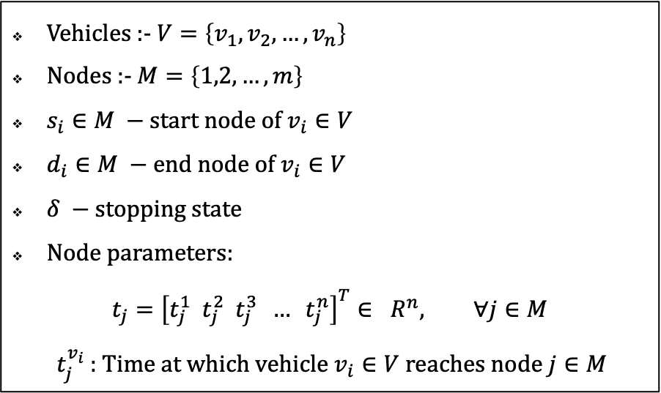



A Preliminary Model
$$v_{1}$$
1
Vehicles :- $V=\left\{v_{1},v_{2},…, v_{n}\right\}$
Nodes :- $M=\left\{1,2,…, m\right\}$
$s_{i}∈M −$ start node of $v_{i}∈V$
$d_{i}∈M −$ end node of $v_{i}∈V$
$δ −$stopping state
Node parameters:
$$t_{j}={\left[t_{j}^{1} { t}_{j}^{2} t_{j}^{3} … t_{j}^{n}\right]}^{T}∈ R^{n}, ∀j∈M$$
$t_{j}^{v_{i}}$ : Time at which vehicle $v_{i}∈V$ reaches node $j∈M$
$v_{3}$
$v_{2}$
2
4
3
$v_{2}$
5
6
7
$v_{3}$
$$\left[\begin{matrix}t_{3}^{v_{1}} \\ t_{3}^{v_{2}} \\ t_{3}^{v_{3}}\end{matrix} \right]$$
8
9
$$v_{1}$$

Slide 3

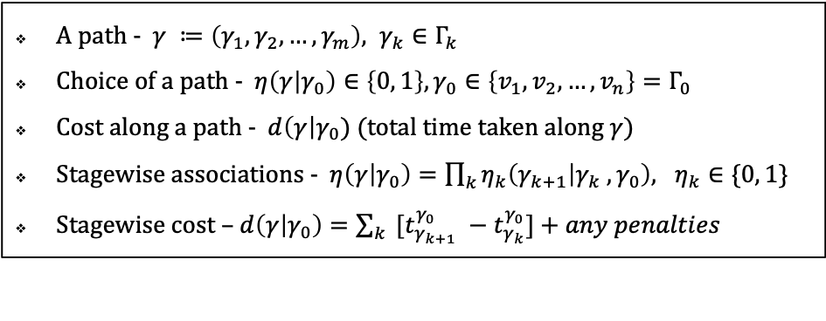




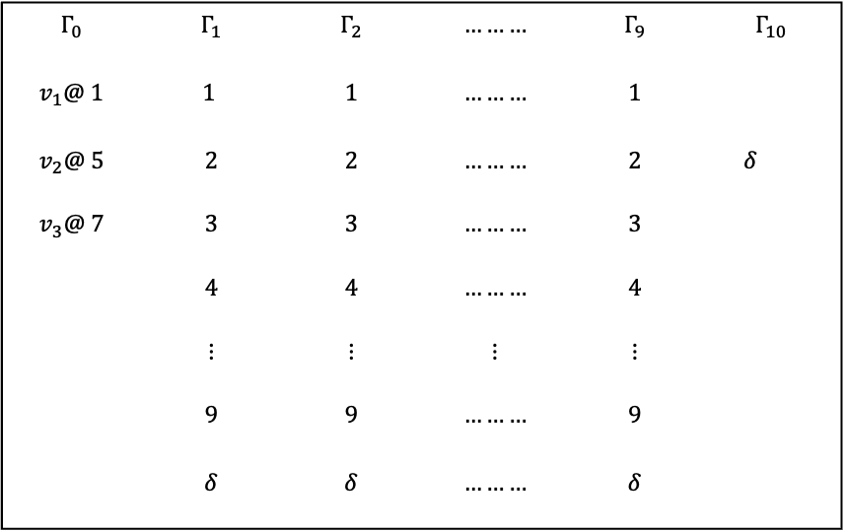

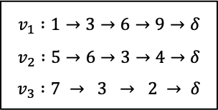













Vehicle Transitions in a Stagewise Manner
$$Γ_{0}$$ | $$Γ_{1}$$ | $$Γ_{2}$$ | $$………$$ | $$Γ_{9}$$ | $$Γ_{10}$$
$$v_{1}@ 1$$ | $$1$$ | $$1$$ | $$………$$ | $$1$$
$$v_{2}@ 5$$ | $$2$$ | $$2$$ | $$………$$ | $$2$$ | $δ$
$$v_{3}@ 7$$ | $$3$$ | $$3$$ | $$………$$ | $$3$$
 | $$4$$ | $$4$$ | $$………$$ | $$4$$
 | $$⋮$$ | $$⋮$$ | $$⋮$$ | $$⋮$$
 | $$9$$ | $$9$$ | $$………$$ | $$9$$
 | $$δ$$ | $$δ$$ | $$………$$ | $$δ$$
$v_{1}$
$$δ$$
1
$v_{3}$
$v_{2}$
$$δ$$
2
4
3
$$v_{1} :1→3→6→9→δ$$
$$v_{2} :5→6→3→4→δ$$
$$v_{3} :7 → 3 → 2 → δ$$
$$γ_{1}=1$$
$$γ_{2}=3$$
$$γ_{3}=6$$
$$γ_{9}=δ$$
$v_{2}$
5
6
$$v_{1}$$
$$δ$$
$$t_{1}^{v_{1}}$$
$$t_{3}^{v_{1}}$$
$$t_{6}^{v_{1}}$$
$$………$$
$$t_{9}^{v_{1}}$$
7
$v_{3}$
A path - $γ ≔\left(γ_{1}, γ_{2}, …, γ_{m}\right), γ_{k}∈Γ_{k}$
Choice of a path - $η\left(γ | γ_{0}\right)∈\left\{0, 1\right\}, γ_{0}∈\left\{v_{1}, v_{2}, …, v_{n}\right\}=Γ_{0}$
Cost along a path - $d\left(γ\right|γ_{0})$(total time taken along $γ$)
Stagewise associations - $η\left(γ | γ_{0}\right)=\prod_{k}{η_{k}\left(γ_{k+1} | γ_{k} , γ_{0}\right), η_{k}∈\{0, 1\}}$
Stagewise cost – $d\left(γ | γ_{0}\right)=\sum_{k}{ [t_{γ_{k+1}}^{γ_{0}} −t_{γ_{k}}^{γ_{0}}}]+any penalties$
8
9
$v_{1}$
$$δ$$

Slide 4
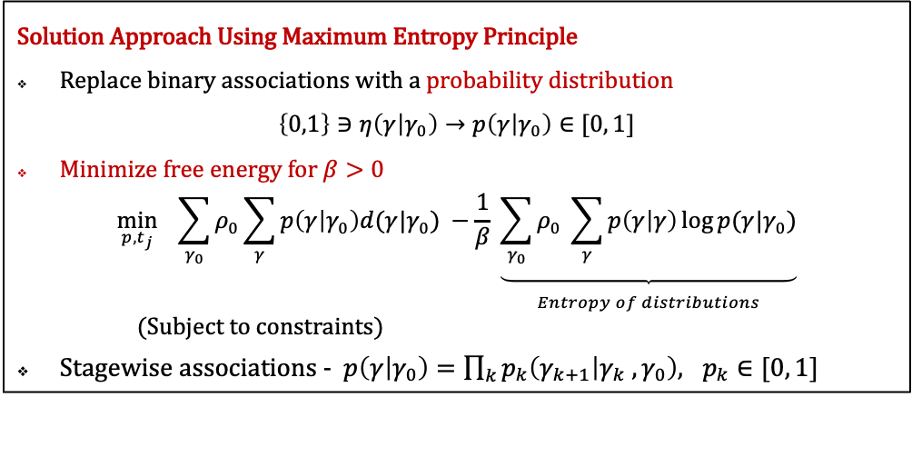
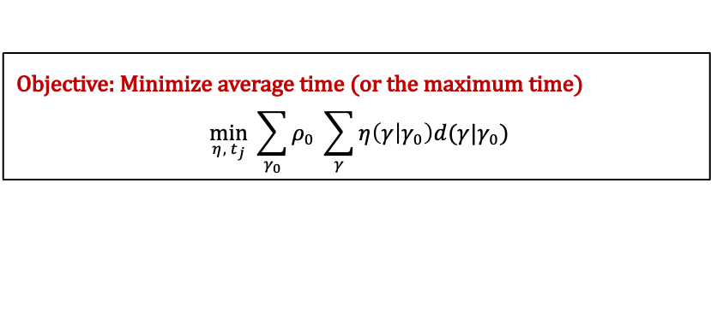
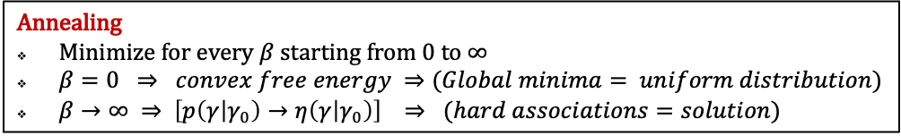
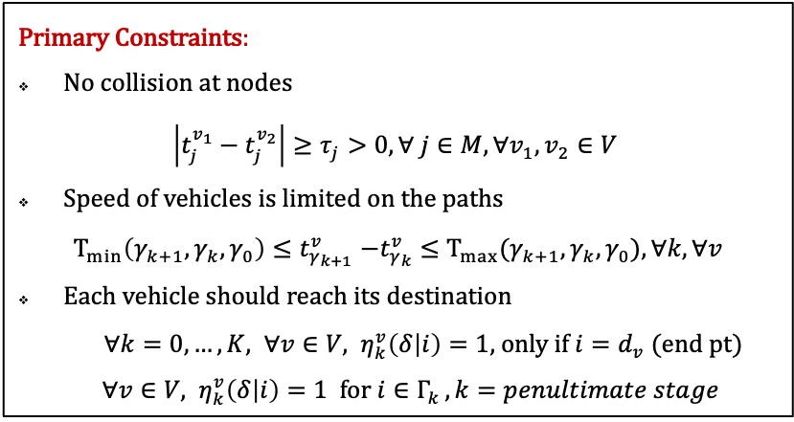
The Optimization Problem
Objective: Minimize average time (or the maximum time)
$$\min_{η, { t}_{j}}{ \sum_{γ_{0}}{ρ_{0} \sum_{γ}{η\left(γ | γ_{0}\right)d(γ|γ_{0})} }}$$
Solution Approach Using Maximum Entropy Principle
Replace binary associations with a probability distribution
$$\left\{0,1\right\}∋η\left(γ | γ_{0}\right)→p\left(γ | γ_{0}\right)∈[0, 1]$$
Minimize free energy for $β>0$
$$\min_{p, t_{j}}{ \sum_{γ_{0}}{ρ_{0}\sum_{γ}{p\left(γ | γ_{0}\right)d(γ|γ_{0})} −\frac{1}{β} \underset{\begin{aligned} \\ Entropy of distributions\end{aligned}}{\underbrace{\sum_{γ_{0}}{ρ_{0} \sum_{γ}{p\left(γ | γ\right)\log{p(γ|γ_{0})}}}}}}}$$
(Subject to constraints)
Stagewise associations - $p\left(γ | γ_{0}\right)=\prod_{k}{p_{k}\left(γ_{k+1} | γ_{k} , γ_{0}\right), p_{k}∈[0, 1]}$
Primary Constraints:
No collision at nodes
$$\left|t_{j}^{v_{1}}−t_{j}^{v_{2}}\right|≥τ_{j}>0, ∀ j∈M, ∀v_{1}, v_{2}∈V$$
Speed of vehicles is limited on the paths
$$T_{min}\left(γ_{k+1}, γ_{k}, γ_{0}\right){≤t}_{γ_{k+1}}^{v}−t_{γ_{k}}^{v}≤T_{max}(γ_{k+1}, γ_{k}, γ_{0}), ∀k, ∀v$$
Each vehicle should reach its destination
${∀k=0, …, K, ∀v∈V, η}_{k}^{v}\left(δ | i\right)=1,$ only if $i=d_{v}$ (end pt)
${∀v∈V, η}_{k}^{v}\left(δ | i\right)=1$ for $i∈Γ_{k }, k=penultimate stage$
Annealing
Minimize for every $β$ starting from $0$ to $∞$
$β=0 ⇒ convex free energy ⇒(Global minima= uniform distribution)$
$β→∞ ⇒ \left[p\left(γ | γ_{0}\right)→η\left(γ | γ_{0}\right)\right] ⇒ (hard associations=solution)$

Slide 5

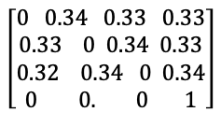

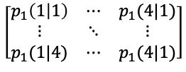


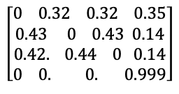
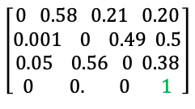
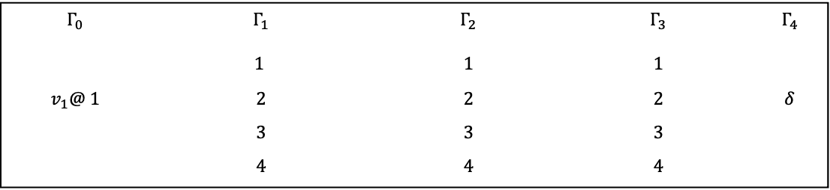
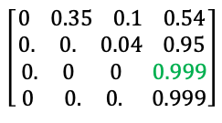




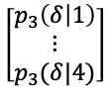

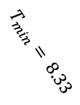

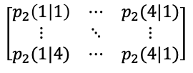
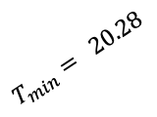

In Progress Implementation
2
$$Γ_{0}$$ | $$Γ_{1}$$ | $$Γ_{2}$$ | $$Γ_{3}$$ | $$Γ_{4}$$
 | $$1$$ | $$1$$ | $$1$$
$$v_{1}@ 1$$ | $$2$$ | $$2$$ | $$2$$ | $$δ$$
 | $$3$$ | $$3$$ | $$3$$
 | $$4$$ | $$4$$ | $$4$$
$$T_{min}= 20.28$$
$$p_{1}(3|1)$$
$$T_{min}= 8.33$$
$v_{1}$
1
$$T_{min} = 26.72$$
$$\left[p_{0}\left(1 | 1\right)…p_{0}(4|1)\right]$$
$$\left[\begin{matrix}p_{1}\left(1 | 1\right) & ⋯ & p_{1}(4|1) \\ ⋮ & ⋱ & ⋮ \\ p_{1}(1|4) & ⋯ & p_{1}(4|1)\end{matrix}\right]$$
$$\left[\begin{matrix}p_{2}\left(1 | 1\right) & ⋯ & p_{2}(4|1) \\ ⋮ & ⋱ & ⋮ \\ p_{2}(1|4) & ⋯ & p_{2}(4|1)\end{matrix}\right]$$
$$\left[\begin{aligned}p_{3}\left(δ | 1\right) \\ \begin{aligned}⋮ \\ p_{3}(δ|4)\end{aligned}\end{aligned}\right]$$
3
$$β=1e−5$$
$$β=10 β$$
$$β=1000$$
Probability
Distributions
$$\left[0 0.47 0.46 0.07\right]$$
$$\left[\begin{aligned}0 0.32 0.32 0.35 \\ 0.43 0 0.43 0.14 \\ 0.42. 0.44 0 0.14 \\ 0 0. 0. 0.999\end{aligned}\right]$$
$$\left[\begin{aligned}0 0.34 0.33 0.33 \\ 0.33 0 0.34 0.33 \\ 0.32 0.34 0 0.34 \\ 0 0. 0 1\end{aligned}\right]$$
$$\left[\begin{aligned}1 \\ 1 \\ 1 \\ 1\end{aligned}\right]$$
$$\left[0 0 0.96 0.04\right]$$
$$\left[\begin{aligned}0 0.35 0.1 0.54 \\ 0. 0. 0.04 0.95 \\ 0. 0 0 0.999 \\ 0 0. 0. 0.999\end{aligned}\right]$$
$$\left[\begin{aligned}0 0.58 0.21 0.20 \\ 0.001 0 0.49 0.5 \\ 0.05 0.56 0 0.38 \\ 0 0. 0 1\end{aligned}\right]$$
$$\left[\begin{aligned}1 \\ 1 \\ 1 \\ 1\end{aligned}\right]$$
Time
Schedule
$t_{1}^{v}=0 t_{2}^{v}=21.6\sec{t_{3}^{v}=28. 4 sec}$
$t_{1}^{v}=0 t_{2}^{v}=25.9\sec{t_{3}^{v}=26. 75 sec}$

Slide 6

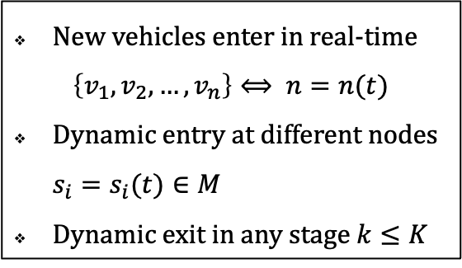
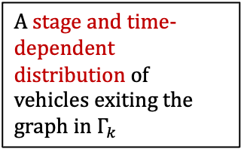
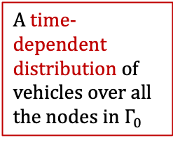
Future Considerations
$$Γ_{0}$$ | $$Γ_{1}$$ | $$Γ_{2}$$ | $$………$$ | $$Γ_{9}$$ | $$Γ_{10}$$
$$1$$ | $$1$$ | $$1$$ | $$………$$ | $$1$$
$$2$$ | $$2$$ | $$2$$ | $$………$$ | $$2$$ | $δ$
$$3$$ | $$3$$ | $$3$$ | $$………$$ | $$3$$
$$4$$ | $$4$$ | $$4$$ | $$………$$ | $$4$$
$$⋮$$ | $$⋮$$ | $$⋮$$ | $$⋮$$ | $$⋮$$
$$9$$ | $$9$$ | $$9$$ | $$………$$ | $$9$$
 | $$δ$$ | $$δ$$ | $$………$$ | $$δ$$
New vehicles enter in real-time
$$\left\{v_{1},v_{2},…, v_{n}\right\}⟺ n=n(t)$$
Dynamic entry at different nodes $s_{i}=s_{i}(t)∈M$
Dynamic exit in any stage $k≤K$
A time-dependent distribution of vehicles over all the nodes in $Γ_{0}$
A stage and time-dependent distribution of vehicles exiting the graph in $Γ_{k}$

Slide 7


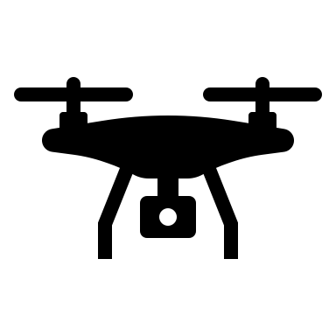














Optimizing Drone Deployment and Charging Strategies for Minimizing Makespan in Delivery Systems
N drones, k stationary charging stations, and T destination targets.
Each drone has a pre-defined charging capacity and operates at a pre-specified speed.
The objective is to minimize the makespan, which is the maximum total time over all drones to reach their destination, while ensuring that no drone runs out of charge on its way to the destination.
The charging stations have certain load capacity.
The solution involves scheduling drones to charging facilities along the route.
The drones can choose to go to the destination directly or via a subset of charging facilities to ensure battery capacity, depending on the deploying coordinates and the destination.
The cost associated with going to the charging stations is: a) transportation time b) (possible) waiting time for other drones to recharge c) charging time. For the destination points, the cost is only the transportation time.
$$v_{1}$$
$$δ_{3}$$
$$f_{1}$$
$$f_{2}$$
$$δ_{1}$$
$$v_{4}$$
$$f_{3}$$
$$v_{2}$$
$$δ_{2}$$
$$v_{3}$$

Slide 8
Thank You!

Slide 9
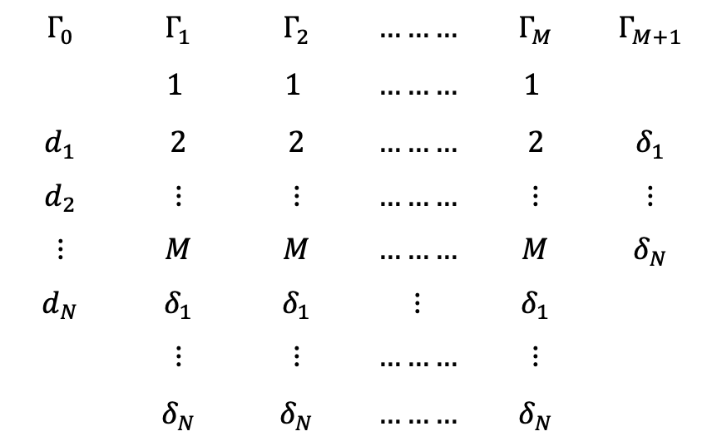
$$Γ_{0}$$ | $$Γ_{1}$$ | $$Γ_{2}$$ | $$………$$ | $$Γ_{M}$$ | $$Γ_{M+1}$$
 | $$1$$ | $$1$$ | $$………$$ | $$1$$
$$d_{1}$$ | $$2$$ | $$2$$ | $$………$$ | $$2$$ | $$δ_{1}$$
$$d_{2}$$ | $$⋮$$ | $$⋮$$ | $$………$$ | $$⋮$$ | $$⋮$$
$$⋮$$ | $$M$$ | $$M$$ | $$………$$ | $$M$$ | $$δ_{N}$$
$$d_{N}$$ | $$δ_{1}$$ | $$δ_{1}$$ | $$⋮$$ | $$δ_{1}$$
 | $$⋮$$ | $$⋮$$ | $$………$$ | $$⋮$$
 | $$δ_{N}$$ | $$δ_{N}$$ | $$………$$ | $$δ_{N}$$

