Slide 1
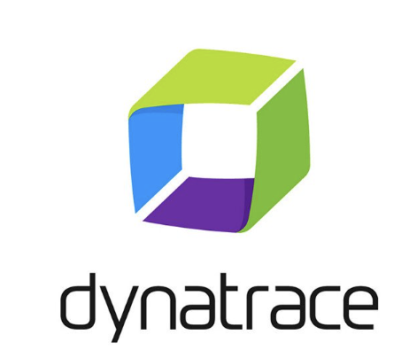
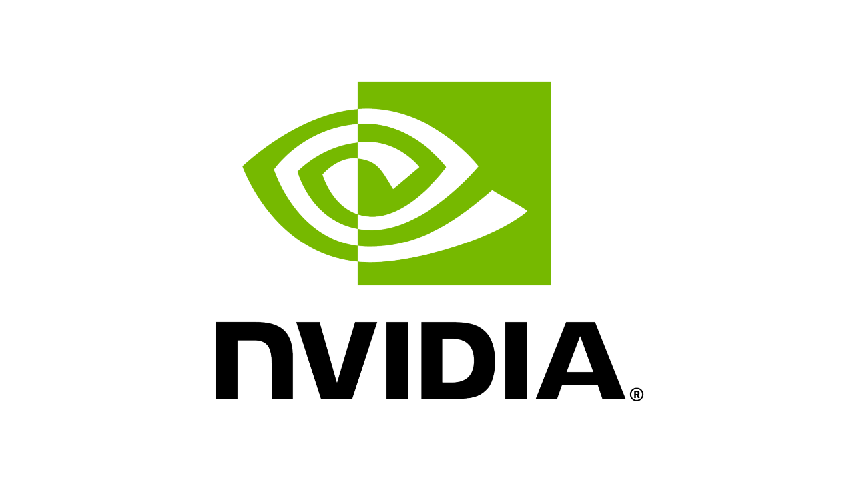
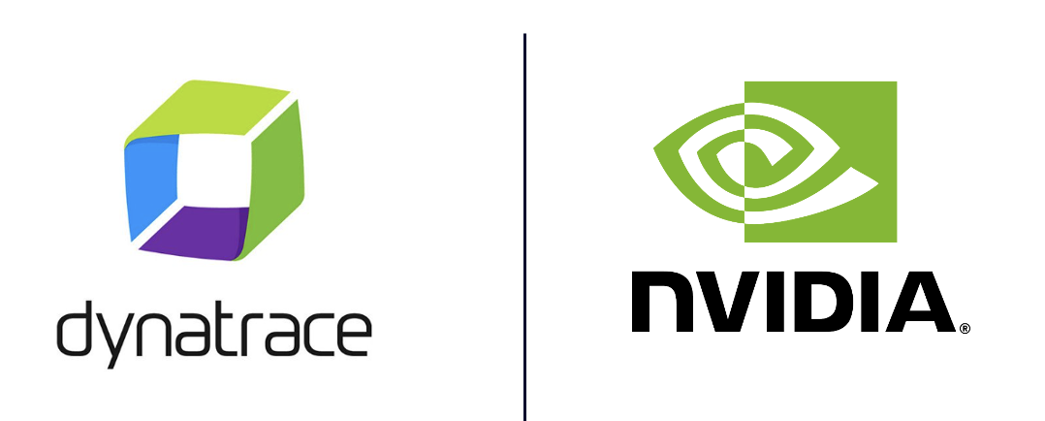

Slide 2



Slide 3

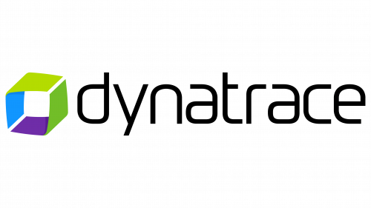
Kubernetes
GPU Metrics
NVIDIA DCGM
Exporter
Models
AI Native
Web Search
Chat App
& AI Agent
OTel Collector
conversational LLM
text embedding
content safety guardrail
Topic control guardrail
Dynatrace Kubernetes Solution
Kubernetes platform health and logs
Application Traces + Inference metrics + GPU Metrics

Slide 4
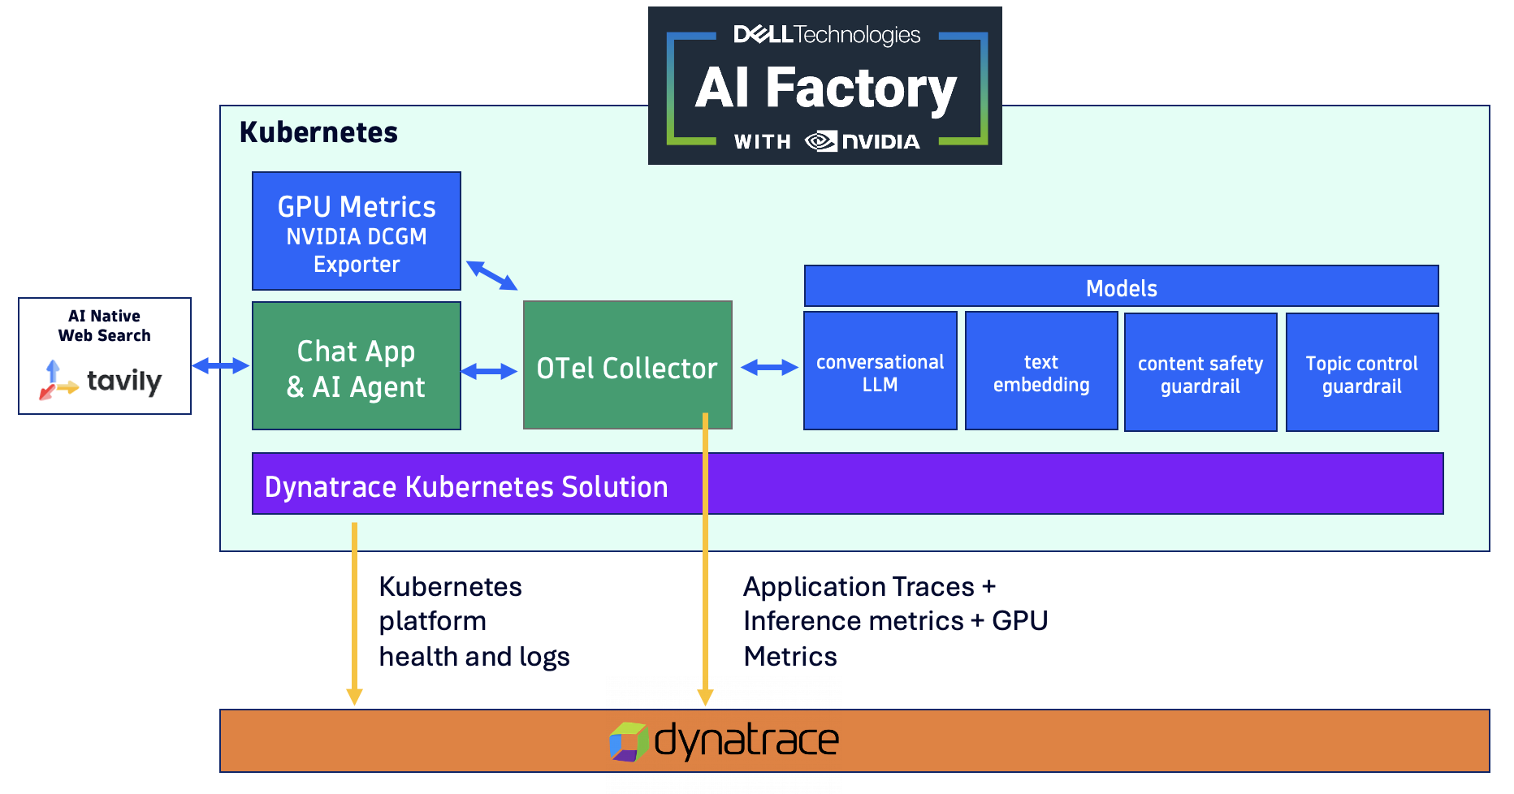
Kubernetes
GPU Metrics
NVIDIA DCGM
Exporter
Models
AI Native
Web Search
Chat App
& AI Agent
OTel Collector
conversational LLM
text embedding
content safety guardrail
Topic control guardrail
Dynatrace Kubernetes Solution
Kubernetes platform health and logs
Application Traces + Inference metrics + GPU Metrics

