Slide 1
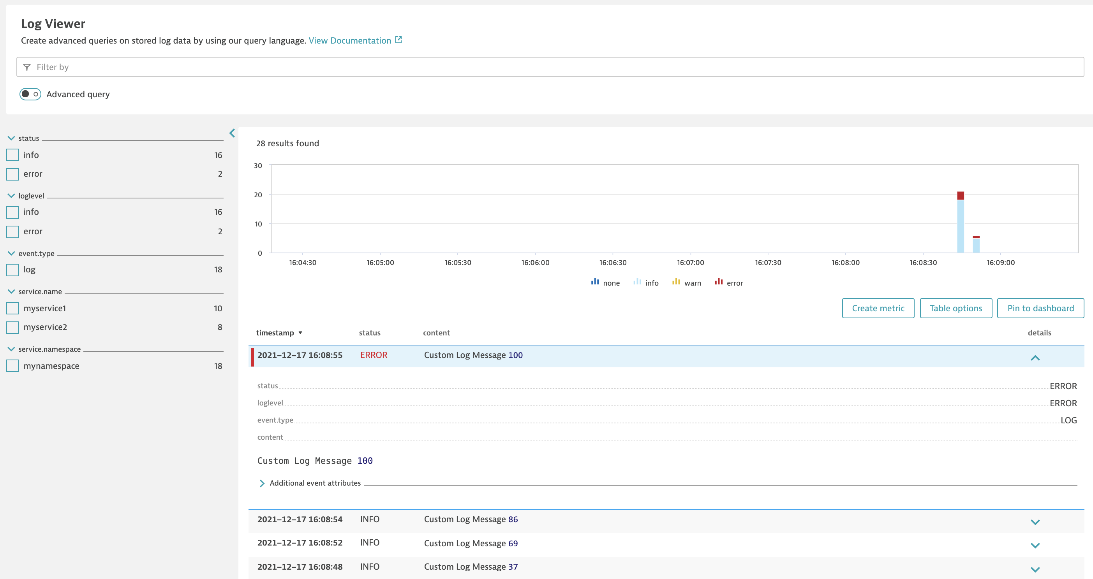

Slide 2
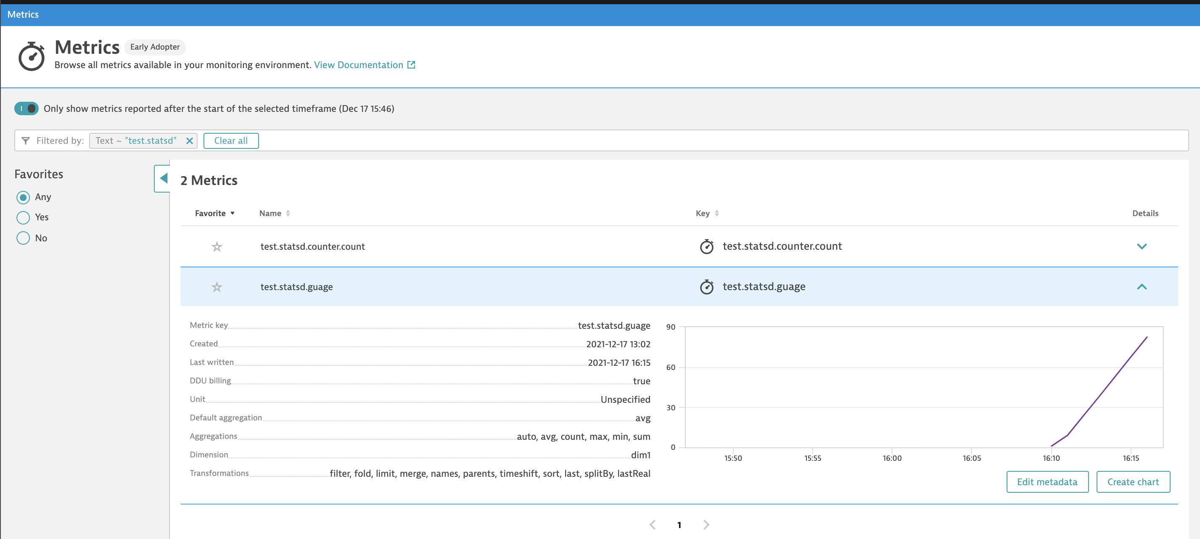

Slide 3
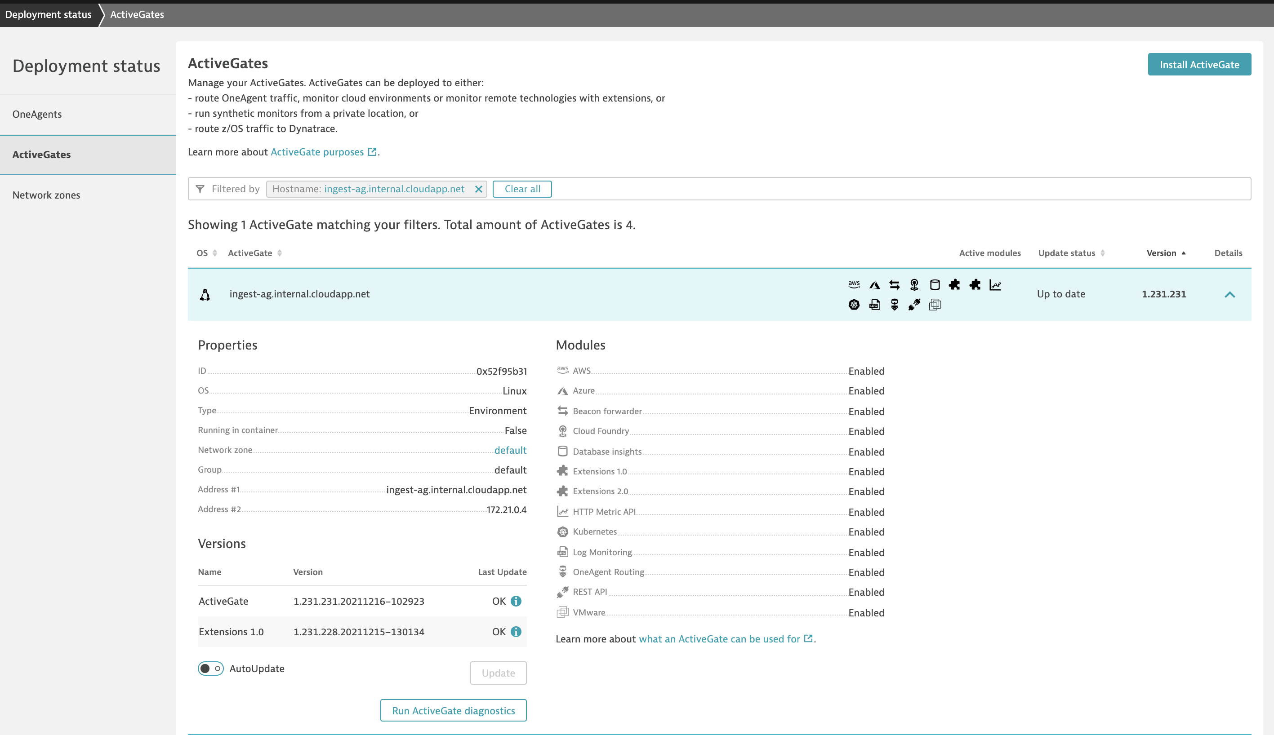

Slide 4
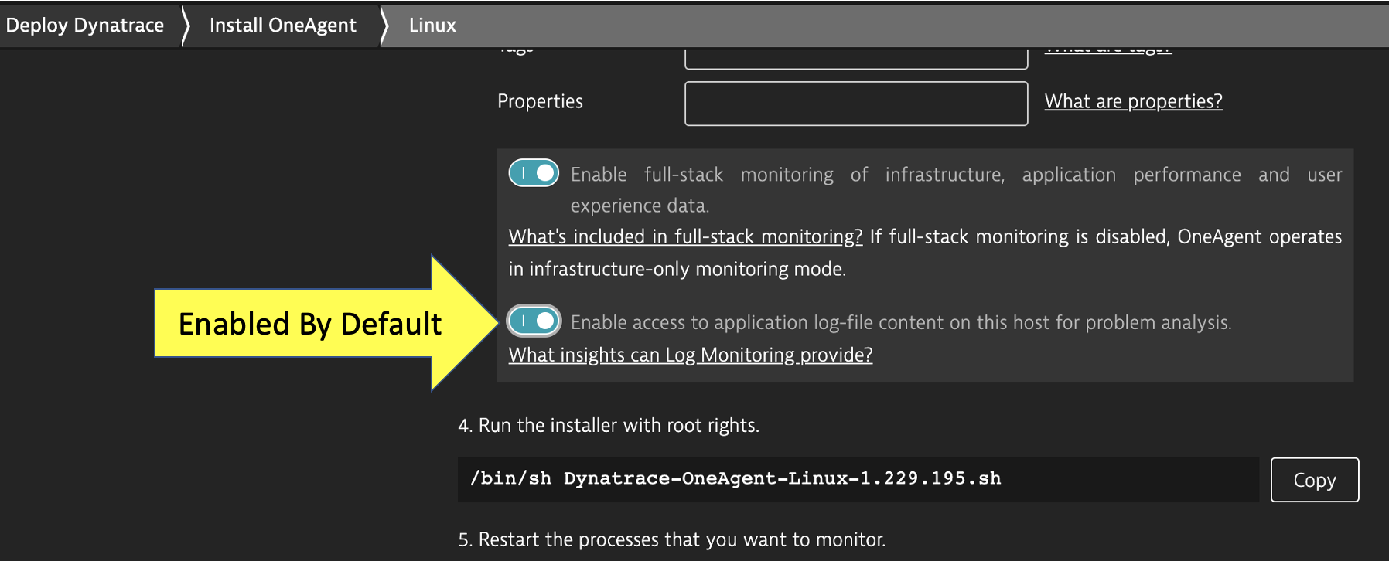
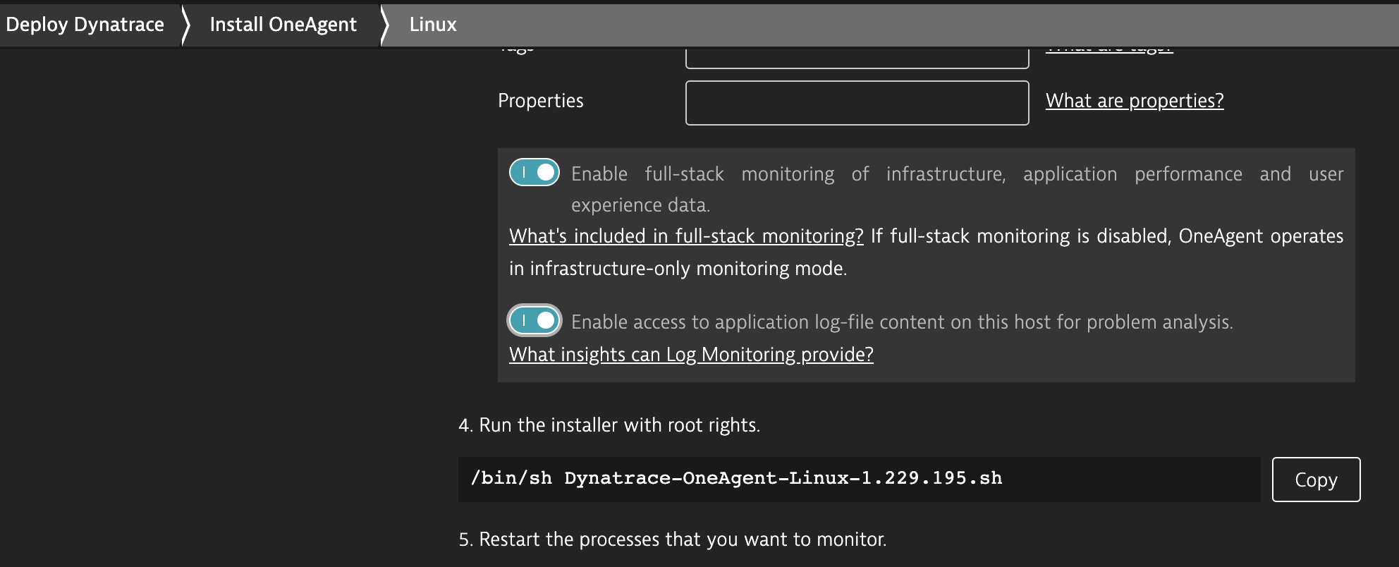
Enabled By Default

Slide 5

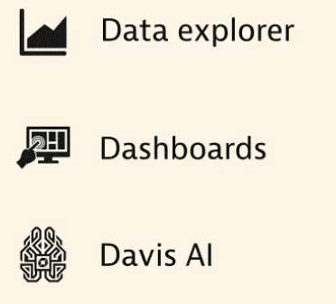
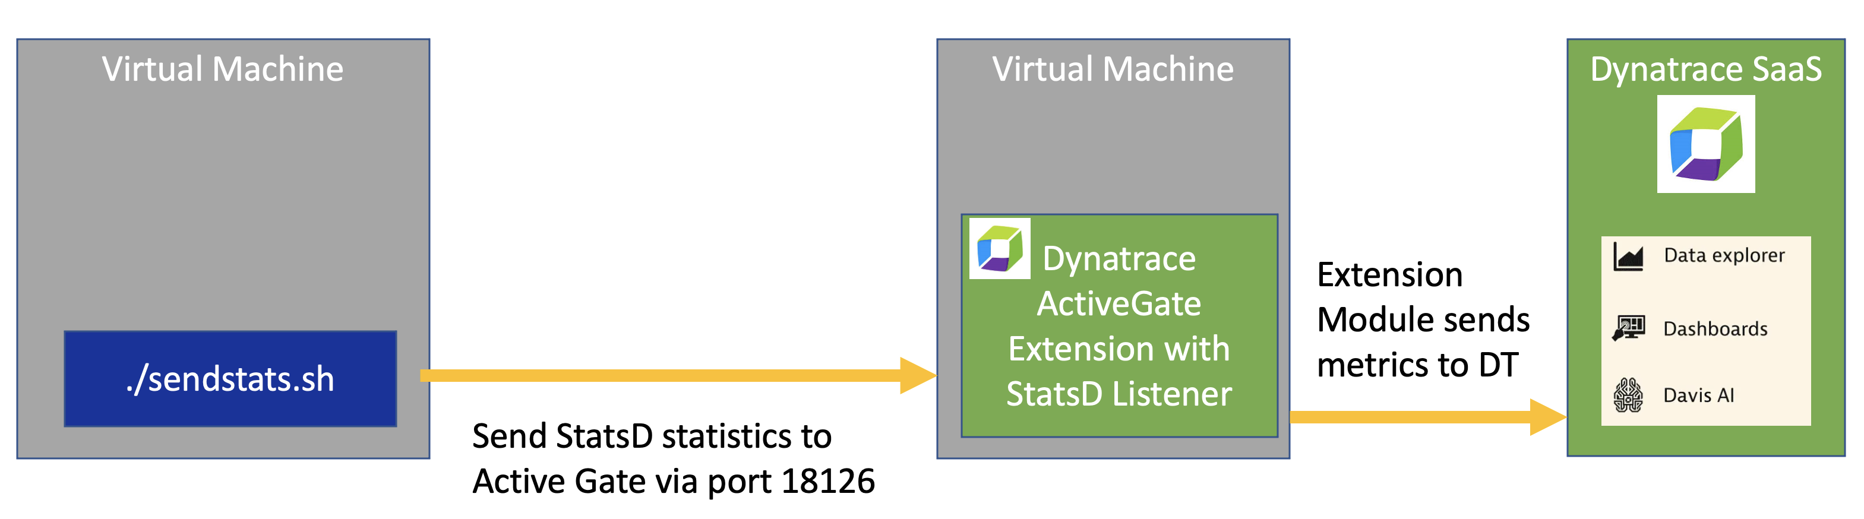
StatsD Metrics
Virtual Machine
Virtual Machine
Dynatrace SaaS
Dynatrace ActiveGate Extension with StatsD Listener
Extension Module sends metrics to DT
./sendstats.sh
Send StatsD statistics to Active Gate via port 18126

Slide 6
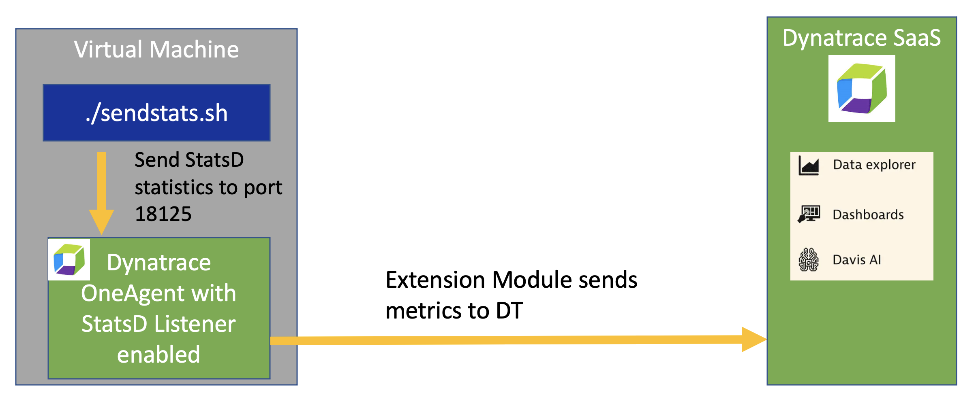
Application Logs
Virtual Machine
Dynatrace SaaS
./sendstats.sh
Send StatsD statistics to port 18125
Dynatrace OneAgent with StatsD Listener enabled
Extension Module sends metrics to DT

Slide 7
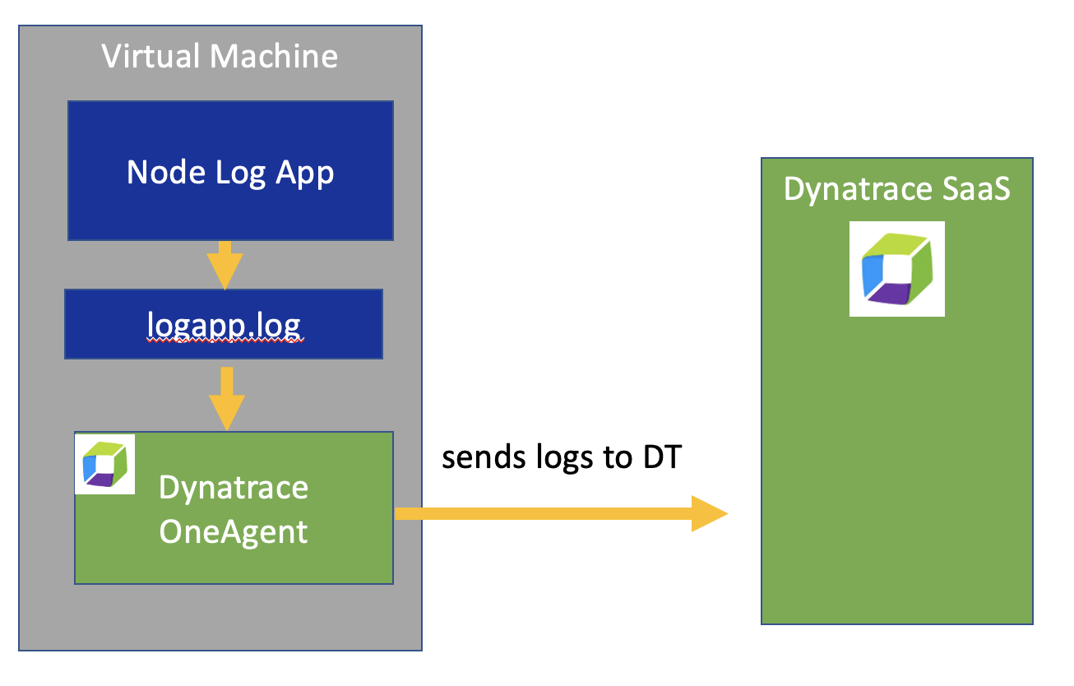
https://www.youtube.com/watch?v=j76ozzIbuO8
Dynatrace ActiveGate Extension with Fluentd Collector
Log Ingest API
-OR-
Application Logs
Virtual Machine
Node Log App
Dynatrace SaaS
logapp.log
Dynatrace OneAgent
sends logs to DT

Slide 8
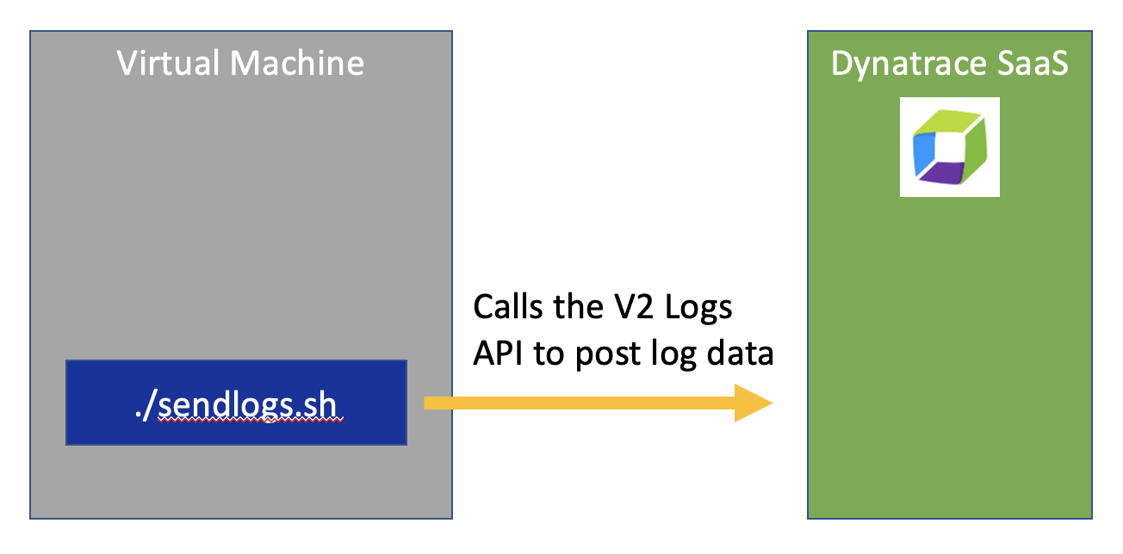
https://www.youtube.com/watch?v=j76ozzIbuO8
Dynatrace ActiveGate Extension with Fluentd Collector
Log Ingest API
-OR-
Application Logs
Virtual Machine
Dynatrace SaaS
Calls the V2 Logs API to post log data
./sendlogs.sh

Slide 9
End to End Flow
Dynatrace Analysis & Dashboards
StatsD metrics sent in via Dynatrace ActiveGate
Dynatrace Metric
Dynatrace Metric
Dynatrace Metric Event for Alerting
Application Log
Dynatrace OneAgent send Log to DT
Dynatrace Log Metric Rule makes metric
Incident and Change Management workflows with partner tools (e.g. PagerDuty, xmatter, etc)
Dynatrace Problem Notification and Cloud Automation
Dynatrace Davis AI Engine

