Slide 1


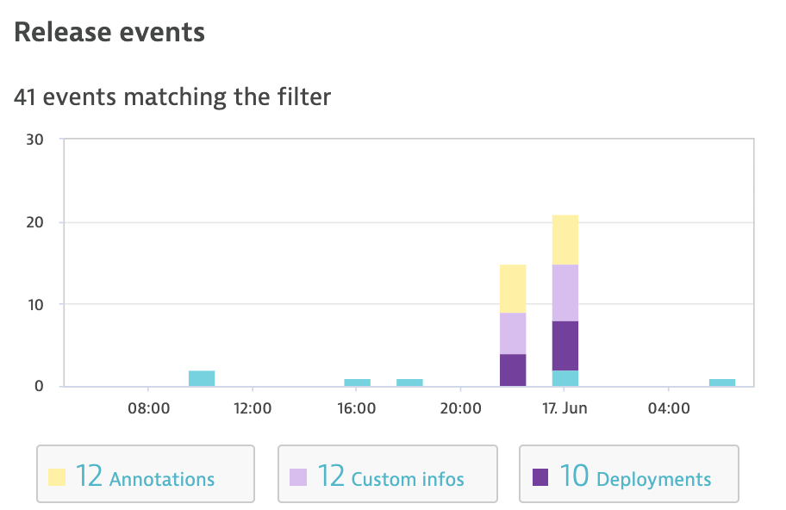
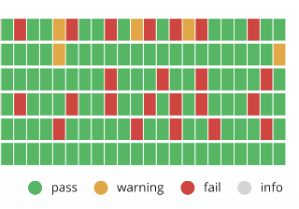
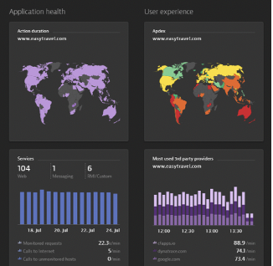



GitHub Actions – Continuous Delivery workflow
A
B
C
D
E
F
Kubernetes Preparation & Deploy Application Code
Onboard service to Dynatrace Cloud Automation
Run Dynatrace Monitoring as Code
Send Dynatrace Deployment Event
Run Automated SLO Evaluation
Add pipeline execution metrics as Dynatrace custom metrics
Stop pipeline yes/no ??
Application
Application, Infrastructure, Release Monitoring & Cloud Automation
AKS Cluster
Dynatrace
Operator

