Slide 1


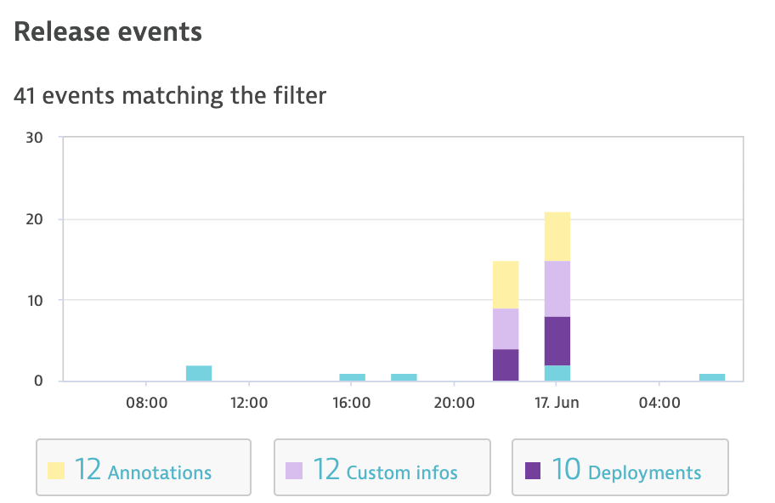
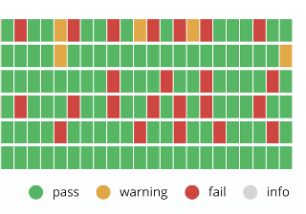
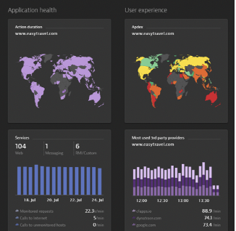



GitHub Actions – Continuous Delivery workflow
1
2
3
4
5
6
Kubernetes Prep & Code Deploy
Dynatrace Monitoring as Code
Dynatrace Deployment Event
Performance Test
Dynatrace Annotation Test Event
Automated SLO Evaluation
Stop pipeline yes/no ??
Application
Application, Infrastructure, Release Monitoring & Cloud Automation
AKS Cluster
Dynatrace
Operator

