Slide 1

Project 2
Response to Arbitrary Signal and
Frequency Response of a Linear TLI
班級：資工三 學號：S10259002
姓名：黃詩豪 指導教授：陳榮銘

Slide 2
Project. Outline
Functions in the System
How to Work
Analysis Some LTI System

Slide 3
Functions in the System
Parameters
Sampling Rate
Number of Sampling Period
Frequency Response X Axis Bound

Slide 4
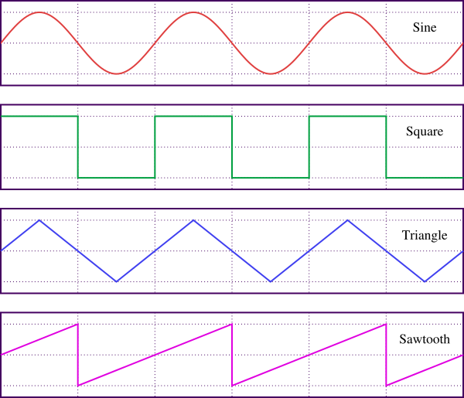
Functions in the System
Arbitrary Input Signal
Unit-Step, Unit-Sample
Sine Wave, Cosine Wave
Square Wave
Sawtooth Wave
Triangle Wave
Natural Exponential

Slide 5
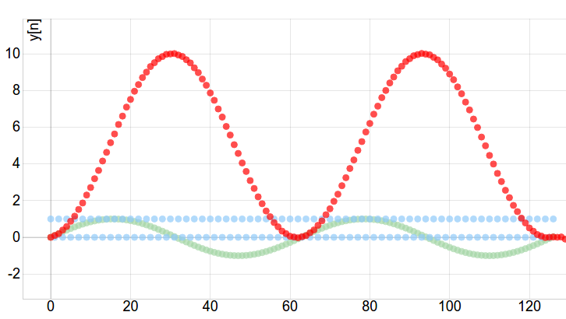
Functions in the System
Difference Equation for LTI
Using difference equation represents LTI System
For example:
y[n]=x[n]+y[n-2]

Slide 6
How to Work
Web Based
Mathmatics
Plot Graphics
HTML5
CSS
JavaScript
1D Convolution
Frequency Response by
Definition
H(jw)
Function-Plot Plugin

Slide 7
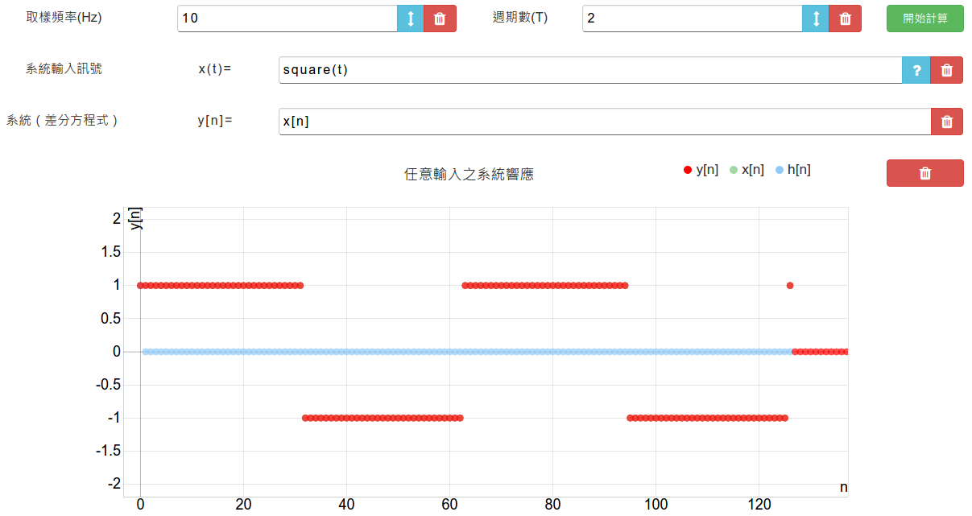
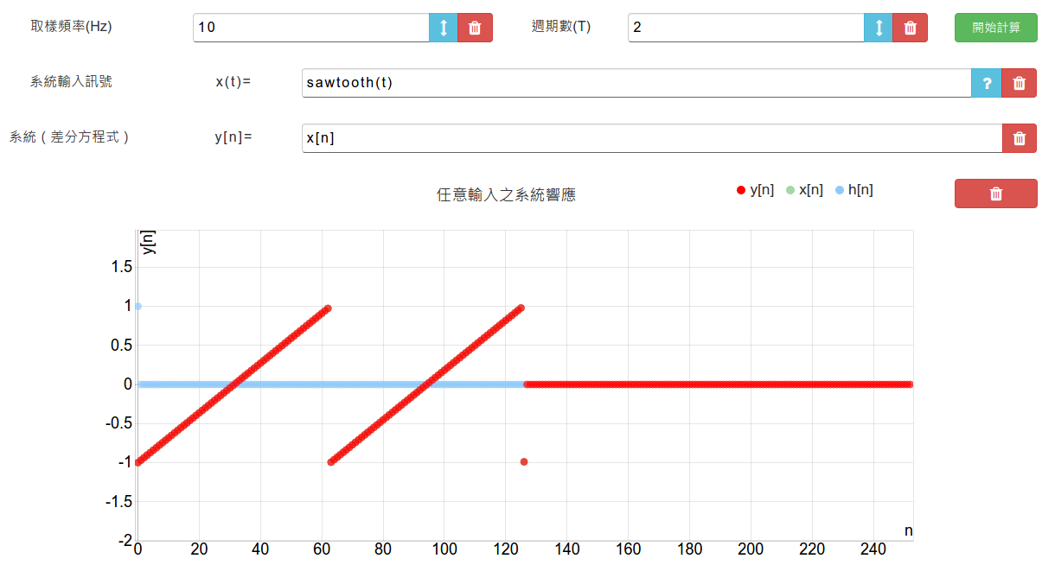
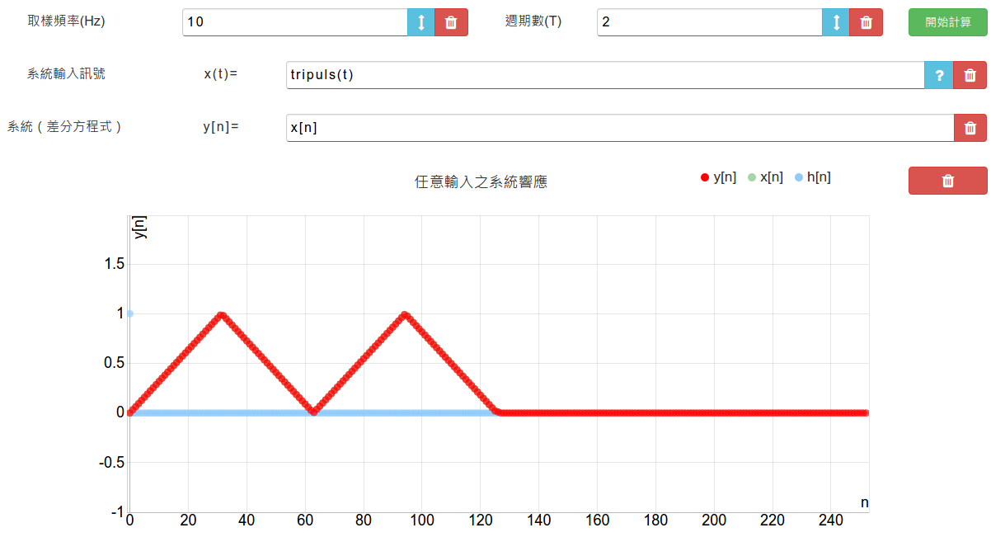
Analysis
Some LTI System
System: y[n]=x[n]
Input: square(t), sawtooth(t), tripuls(t)

Slide 8
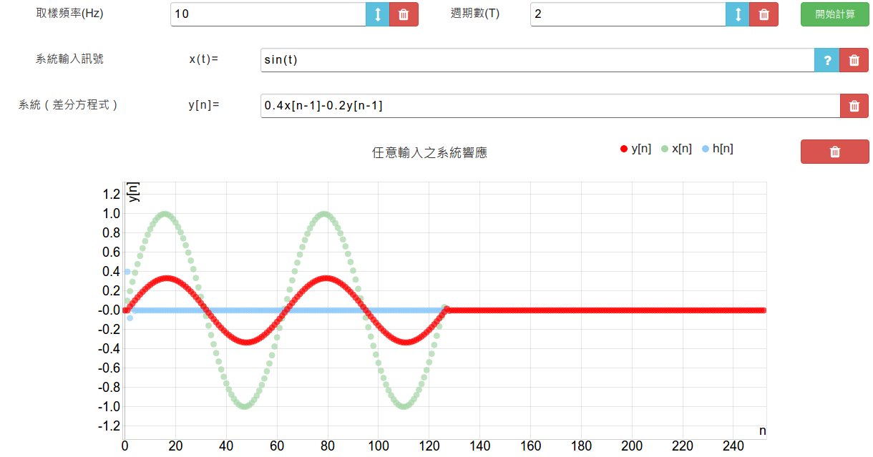
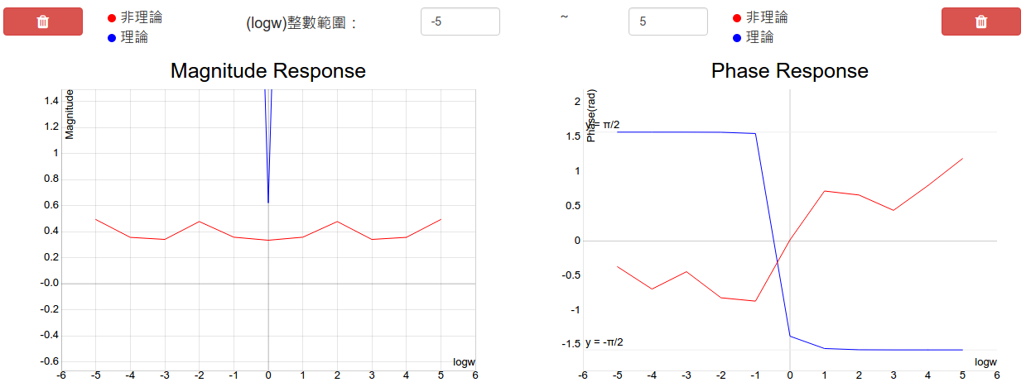
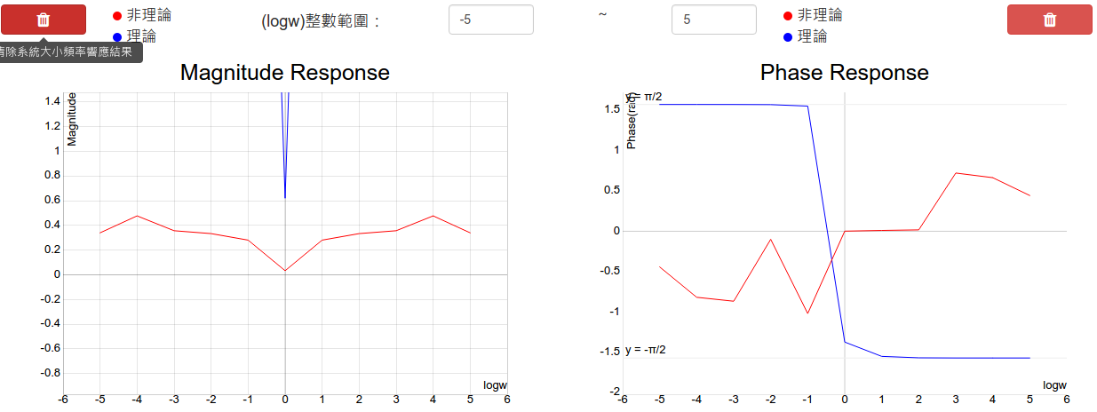
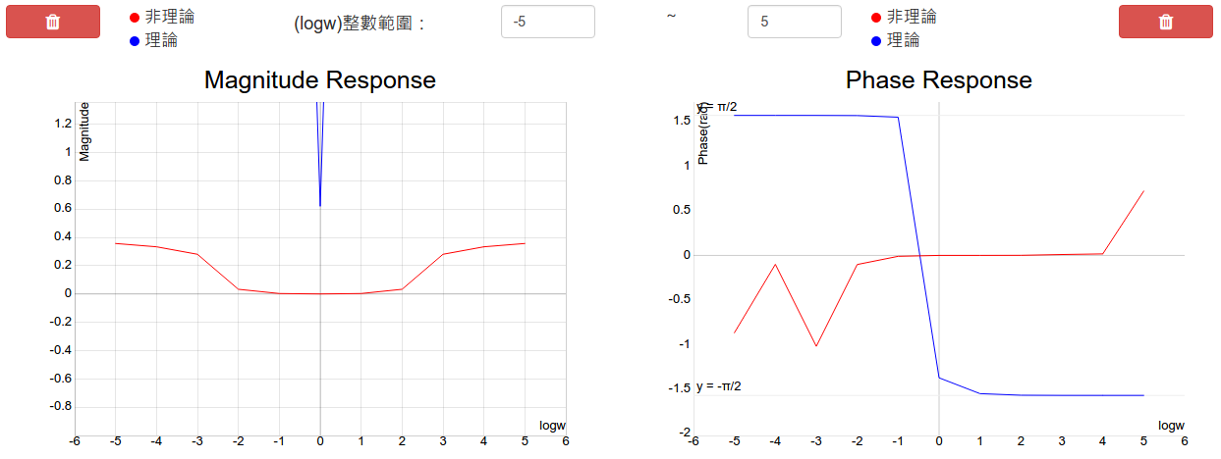
Analysis
Some LTI System
Sampling Rate = 10Hz
System: y[n]=0.4x[n-1]-0.2y[n-1]
Input: sin(t)
Sampling Rate = 1000Hz
Sampling Rate = 100KHz

Slide 9
Thanks for your attention

