Slide 1

The Final Report was prepared by Duygu Tabak on 2.19.2018

Slide 2
The First Exercise: Exploring the Database
64.5k users have signed up to rover.com in total. 35.5k (55%) users signed up prior to 2017-01-12.
80% of users have added pets and 1.5 pets per user have been added on average. 25% of pets play well with cats.

Slide 3
The Second Exercise: Conversations and Bookings (1/2)
Some facts and statistics are presented regarding each service type.

Slide 4
The Second Exercise: Conversations and Bookings (2/2)
For un-cancelled bookings, owner is more likely to leave a review.
Owner also tends to leave better reviews.

Slide 5
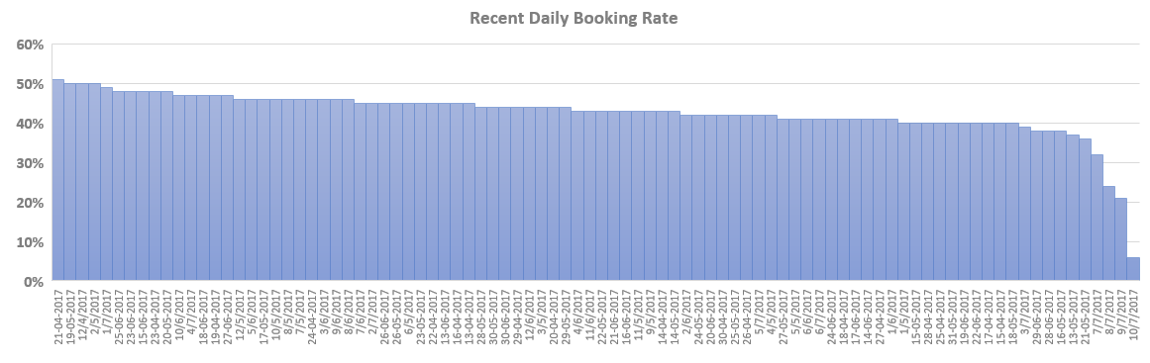
The Third Exercise: Recent Daily Booking Rate
The trend of daily booking rate for each of the 90 days prior to 2017-07-11 is presented in the figure.
Although there is not much difference in the count of conversations, the presence of a downward trend in booking rates is noticeable. Especially reasons of the immediate drop in last couple of days should be investigated.

Slide 6
The Forth Exercise: Analyzing Take Rate (1/3)
Gross billings, net revenue and take rates are presented on a monthly basis.
Take rate had an upward trend. Gross billings and net revenue were also going up.

Slide 7
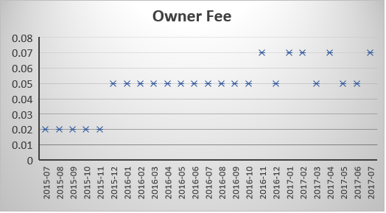
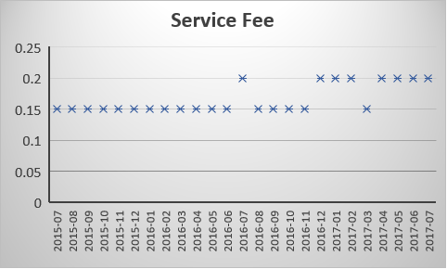
The Forth Exercise: Analyzing Take Rate (2/3)
One of the reasons of take rate having an upward trend is the increase in owner fees and service fees. Rover.com started to make more money for each transaction that led to higher revenue and take rate.

Slide 8
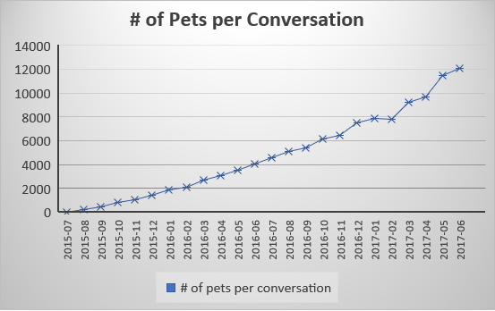
The Forth Exercise: Analyzing Take Rate (3/3)
The other reason that contributed to the upward trend of take rate was the increase in the number of pets associated with conversations. Conversations and bookings involved more pets by time.

Slide 9
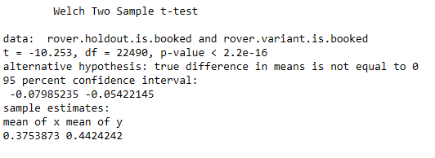
The Fifth Exercise: New Conversation Flow
The new conversation flow was usually going to have a positive impact on booking rates.
t-testing was performed to measure statistical significance. In summary, since the P-value is much less than zero, any observed booking rate difference is not due to random sampling error.
For details of the t-test, please click the following document.

Slide 10
Summary
User acquisition had been increased remarkably and almost half of the users signed up after 2017-01-12.
Boarding is the most revenue generating service whereas the dog walking is the most booked one.
For un-cancelled bookings, owner is more likely to leave a review and they tend to leave better reviews.
Daily booking rates had decreased slightly in the last 3 months while the gross billings, net revenue and take rate had been going up.
Service and owner fees increased and more pets associated with conversations by time. These contributed to higher revenue and take rate.
The new conversation flow had a positive impact on booking rates.

