Slide 1

The Final Report, prepared by Duygu Tabak on 2.19.2018

Slide 2
The First Exercise: Exploring the Database
64.5k users have signed up to rover.com. 35.5k (55%) users signed up prior to 2017-01-12.
80.44% of users have added pets and 1.5 pets per user have been added on average. 24.78% of pets play well with cats.

Slide 3
The Second Exercise: Conversations and Bookings (1/2)
Some facts and statistics are presented regarding each service type.

Slide 4
The Second Exercise: Conversations and Bookings (2/2)
For un-cancelled bookings, owner is more likely to leave a review.
Owner also tends to leave better reviews.

Slide 5
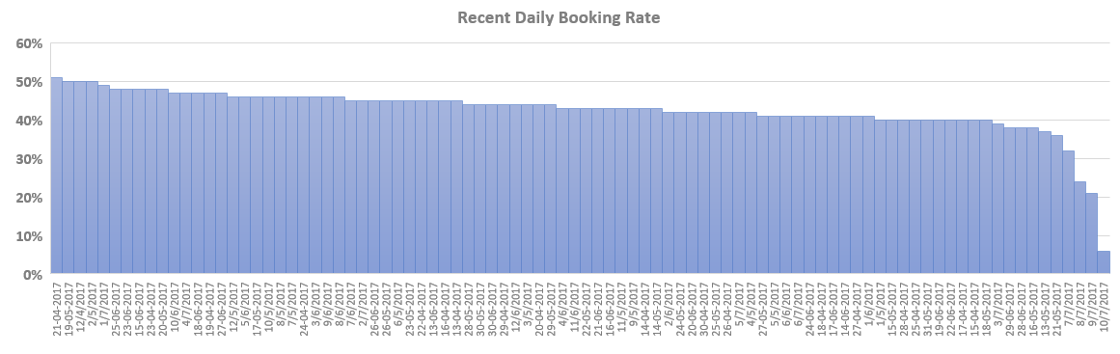
The Third Exercise: Recent Daily Booking Rate
The trend of daily booking rate for each of the 90 days prior to 2017-07-11 is presented in the figure.
Although there is not much difference in the count of conversations and bookings, the presence of a downward trend in booking rates is noticeable. Especially reasons of the immediate drop in the last couple of days should be investigated.

Slide 6
The Forth Exercise: Analyzing Take Rate (1/3)
Gross billings, net revenue and take rates are presented for each month.
Take rate has an upward trend. Gross billings and net revenue are also going up.

Slide 7
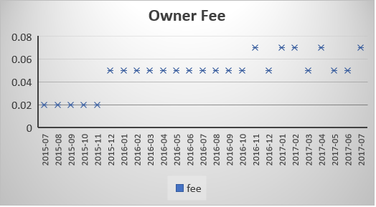
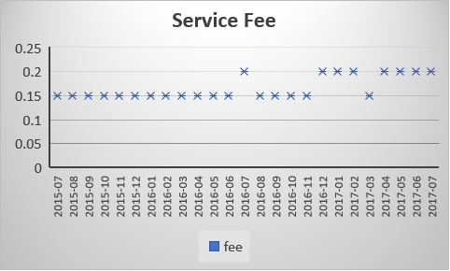
The Forth Exercise: Analyzing Take Rate (2/3)
One of the reasons of take rate having an upward trend is the increase in owner fees and service fees. Rover.com started to make more money for each transaction that adds up to higher revenue and take rate.

Slide 8
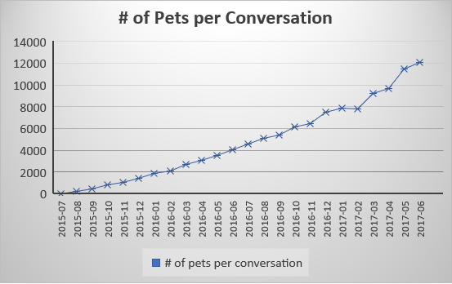
The Forth Exercise: Analyzing Take Rate (3/3)
The other reason that contributed to upward trend of take rate is the increase in the number of pets associated with conversations. Conversations and bookings involved more pets by time.

Slide 9
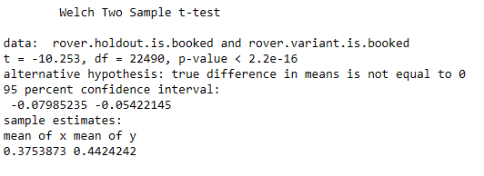
The Fifth Exercise: New Conversation Flow
The new conversation flow is usually going to have a positive impact on booking rates.
t-testing was performed to measure statistical significance. In summary, since the P-value is much less than zero, any observed booking rate difference is not due to random sampling error.
For details of the t-test, please click the following document.

