Slide 1

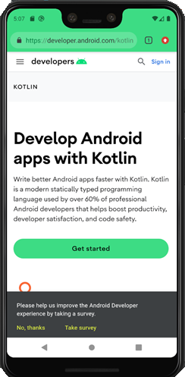
Introduction to Mobile Development
Abedalrhman Alkhateeb

Slide 2
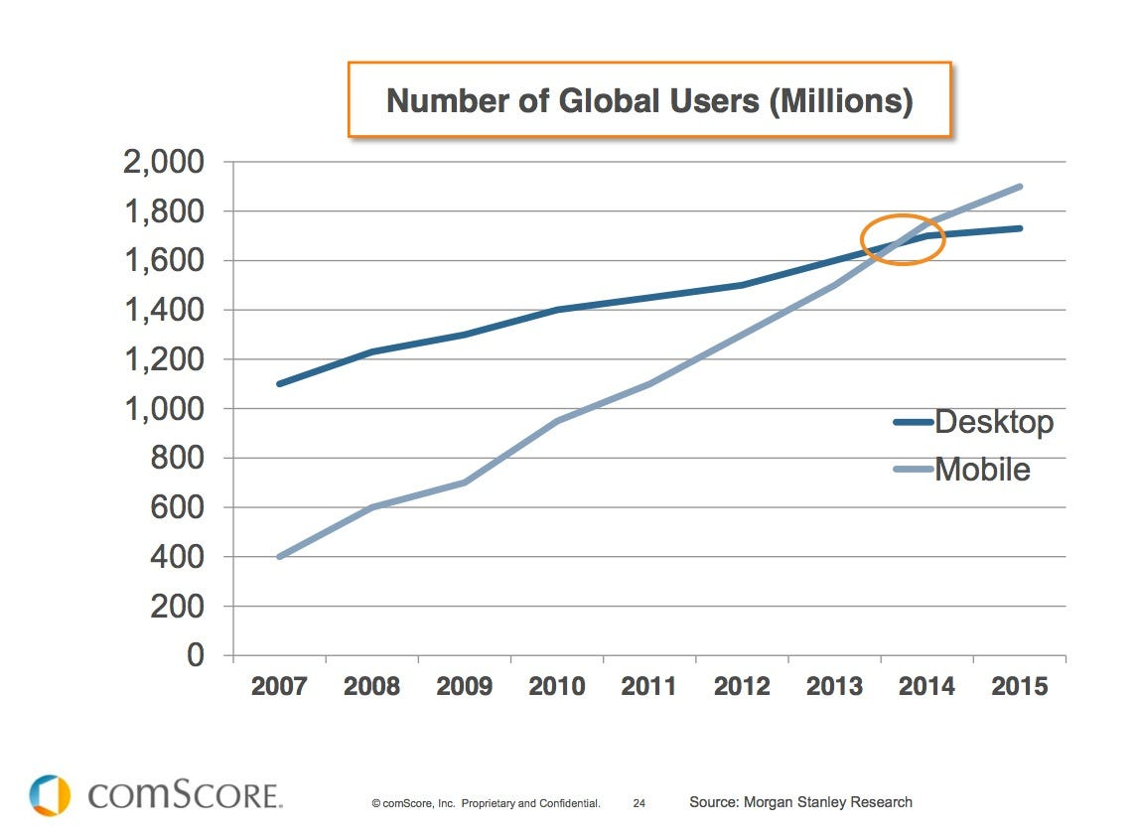
Desktop vs Handsets
In 2014, Active handset devices outnumbered the desktop computers.
The small handsets are powered with powerful computational resources.
Smartphones are getting smarter!

Slide 3
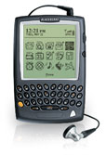
History
In 1999, BlackBerry Inc. (Research in Motion, formerly) developed BlackBerry OS, it was used for pagers.
In 2002, BlackBerry 5810 with BlackBerry OS:
Secure Wireless email push notification.
SMS and phone.
Incorporates Java 2 Micro Edition (J2ME) as its core operating system, providing a secure and open platform for customers, carriers, and developers.
~Courtesy: BlackBerry.com

Slide 4
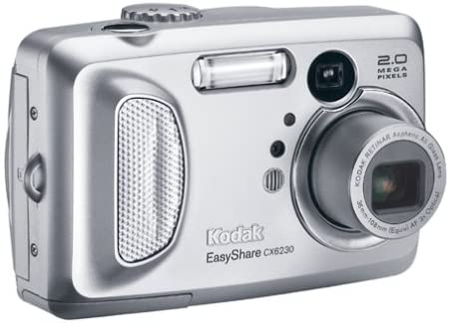
History
In 2003, Android Inc. began to develop an operating system for digital cameras.
In 2004, early Android OS was pitched to operate on Microsoft cellphone.
In 2005, Google acquired a software company in Silicon Valley that’s named Android Inc.
~Courtesy: Amazon.com

Slide 5
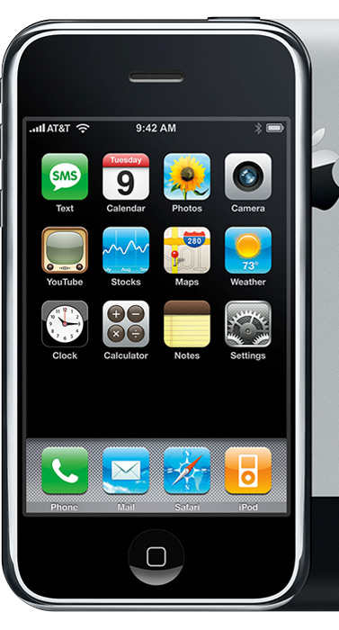
History
June 29, 2007 , Apple released it’s first generation of Iphone.
Iphone is powered by IOS operating system which:
The first OS designed for touch screen devices
Has an app store!
~Courtesy: Apple.com

Slide 6
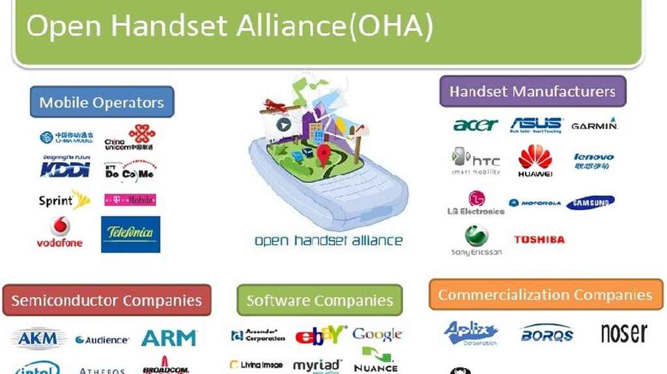
History
November 5, 2007, Google lined up industrial partners to develop and promote Android.
~Courtesy: elespanol.com

Slide 7
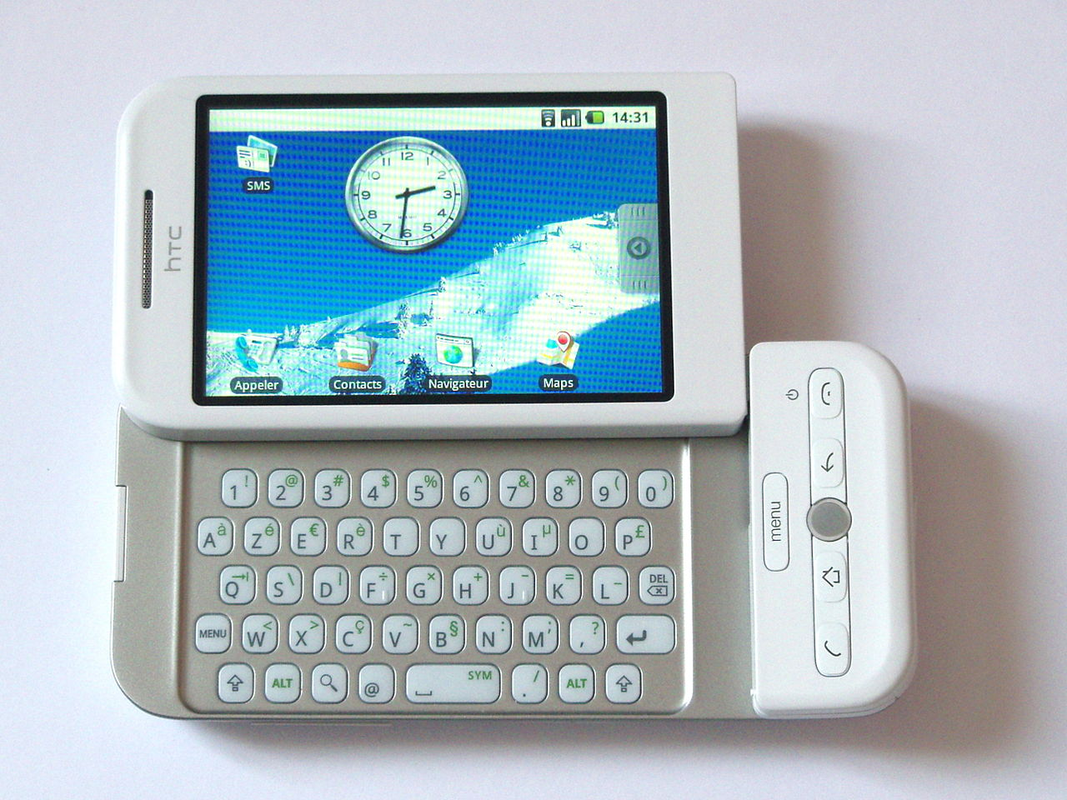
History
September 2008, HTC-Dream was released as the first android smartphone.
It uses Linux-based Android.
~Courtesy: Wiki

Slide 8
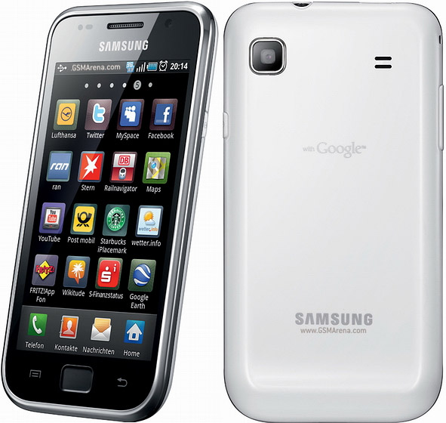
History
June 2010, Samsung released it’s first touch screen smartphone, Samsung I9000 Galaxy S.
Android 2.1, up to 2.3.
Accelerometer, and other sensors.
~Courtesy: gsmarena.com.

Slide 9
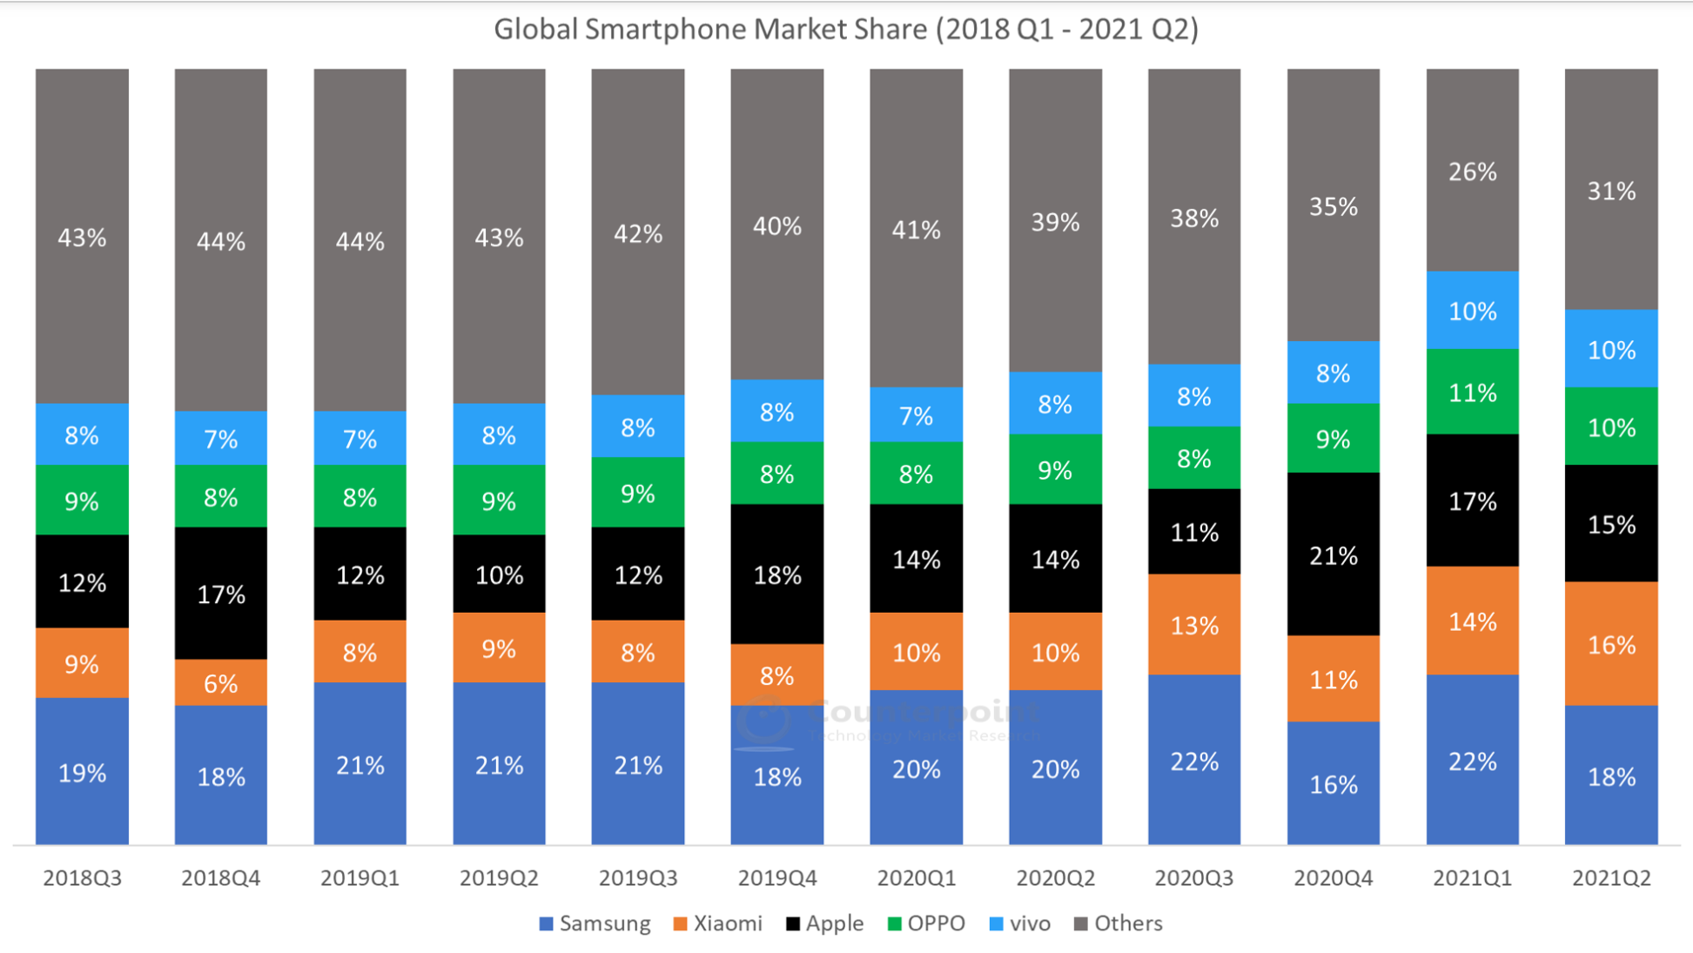
~Courtesy: Market Monitor Service

Slide 10
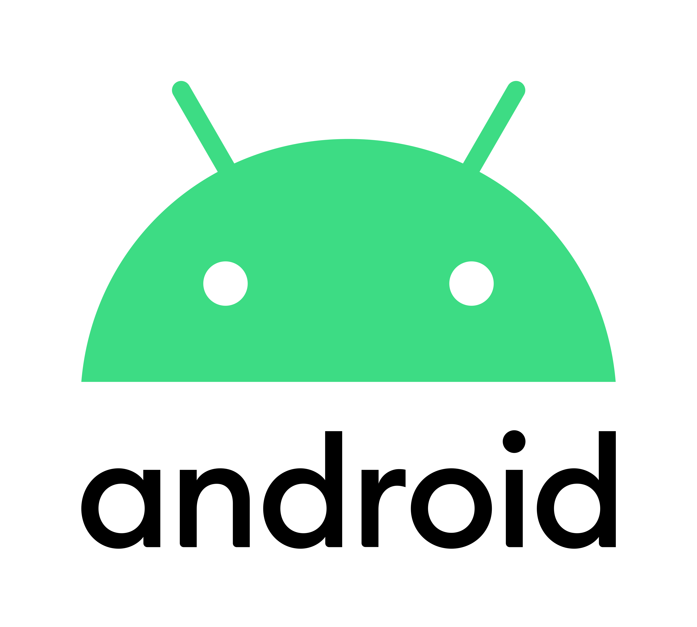
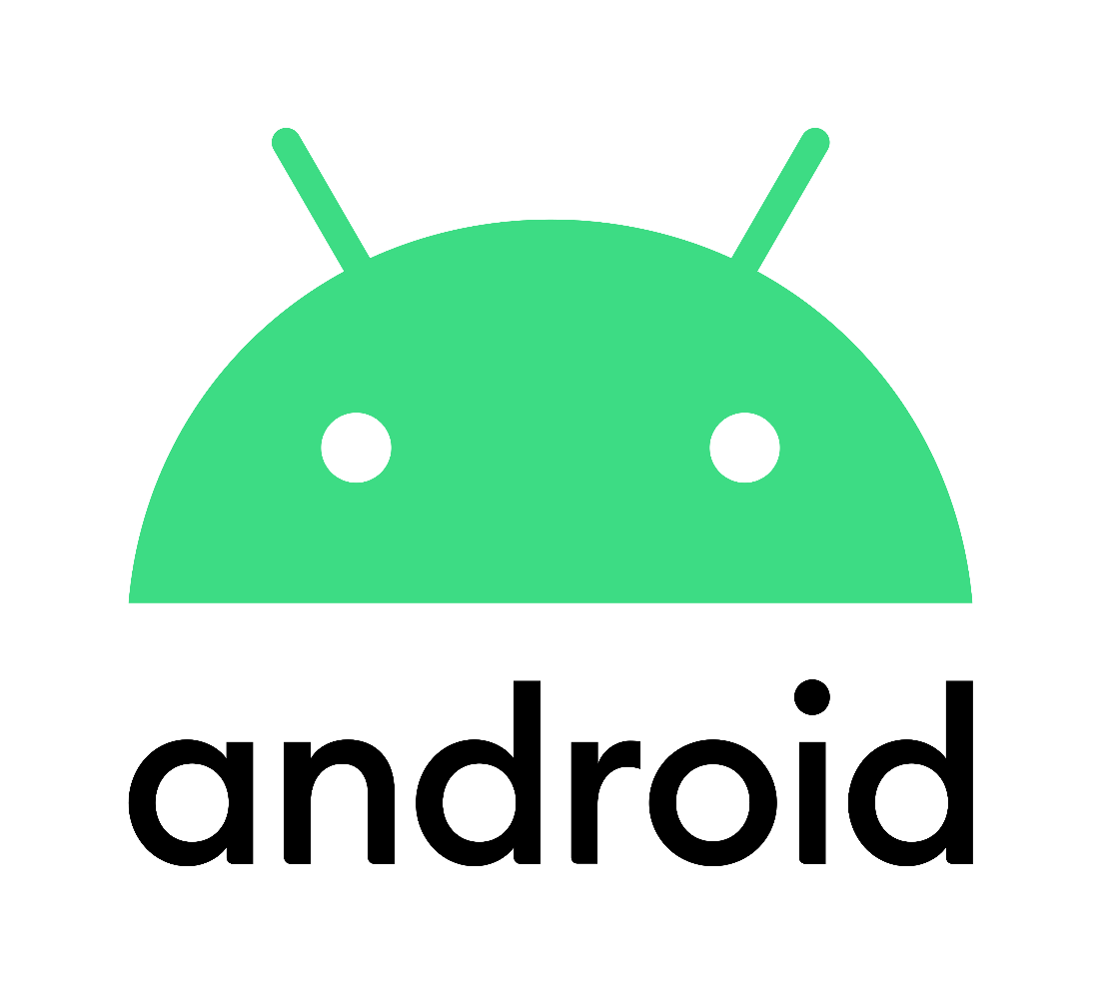
Android
Free open-source operating system that is based on Linux-kernel and other open-source softwares.
IT has an app store called Google Play.
It operates on:
Touchscreen devices (Cellphones, Tablets)
Wearable devices (Bracelets, Glasses)
Automobile (Cars).
~Courtesy: logodownload.org.

Slide 11
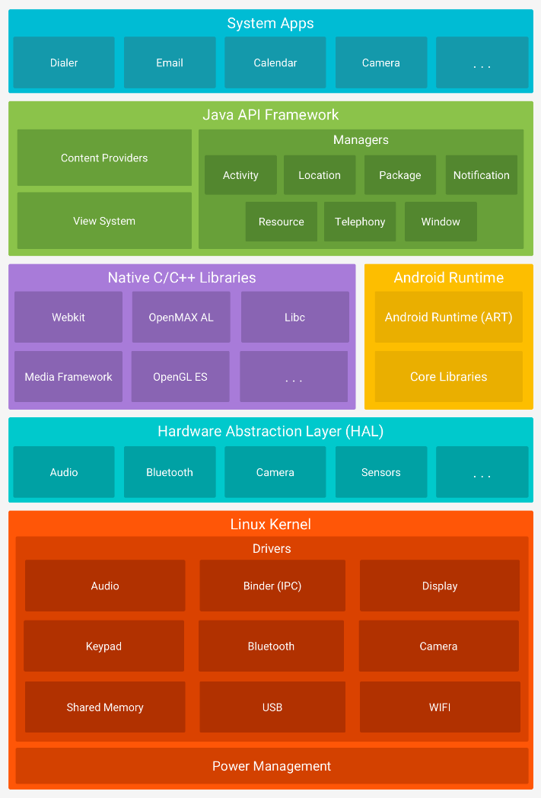
Android Kernel

Slide 12
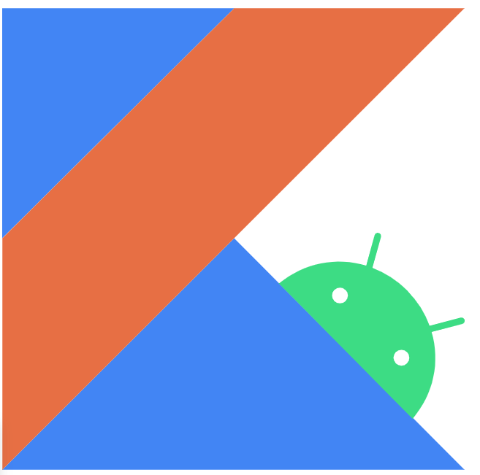
Kotlin
Java was the dominant programing language for Android apps.
Kotlin operates under Apache 2.0 open-source license. Cross-platform programming language.
It has it is own compiler that compile to Java 8 byte codes.
These Bytes can run on Java Virtual Machine JVM.
Why Google adopted Kotlin:
Easier to use.
10% faster than Android Java apps.
The developers pushed for it!
~Courtesy: developer.android.com.

Slide 13
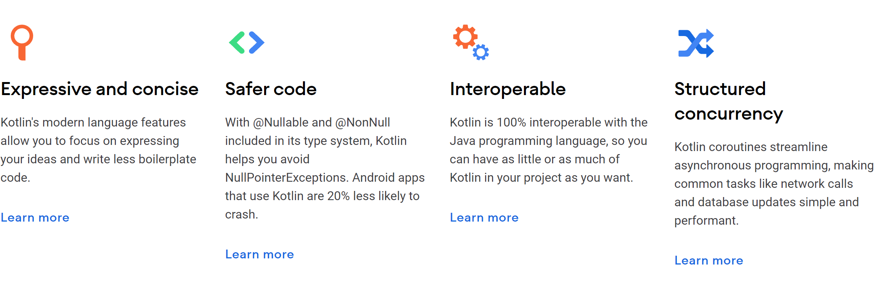
Because ..
~Courtesy: developer.android.com.

Slide 14
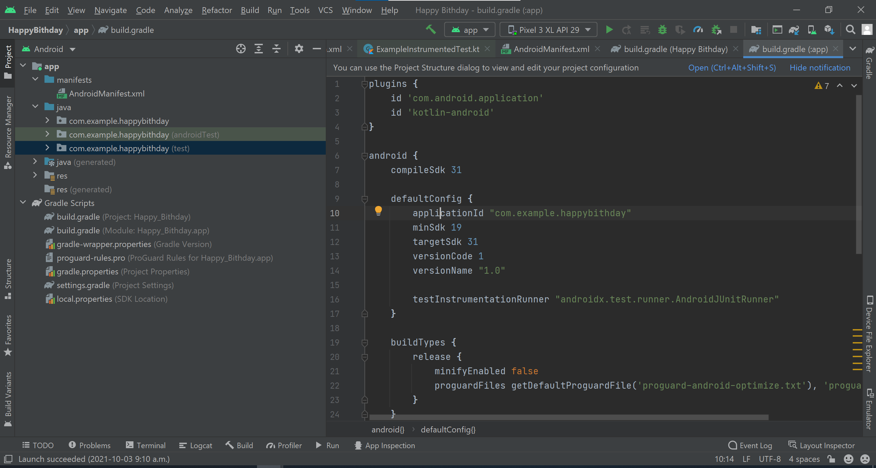
Android Studio
Android Studio is the official integrated development environment (IDE) for Google's Android operating system.
It was built on JetBrains' IntelliJ IDEA software and designed specifically for Android development.

Slide 15
Download and Install Android Studio
Open any web browser and go to https://developer.android.com/studio.
This page automatically detects your operating system.
Click Download Android Studio. The Terms and conditions page with the Android Studio license agreement opens.
Read the license agreement.
At the bottom of the page, if you agree with the terms and conditions, check "I have read and agree with the above terms and conditions".
Click Download Android Studio for... to start the download.
When prompted, save the file to a location where you can easily locate it (for example, the Desktop or Downloads folder).
Double-click the downloaded file.

Slide 16
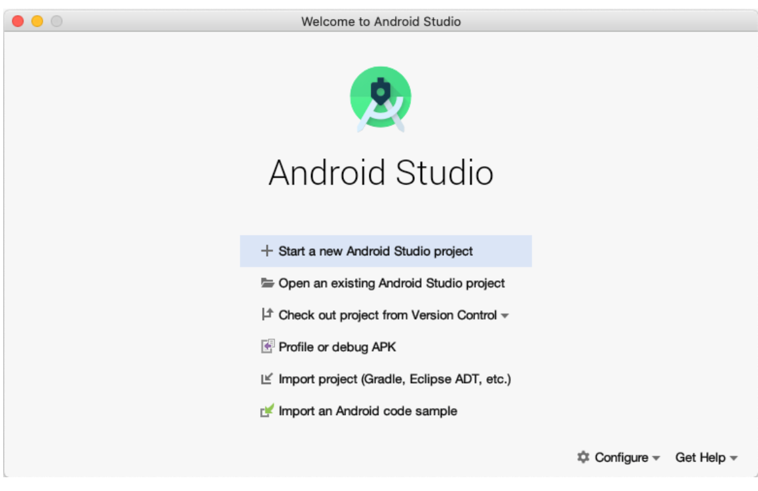
First App

Slide 17
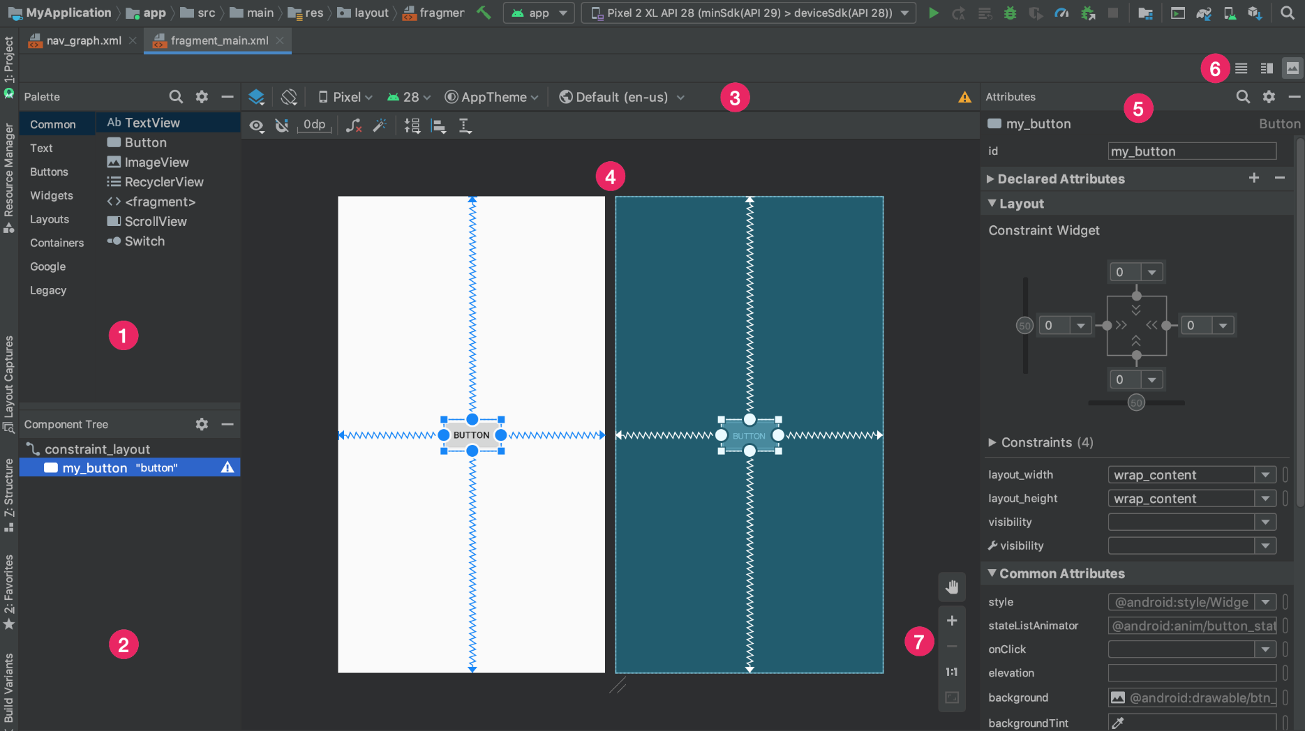
Android Studio – Layout Editor

Slide 18
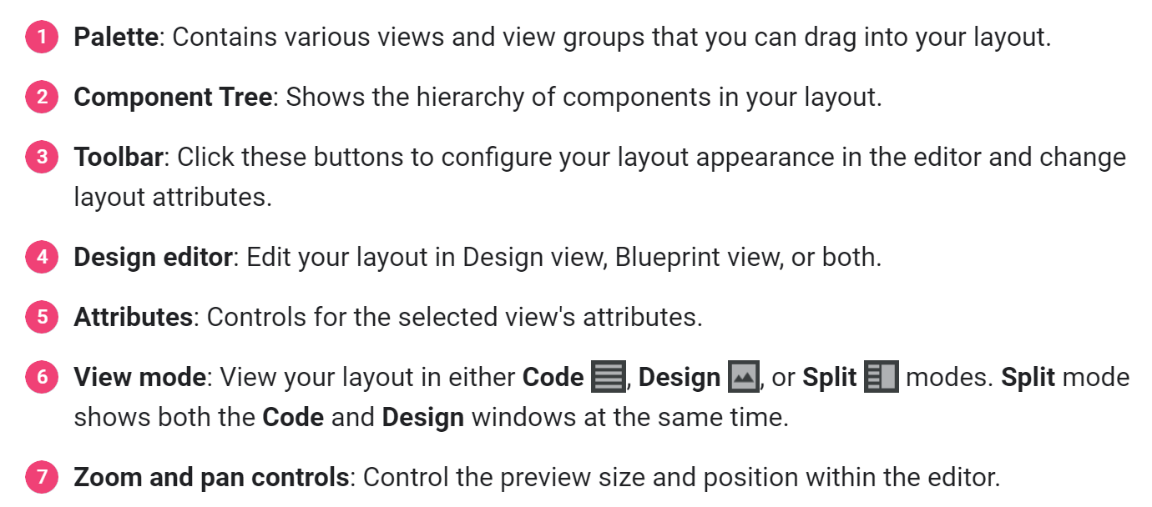
Android Studio – Layout Editor

Slide 19
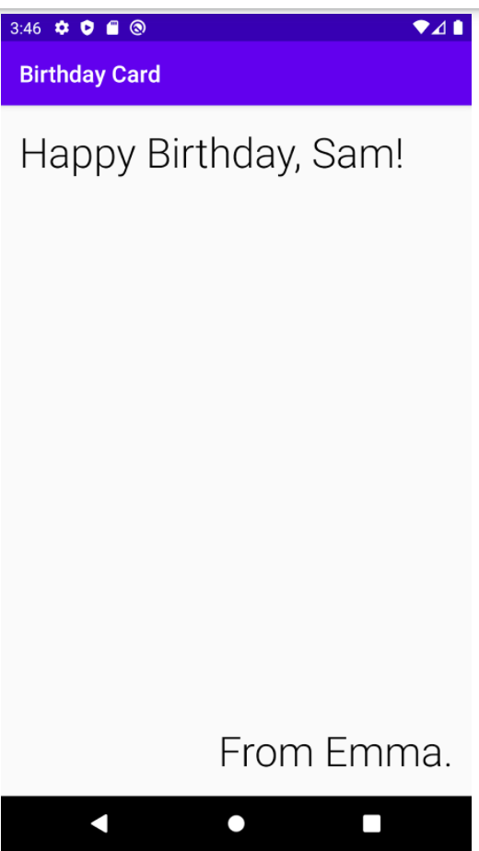
Lab1 – Birthday App
Follow the instructions here

Slide 20
References
Wikipedia.com
Android.com
developer.android.com
Blackberry.com
https://www.techyourchance.com/why-google-adopted-kotlin-for-android/

