Slide 1
ImageView
<Button android:id="@+id/showbtn" android:layout_width="wrap_content" android:layout_height="wrap_content" android:layout_marginTop="12dp" android:text="show" app:layout_constraintEnd_toEndOf="parent" app:layout_constraintHorizontal_bias="0.498" app:layout_constraintStart_toStartOf="parent" app:layout_constraintTop_toBottomOf="@+id/imageView" /> <Button android:id="@+id/hidebtn" android:layout_width="wrap_content" android:layout_height="wrap_content" android:layout_marginTop="20dp" android:text="hide" app:layout_constraintEnd_toEndOf="parent" app:layout_constraintHorizontal_bias="0.489" app:layout_constraintStart_toStartOf="parent" app:layout_constraintTop_toBottomOf="@+id/showbtn" /> <Button android:id="@+id/changebtn" android:layout_width="wrap_content" android:layout_height="wrap_content" android:text="change" app:layout_constraintBottom_toBottomOf="parent" app:layout_constraintEnd_toEndOf="parent" app:layout_constraintHorizontal_bias="0.501" app:layout_constraintStart_toStartOf="parent" app:layout_constraintTop_toBottomOf="@+id/hidebtn" app:layout_constraintVertical_bias="0.075" /> </androidx.constraintlayout.widget.ConstraintLayout>
Create an empty activity project, and name
it ImageView
The following is activity_main.xml
<?xml version="1.0" encoding="utf-8"?> <androidx.constraintlayout.widget.ConstraintLayout
xmlns:android="http://schemas.android.com/apk/res/android" xmlns:app="http://schemas.android.com/apk/res-auto" xmlns:tools="http://schemas.android.com/tools" android:layout_width="match_parent" android:layout_height="match_parent" tools:context=".MainActivity"> <ImageView android:id="@+id/imageView" android:layout_width="wrap_content" android:layout_height="wrap_content" android:layout_marginTop="4dp" android:src="@drawable/smile" app:layout_constraintEnd_toEndOf="parent" app:layout_constraintHorizontal_bias="0.498" app:layout_constraintStart_toStartOf="parent" app:layout_constraintTop_toTopOf="parent" tools:srcCompat="@tools:sample/avatars" />

Slide 2
MainActivity.kt
package com.example.imageview import androidx.appcompat.app.AppCompatActivity import android.os.Bundle import android.view.View import android.widget.Button import android.widget.ImageView import android.widget.Toast import androidx.core.content.ContextCompat class MainActivity : AppCompatActivity() { override fun onCreate(savedInstanceState: Bundle?) { super.onCreate(savedInstanceState) setContentView(R.layout.activity_main) var show:Button = findViewById(R.id.showbtn) var hide:Button = findViewById(R.id.hidebtn) var change:Button = findViewById(R.id.changebtn) var image:ImageView = findViewById(R.id.imageView) show.setOnClickListener(){ image.setVisibility(View.VISIBLE); Toast.makeText(this,"show",Toast.LENGTH_LONG).show() }
hide.setOnClickListener(){ image.setVisibility(View.INVISIBLE); Toast.makeText(this,"hide",Toast.LENGTH_LONG).show() } change.setOnClickListener(){ image.setImageDrawable( ContextCompat.getDrawable( applicationContext, // Context R.drawable.sad // Drawable ) ) Toast.makeText(this,"change",Toast.LENGTH_LONG).show() } } }

Slide 3
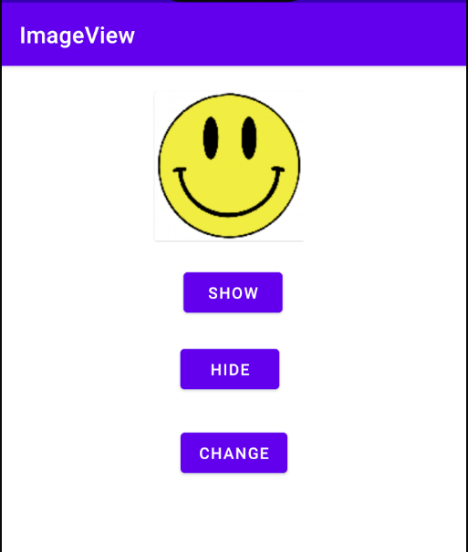
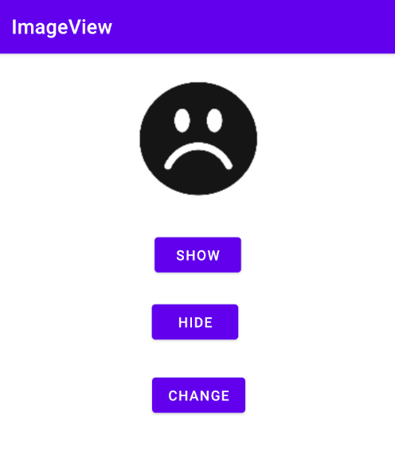
Let’s try it

Slide 4



Sensors

Slide 5
Sensors
Android system empowers the devices to observe data and provide measurements/ indicators such as:
Motion sensors
Position sensors
Environmental sensors
Raw GNSS Measurements

Slide 6
Android 3-D Coordinates
Android Accelerometer collects:
Acceleration along X-Axis
Acceleration along Y-Axis
Acceleration along Z-Axis
y
x
z

Slide 7
Accelorometer
New -> Project from version control
->https://github.com/federicocotogno/accelerometer.git
The MainActivity extends SensorEventListener
The activity_main.xml uses RelativeLayout.
RelativeLayout is a view group that displays child views in relative positions.
A RelativeLayout is a very powerful utility for designing a user interface because it can eliminate nested view groups and keep your layout hierarchy flat, which improves performance.

Slide 8
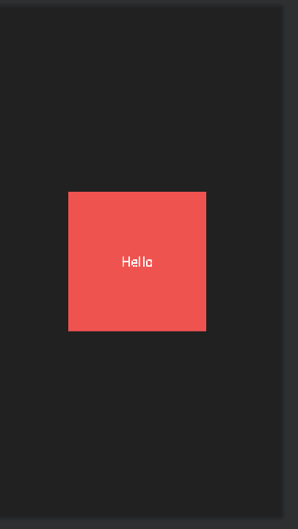
Activity_main.xml
<?xml version="1.0" encoding="utf-8"?> <RelativeLayout xmlns:android="http://schemas.android.com/apk/res/android" xmlns:app="http://schemas.android.com/apk/res-auto" xmlns:tools="http://schemas.android.com/tools" android:layout_width="match_parent" android:layout_height="match_parent" android:background="#212121" tools:context=".MainActivity"> <TextView android:id="@+id/tv_square" android:layout_width="200dp" android:layout_height="200dp" android:layout_centerInParent="true" android:background="#EF5350" android:gravity="center" android:text="Hello" android:textColor="@color/white" android:textSize="20sp" /> </RelativeLayout>

Slide 9
imports
package com.codepalace.accelerometer import android.graphics.Color import android.hardware.Sensor import android.hardware.SensorEvent import android.hardware.SensorEventListener import android.hardware.SensorManager import androidx.appcompat.app.AppCompatActivity import android.os.Bundle import android.widget.TextView import androidx.appcompat.app.AppCompatDelegate

Slide 10
MainActivity.kt
class MainActivity : AppCompatActivity(), SensorEventListener { private lateinit var sensorManager: SensorManager private lateinit var square: TextView override fun onCreate(savedInstanceState: Bundle?) { super.onCreate(savedInstanceState) setContentView(R.layout.activity_main) // Keeps phone in light mode AppCompatDelegate.setDefaultNightMode(AppCompatDelegate.MODE_NIGHT_NO) square = findViewById(R.id.tv_square) setUpSensorStuff() }
MainActivity starts here!

Slide 11
setUpSensorStuff()
private fun setUpSensorStuff() { // Create the sensor manager sensorManager = getSystemService(SENSOR_SERVICE) as SensorManager // Specify the sensor you want to listen to sensorManager.getDefaultSensor(Sensor.TYPE_ACCELEROMETER)?.also { accelerometer -> sensorManager.registerListener( this, accelerometer, SensorManager.SENSOR_DELAY_FASTEST, SensorManager.SENSOR_DELAY_FASTEST ) } }

Slide 12
onSensorChanged
override fun onSensorChanged(event: SensorEvent?) { // Checks for the sensor we have registered if (event?.sensor?.type == Sensor.TYPE_ACCELEROMETER) { //Log.d("Main", "onSensorChanged: sides ${event.values[0]} front/back ${event.values[1]} ") // Sides = Tilting phone left(10) and right(-10) val sides = event.values[0] // Up/Down = Tilting phone up(10), flat (0), upside-down(-10) val upDown = event.values[1] square.apply { rotationX = upDown * 3f rotationY = sides * 3f rotation = -sides translationX = sides * -10 translationY = upDown * 10 } // Changes the colour of the square if it's completely flat val color = if (upDown.toInt() == 0 && sides.toInt() == 0) Color.GREEN else Color.RED square.setBackgroundColor(color) square.text = "up/down ${upDown.toInt()}\nleft/right ${sides.toInt()}" } }

Slide 13
Finish overrides!
override fun onAccuracyChanged(sensor: Sensor?, accuracy: Int) { return } override fun onDestroy() { sensorManager.unregisterListener(this) super.onDestroy() } }
MainActivity is done here!

Slide 14
References
https://developer.android.com/guide/topics/sensors/sensors_overview
https://github.com/federicocotogno/accelerometer

