Slide 1



Service

Slide 2

Service
Recall

Slide 3
Service
A service is a component that runs in the background to perform long-running operations such:
playing music.
handle network transactions.
interacting with content providers without needing to interact with the user and it works even if the application is destroyed.
It doesn’t have any UI (user interface).
Service is a subclass of ContextWrapper class.
android.app.Service

Slide 4
Service
A service can essentially take two states:
Started:
A service is started when a component (like activity) calls the startService() method, now it runs in the background indefinitely.
It is stopped by the stopService() method. The service can stop itself by calling the stopSelf() method.
Bound:
A service is bound when another component (e.g. client) calls the bindService() method.
A bound service offers a client-server interface that allows components to interact with the service, send requests, get results, and even do so across processes with interprocess communication (IPC).
The client can unbind the service by calling the unbindService() method.

Slide 5
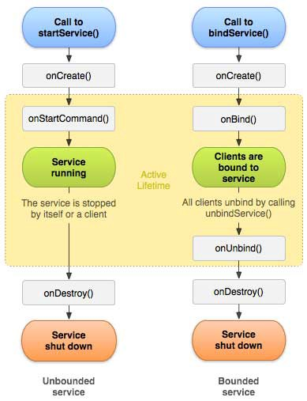
Service Life Cycle
~courtesy: Stackoverflow

Slide 6
Service – callback methods
onStartCommand():
The system calls this method when another component, such as an activity, requests that the service be started, by invoking startService().
When this method executes, the service is started and can run in the background indefinitely.
If you implement make sure to stop the service when its work is done, by calling stopSelf() or stopService() methods.
onBind():
The system calls this method when another component wants to bind with the service by calling bindService().
If you implement this method, you must provide an interface that clients use to communicate with the service, by returning an IBinder object.
You must always implement this method, but if you don’t want to allow binding, then you should return null.
onUnbind():
The system calls this method when all clients have disconnected from a particular interface published by the service.

Slide 7
Service – callback methods
onRebind():
The system calls this method when new clients have connected to the service after it had previously been notified that all had disconnected in its onUnbind(Intent).
onCreate():
The system calls this method when the service is first created using onStartCommand() or onBind().
This call is required to perform a one-time set-up.
onDestroy():
The system calls this method when the service is no longer used and is being destroyed.
Your service should implement this to clean up any resources such as threads, registered listeners, receivers, etc.

Slide 8
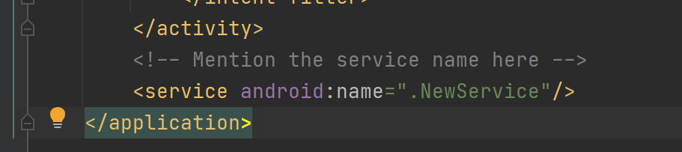
Media Player Project
Create a new empty activity project and name it MediaPlayerService.
In the AndroidManifest.xml, please mention the service inside the <application> tag:
This is the servie that we are going to implement

Slide 9

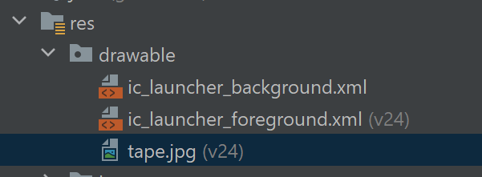
Image file
Download tape.jpg from e-learning resources menu, dagr drop it in the drawable folder

Slide 10
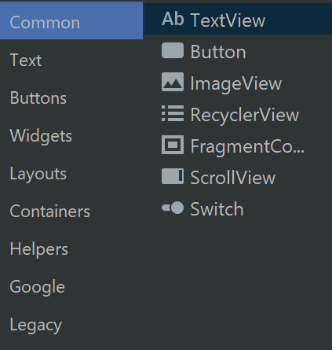
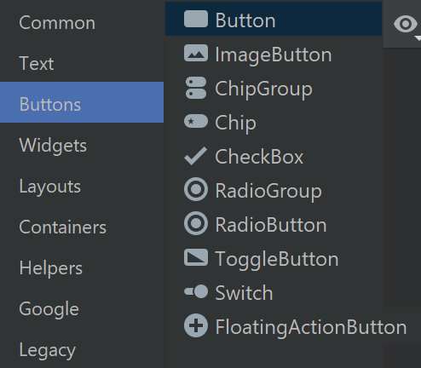
acitivity_main.xml
<?xml version="1.0" encoding="utf-8"?> <androidx.constraintlayout.widget.ConstraintLayout xmlns:android="http://schemas.android.com/apk/res/android" xmlns:app="http://schemas.android.com/apk/res-auto" xmlns:tools="http://schemas.android.com/tools" android:layout_width="match_parent" android:layout_height="match_parent" android:background="#168BC34A" tools:context="MainActivity"> <LinearLayout android:id="@+id/linearLayout" android:layout_width="match_parent" android:layout_height="wrap_content" android:layout_centerVertical="true" android:orientation="vertical" app:layout_constraintBottom_toBottomOf="parent" app:layout_constraintEnd_toEndOf="parent" app:layout_constraintStart_toStartOf="parent" app:layout_constraintTop_toTopOf="parent" app:layout_constraintVertical_bias="1.0" tools:ignore="MissingConstraints"> <ToggleButton android:id="@+id/toggle1" android:layout_width="wrap_content" android:layout_height="wrap_content" android:layout_marginLeft="100dp" android:layout_marginTop="120dp" android:checked="true" android:textOff="OFF" android:textOn="ON" />
<TextView android:id="@+id/textView1" android:layout_width="match_parent" android:layout_height="wrap_content" android:layout_marginBottom="170dp" android:text="@string/heading" android:textAlignment="center" android:textAppearance="@style/TextAppearance.AppCompat.Large" android:textColor="@android:color/holo_green_dark" android:textSize="36sp" android:textStyle="bold" /> <ImageView android:id="@+id/imageView" android:layout_width="match_parent" android:layout_height="wrap_content" android:layout_marginTop="80dp" android:src="@drawable/tape" /> </LinearLayout> </androidx.constraintlayout.widget.ConstraintLayout>
ImageView can be found in Common
ToggleButton in Buttons

Slide 11
MainActivity.kt
package com.example.mediaplayerservice import android.content.Intent import android.os.Bundle import android.view.View import android.widget.ToggleButton import androidx.appcompat.app.AppCompatActivity class MainActivity : AppCompatActivity() { override fun onCreate(savedInstanceState: Bundle?) { super.onCreate(savedInstanceState) setContentView(R.layout.activity_main) val toggle = findViewById<View>(R.id.toggle1) as ToggleButton toggle.setOnCheckedChangeListener { buttonView, isChecked -> if (isChecked) { startService(Intent(this, NewService::class.java)) } else { stopService(Intent(this, NewService::class.java)) } } } }
Toggle Listener
For both cases: Checked and unChecked
startService() and stopService() change the status of the service

Slide 12
NewService.kt
package com.example.mediaplayerservice import android.app.Service import android.content.Intent import android.media.MediaPlayer import android.os.IBinder import android.provider.Settings class NewService : Service() { private lateinit var player:MediaPlayer override fun onStartCommand(intent: Intent, flags: Int, startId: Int): Int { player = MediaPlayer.create(this, Settings.System.DEFAULT_RINGTONE_URI) player.setLooping(true) // starting the process player.start() // returns the status of the program return START_STICKY } // execution of the service will stop on calling this method override fun onDestroy() { super.onDestroy() // stopping the process player.stop() } override fun onBind(intent: Intent): IBinder? { return null } }
This will run when the activity starts this service
This will run when the activity stops this service
This is a must to override

Slide 13
Foreground Service
Create an empty acrtivity project and name it as ForegroundSerivce.
ForegroundService must be defined in the app manifest
To use ForegroundService, you need to <use-permission> in the app manifest.
ForegroundService must have a notification.

Slide 14
Menifest.xml
<?xml version="1.0" encoding="utf-8"?> <manifest xmlns:android="http://schemas.android.com/apk/res/android" package="com.example.foregroundservice"> <uses-permission android:name="android.permission.FOREGROUND_SERVICE"/ <application android:allowBackup="true" android:icon="@mipmap/ic_launcher" android:label="@string/app_name" android:roundIcon="@mipmap/ic_launcher_round" android:supportsRtl="true" android:theme="@style/Theme.MyApplication"> <activity android:name=".MainActivity" android:exported="true"> <intent-filter> <action android:name="android.intent.action.MAIN" /> <category android:name="android.intent.category.LAUNCHER" /> </intent-filter> </activity> <service android:name=".ForegroundService" android:enabled="true" android:exported="true"></service> </application> </manifest>

Slide 15
Implementing the service
Create ForegroundService.kt service
class ForegroundService : Service() { private val CHANNEL_ID = "ForegroundService Kotlin" companion object { fun startService(context: Context, message: String) { val startIntent = Intent(context, ForegroundService::class.java) startIntent.putExtra("inputExtra", message) ContextCompat.startForegroundService(context, startIntent) } fun stopService(context: Context) { val stopIntent = Intent(context, ForegroundService::class.java) context.stopService(stopIntent) } }
}
package com.example.foregroundservice import android.app.NotificationChannel import android.app.NotificationManager import android.app.PendingIntent import android.app.Service import android.content.Context import android.content.Intent import android.os.Build import android.os.IBinder import androidx.core.app.NotificationCompat import androidx.core.content.ContextCompat

Slide 16
ForegroundService.kt
Add the remaining function in the class
override fun onStartCommand(intent: Intent?, flags: Int, startId: Int): Int { //do heavy work on a background thread val input = intent?.getStringExtra("inputExtra") createNotificationChannel() val notificationIntent = Intent(this, MainActivity::class.java) val pendingIntent = PendingIntent.getActivity( this, 0, notificationIntent, 0 ) val notification = NotificationCompat.Builder(this, CHANNEL_ID) .setContentTitle("Foreground Service Kotlin Example") .setContentText(input) .setSmallIcon(R.drawable.ic_launcher_foreground) .setContentIntent(pendingIntent) .build() startForeground(1, notification) //stopSelf(); return START_NOT_STICKY }
override fun onBind(intent: Intent): IBinder? { return null } private fun createNotificationChannel() { if (Build.VERSION.SDK_INT >= Build.VERSION_CODES.O) { val serviceChannel = NotificationChannel(CHANNEL_ID,
"Foreground Service Channel", NotificationManager.IMPORTANCE_DEFAULT) val manager = getSystemService(NotificationManager::class.java) manager!!.createNotificationChannel(serviceChannel) } } }

Slide 17
MainActivity.kt
package com.example.foregroundservice import android.content.Intent import android.os.Bundle import android.view.View import android.widget.Button import androidx.appcompat.app.AppCompatActivity import androidx.core.content.ContextCompat class MainActivity : AppCompatActivity() { var btnStartService: Button? = null var btnStopService: Button? = null override fun onCreate(savedInstanceState: Bundle?) { super.onCreate(savedInstanceState) setContentView(R.layout.activity_main) val btnStartService:Button = findViewById(R.id.buttonStartService) val btnStopService:Button = findViewById(R.id.buttonStopService) btnStartService.setOnClickListener(View.OnClickListener { startService() }) btnStopService.setOnClickListener(View.OnClickListener { stopService() }) } fun startService() { val serviceIntent = Intent(this, ForegroundService::class.java) serviceIntent.putExtra("inputExtra", "Foreground Service Example in Android") ContextCompat.startForegroundService(this, serviceIntent) } fun stopService() { val serviceIntent = Intent(this, ForegroundService::class.java) stopService(serviceIntent) } }

Slide 18
Activity_main.xml
<?xml version="1.0" encoding="utf-8"?> <androidx.constraintlayout.widget.ConstraintLayout xmlns:android="http://schemas.android.com/apk/res/android" xmlns:app="http://schemas.android.com/apk/res-auto" xmlns:tools="http://schemas.android.com/tools" android:layout_width="match_parent" android:layout_height="match_parent" tools:context=".MainActivity"> <Button android:id="@+id/buttonStartService" android:layout_width="wrap_content" android:layout_height="wrap_content" android:layout_marginStart="8dp" android:layout_marginEnd="8dp" android:background="@color/teal_700" android:padding="16dp" android:text="Start Service" android:textColor="#fff" app:layout_constraintBottom_toTopOf="@+id/buttonStopService" app:layout_constraintEnd_toEndOf="parent" app:layout_constraintHorizontal_bias="0.5" app:layout_constraintStart_toStartOf="parent" app:layout_constraintTop_toTopOf="parent" app:layout_constraintVertical_chainStyle="packed" /> >
<Button android:id="@+id/buttonStopService" android:layout_width="wrap_content" android:layout_height="wrap_content" android:layout_marginStart="8dp" android:layout_marginTop="24dp" android:layout_marginEnd="8dp" android:layout_marginBottom="8dp" android:background="@color/teal_700" android:padding="16dp" android:text="Stop Service" android:textColor="#fff" app:layout_constraintBottom_toBottomOf="parent" app:layout_constraintEnd_toEndOf="parent" app:layout_constraintHorizontal_bias="0.5" app:layout_constraintStart_toStartOf="parent" app:layout_constraintTop_toBottomOf="@+id/buttonStartService" app:layout_constraintVertical_bias="0.218" /> </androidx.constraintlayout.widget.ConstraintLayout>

Slide 19
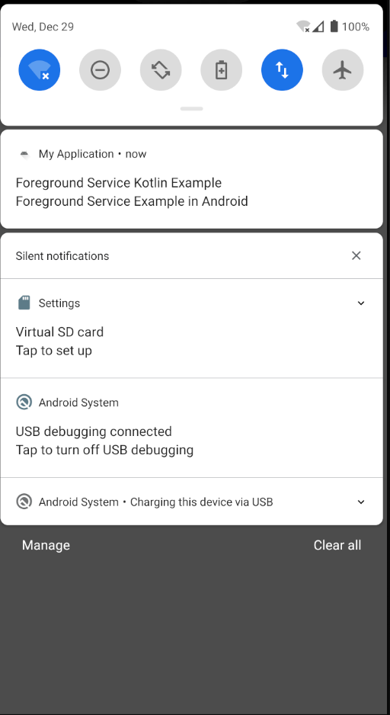
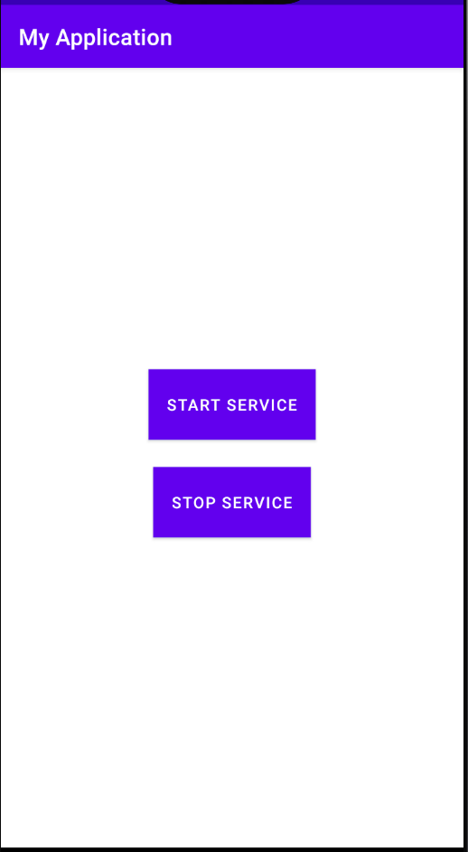
The app

Slide 20
References
Chetan, April 2021, https://csj5483.medium.com/basic-concepts-of-android-part-1-efdbcb1af92b.
https://developer.android.com/guide/components/services
https://www.geeksforgeeks.org/services-in-android-with-example/
https://androidwave.com/foreground-service-android-example/

