Slide 1



Notifications

Slide 2
Notification
Notification can be an alert, a message, or a status of an application
The app provides an update (message) to the user, while the app is not in use.
Type of notifications:
Status Bar Notification (appears in the same layout as the battery percentage, the current time)
Notification drawer Notification (appears in the drop-down menu)
Lock-Screen Notification
Heads-Up (overlay) Notification, e.g. Whatsapp notification, OTP messages)

Slide 3
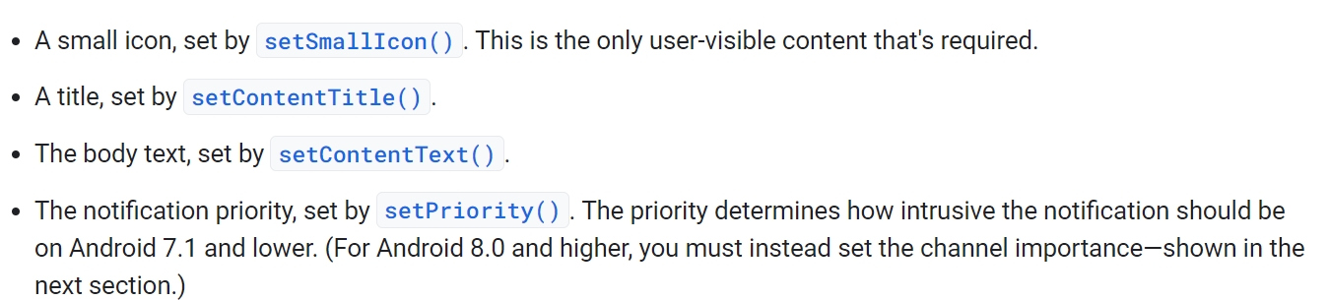
Notification
Some attributes including:

Slide 4
PendingIntent
An Intent description and target action to perform with it.
This Intent instance is used with the following functions:
getActivity(Context, int, Intent, int)
getActivities(Context, int, Intent[], int)
getBroadcast(Context, int, Intent, int)
getService(Context, int, Intent, int)
The returned object is handed to the explicitly specified class/application so they can do the specified class on your behalf.
In another words, Granting the other classes/application the right to do the task on your behalf.

Slide 5
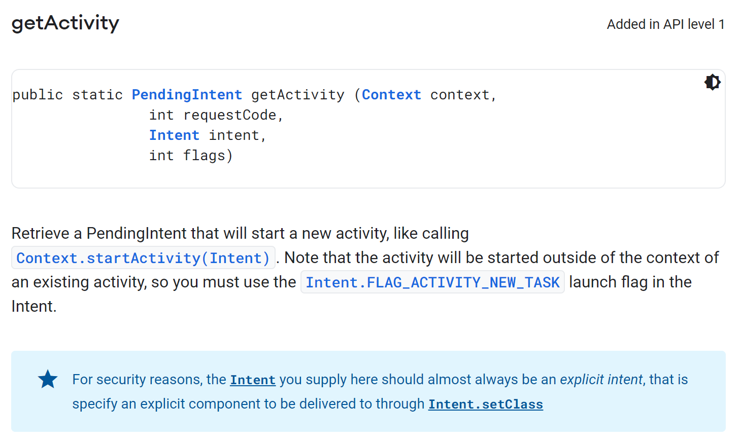
PendingIntent

Slide 6
Channels
You can have many channels, so the user can silence a specific channel without silencing the whole app.
channels can package the notifications based on similar business/logic.

Slide 7
Notifications app
Create new empty activity app name it Notifications.
In the MainActivity.kt insert the following imports
package com.example.notifications import AfterNotification import android.app.Notification.EXTRA_NOTIFICATION_ID import android.app.NotificationChannel import android.app.NotificationManager import android.app.PendingIntent import android.content.Context import android.content.Intent import android.os.Build import android.os.Bundle import android.widget.Button import androidx.annotation.RequiresApi import androidx.appcompat.app.AppCompatActivity import androidx.core.app.NotificationCompat import androidx.core.app.NotificationManagerCompat

Slide 8
Basic Notification
class MainActivity : AppCompatActivity() { private var notificationId1 :Int = 123 private var notificationId2 :Int = 234 private var notificationId3 :Int = 345 private val channelId = "App_Channel.testNotification" private val description = "Trying to test different types notification" private fun basicNotification() { val builder = NotificationCompat.Builder(this, channelId) .setSmallIcon(R.mipmap.ic_launcher) .setContentTitle("Test notification") .setContentText("Test Notification body") .setPriority(NotificationCompat.PRIORITY_DEFAULT) with(NotificationManagerCompat.from(this)) { notify(notificationId1, builder.build()) } }
}

Slide 9
Pending Notification
class MainActivity : AppCompatActivity() {
….
private fun pendingNotification() { val intent = Intent(this, MainActivity::class.java).apply { flags = Intent.FLAG_ACTIVITY_NEW_TASK or Intent.FLAG_ACTIVITY_CLEAR_TASK } val pendingIntent: PendingIntent = PendingIntent.getActivity(this, 0, intent, 0) val builder = NotificationCompat.Builder(this, channelId) .setSmallIcon(R.mipmap.ic_launcher) .setContentTitle("My notification") .setContentText("Hello World!") .setPriority(NotificationCompat.PRIORITY_DEFAULT) .setContentIntent(pendingIntent) .setAutoCancel(true) with(NotificationManagerCompat.from(this)) { notify(notificationId2, builder.build()) } }
}

Slide 10
class MainActivity : AppCompatActivity() {
….
@RequiresApi(Build.VERSION_CODES.O) private fun actionsNotification() { val snoozeIntent = Intent(this, MainActivity::class.java).apply { action = "snooze" putExtra(EXTRA_NOTIFICATION_ID, 0) } val snoozePendingIntent: PendingIntent = PendingIntent.getBroadcast(this, 0, snoozeIntent, 0) val builder = NotificationCompat.Builder(this, channelId) .setSmallIcon(R.mipmap.ic_launcher) .setContentTitle("My notification") .setContentText("Hello World!") .setPriority(NotificationCompat.PRIORITY_DEFAULT) .setContentIntent(snoozePendingIntent) .addAction( R.drawable.ic_launcher_background, "Snooze", snoozePendingIntent )
with(NotificationManagerCompat.from(this)) { notify(notificationId3, builder.build()) } val br: BroadcastReceiver = AfterNotification() val filter = IntentFilter(ConnectivityManager.CONNECTIVITY_ACTION).apply { addAction(Intent.ACTION_AIRPLANE_MODE_CHANGED) } registerReceiver(br, filter) }
}

Slide 11
Channel
class MainActivity : AppCompatActivity() {
….
private fun createNotificationChannel() { if (Build.VERSION.SDK_INT >= Build.VERSION_CODES.O) { val name = "test_notification" val descriptionText = description val importance = NotificationManager.IMPORTANCE_DEFAULT val channel = NotificationChannel(channelId, name, importance).apply { description = descriptionText } val notificationManager: NotificationManager = getSystemService(Context.NOTIFICATION_SERVICE) as NotificationManager notificationManager.createNotificationChannel(channel) } }
}

Slide 12
onCreate - Buttons
class MainActivity : AppCompatActivity() {
override fun onCreate(savedInstanceState: Bundle?) { super.onCreate(savedInstanceState) setContentView(R.layout.activity_main) createNotificationChannel() var btnShowNotification:Button= findViewById(R.id.btnShowNotification) var btnShowPendingNotification:Button = findViewById(R.id.btnShowPendingNotification) var btnShowActionNotification:Button = findViewById(R.id.btnShowActionNotification) btnShowNotification.setOnClickListener { basicNotification() } btnShowPendingNotification.setOnClickListener { pendingNotification() } btnShowActionNotification.setOnClickListener { //Checks the android version if (Build.VERSION.SDK_INT >= Build.VERSION_CODES.O) { actionsNotification() } } } }

Slide 13
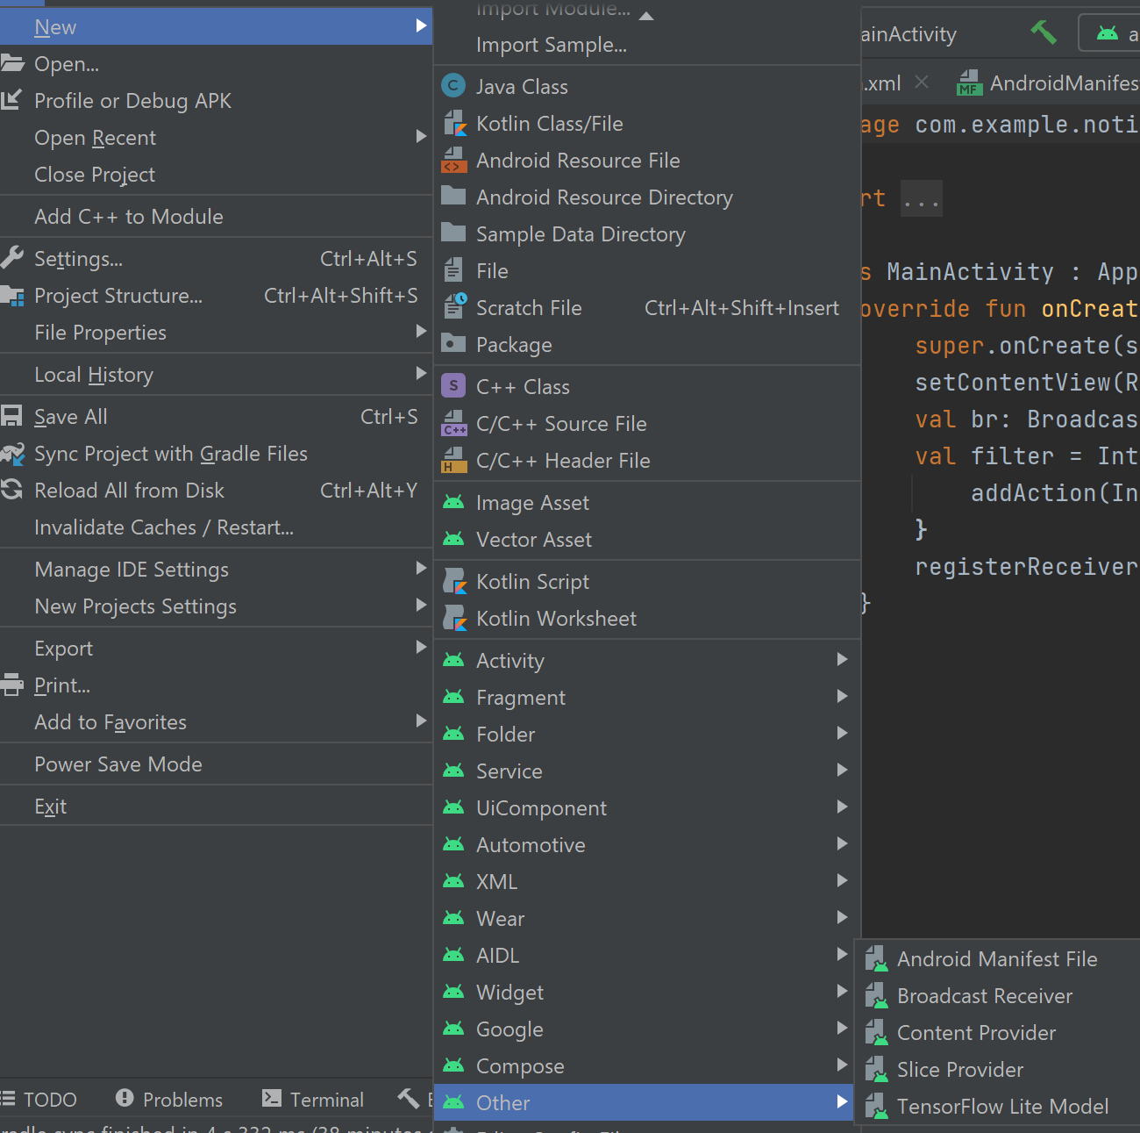
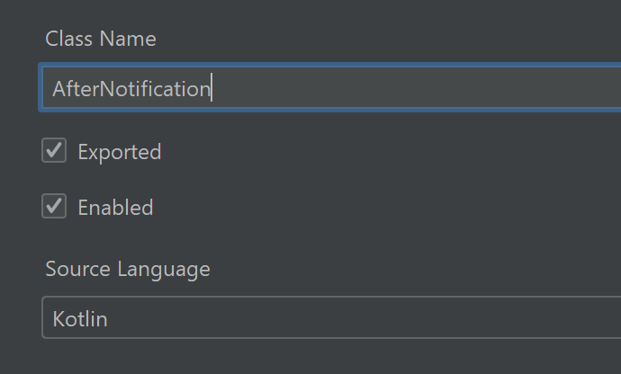
This will create a receiver class and change the manifest

Slide 14
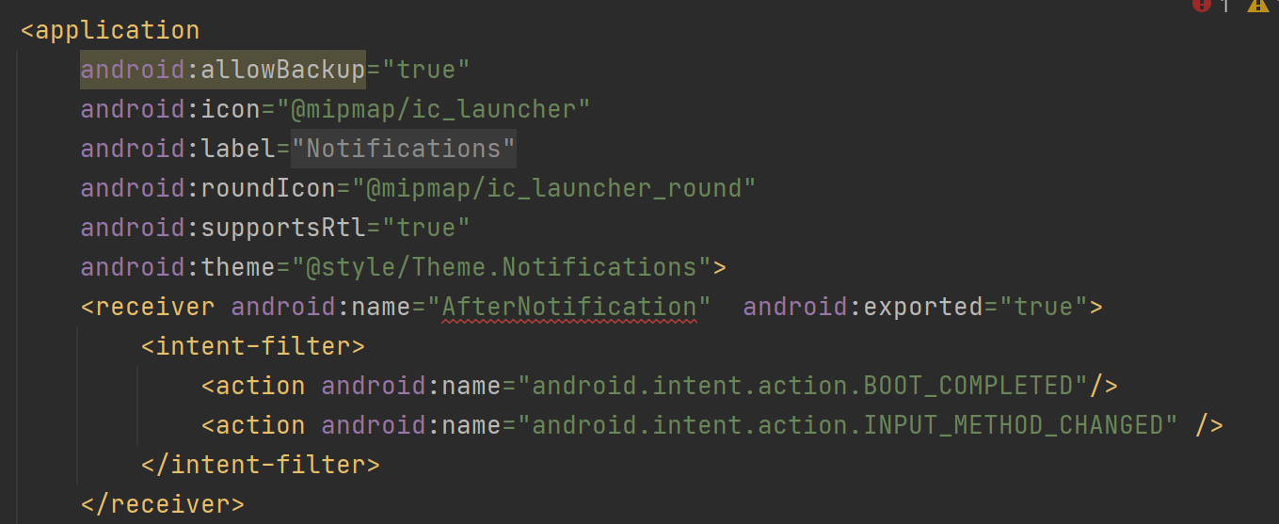
Receiver - Manifest

Slide 15
BroadcastReciver class
import android.content.BroadcastReceiver import android.content.Context import android.content.Intent import android.util.Log import android.widget.Toast private const val TAG = "MyBroadcastReceiver" class AfterNotification : BroadcastReceiver() { override fun onReceive(context: Context, intent: Intent) { StringBuilder().apply { append("Action: ${intent.action}\n") append("URI: ${intent.toUri(Intent.URI_INTENT_SCHEME)}\n") toString().also { log -> Log.d(TAG, log) Toast.makeText(context, log, Toast.LENGTH_LONG).show() } } } }

Slide 16
References
https://www.section.io/engineering-education/push-notification-in-nodejs-using-service-worker/

