Slide 1
Preliminary Plots Using New Georegions
2/24/2022

Slide 2
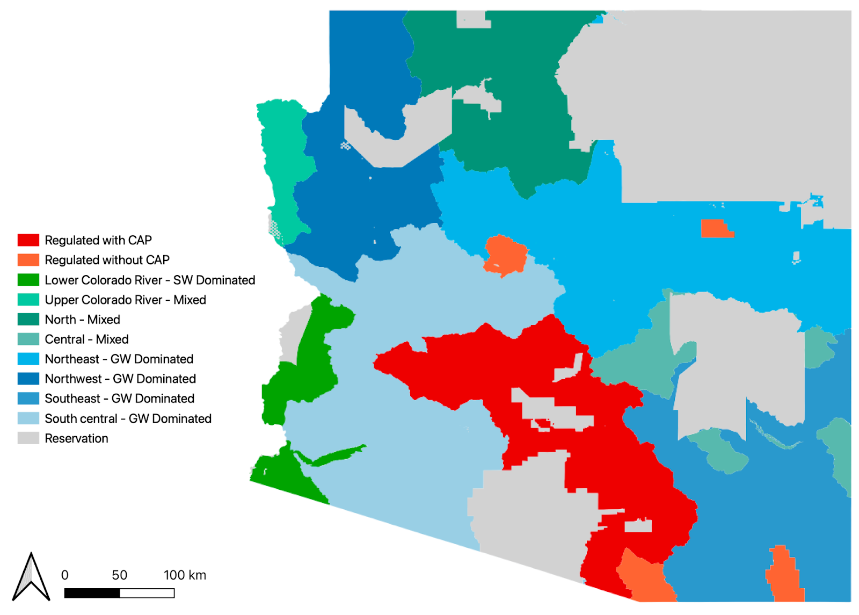

Slide 12
Wells (#)

Slide 13
Wells (#)

Slide 14
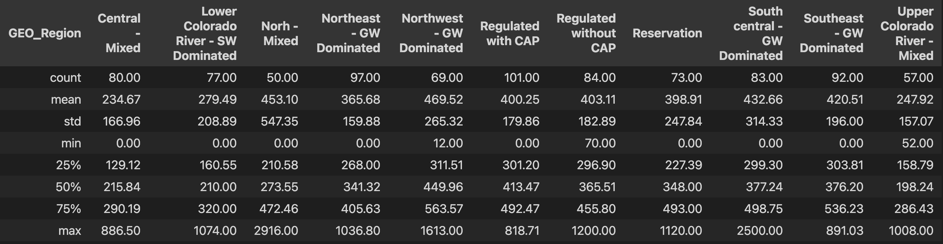
Well Depths for Each of the regions (ft)

Slide 26
Regulated vs. Unregulated

Slide 27
Regulated vs. Unregulated

