Slide 1
Web development using HTML5 & CSS3
Overview of CSS3
LEVEL – PRACTITIONER

Slide 2
Nirmala Devi Selvaraju(161124)
Nirmala Devi from Academy having 5+ years of experiences in Java/JEE technologies, HTML , HTML5, JavaScript, Ajax..

Slide 3









Icons Used
Hands on Exercise
Questions
Tools
Coding Standards
Test Your Understanding
Case Study
Best Practices & Industry Standards
Demonstration
Workshop

Slide 4
CSS3 : Overview
Introduction:
CSS3 is an extension of CSS 2.1: it adds a lot of features to make life easier for web designers and developers
CSS is used to control the style and layout of Web pages
CSS3 is the latest standard for CSS

Slide 5
Overview of CSS3 - Objectives
Objective:
After completing this chapter you will be able to understand :
About CSS
CSS2 vs CSS3
Rounded Corners: border-radius
Drop Shadows
Text Shadows
CSS3 Gradient Generator
CSS3 Transforms and Transitions
Fonts and Multicolumn Layouts
Pros and Cons of using CSS3

Slide 6
Whats CSS?
Cascading Style Sheets (CSS) is a style sheet language used for describing the presentation semantics (the look and formatting) of a document written in a markup language.
Its most common application is to style web pages written in HTML and XHTML, but the language can also be applied to any kind of XML document, including plain XML, SVG and XUL
File extension is .css
Content-type is “text/css”

Slide 7
CSS2 Vs CSS3
CSS 2 | CSS3
CSS2 was submitted as a single document with all the Cascading Style Sheets information within it. Because each of the modules is being worked on individually, we have a much wider range of browser support for CSS3 modules | CSS3 has been split up into different sections, called modules. Each of these modules is making it's way through the W3C in various stages of the recommendation process

Slide 8
What is meant by CSS3?
CSS3 is completely backwards compatible
CSS3 Modules
CSS3 is split up into "modules". The old specification has been split into smaller pieces, and new ones are also added.
Some of the most important CSS3 modules are:
Selectors
Box Model
Backgrounds and Borders
Text Effects
2D/3D Transformations
Animations
Multiple Column Layout
User Interface

Slide 9

CSS3 Borders
CSS3 Border properties :
border- radius
box-shadow
border-image
CSS3 Rounded Corners
In CSS2 , adding rounded corners in CSS2 was tricky . But in CSS3 , creating rounded corners is easy
border-radius property is used for creating rounded corners
Eg : div
{
border:2px solid;
border-radius:25px;
-moz-border-radius:25px; /* Firefox 3.6 and earlier */
}
For DEMO : Navigate to DEMO folder -> CSS3
Notes:
Link : http://www.css3.info/preview/border-image/

Slide 10


CSS3 Borders(Contd.)
CSS3 Box Shadow
It is used to add shadow to boxes
Eg: div
{
box-shadow: 10px 10px 5px #888888;
}
CSS3 Border Image
we can use image to create a border
Eg: div { border-image:url(border.png) 30 30 round; -moz-border-image:url(border.png) 30 30 round; /* Firefox */ -webkit-border-image:url(border.png) 30 30 round; /* Safari and Chrome */ -o-border-image:url(border.png) 30 30 round; /* Opera */ }
For DEMO : Navigate to DEMO folder -> CSS3

Slide 11

CSS3 Gradient Generator
The CSS3 gradient property is one of the most useful tools available to a web designer. It allows you to create stunning interfaces using gradients without the need for images
Each browser has their own prefix so the syntax can be quite complex
Eg :
#myDiv {
background: rgb(30, 50, 230);
background: -moz-linear-gradient(30deg, rgb(30, 50, 230) 30%, rgb(90, 140, 250) 70%);
background: -webkit-linear-gradient(30deg, rgb(30, 50, 230) 30%, rgb(90, 140, 250) 70%);
background: -o-linear-gradient(30deg, rgb(30, 50, 230) 30%, rgb(90, 140, 250) 70%);
background: -ms-linear-gradient(30deg, rgb(30, 50, 230) 30%, rgb(90, 140, 250) 70%);
background: linear-gradient(30deg, rgb(30, 50, 230) 30%, rgb(90, 140, 250) 70%);
}
For DEMO : Navigate to DEMO folder -> CSS3
Notes:
Link : http://css3gen.com/gradient-generator/

Slide 12
CSS3 Gradient Generator(Contd.)
Online CSS3 Generator
http://gradients.glrzad.com/
http://css3gen.com/gradient-generator/
Online Demo : http://www.youtube.com/watch?v=ryaAzv5PxlA

Slide 13
CSS3 Transforms
With CSS3 transform, we can move, scale, turn, spin, and stretch elements
A transform is an effect that lets an element change shape, size and position. We can transform your elements using 2D or 3D transformation
2D Transforms
translate()
rotate()
scale()
skew()
matrix()
rotateX()
rotateY()
3D Transforms
For DEMO : Navigate to DEMO folder -> CSS3

Slide 14
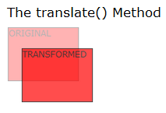
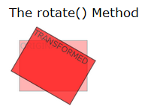
2D Transforms
With the translate() method, the element moves from its current position, depending on the parameters given for the left (X-axis) and the top (Y-axis) position
div { transform: translate(50px,100px); -ms-transform: translate(50px,100px); /* IE 9 */ -webkit-transform: translate(50px,100px); /* Safari and Chrome */ -o-transform: translate(50px,100px); /* Opera */ -moz-transform: translate(50px,100px); /* Firefox */ }
With the rotate() method, the element rotates clockwise at a given degree. Negative values are allowed and rotates the element counter-clockwise
div { transform: rotate(30deg); -ms-transform: rotate(30deg); /* IE 9 */ -webkit-transform: rotate(30deg); /* Safari and Chrome */ -o-transform: rotate(30deg); /* Opera */ -moz-transform: rotate(30deg); /* Firefox */ }

Slide 15
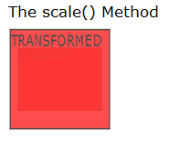
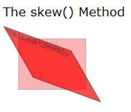
2D Transforms(Contd.)
With the scale() method, the element increases or decreases the size, depending on the parameters given for the width (X-axis) and the height (Y-axis):
div { transform: scale(2,4); -ms-transform: scale(2,4); /* IE 9 */ -webkit-transform: scale(2,4); /* Safari and Chrome */ -o-transform: scale(2,4); /* Opera */ -moz-transform: scale(2,4); /* Firefox */ }
With the skew() method, the element turns in a given angle, depending on the parameters given for the horizontal (X-axis) and the vertical (Y-axis) lines
div { transform: skew(30deg,20deg); -ms-transform: skew(30deg,20deg); /* IE 9 */ -webkit-transform: skew(30deg,20deg); /* Safari and Chrome */ -o-transform: skew(30deg,20deg); /* Opera */ -moz-transform: skew(30deg,20deg); /* Firefox */ }

Slide 16
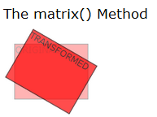
2D Transforms(Contd.)
The matrix() method combines all of the 2D transform methods into one.
div { transform:matrix(0.866,0.5,-0.5,0.866,0,0); -ms-transform:matrix(0.866,0.5,-0.5,0.866,0,0); /* IE 9 */ -moz-transform:matrix(0.866,0.5,-0.5,0.866,0,0); /* Firefox */ -webkit-transform:matrix(0.866,0.5,-0.5,0.866,0,0); /* Safari and Chrome */ -o-transform:matrix(0.866,0.5,-0.5,0.866,0,0); /* Opera */ }
For DEMO : Navigate to DEMO folder -> CSS3

Slide 17
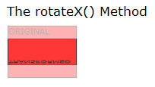
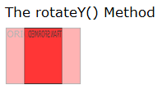
3D Transforms
With the rotateX() method, the element rotates around its X-axis at a given degree.
div { transform: rotateX(120deg); -webkit-transform: rotateX(120deg); /* Safari and Chrome */ -moz-transform: rotateX(120deg); /* Firefox */ }
With the rotateY() method, the element rotates around its Y-axis at a given degree
div { transform: rotateY(130deg); -webkit-transform: rotateY(130deg); /* Safari and Chrome */ -moz-transform: rotateY(130deg); /* Firefox */ }
For DEMO : Navigate to DEMO folder -> CSS3

Slide 18
CSS3 Transition
With CSS3, we can add an effect when changing from one style to another, without using Flash animations or JavaScripts
CSS3 transitions are effects that will gradually change the element from one style to another.
To achieve this , we need to do two things:
Specify the CSS property you want to add an effect to
Specify the duration of the effect.
div { transition: width 2s; -moz-transition: width 2s; /* Firefox 4 */ -webkit-transition: width 2s; /* Safari and Chrome */ -o-transition: width 2s; /* Opera */ }
For DEMO : Navigate to DEMO folder -> CSS3

Slide 19
CSS3 Transition Properties
Property | Description
transition | A shorthand property for setting the four transition properties into a single property
transition-property | Specifies the name of the CSS property to which the transition is applied
transition-duration | Defines the length of time that a transition takes. Default 0
transition-timing-function | Describes how the speed during a transition will be calculated. Default "ease"
transition-delay | Defines when the transition will start. Default 0

Slide 20
CSS3 Fonts
Before CSS3, web designers had to use fonts that were already installed on the user's computer.
With CSS3, web designers can use whatever font he/she likes
Eg: 1
<style type="text/css"> @font-face { font-family: myFirstFont; src: url('Sansation_Light.ttf'), url('Sansation_Light.eot'); /* IE9+ */ } div { font-family:myFirstFont; } </style>
Eg :2
@font-face { font-family: myFirstFont; src: url('Sansation_Bold.ttf'), url('Sansation_Bold.eot'); /* IE9+ */ font-weight:bold; }
For DEMO : Navigate to DEMO folder -> CSS3

Slide 21
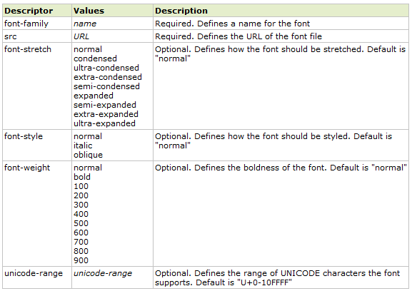
CSS3 Font Descriptors

Slide 22
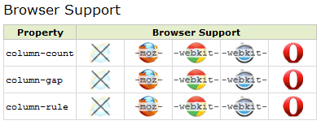
CSS3 Multicolumn Layouts
With CSS3, we can create multiple columns for laying out text - like in newspapers!
CSS3 Multiple column properties:
column-count
column-gap
column-rule

Slide 23
CSS3 Multicolumn Layouts(Contd.)
CSS3 Create Multiple Columns
Divide the text in a div element into three columns:
div { -moz-column-count:3; /* Firefox */ -webkit-column-count:3; /* Safari and Chrome */ column-count:3; }
CSS3 Specify the Gap Between Columns
Specify a 40 pixels gap between the columns:
div { -moz-column-gap:40px; /* Firefox */ -webkit-column-gap:40px; /* Safari and Chrome */ column-gap:40px; }
CSS3 Column Rules :
Specify the width, style and color of the rule between columns:
div { -moz-column-rule:3px outset #ff00ff; /* Firefox */ -webkit-column-rule:3px outset #ff00ff; /* Safari and Chrome */ column-rule:3px outset #ff00ff; }

Slide 24
Advantages of CSS3
Learning Language - CSS3 is a much easier language to learn, especially for all those front end developers out there that have been coding CSS2 for years and simply want to add a few extra aesthetics to their sites
Size - CSS3 is much smaller. The code is tiny in comparison and you can work it straight into your standard stylesheets
Implementation - CSS3 can be written straight into your standard stylesheet and there is no need for extra files. This means you can avoid linking to various libraries and files full of complicated code in the <head> of your html documents
Accessibility - Accessibility is really important on the Web, especially if you are designing sites that are potentially going to be visited by disabled users. As CSS3 will be part of the W3C Web Standards then it will be completely accessible, no matter what technology you are using to browse the Internet.

Slide 25
Disadvantages of CSS3
The biggest problem is compatibility with old browsers and even new ones. This is because CSS3 is still under development, actually there are different modules being developed separately.
Many properties have not even reached a mature syntax yet, this is why you will need to use prefixes like moz and webkit for those ones.

Slide 26


Questions from Participants
Questions from participants

Slide 27
Summary
Cascading Style Sheets (CSS) is a style sheet language used for describing the presentation semantics (the look and formatting) of a document written in a markup language
The CSS3 gradient property is one of the most useful tools available to a web designer. It allows you to create stunning interfaces using gradients without the need for images
A transform is an effect that lets an element change shape, size and position. We can transform your elements using 2D or 3D transformation

Slide 28

Source
Websites:
http://en.wikipedia.org/wiki/Cascading_Style_Sheets
http://webdesign.about.com/od/css3/a/differences-css2-css3.htm
CSS Border : http://www.sitepoint.com/css3-border-images/
http://www.whatcreative.co.uk/blog/tips/the-benefits-of-css3-vs-jquery/
CSS3 -Pros and Cons : http://a-developer-life.blogspot.in/2011/07/pros-and-cons-of-css3.html
Disclaimer: Parts of the content of this course is based on the materials available from the Web sites and books listed above. The materials that can be accessed from linked sites are not maintained by Cognizant Academy and we are not responsible for the contents thereof. All trademarks, service marks, and trade names in this course are the marks of the respective owner(s).

Slide 29
Web development using HTML5 & CSS3
You have successfully completed -
Overview of CSS3

