Slide 1
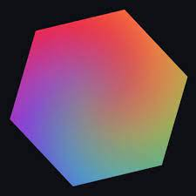
DreamStudio AI Tool
Unleash your creativity with AI-powered image generation
Tandel Divya
12102130601022

Slide 2
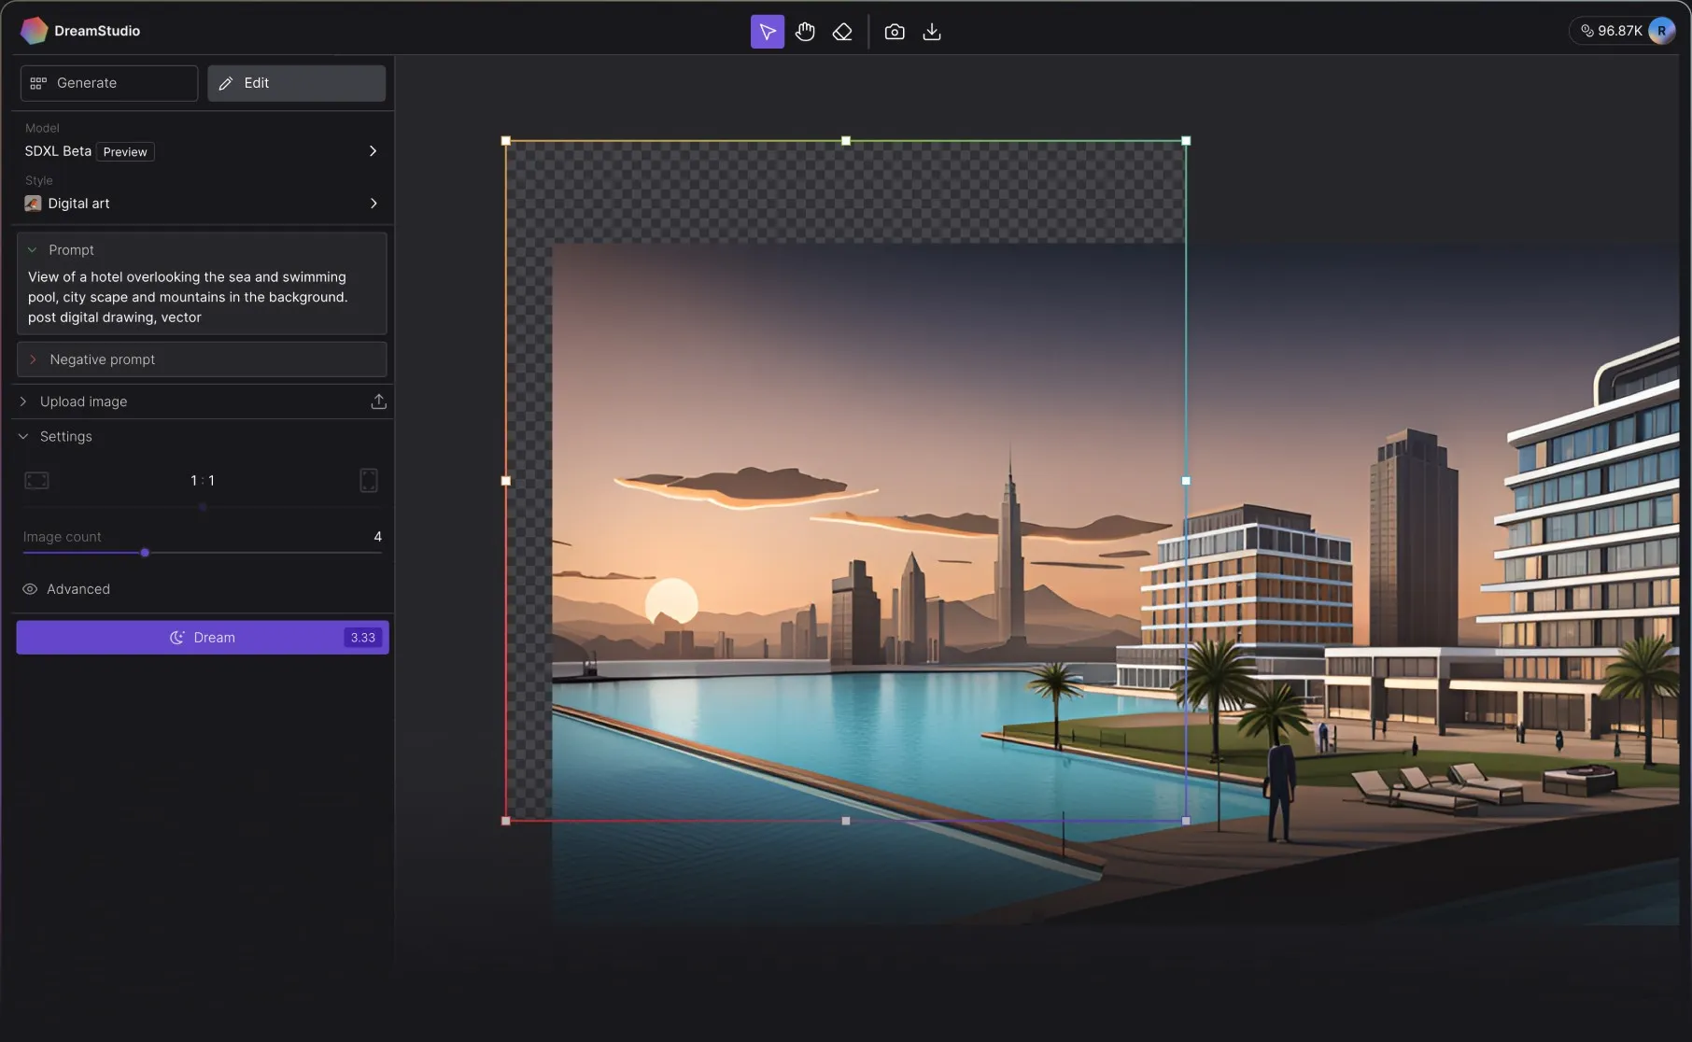
Overview
DreamStudio is an AI-powered platform that allows anyone to easily generate, edit, and modify images through text prompts.
It Utilizes Stable Diffusion models to create images in any style imaginable.

Slide 3
How Does DreamStudio Work?
DreamStudio uses a Text-to-Image AI model called Stable Diffusion to generate images.
You simply type a text prompt describing the image you want to create.
The AI will then generate an image matching the description.
You can iterate and refine the images by editing the text prompts.

Slide 4
Use Cases and Applications
Digital art
Create original artworks, illustrations, concept art etc.
Graphic design
Design logos, posters, marketing materials, presentations
Photography
Enhance, edit, or modify photos with inpainting and outpainting.
3D rendering
Use AI to quickly create realistic 3D renders and textures
Gaming
Design game assets like environments, characters, props etc.
Special effects
Add visual effects and touch up images/videos

Slide 5
Who is DreamStudio For?
Artists
Designers
Photographers
3D Artists
Game Developers
Marketers
Social Media Influencers
Students
AI Enthusiasts

Slide 6
Key Features and Benefits
Generate images
Create art, photos, and illustrations in any style with text prompts
Edit images
Seamlessly edit images by adding, removing, or modifying elements
Inpainting & Outpainting
Replace or add new elements in images with inpainting and outpainting
History
Revisit and iterate on past generated images
Canvas
Infinite workspace to visualize and create images
Cutting-edge AI
Use the latest and most advanced Stable Diffusion models

Slide 7
Thank You

