Slide 1


Slide 2
Online Quiz
Tank Dipali (176020307107)
Mardiya Mitali (176020307061)
Bundela Tulsi(176020307512)
Chudasama Nikita (176020307024)
Department of Computer Engineering
A.V Parekh Technical Institute, Rajkot
(Affiliated to Gujarat Technological University)

Slide 3
Abstract:
Online Quiz system is web based application for technical evaluation.
It is very useful for an Institue to test its students continuously for their mutual development.
This system is helpful for conducting (M.C.) Multi Choice examinations which can be conducted regularly as well as for surprise test and provides immediate results saving the time of faculties to check the papers and prepare marksheets.
Students can give exam without the need of going to any physical destination. They can view the result at the same time.

Slide 4
Introduction:
Online Quiz system is Multiple Choice Questions(M.C.Q) based examination system. It provides an easy to use enviroment for both test conductors and students appearing for examination. The main objective of online quiz system is porvide all the features that an examination system.
The online quiz is web application for to take online test in an effcient manner and no time wasting for checking the paper.
The main objective of online quiz is to efficiently evaluate the candidate thoroughly through a fully automated system that not only saves lot of time but also gives fast results.
For students they give papers according to their convenience and time and there is no need of using extra thing like paper , pen etc.
This can be used in educational institutions as well as in corporate world.
Can be used any where any time as it is a web based application.
No restriction that examiner has to be present when the candidate takes the test.

Slide 5
Software Requirement:
Admin:-
Admin will login to the site using his user name and password.
Admin will view all registrations and logins of all Students.
Admin can manage all categories and subcategories and can even add or modify a category.
Admin can manage the test and display the question.
Admin will manage all results of the students.
Admin will view all the feedback and replay the feels.
Student:-
Student will register using his personal information like name, email, DOB, mobile no, gender etc.
Student will login using his user name and password
Student will choose a particular category as per their course.
Student can apply test from this course.
Student will view all result.
Student can give any feedbacks and complaints.

Slide 6
Advantages:
Physical presence at a given location is absolutely not necessary.
No time is spent on evaluation.
Results are available instantly.
Can be easily accessed over the open test period.
Secure because of authentication.
Available at a reduced cost.
Accuracy in checking the answer, calculating result.

Slide 7
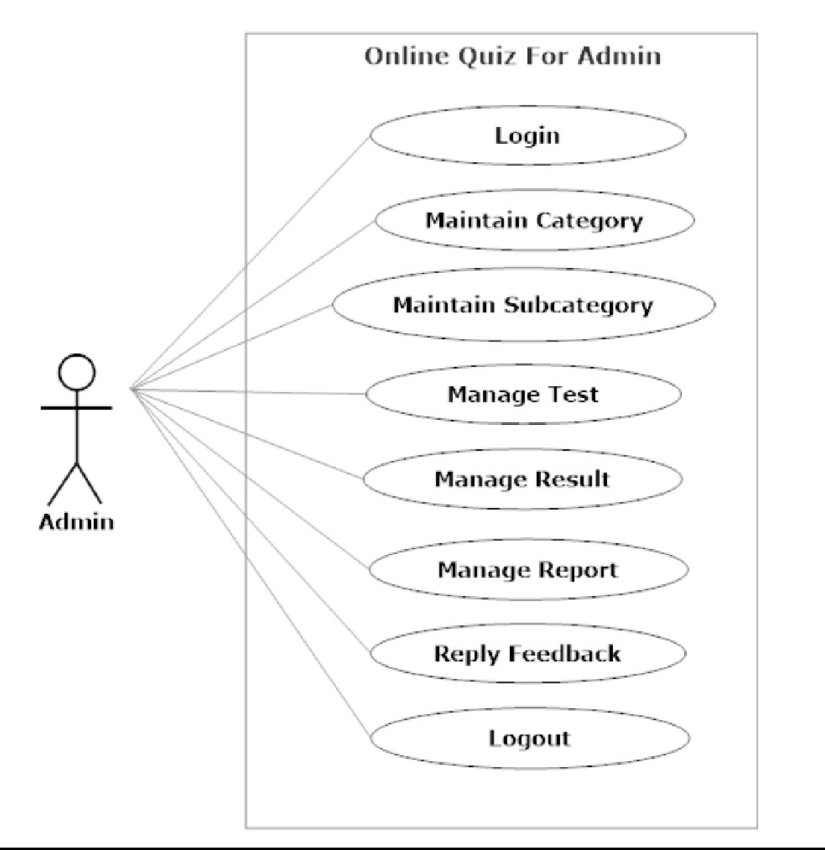
Use Case Diagram For Admin

Slide 8
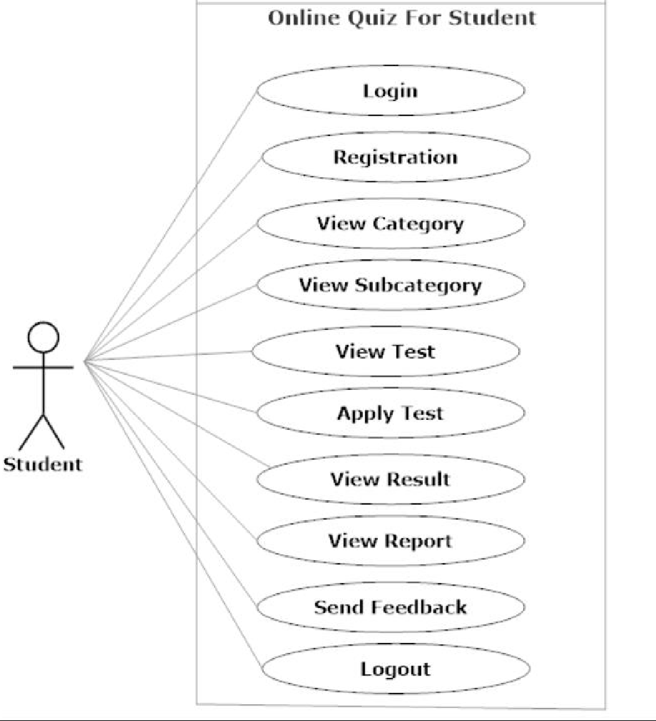
Use Case Diagram For Student

Slide 9
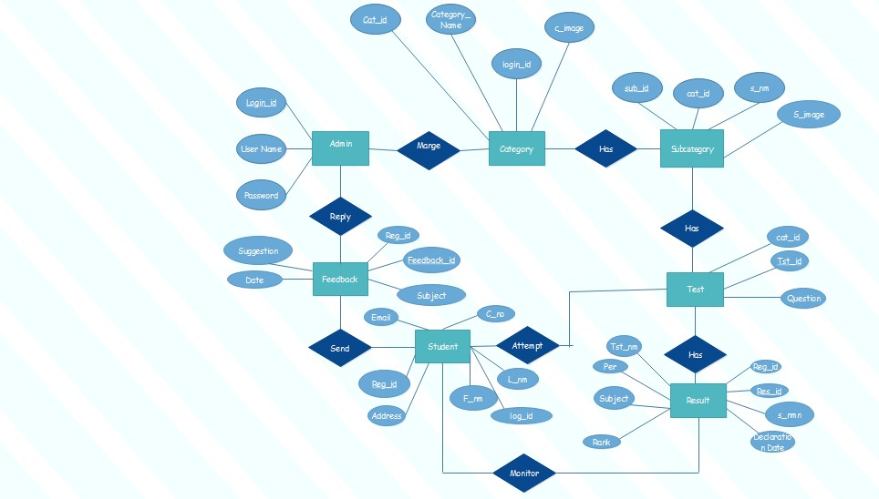
E-R Diagram

Slide 10
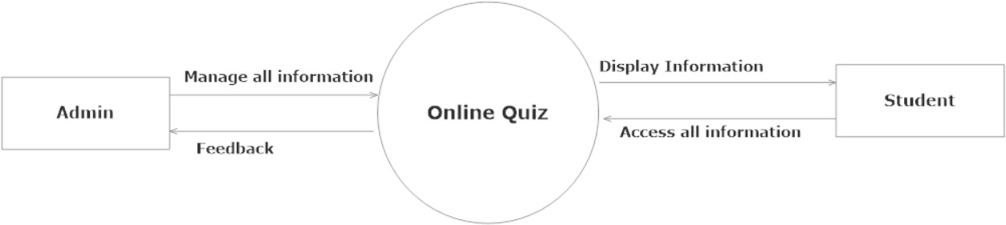
Data Flow Diagram (Level-0)

Slide 11
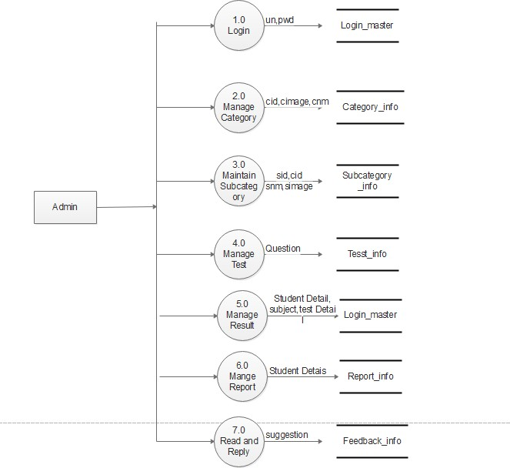
Data Flow Diagram(Level-1) for Admin

Slide 12
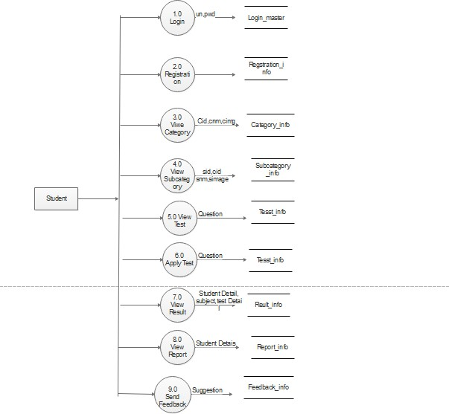
Data Flow Diagram(Level-1) for Student

Slide 13
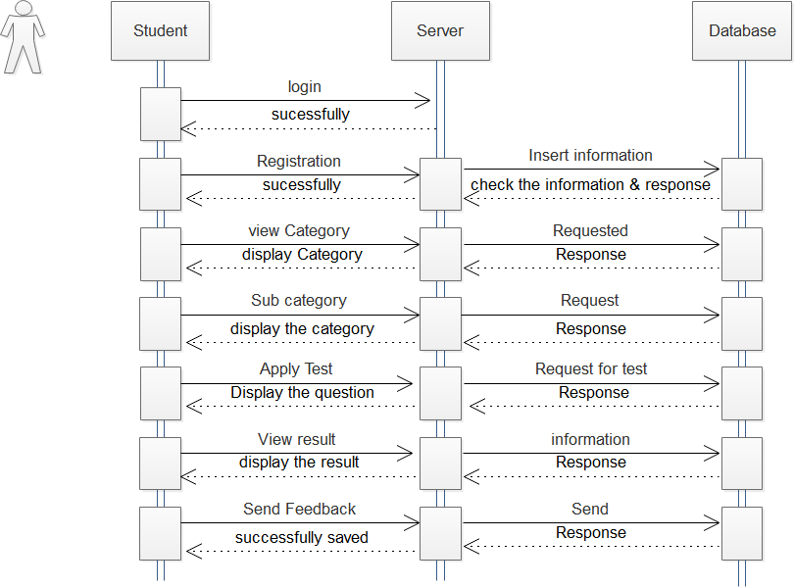
Sequence Diagram

Slide 14
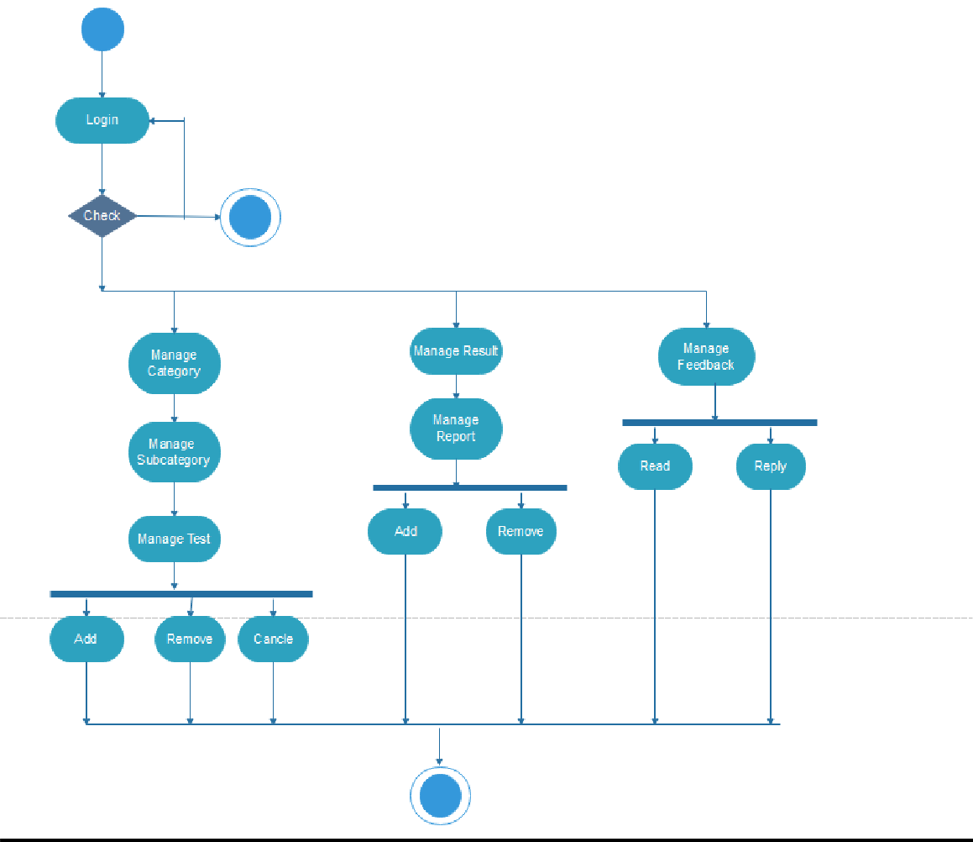
Activity Diagram for Admin

Slide 15
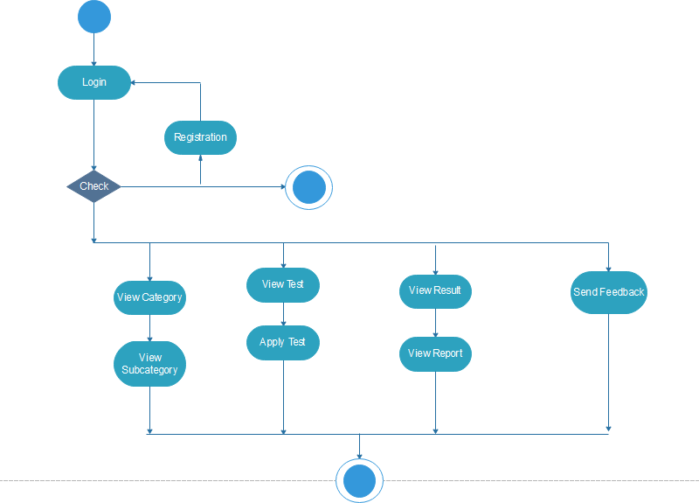
Activity Diagram for Student

Slide 16
Data Dictionary
Login
Field Name | Datatype | Constrain
Uid | Int(10) | PrimaryKey
Username | Varchar(50) | UniqueKey
Password | Varchar(50) | NotNull

Slide 17
Registration
Field Name | Datatype | Constrain
User_id | Int(10) | PrimaryKey
Name | Varchar(50) | NotNull
Gender | Varchar(50) | NotNull
College | Varchar(50) | NotNull
Email | Varchar(50) | UniqueKey
Moblie | Varchar(50) | UniqueKey
Password | Varchar(50) | NotNull

Slide 18
Category_info
Field Name | Datatype | Constrain
C_id | Int(10) | PrimaryKey
Category_Name | Varcher(50) | NotNull
Category_Image | Text | NotNull

Slide 19
Subcategory_info
Field Name | Datatype | Constrain
S_cid | Int(10) | PrimaryKey
Subcategory_Name | Varcher(50) | NotNull
Subcategory_Image | Text | NotNull

Slide 20
Test_info
Field Name | Datatype | Constrain
Test_id | Int(10) | PrimaryKey
Marks | Int(100) | NotNull
Question | Text | NotNull

Slide 21
Question
Field Name | Datatype | Constrain
Q_id | Int(10) | PrimaryKey
Question_Title | Text | NotNull
Question | Text | NotNull
Option 1 | Text | NotNull
Option 2 | Text | NotNull
Option 3 | Text | NotNull
Option 4 | Text | NotNull
Answer | Text | NotNull

Slide 22
Result_info
Field Name | Datatype | Constrain
Res_id | Int(10) | PrimaryKey
Student_Rollno. | Int(10) | UniqueKey
Student_Name | Varchar(50) | NotNull
Category_Name | Varchar(50) | NotNull
Percentage | Text | NotNull
Rank | Text | NotNull
Declaration_Date | Date | NotNull
Total | Int(50) | NotNull

Slide 23
Report_info
Field Name | Datatype | Constrain
Rep_id | Int(10) | PrimaryKey
Student_Name | Varchar(50) | NotNull
Category_Name | Text | NotNull
Rank | Text | NotNull

Slide 24
Feedback
Field Name | Datatype | Constrain
Fid | Int(10) | PrimaryKey
Name | Varchar(100) | NotNull
Subject | Varchar(100) | NotNull
Email | Varchar(100) | UniqueKey
Feedback | Varchar(100) | NotNull
Date | Date | NotNull
Time | Varchar(100) | NotNull
Notes:
Fid
Int(10)
PrimaryKey
Name
Varchar(100)
NotNull
Subject
Varchar(100)
NotNull
Email
Varchar(100)
UniqueKey
Feedback
Varchar(100)
NotNull
Date
Date
NotNull
Time
Varchar(100)
NotNull

Slide 25
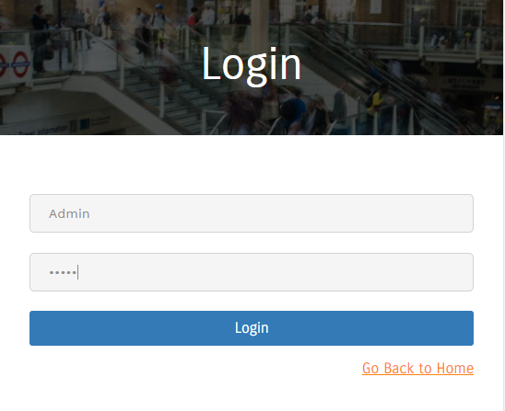
Screen short
Admin Login

Slide 26
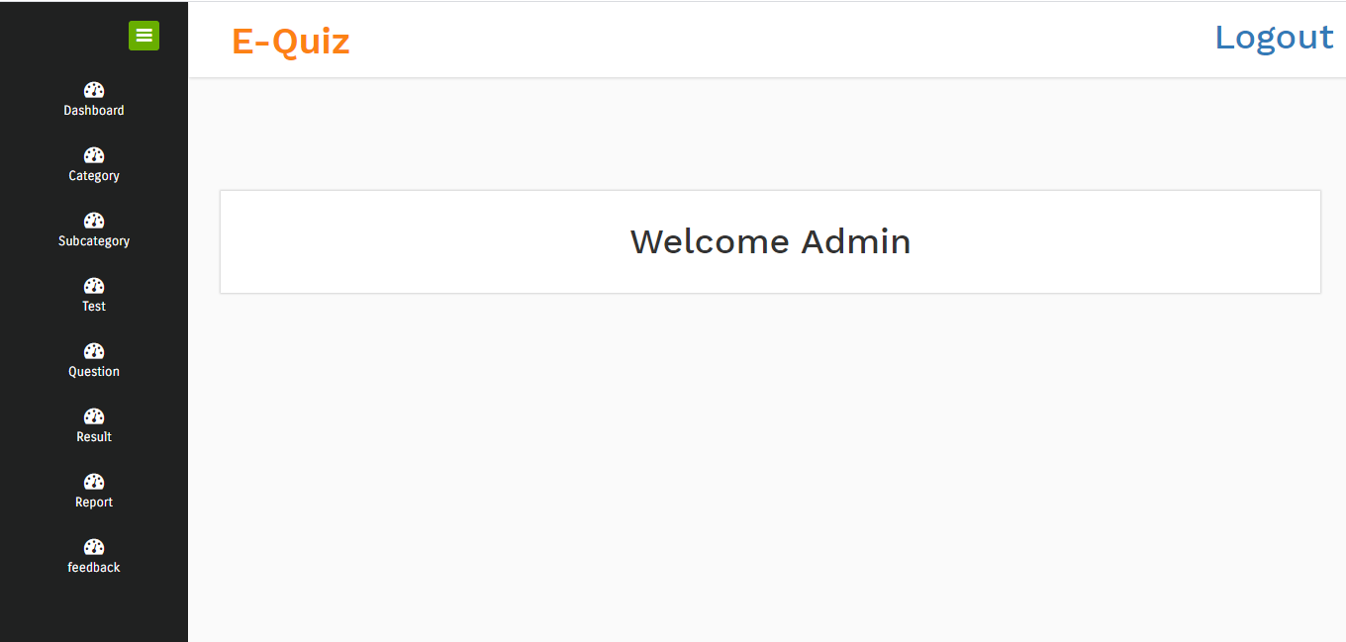
Welcome Page of Admin

Slide 27
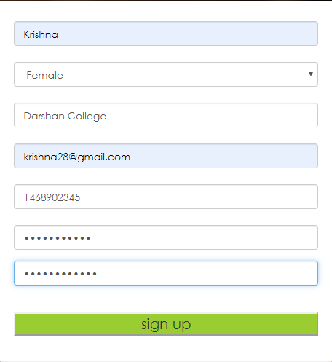
Student Registration

Slide 28
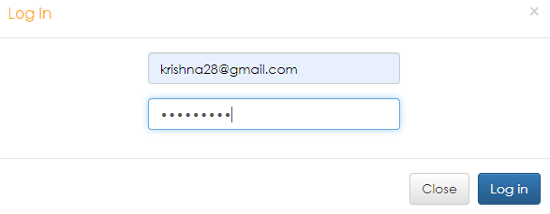
Student Login

Slide 29
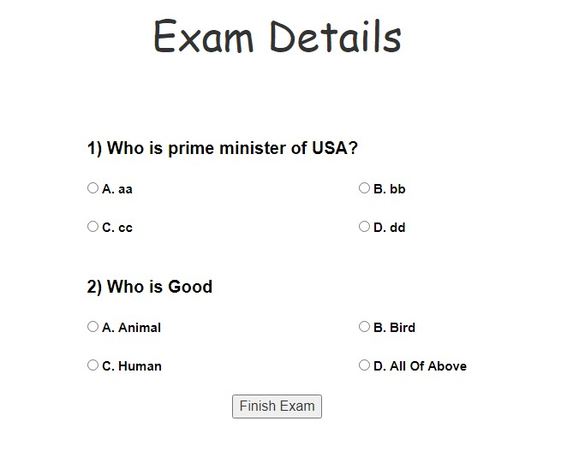
Quiz

Slide 30
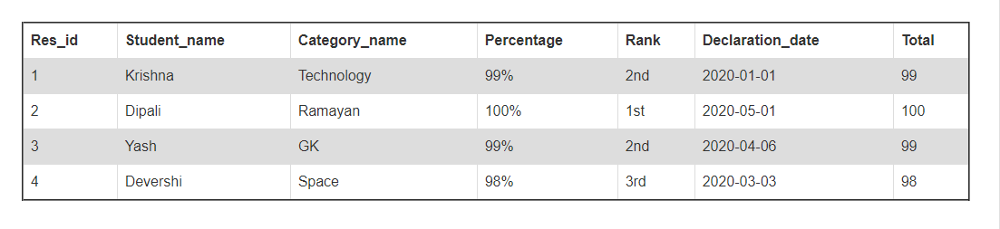
Result

Slide 31
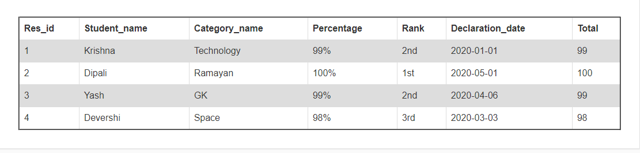
Report

Slide 32
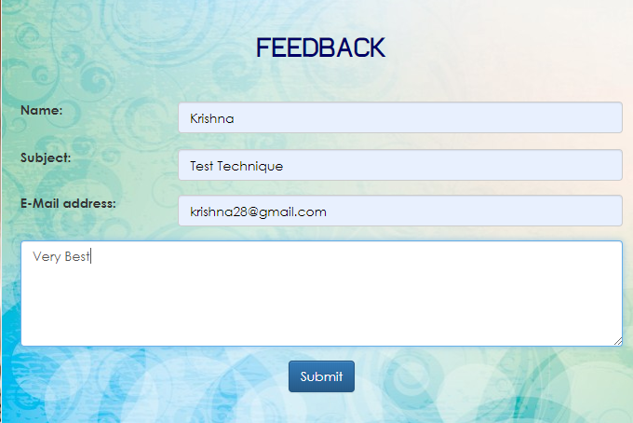
Feedback

Slide 33
Future Enhancement
Online Quiz system is widely used as compared to other exams. Online quiz system can be used in private institutes as well as educational institution. As it is user friendly web base application it can be used anywhere and anytime.
We will Provide Online Facility.
This application avoids the manual work and the problems concern with it. It is an easy way to obtain the information regarding the different scheduled examinations information that are Currently issued
Still ,we found out that the project can be done in a better way. Primarily, when we request information about a particular schedules it just shows the exam date and platform. So, after getting the information we can get access to the online exam.
The enhancement that we can add the searching option. We can directly search to the particular student details from this site.

Slide 34
Thank You

