Slide 1

DO FREQUENT FLYERS FEEL CHEATED?
Done by: Abdulla
Ali
Zeyad

Slide 2
An INTRODUCTION TO BRITISH AIRWAYS
British Airways is a one of the world’s leading global premium airlines
Flag carrier of the United Kingdom
Destinations: 200+ cities in over 80 countries
Annual Passengers: Around 40 million
Main hub: London Heathrow Airport
Current ranking: #13 Globally
Current situation: Hasn’t been in top 10 since 2006

Slide 3
Short Haul KPI comparison between b.a and competitors
Jet2 (75 destinations) | Moderate pricing Higher customer scoring for value for money Good customer service High reliability​
Loganair (40 destinations) | Higher than average pricing Good customer scoring for value for money Moderate customer service High reliability
British Airways (143 destinations) | Larger airline Wider network Expensive Operational issues

Slide 4
Long Haul KPI comparison between b.a and competitors
Singapore (32 countries) Emirates (85 countries) Etihad (40 countries) | Higher Customer scoring value of money Newer Fleet Seat Comfort Better Food & beverages Better on board Service​
British Airways (80 countries) | Lower customer scoring for value of money Issues relating to flights punctuality, cancellations and route changing Lesser seat comfort Less and dull food and beverages selections Average onboard service ​

Slide 5
B.A Strategic goals
01
03
02
Improving customer experience through tech
Enhancing operational performance & punctuality
Heavy investments in ai, machine learning & data science

Slide 6
Problem dESCRIPTION
VALUE FOR MONEY
Customers ranked value for money as their top priority (UK CAA survey)
British Airways received average ratings
Disruptions and delays
Customers ranked Disruptions & Delays as their 2nd priority (UK CAA survey)
40% of passengers reported disruptions or delays
70% of those would not recommend British Airways

Slide 7
HOW EVERYTHING CONNETS
Missing data
Categorized flights
Ranked
Comparison
All services
Value for money
Overall rating
Recommend

Slide 8
Nps rating shows that customers will NOT recommend the airline
17.2%
18.5%
40.4%
59.6%
64.3%

Slide 9
FOCUS WILL BE ON SHORT AND LONG HAUL BECAUSE There isn’t enough data in Medium haul
27.5%
9.8%
62.7%

Slide 10
Value for money has the lowest average rating when prioritizing MAIN factors FOR SHORT AND LONG
SHORT
LONG

Slide 11
MOST FLIGHTS FOR SHORT AND LONG HAULS ARE ECONOMY AND BUSINESS
15%
32.2%
8.8%
31.4%
66.5%
44.8%

Slide 12
AVERAGE RATINGS FOR VALUE FOR MONEY HAS BEEN DECREASING FOR THE LAST 10 YEARS

Slide 13
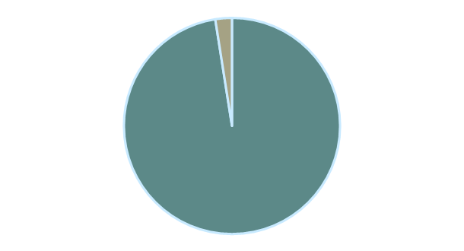
PEOPLE WHO RATED VALUE FOR MONEY BELOW AVERAGE TEND TO NOT RECOMMEND WHILE ABOVE AVERAGE RECOMMEND IT
BELOW AVERAGE
ABOVE AVERAGE
2.5%
24.3%
YES
97.5%
75.7%
NO
TOTAL: 1776
TOTAL: 1911

Slide 14
KEY INSIGHTS
All other services directly affects value for money.
An increase in value for money predicts the highest increase by 55% in overall rating.
An increase in overall rating will increase the recommendation rate.
Short haul flights: seat comforts, food and beverages, cabin staff correlates highly with value for money.
Long haul flights: Food and beverages, seat comfort and cabin staff correlates highly with value for money.

Slide 15
reccomendations
Transparency | Adding value by offering competitive and transparent fares with clear options
Avoid surprises | Clearly display all fees including baggage, seat selection and any other charges
Courtesy | B.A should show efficient and helpfulness throughout the full journey experience
Loyalty Program | Powered by Ai with assisted recommendations benefits bonus points and personalized perks to every frequent flyer
Super value | Offering options such as baggage pickup and or delivery, lounge access, car rentals, hotel bookings and lost and found support.

Slide 16
Specific recommendations
British Airways was approved a £7bn transformation investment program that has been used to airline boost its operational performance to record levels. (2024-2026)​
£3.5 billion for new aircraft/fleet expansion​​
£100 million in AI, machine learning, and automation​​
£750 million upgrading IT infrastructure/cloud migration
£2.65 billion to be allocated for new and existing Lounges renovations, while cabin refurbishments (short-haul & long-haul seats) was not yet been announced
A clear budget is needed to be assigned to refurbishing aircrafts for both Short and Long Hauls mainly for Economy and Business class (As an example, to refurbish an Airbus A320 cabin can range from £220,000 to £730,000 or more, depending on the scope and materials used.)​
Out of 250 aircrafts in operation, there are 92 units of A320s and 41 units of 787 that are considered out dated and need refurbishing to push forward into the comfort of customer. (considering the value of money factor, we suggest to allocate £250 million, averaging a maximum of £1.87 million per aircraft.
​​

