Slide 1

Montgomery County Crash Severity & High-Injury Network
Presented by: Abdulla Tarek

Slide 2
Agenda
1
Vision Zero
4
Factors
2
Problem
5
Findings
3
Objectives
6
HIN & Exposure
7
Recommendations

Slide 3
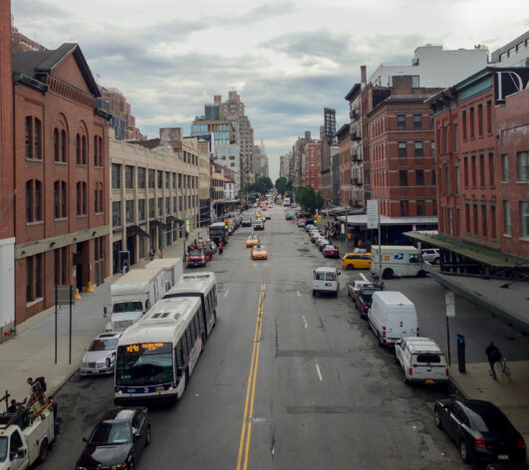
What is Vision Zero?
Data driven initiative to eliminate traffic death and severe injuries

Slide 4
Problem Statement
From 2020-2024, Montgomery County recorded 59,476 crashes. Of these, 1,400 were fatal or suspected serious injury crashes (KSI), with an estimated $7.1 billion in societal cost. To reach Vision Zero, the County should focus engineering, enforcement, and policy on the corridors and conditions most strongly linked to severe crashes.

Slide 5
Objectives
When and where do severe crashes occur (2020–2024)?
Which roadway, environmental, and driver factors increase crash severity?
What is the role of vulnerable road users (VRUs)?
Where does the harm concentrate?
How does exposure (AADT) change the picture?
Which corridors should be prioritized for interventions?
How should progress be monitored?

Slide 6
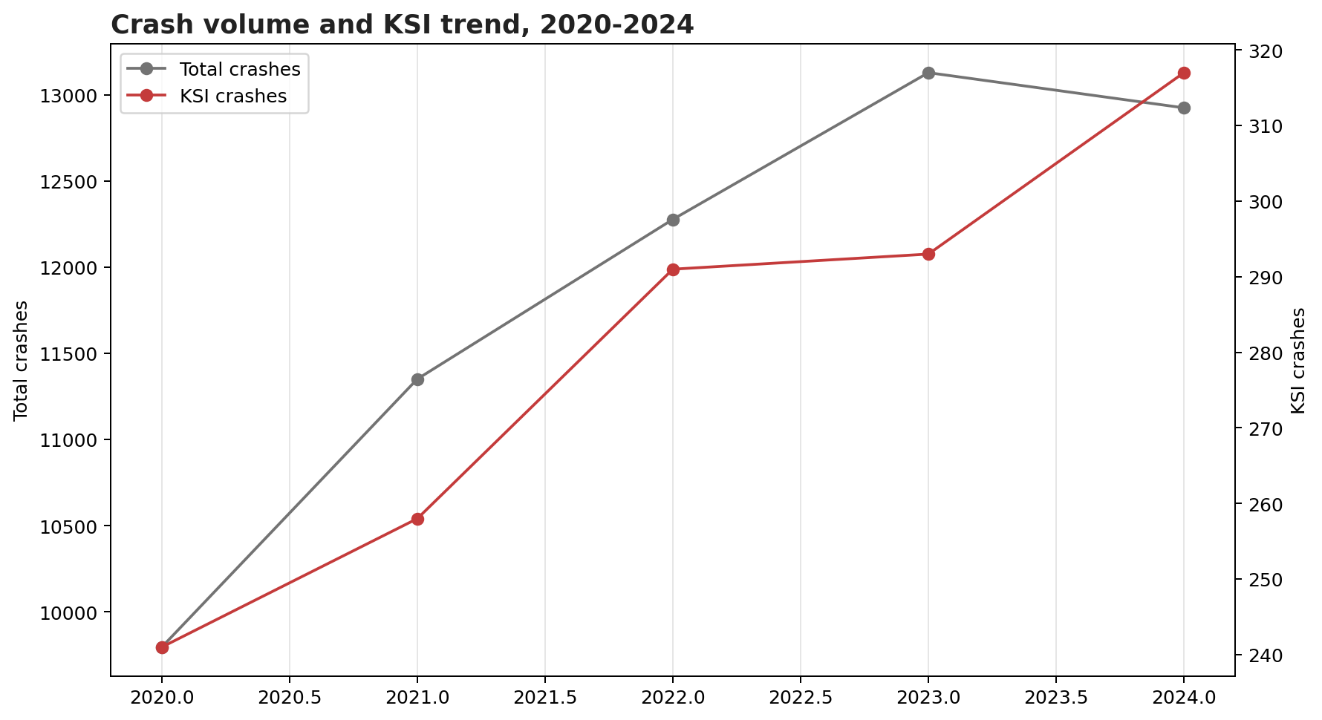
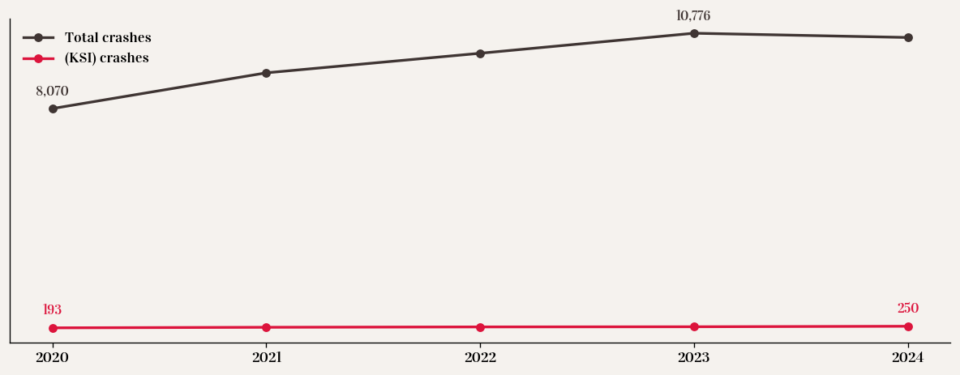
KSI crashes remain steady while totals fluctuate

Slide 7
KABCO
Factors
Human
Vehicle
Environmental
Roadway
Measures Injury Severity
Accounts for Societal Cost
Average per KSI crash ($12.5 million)

Slide 8
What Makes Some Crashes More Deadly Than Others?

Slide 9
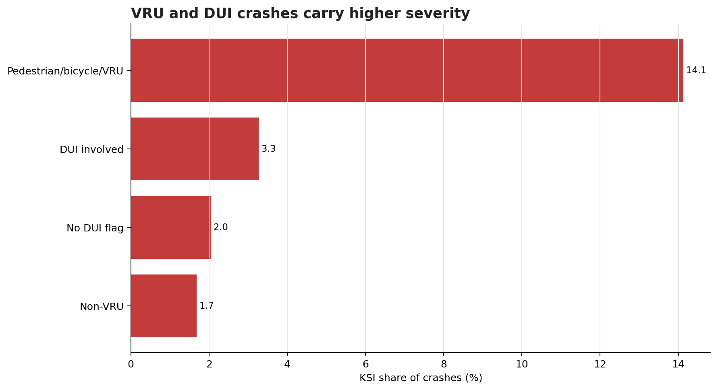
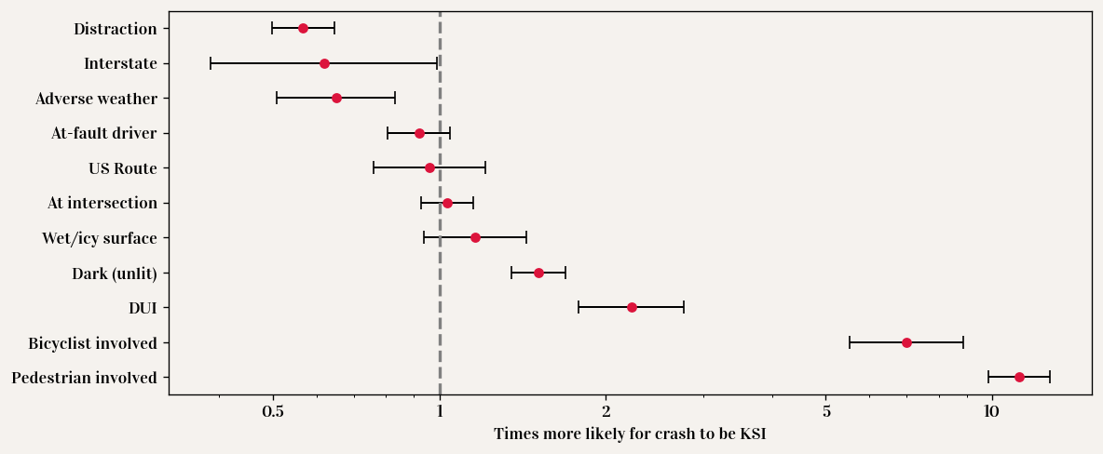
Pedestrian, bicyclist, and DUI crashes are far more deadly

Slide 10
Average cost per crash shows the true impact of each severe crash on society.
Estimated Total Societal cost
($6.3 billion)

Slide 11
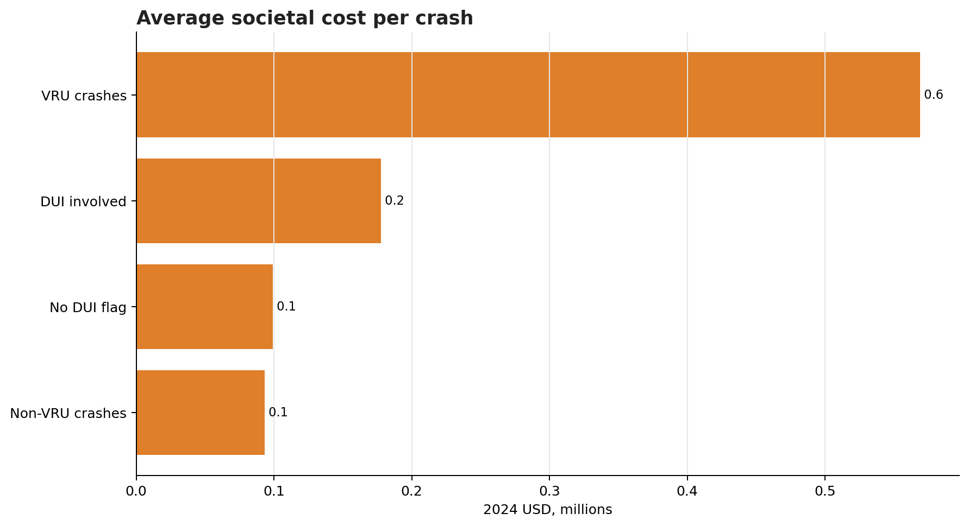
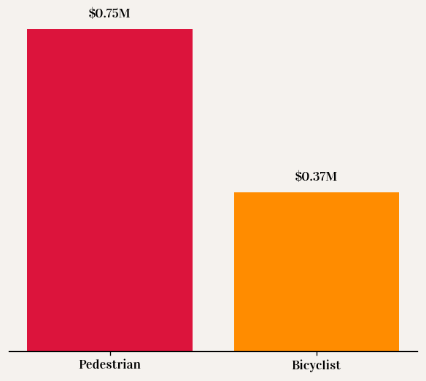
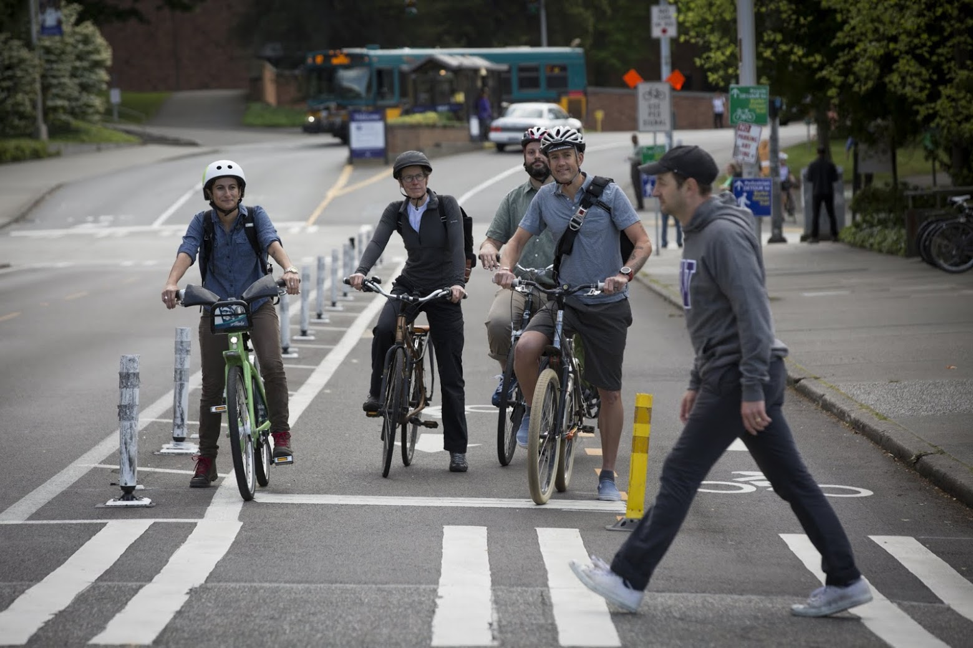
Average pedestrian crash costs society $0.75M — double bicyclist crashes

Slide 12
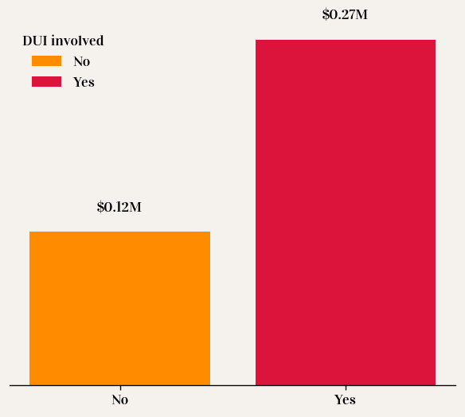
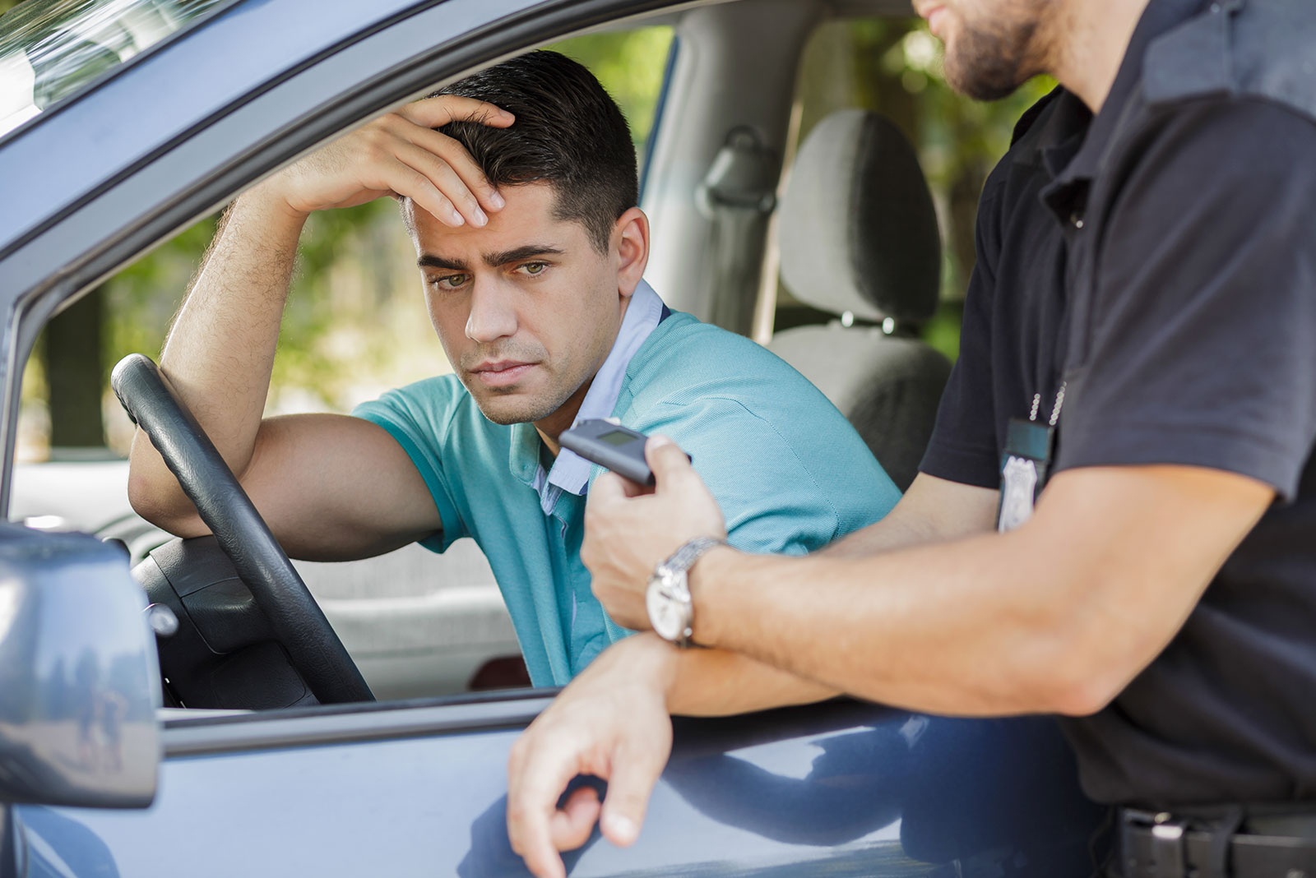
Crashes involving DUI cost more than twice as much as other crashes

Slide 13
Limited resources require focused safety investment

Slide 14
What is a High Injury Network?
There is no definitive way to create it
Instead of looking at every crash everywhere, HIN focuses on the worst corridors.
Identify the smallest % of roads responsible for the largest % of KSI crashes.
We created Montgomery County’s HIN by:
Splitting roads into small segments (~½ km).
Counting KSI crashes on each segment (2020–2024).
Ranking segments from highest to lowest harm.

Slide 15
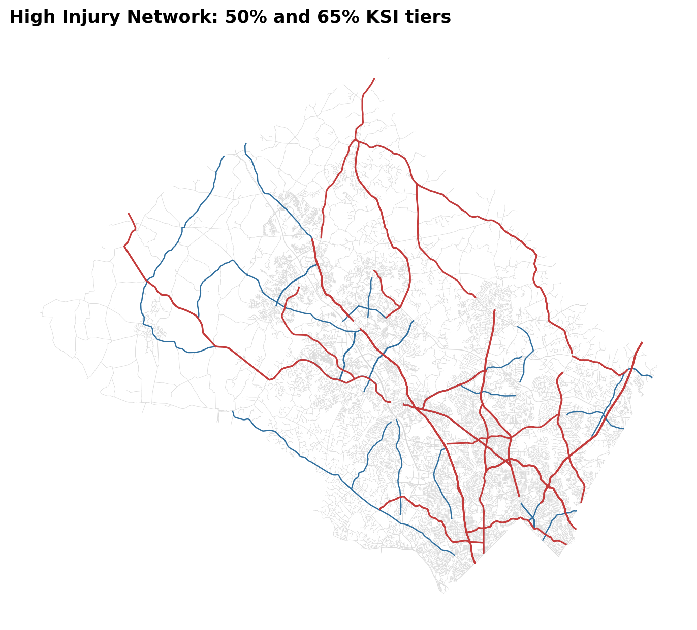
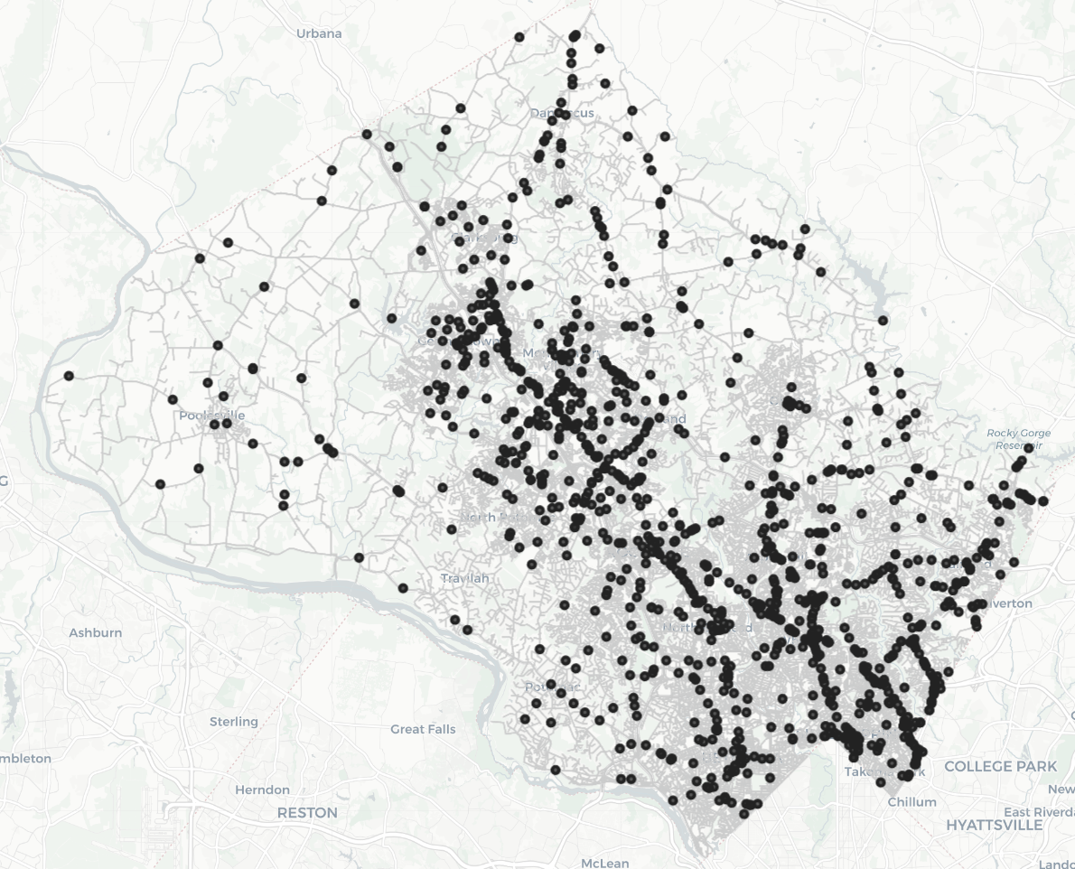

Slide 16
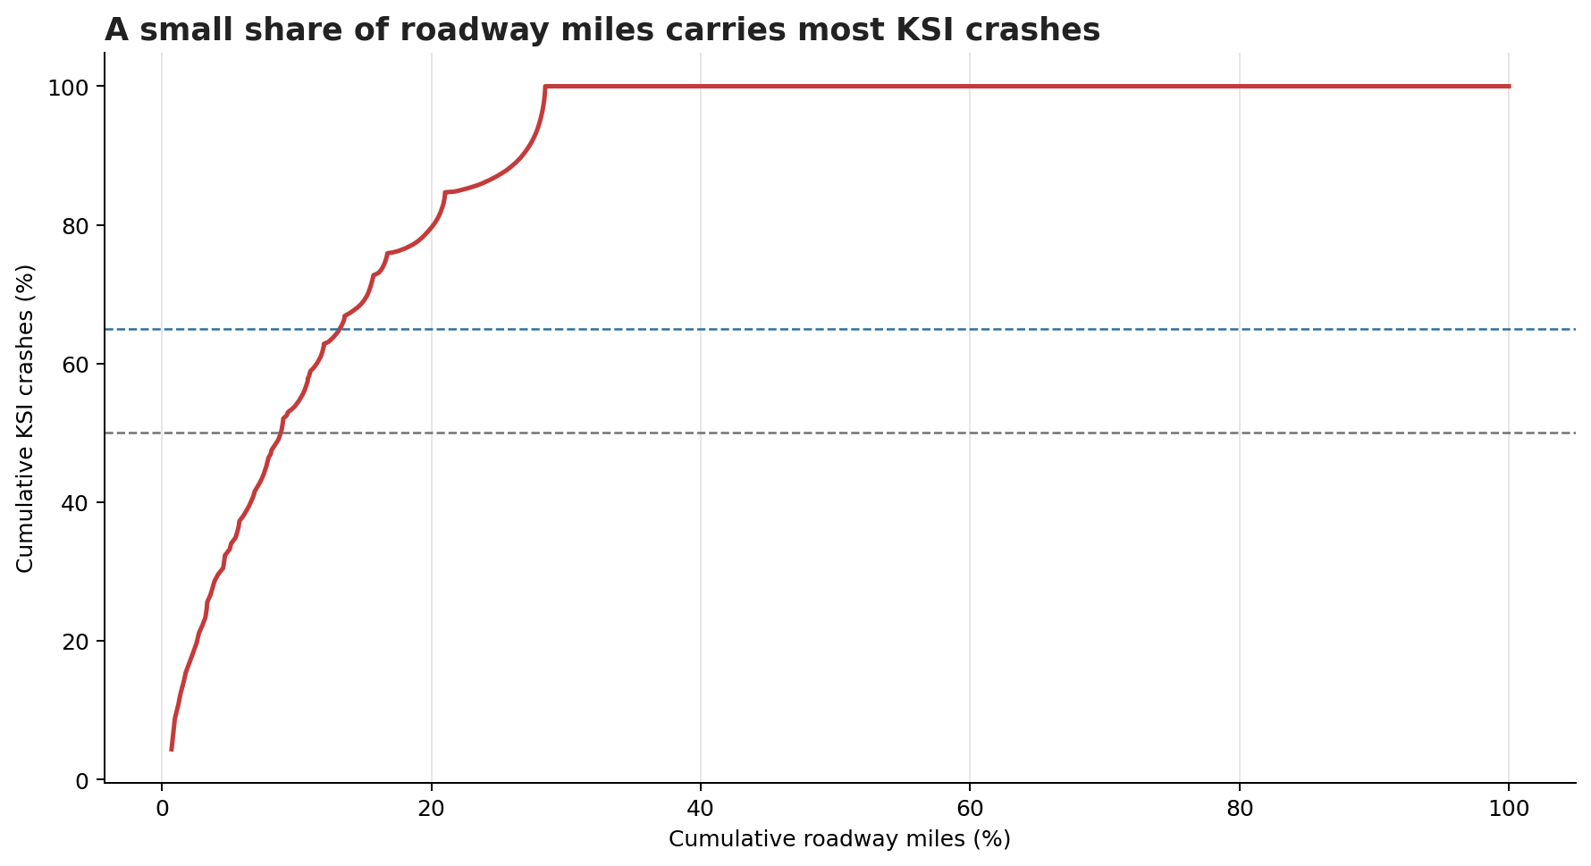
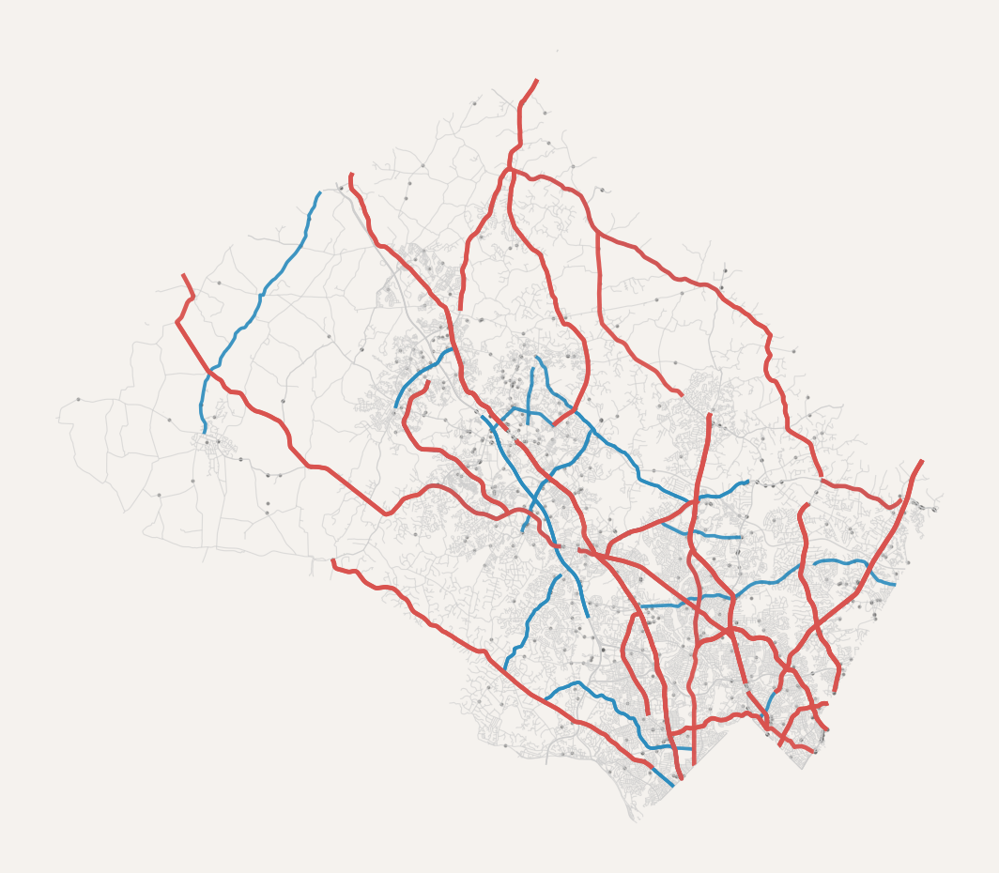
9.9% of roads account for (50% KSI) RED 14.6% of roads account for (65% KSI) RED + BLUE

Slide 17
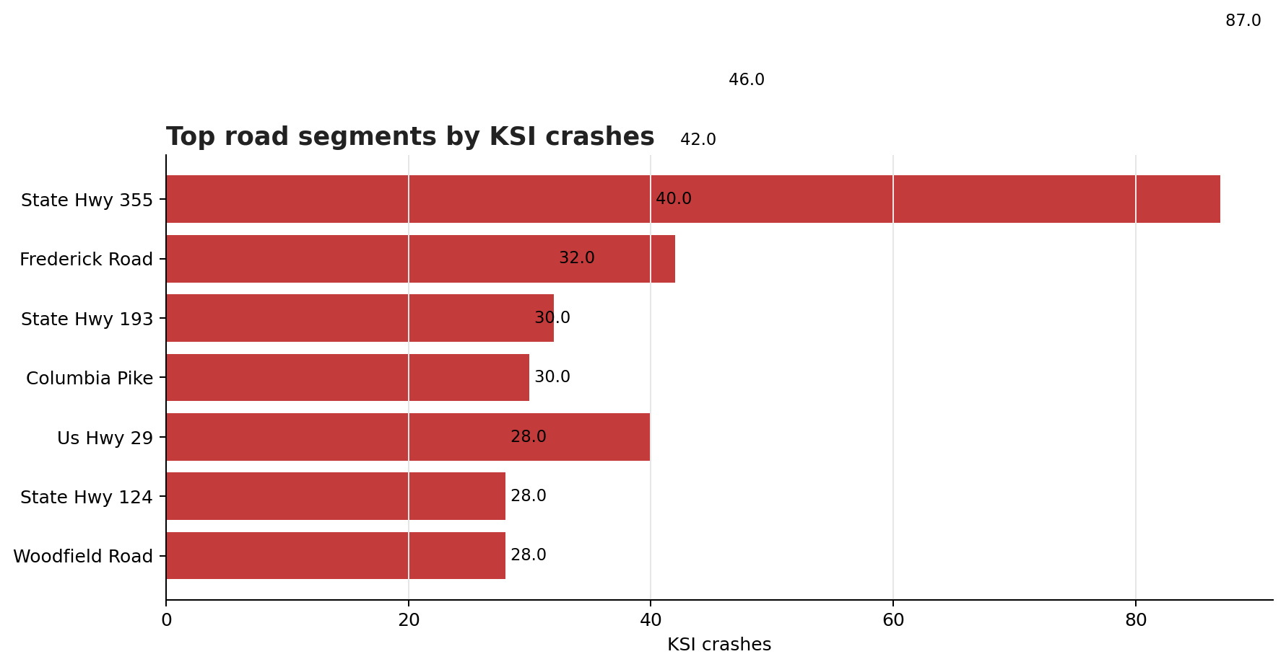
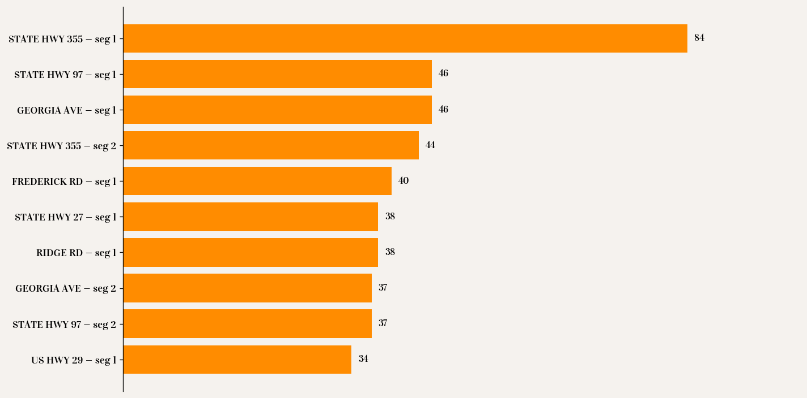
Top 10 Road Segments by KSI Crashes (2020–2024)

Slide 18
Do accidents happen because of high traffic or road conditions?

Slide 19
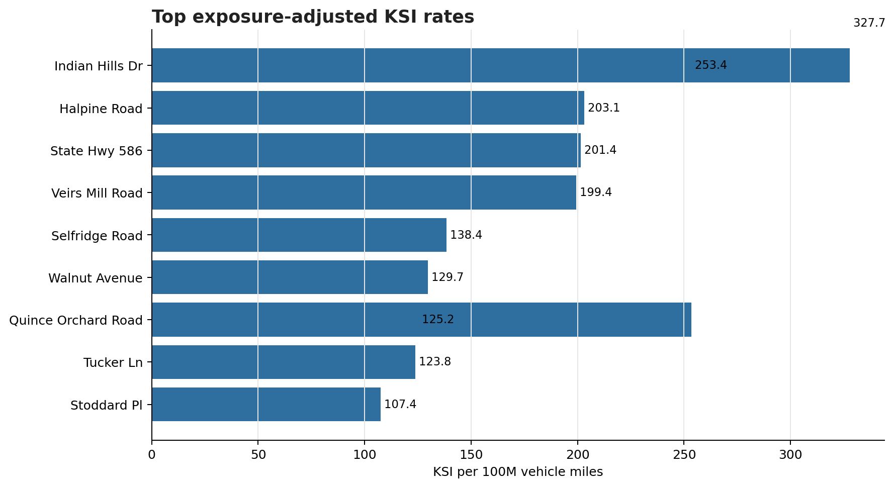
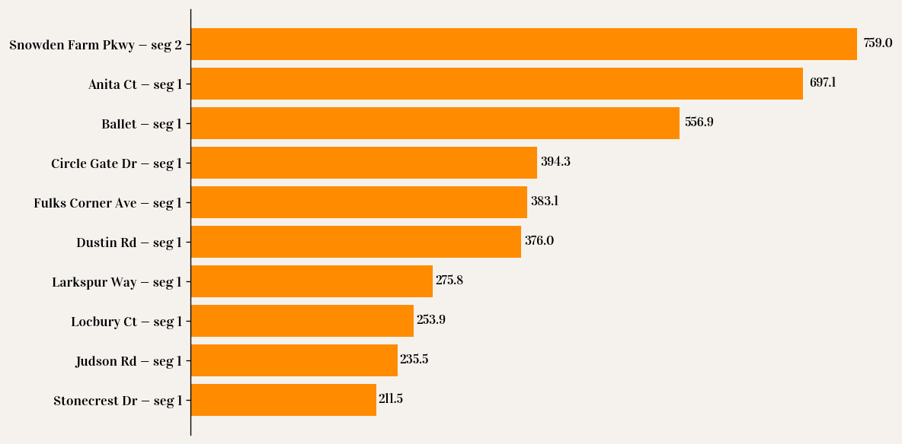
Top 10 Segments by Exposure-Adjusted KSI Rate
Per 100M VMT

Slide 20
Together they balance:
Where the most harm is (HIN)
Where the risk is abnormal
(Exposure)

Slide 21
Priority scoring adds equity and vulnerable users

Slide 22
Prioritization Score Formula
(0.50 x VRU KSI)
(0.25 x KSI in disadvantaged tracts)
KSI crash burden
(1.00 x KSI burden)
Priority Score
(0.25 x exposure-adjusted risk)

Slide 23
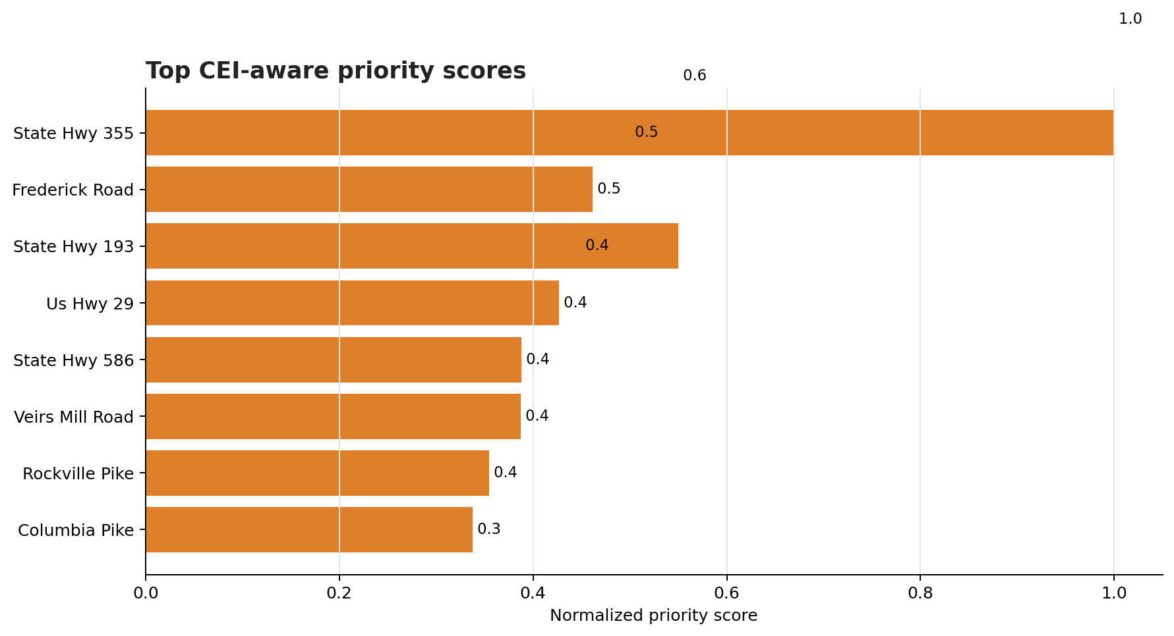
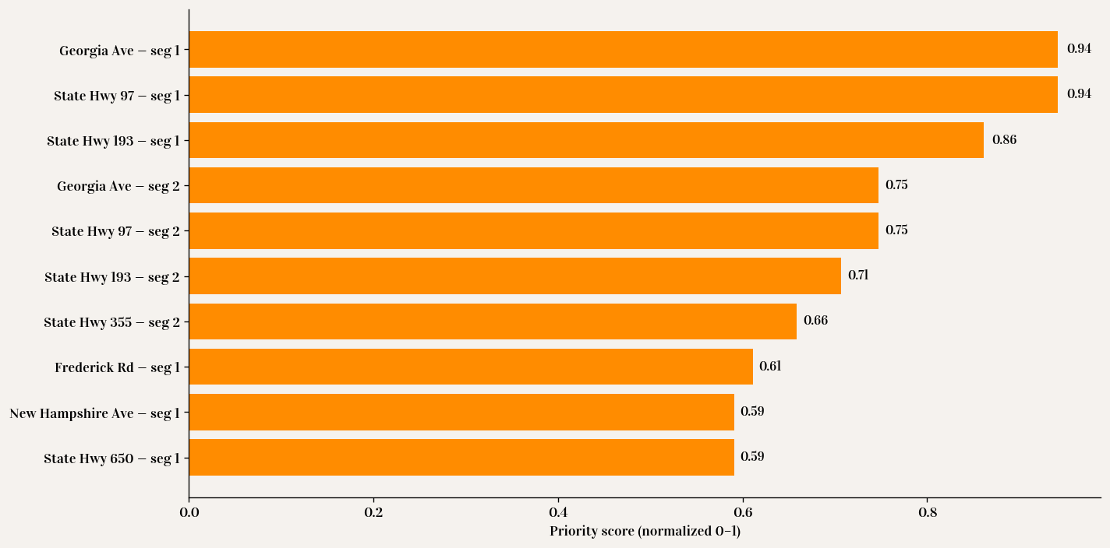
Top 10 Segments by CEI-aware priority score

Slide 24
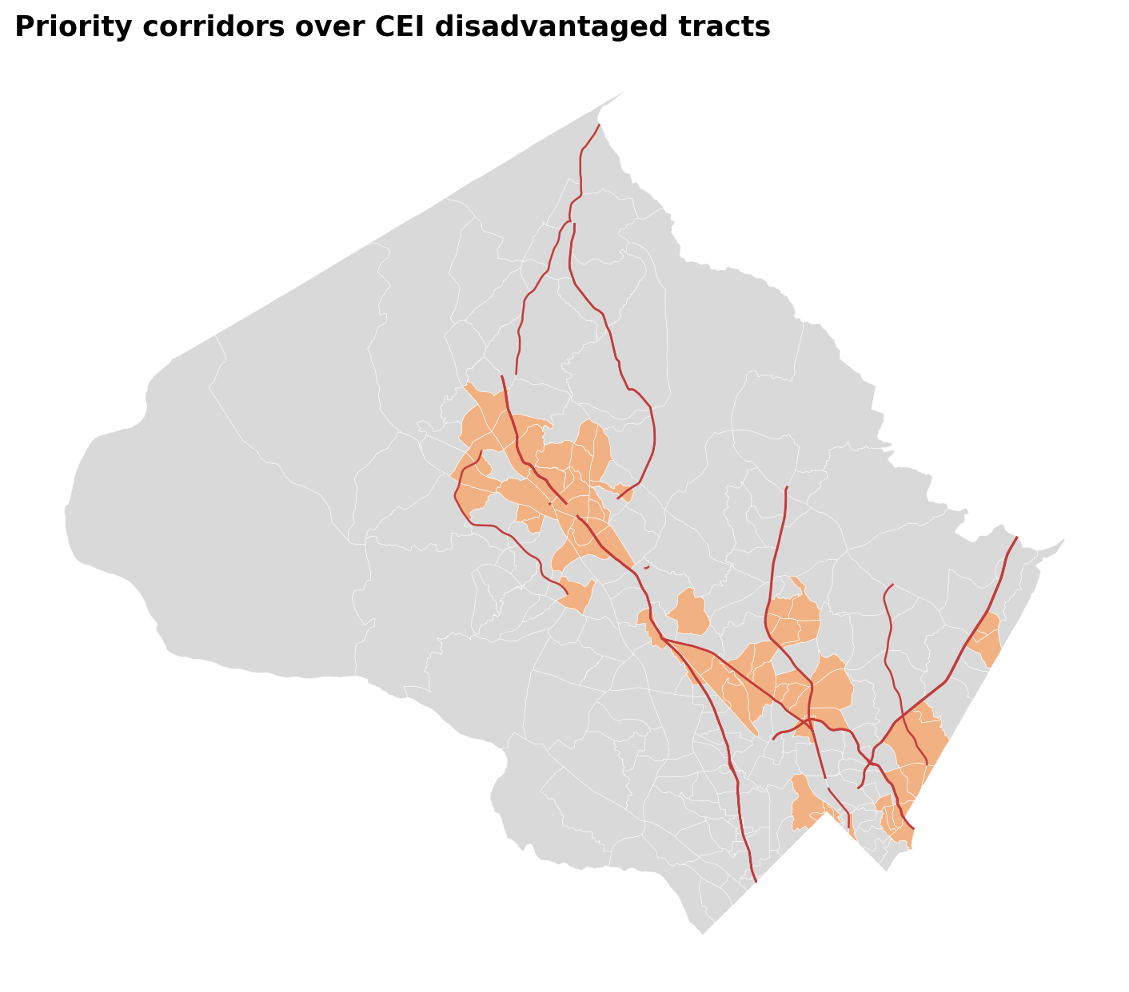
CEI disadvantaged tracts and priority corridors
CEI disadvantaged tracts and priority corridors
CEI disadvantaged tracts and priority corridors
Recommendations

Slide 25
What to do?
Design for human error: Safe System principle
Focus on high-injury corridors (HIN 50–65% of KSI)
Proven fixes: (road diets, daylighting)
Manage speeds: Automated speed enforcement + self-enforcing design
Protect pedestrians & cyclists: LPIs, safe crossings near schools

Slide 26
Plan & next steps
Prioritizes high-harm corridors, including corridors in disadvantaged tracts
Re-score every 2-3 years
Phased delivery:
Year 1: quick wins such as LPIs, daylighting, and pilot road diets
Years 1-3: corridor redesigns
Years 3-5: major reconstructions
Track progress: KSI, HIN share, VRU KSI, CEI contribution, and exposure-adjusted risk

Slide 27
Thank You

