Slide 1
JavaScript
RESTful Resources

Slide 2
What is JavaScript?
JavaScript is a programming language that executes inside your browser
JavaScript is typically used to interact with the web page in response to user actions like clicks

Slide 3
Including JavaScript in your web page
Requires use of <script> tags
Can include code directly inside a <script></script> block pair
Can also include code from a separate JavaScript file by using src attribute of <script> tag
<script src=”my-javascript.js”></script>

Slide 4
Including JavaScript in your web page (cont’d)
<script> tags must go either in the <head> block after all <link> tags or in the <body> block at the bottom, after all other HTML tags
Putting in the body block is better, to make sure entire web page loads before JavaScript code starts executing

Slide 5
Basic JavaScript Fundamentals
Two of the central ideas in JavaScript are variables and functions
Variables are like named notes your program uses to remember things (data)
typically named as nouns because they represent some value
Functions are named blocks of code to perform a defined task
typically named as verbs because they represent what you can do

Slide 6
JavaScript Variables
You declare (create) a variable using one of three keywords:
var
let
const
The differences between these will be discussed later. For now we will use the oldest one, var.

Slide 7
JavaScript Variables (cont’d)
How to declare a variable named car:
var car;
The variable now exists but as yet has no value
The name of the variable can be almost anything, but it should represent the purpose of the variable (e.g. var numOfStudents would represent a number of students)

Slide 8
JavaScript Variables (cont’d)
Rules of naming variables:
Must begin with one of the following:
A letter (A-Z or a-z)
A dollar sign ($)
An underscore (_)
Must not be a reserved JavaScript word
Variable names should be camelCase
- the first word in the variable name is lower-case and each subsequent word is capitalized

Slide 9
JavaScript Variables (cont’d)
A variable is assigned its value through the equals sign
A variable can be assigned its value when it is declared or after it is declared
var car = “Volvo”;
var numOfStudents;
numOfStudents = 5;

Slide 10
JavaScript Variables (cont’d)
Variables can hold text (called a string) or numbers
Quotes are used when assigning a variable a text value
var name = “Ben”;
Quotes are not used when assigning a variable a number value
var count = 2;

Slide 11
JavaScript Arrays
Arrays are variables that are like pages in a notebook
Each page is like a single variable, but the notebook can store multiple pages
The array variable has one name, and each page is accessed by its number, called the index, which is like a page number
The first index is 0, not 1

Slide 12
JavaScript Arrays (cont’d)
var fruit = [“Apple”, “Orange”, “Banana”];
fruit[0] is Apple
fruit[1] is Orange
fruit[2] is Banana

Slide 13
JavaScript Arrays (cont’d)
var fruit = [“Apple”, “Orange”, “Banana”];
Arrays know how many components they store, and this property is called length
For our example, fruit.length has a value of 3
Add items to the end of an array with the function push
fruit.push(“Kiwi”);
This adds Kiwi after Banana
[“Apple”, “Orange”, “Banana”, “Kiwi”]
fruit.length is now 4

Slide 14
JavaScript Arrays (cont’d)
Remove items from the end of an array with pop
[“Apple”, “Orange”, “Banana”, “Kiwi”]
fruit.pop();
This removes “Kiwi” from the array
[“Apple”, “Orange”, “Banana”]

Slide 15
JavaScript Arrays (cont’d)
Remove items from anywhere in an array with splice
[“Apple”, “Orange”, “Banana”]
fruit.splice(0,1);
This removes Apple, where 0 is the array index to start at and 1 is the number of elements to remove
[“Orange”, “Banana”]

Slide 16
JavaScript Objects
JavaScript objects are variables capable of holding data composed of many parts
The object variable has a single name, like both variables and arrays, but its value is composed of multiple name/value pairs
These names are also called keys

Slide 17
JavaScript Objects (cont’d)
var student = {
lastName: “Cool”,
firstName: “Joe”,
id: 12345
}
Accessing each name/value pair is done using the . (dot) operator
var fullName = student.lastName + “, “ + student.firstName;
The above statement shows string concatenation using the + sign

Slide 18
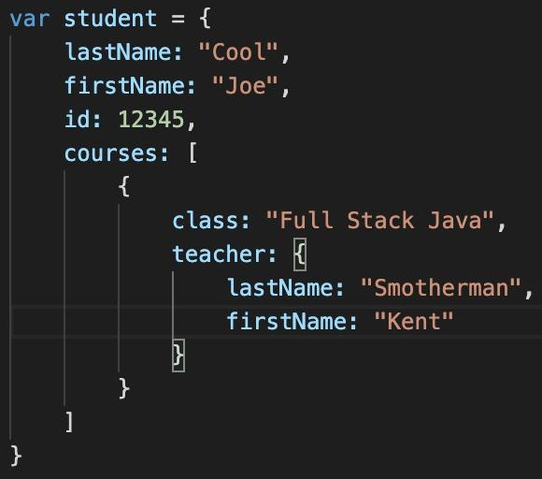
JavaScript Objects (cont’d)
Object values for a name/value pair can be anything, like a number, a text string, an array, or even another object.

Slide 19
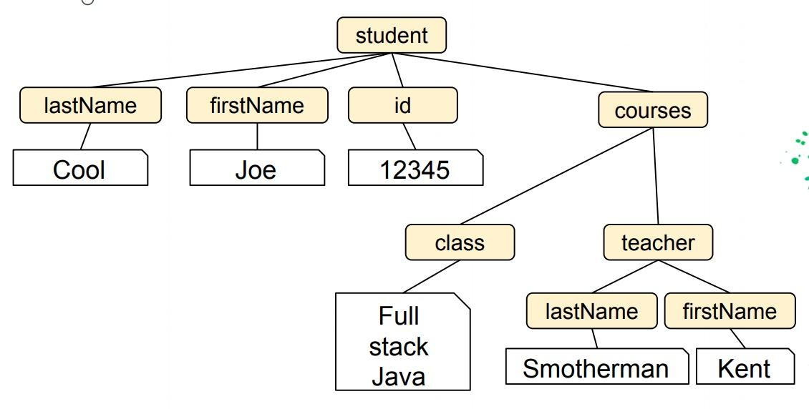
JavaScript Objects (cont’d)

Slide 20
JavaScript Code
JavaScript code is a series of statements.
Each statement does one thing, like declaring a variable or adding two numbers.
A statement must end with a semicolon (;)
Statements in JavaScript code generally execute from top to bottom.

Slide 21
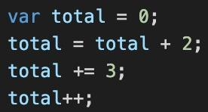
JavaScript Code (cont’d)
Declares variable named “total” and assigns value of 0
Adds 2 to total
Adds 3 to total
Adds 1 to total

Slide 22
JavaScript Code (cont’d)
console.log() - a way to print messages into Google DevTool’s Console
console.log(“Total is “ + total);
The above statement will print in the Console the text “Total is “ followed by the value of the variable total
Total is 6
Try this yourself

Slide 23
JavaScript Decisions
Variables are the most important things a program has, but the ability to make decisions is the most important thing a program does
Making decisions is done with the if/else statement

Slide 24
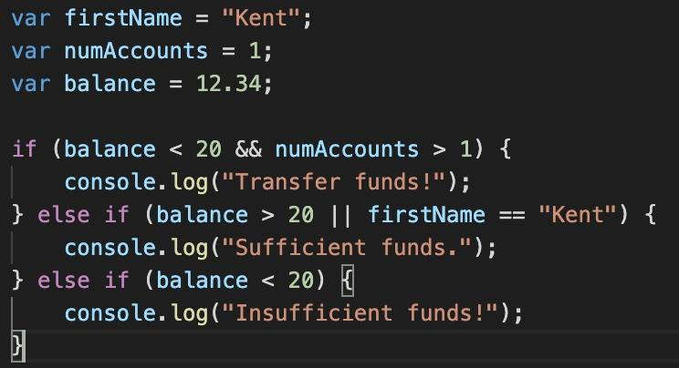
JavaScript Decisions (cont’d)

Slide 25
JavaScript Loops
A block of code can be executed multiple times in a loop. The two primary types of loops in JavaScript are the for loop and the while loop.
for loops have an initializer, a conditional, and an increment.
The initializer is where the loop starts counting
The conditional is where the loop determines whether to continue looping based on whether a certain count has been reached
The increment is where the count increases

Slide 26
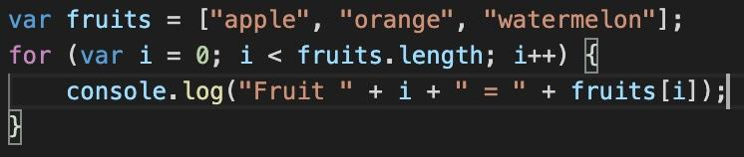
JavaScript Loops (cont’d)
i is the initializer - it starts its count at 0
i < fruits.length is the conditional - the loop will stop when i is no longer less than fruits.length (which is 3)
i++ is the increment - i will go up by 1 each time the loop runs

Slide 27
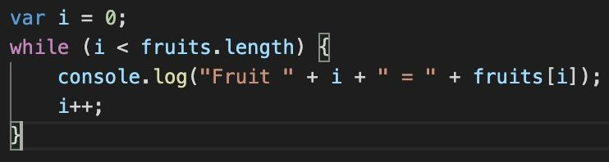
JavaScript Loops (cont’d)
A while loop has a conditional and an increment, but no initializer in the loop
An initial value for the variable incremented is set outside the loop

Slide 28
JavaScript Functions
Functions allow code to be organized into blocks that can be independently executed
Functions usually have a name, like variables
Function names are typically verb-oriented
Anonymous functions do not have a name (more on these later)
Functions execute when they are called, which is done by simply stating the name of the function
The name of a function is a reference to that function (this is important in jQuery).

Slide 29
JavaScript Functions (cont’d)
Functions may define their own variables within their block
These are called local variables
Functions may have parameters, which are special local variables used to bring in information that the function needs to do its job
The values of these variables are supplied (within a set of parentheses) when the function is called and are referred to as arguments

Slide 30
JavaScript Functions (cont’d)
A function block generally begins with the word function, followed by the name of the function and a set of parentheses, which will either contain parameters or, if no outside information is needed, will be empty.
Following the parentheses is a set of curly braces (just like CSS Selector blocks). The statements to be executed in the function are contained within the curly braces.

Slide 31
JavaScript Functions (cont’d)
How a function block looks:
function addTwoNumbers(num1, num2) {
var total;
total = num1 + num2;
return total;
}

Slide 32
JavaScript Scope
Scope is an important concept in all programming languages
Variables declared with var and functions belong to (are visible to and usable by) the nearest function within which they are defined
Variables/functions not defined inside a function are global and can be used anywhere

Slide 33
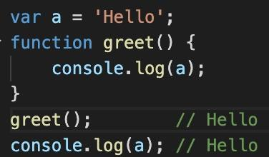
JavaScript - Global Scope

Slide 34
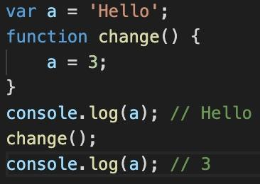
JavaScript - Global Scope (cont’d)

Slide 35
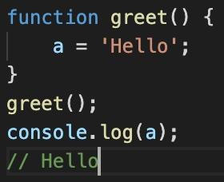
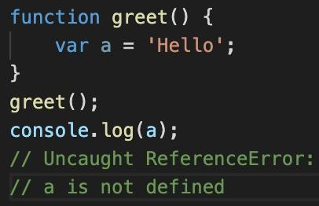
Global Scope (cont’d)

