Slide 1
JSON APIs
By david Tarvin, Bellevue university

Slide 2
What is JSON?
JSON stands for JavaScript Object Notation
A format used in RESTful APIs
The most widely used data format for data interchange on the web
A data format that is both human-readable and machine-readable
Built on two structures:
Collection of name/value pairs
Ordered list of values

Slide 3
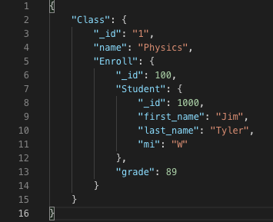
JSON Example – name/value pairs

Slide 4
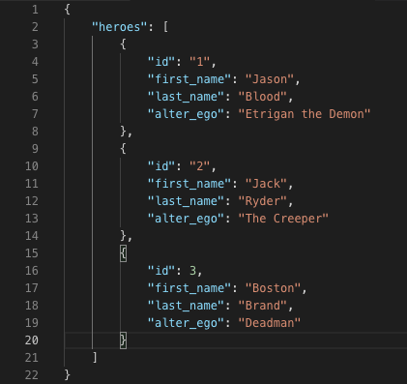
JSON Example – ordered list of values

Slide 5
What is a JSON API?
JSON API is a specification for requesting and receiving documents over the web
JSON API defines how resources are structured
Designed to minimize both number of requests and amount of data transmitted between clients and servers
Does not compromise readability, flexibility or discoverability

Slide 6
Features of a JSON API
Allows Compound Documents – resources which include the data of included relations
Allows specifying what relations to include in the response
Allows sparse fieldsets – including only the fields you need in the response
Can support sorting, pagination, and filtering
Uses the standard HTTP verbs to communicate actions - GET, POST, PATCH and DELETE

Slide 7
How JSON APIs differ from SOAP APIs
SOAP API uses the XML format, which is not as straightforward to use as the JSON format
JSON API is truly RESTful, whereas SOAP API cannot be RESTful
JSON API data can either be in the form of a single object or an array

Slide 8
SOAP API structure vs JSON API structure
A SOAP API consists of:
An Envelope (required) – the starting and ending tags of the message
A Header (optional) – contains the optional attributes of the message
A Body (required) – contains the XML data to transmit
A Fault (required) – carries information about errors occurring
A JSON API consists of:
A Request Header
A Request Body
A Response Body

Slide 9
JSON Request Header
Includes the HTTP Verb for the action requested
GET, POST, PUT, PATCH, DELETE
Includes the media type of the body content (not necessary with GET request)
Content-Type: application/vnd.api+json
Includes the media type accepted as a response
Accept: application/vnd.api+json

Slide 10
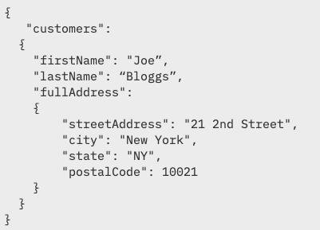
JSON Request Body
Contains the content of the request for POST, PUT, PATCH and DELETE
Obviously in JSON format

Slide 11
JSON Response Body
Includes HTTP Status Code
If request is successful: 200 OK
If request is unsuccessful because the resource doesn’t exist: 404 Not Found
Other HTTP status codes also used
Includes Content-Type as with headers
Includes data formatted as JSON object

Slide 12

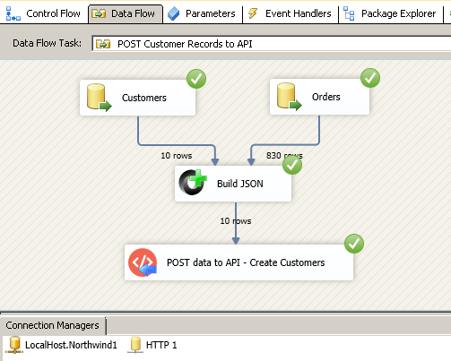
End-to-end flow of a JSON API
Retrieved from https://zappysys.com/blog/http-post-in-ssis-send-data-to-web-api-url-json-xml/

Slide 13
Resources
Introduction to JSON (tutorial) (no author). (n.d.). Retrieved from https://restfulapi.net/introduction-to-json/
(Rapid API Staff). (2019, Feb 13). SOAP Vs REST (Vs JSON) (article). Retrieved from https://blog.rapidapi.com/soap-vs-rest-api/
(Anna Monus). (2019, Jan). SOAP Vs REST Vs JSON Comparison [2019] (article). Retrieved from https://raygun.com/blog/soap-vs-rest-vs-json/
(Björn Brala). (2018, Dec 02). Introduction To The JSON API (article). Retrieved from https://Laravel-news.com/json-api-introduction
Latest Specification (v1.0). (no author). (n.d.). Retrieved from https://jsonapi.org/format/
Ervin Varga. (2016). Creating Maintainable APIs: A Practical, Case Study Approach (book). Retrieved from https://library-books24x7-com.ezproxy.bellevue.edu/assetviewer.aspx?bookid=119898&chunkid=326631004&noteMenuToggle=0&leftMenuState=1
ZappySys. (2015, Nov 26).

