Slide 1
Hypermedia design
David Tarvin, Bellevue university

Slide 2
Backstory – boy scouts of america
The Boy Scouts of America sell popcorn every year as a fundraiser. The Scouts go door-to-door to do this, using sheets of paper on which to write orders. The BSA has asked us to create an API that can be used in an app to track popcorn sales.

Slide 3
Return on investment
Giving the Scouts the ability to track sales on an app on their phone will make tracking sales much easier, which is believed will result in a greater number of Scouts willing to engage in a greater amount of fundraising.

Slide 4
Final steps
Write the code
Implement the code

Slide 5
Seven-step design process
1. List all semantic descriptors
2. Draw a state diagram
3. Reconcile semantic descriptors with existing profiles
4. Choose a media type
5. Write a profile
6. Write the code for the API
7. Publish the API

Slide 6
Semantic descriptors
Customer
First Name
Last Name
Street address
City
State
ZipI
Purchase
Item
Quantity
Total Sale

Slide 7
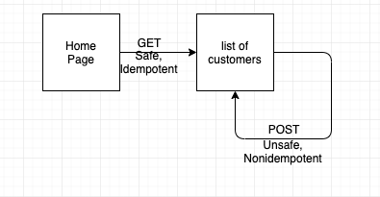
State diagram

Slide 8
Reconcile names
First Name => givenName (Person – schema.org)
Last Name => familyName (Person – schema.org)
Street Address => streetAddress (PostalAddress – schema.org)
City, State, Zip => streetAddress
Item bought => item (Property – schema.org)
Quantity => orderQuantity (Property – schema.org)
Price => price (Property – schema.org)
Total => totalPrice (Property – schema.org)

Slide 9
Select media type
Collection+JSON

Slide 10
Create a profile
ALPS Profile
<link rel=“profile” href=http://schema.org/Person>
<link rel=“profile” href=http://schema.org/PostalAddress”>
<link rel=“profile” href=http://schema.org/Property”>

