Slide 1
SOAP –What is it and how does it work?
David Tarvin, Bellevue University

Slide 2
What is SOAP?
Stands for Simple Object Access Protocol
Is a method for exchanging and sharing information among computers over the Internet
Is based on XML (Extensible Markup Language), a markup language similar to HTML
Is used mostly in the context of a Web Services/Service-Oriented Architecture framework

Slide 3
Benefits of SOAP
Provides security and reliability in connections, delivery and failure recovery
Can ride on a variety of network protocols, meaning it can pass through firewalls easily
Is based on XML, which is fairly easily read, thus making the SOAP message easy to read

Slide 4
What makes up a SOAP message?
A SOAP message contains the following:
An Envelope (mandatory)
A Header (optional)
A Body (mandatory)
A Fault (optional)

Slide 5
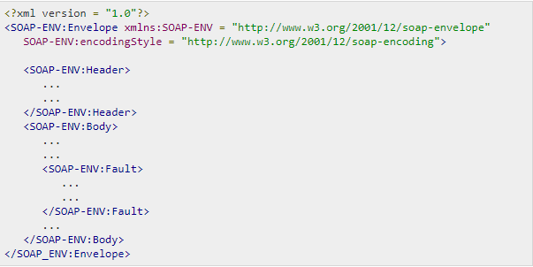
General Structure of a SOAP message

Slide 6
SOAP message - Envelope
The root element of a SOAP message
What defines the document as a SOAP message
Indicates the start and the end of the SOAP message
Contains exactly one Body element
Contains no more than one Header element
Defined as a SOAP envelope by a mandatory namespace xmlns:soap

Slide 7
SOAP message - Header
A means of specifying application-level requirements (i.e. digital signature, account number, etc)
The immediate first child of the SOAP envelope
Can add new features and functionality
Are defined in a namespace

Slide 8
SOAP message – Header attributes
A SOAP Header have two attributes:
Actor
Specifies the recipient of the SOAP header
Used when not all parts of a SOAP message are intended for the ultimate endpoint
MustUnderstand
Indicates whether the Header element is optional or mandatory
If mandatory, recipient must understand and process the Header according to its defined semantics or return a fault

Slide 9
SOAP message - Fault
Is an element in the body of the response to a SOAP message
Returns a predefined fault code, a description of the fault, and the address of the SOAP processor that generated the fault
Linked to the 500 to 599 range of status codes
Can only appear once in a SOAP message

Slide 10
SOAP message – Fault codes
A SOAP Fault element must have one of the following faultCodes:
VersionMismatch – invalid namespace for the SOAP envelope element
MustUnderstand – an immediate child element of the Header element was not understood when such understanding was mandatory
Client – message was incorrectly formed or contained incorrect information
Server – message could not proceed due to problem with the server

Slide 11
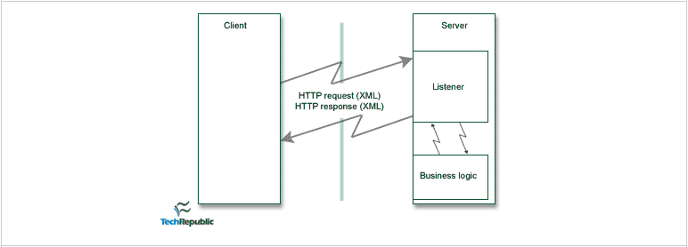
SOAP data flow

Slide 12
Resources
What is SOAP (tutorial). (n.d.). Retrieved from https://www.tutorialspoint.com/soap/what_is_soap.htm
Margaret Rouse. (2019, Feb). SOAP (Simple Object Acces Protocol) (article). Retrieved from https://searchmicroservices.techtarget.com/definition/SOAP-Simple-Object-Access-Protocol

Slide 13
Resources (cont’d)
XML Soap (article). (n.d.). Retrieved from https://www.w3schools.com/xml/xml_soap.asp
Guest Contributor (2001, Apr 02). An Introduction To The Simple Object Access Protocol (SOAP) (article). Retrieved from https://www.techrepublic.com/article/an-introduction-to-the-simple-object-access-protocol-soap/

