Slide 1
Microservices
David Tarvin, Bellevue University

Slide 2
What are microservices?
Microservices is an architectural style that structures an application as a collection of services that are
Highly maintainable and testable
Loosely coupled
Independently deployable
Organized around business capabilities

Slide 3
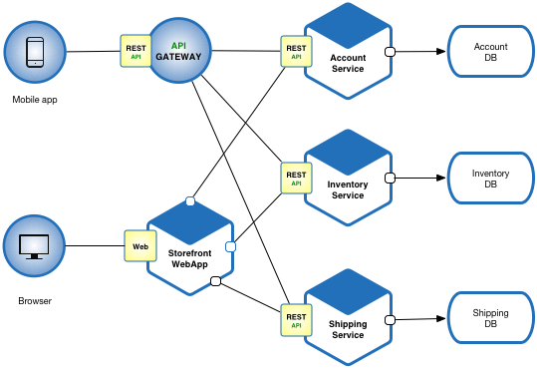

Slide 4
What is an API gateway?
An API gateway is a server that is a single entry point into the system
An API gateway:
Takes all API requests from a client
Determines which services are needed
Combines them into a synchronous experience for the user
It provides an API that is tailored to each client

Slide 5
Advantages of microservices
Applications become easier to build and maintain because they are split into smaller, composable fragments
Allows teams to focus on building business functionality that can be used in multiple contexts
Allows teams to develop different components simultaneously, speeding up productivity
Allows services written in different programming languages to coexist, thus increasing flexibility
Allows teams to work autonomously in small groups and make technical decisions quickly

Slide 6
Disadvantages of microservices
More complex than monolithic applications
Complexity is directly correlated with the number of services involved
More moving parts involved
Existing tools might not be designed to work with service dependencies
Increase in language and frameworks can make application hard to maintain
Can have issues with transaction management and data consistency since each service has its own database
Increase in testing required causes increased demand for automation
Increase in documentation overhead

Slide 7
Disadvantages of Microservices (cont’d)
Requires cultural shift to a mature agile and DevOps culture
More expensive
Lots of remote calls between services and increased network latency
Higher resource demand due to each service requiring its own runtime environment and CPU
Higher cost of management and maintenance due to each service utilizing its own language and technology stack
Increases in inter-service communication creates an opportunity for outside entities to gain access to the system, thus posing a security problem

Slide 8
How microservices are deployed in a production environment
Multiple Service Instances per Host Pattern
Provision one or more physical or virtual hosts and run multiple service instances on each one
Benefits
Resource usage is relatively efficient
Deploying a service instance and starting a service is relatively fast
Drawbacks
Little or no isolation of service instances
Operations team deploying the services has to be familiar with details of all the services, which may be written in a variety of languages and frameworks, thus increasing the risk of errors during deployment

Slide 9
How microservices are deployed in a production environment
Service Instance per Host Pattern
Run each service instance in isolation on its own host
Benefits
Due to isolation, a service can’t steal resources, such as CPU and memory, from other services
Encapsulates implementation technology
Drawbacks
Less efficient resource utilization because every service instance has overhead of an entire virtual machine, including operating system
Deploying a new version is usually slow to build, instantiate and start up because of its size

Slide 10
How microservices are scaled
Scaling can be limited to only components of an app that are impacted by usage demands

Slide 11
References
Chris Richardson. (n.d.). What Are Microservices? (article). Retrieved from https://microservices.io/
Building Microservices: Using An API Gateway (article). (No author). (n.d.). Retrieved from https://www.nginx.com/blog/building-microservices-using-an-api-gateway/
API Gateway (article). (no author). (n.d.). Retrieved from https://www.nginx.com/learn/api-gateway
5 Major Benefits of Microservice Architecture. (2018, Mar 02). (No author). Retrieved from https://skelia.com/articles/5-major-benefits-microservice-architecture/
Phil Wittmer. (2018, Nov 14). Microservices Disadvantages & Advantages (blog). Retrieved from https://www.tiempodev.com/blog/disadvantages-of-a-microservices-architecture/
Chris Richardson. (2016, Feb 10). Choosing A Microservices Deployment Strategy (blog). Retrieved from https://www.nginx.com/blog/deploying-microservices/
Tony Bradley. (n.d.). The Challenges Of Scaling Microservices (article). Retrieved from https://techbeacon.com/app-dev-testing/challenges-scaling-microservices

