Slide 1

Open Authentication (Oauth)
David Tarvin, Bellevue University

Slide 2
What Oauth is
Stands for Open Authorization
An open-standard authorization protocol (OAuth 1.0)/framework (OAuth 2.0)
Describes how unrelated servers and services can safely allow authenticated access to their assets
Doing so without sharing initial, related, single logon credential
Known as secure, third-party, user-agent, delegated authorization
OAuth 1.0 released in 2010
OAuth 2.0 released in 2012

Slide 3
How Oauth works
1. You visit a website (Bitly.com)
2. On Bitly you initiate an action to post a link to your Twitter stream
3. Bitly requests a request token from Twitter
4. Twitter provides Bitly with a token and a secret
The secret is used to prevent

Slide 4
How OAuth works (cont’d)

Slide 5
History of Oauth – Oauth 1.0
December 2007 – OAuth 1.0 addresses delegation with a framework based on digital signatures
2008 – Google begins OAuth 1.0 support
2010 – Twitter forces all third-party apps to use OAuth 1.0
Secure, but a challenge to implement
Required crypto-implementation and crypto-interoperability
Little support at present

Slide 6
History of Oauth – Oauth 2.0
2012 – OAuth 2.0 comes out
2012 – Google moves away from OAuth 1.0 to 2.0
Focused on making OAuth more interoperable and flexible between sites and devices
Introduced concept of token expiration
Not compatible with OAuth 1.0
Not supported by many of the original OAuth founders and supporters
Also adopted by Amazon, Facebook, Instagram, LinkedIn, Microsoft, Netflix and Paypal

Slide 7
Why Oauth is popular
Users appreciate only having to logon once to use multiple services
Website owners appreciate not having to contain their own authentication system with the ability to scale to gigantic proportions

Slide 8

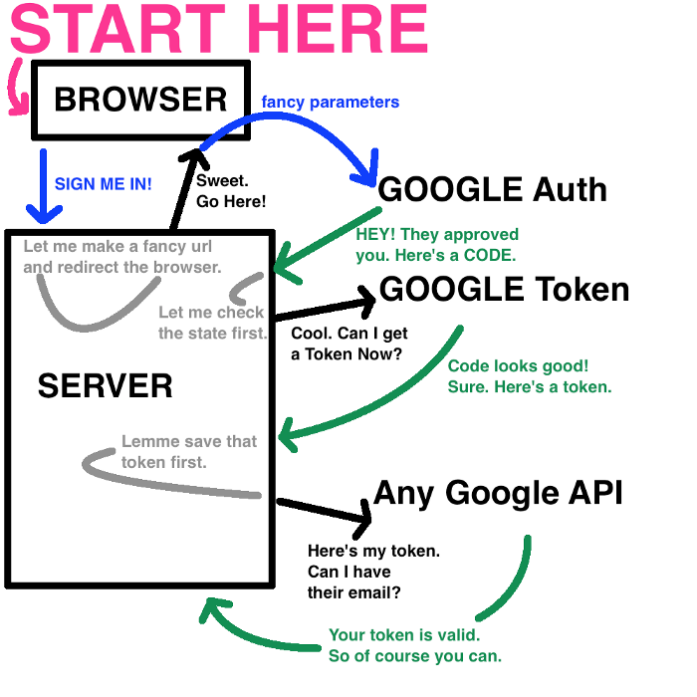
End to end data flow of an Oauth API

Slide 9
References
Valerie Chapple. (2018 Feb 22). The Nitty-Gritty Of Oauth 2.0 Flow (article). Retrieved from https://medium.com/@valeriechapple/how-to-truly-understand-oauth-2-0-69dd3e7574c6
Roger Grimes. (2017 Aug 16). What Is Oauth? How The Open Authorization Framework Works (article). Retrieved from https://www.csoonline.com/article/3216404/what-is-oauth-how-the-open-authorization-framework-works.html
Synopsys Editorial Team. (2016, Mar 11). What’s The Difference? OAuth 1.0 vs OAuth 2.0 (blog). Retrieved from https://www.synopsys.com/blogs/software-security/oauth-2-0-vs-oauth-1-0/

