Slide 1
Hypermedia design
David Tarvin, Bellevue university
WEB 420

Slide 2
Backstory – boy scouts of america
The Boy Scouts of America sell popcorn every year as a fundraiser. The Scouts go door-to-door to do this, using sheets of paper on which to write orders. The BSA has asked us to create an API that can be used in an app to track popcorn sales.

Slide 3
Return on investment
Giving the Scouts the ability to track sales on an app on their phone will make tracking sales much easier, which is believed will result in a greater number of Scouts willing to engage in a greater amount of fundraising.

Slide 4
Seven-step design process
1. List all semantic descriptors
2. Draw a state diagram
3. Reconcile semantic descriptors with existing profiles
4. Choose a media type
5. Write a profile
6. Write the code for the API
7. Publish the API

Slide 5
Semantic descriptors
Customer
First Name
Last Name
Street address
City
State
Zip
Purchase
Item
Quantity
Price
Total Sale

Slide 6
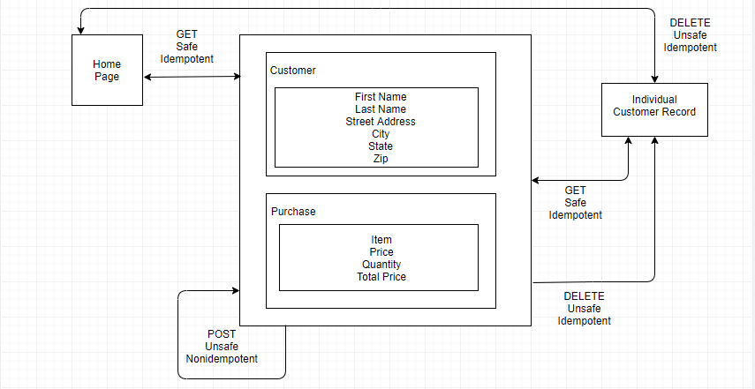
State diagram

Slide 7
Reconcile names
First Name => givenName (Person – schema.org)
Last Name => familyName (Person – schema.org)
Street Address => streetAddress (PostalAddress – schema.org)
City, State, Zip => part of streetAddress
Item bought => item (Property – schema.org)
Quantity => orderQuantity (Property – schema.org)
Price => price (Property – schema.org)
Total => totalPrice (Property – schema.org)

Slide 8
Select media type
Collection+JSON
Supports the use of semantic profiles
JSON-Based for management and querying of simple collections
Supports CRUD – Create, Read, Update and Delete
HTTP verbs – GET, POST, PUT and DELETE

Slide 9
Create a profile
ALPS Profile
<link rel=“profile” href=http://schema.org/Person>
<link rel=“profile” href=http://schema.org/PostalAddress”>
<link rel=“profile” href=http://schema.org/Property”>

Slide 10
Implementation
Write the code for the API
Implement the code
Create the app that will use the API for the Scouts to interact with

Slide 11
publication
Put app on App Store and Google Play
Publish URL – may not be necessary as API is intended only for this app
Publish profile – submit to alps.io
Register new media types and link relations – no new ones used in this API

