Slide 1
Hand Cricket Game Using Server Client Communication
Kirtan uchil(RA2011003010484
SHIVAM BAWARIA(RA2011003010495)
DARSHITA TATED(RA2011003010500)
ARPIT AGGARWAL (RA2011003010515)

Slide 2
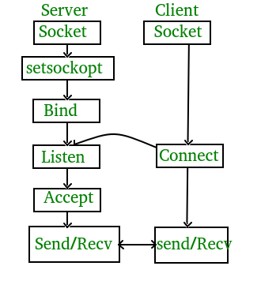
Abstract
Socket programming is a way of connecting two nodes on a network to communicate with each other.
One socket(node) listens on a particular port at an IP, while the other socket reaches out to the other to form a connection.
The server forms the listener socket while the client reaches out to the server. They are the real backbones behind web browsing.
In simpler terms, there is a server and a client.
Here there are two parameters.
The first parameter is AF_INET and the second one is SOCK_STREAM. AF_INET refers to the address-family ipv4.
The SOCK_STREAM means connection-oriented TCP protocol. Socket programming is started by importing the socket library and making a simple socket.

Slide 3
Project Analysis
The topic allocated to us for the socket Programming project is “Hand Cricket”.
Here, the client establishes a connection with the server, this implies that the TCP protocol
Is being used. The Server Should allocate a new thread for every new incoming Client, to accomplish this feature we took care of concurrent threads which is when the number of connections is made with the server, that time each thread doesn’t interfere with one another. Therefore we synchronized the thread.

Slide 4
Design And Implementation
When we are running client1.py then using tkinter making window prompt.
Same as in client2.py file.
After Design window prompt we are implement players and select who’s doing bowling & bating.
Both players are playing game.
At the end we find out who win or lose match

Slide 5


Requirements And Tools Used
Tkinter
Socket
Subprocess
Python Libraries
Programming: Python
Connection: Socket Programming
Protocol: TCP
User Interface: python Tkinter
Data Storage: Using CSV files
Data Updates: python-pandas
Os calls: Python-subprocess

Slide 6
Workflow Description
This is a console based application where you can visualize the hand-cricket game. players can fix their target runs and play against the computer as opponent. Wickets will be counted and runs will be displayed at each play.
In this version of Hand Cricket, the first player is a real person and the second player is the computer.
The player throws one of these moves in front of the webcam as per their choice which is converted into its respective number between 0 and 6, and simultaneously the computer selects a number between 0 and 6 randomly.
If both(player and computer) throw the same number, the batsman is out!.
In the first innings, the person always bats first and computer bowls first and unless the computer takes the wicket of the person, the score of the person keeps on adding as per their move.
When the computer takes the wicket of the person, the computer starts batting and adding up its score and the person has to take the wicket of the computer before they beat the person's score.

Slide 7
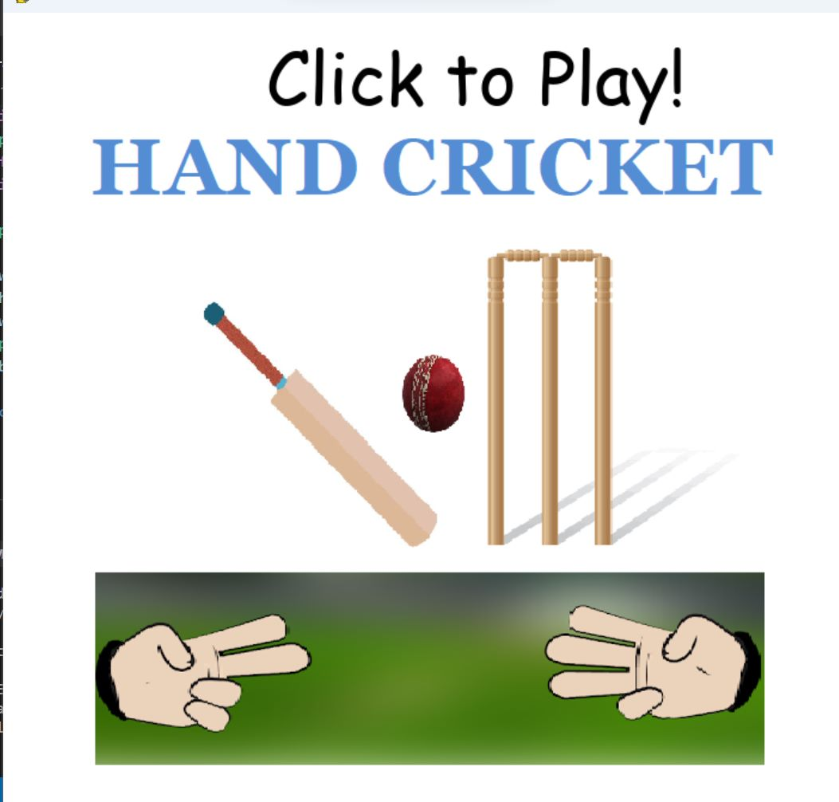
Output Interface

Slide 8
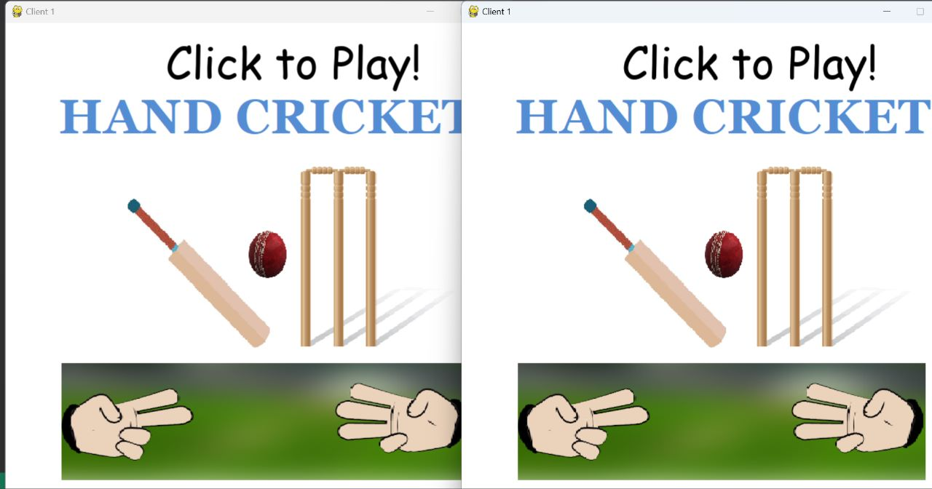
Output Interface

Slide 9
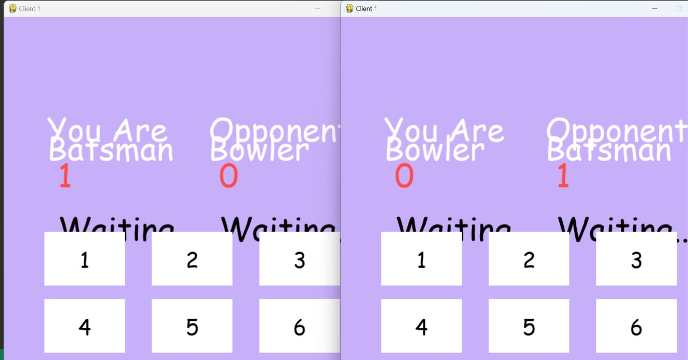
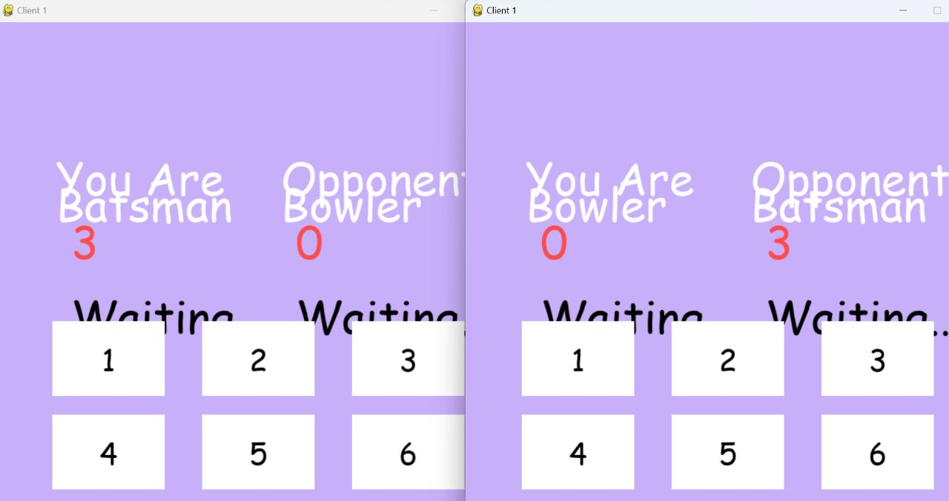
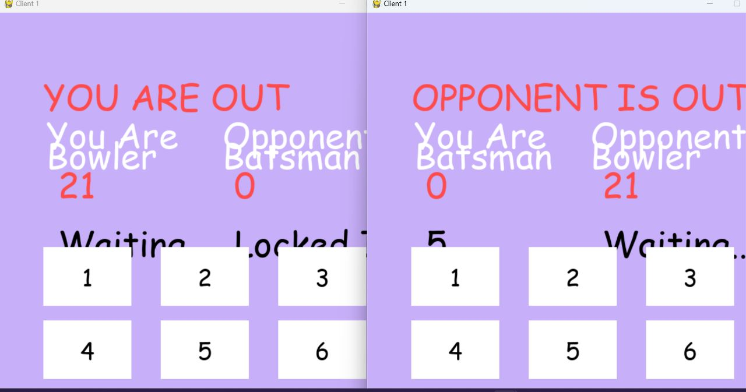
Output Interface

Slide 10
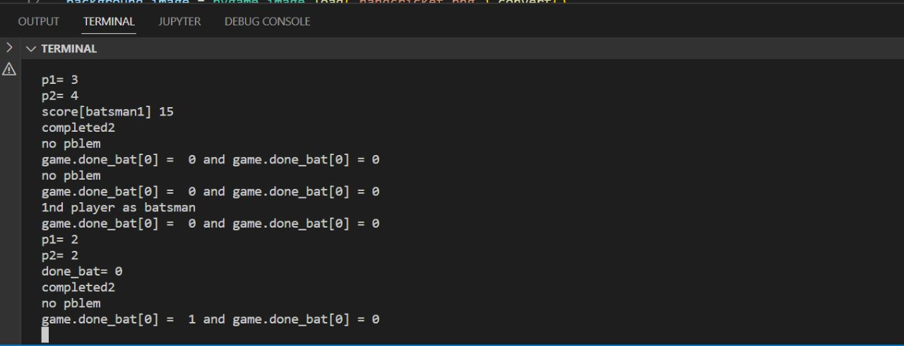
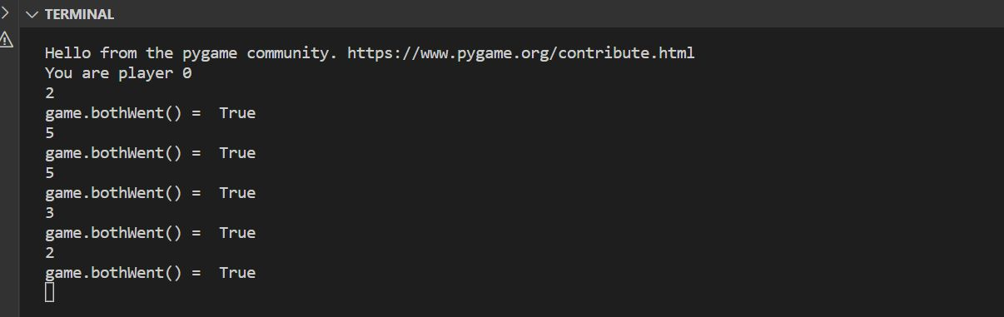
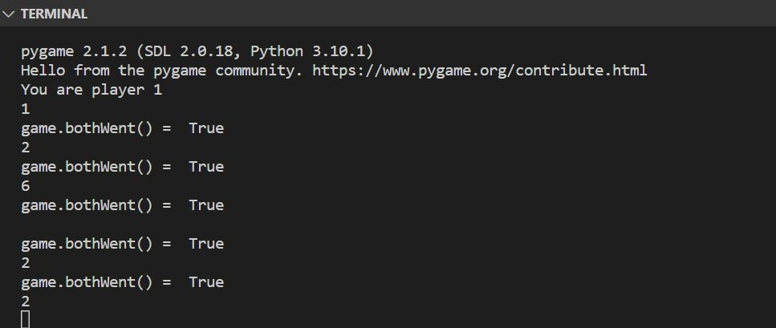
Terminal Result

Slide 11
Conclusion
We have Successfully Executed the Socket programming Project “Hand Cricket” by establishing the connection between the client and the server which implies the use of TCP protocol.
To Support the Above statement we got the desired output which is posted in the above section.

Slide 12
References
https://docs.python.org/3/library/tkinter.html
https://www.pygame.org/news

