Slide 2


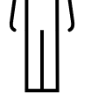

(A)
Motion in B following contact from A (contact causality)
Motion in B in the absence of contact from A
(action-at-a-distance causality)
Entities with elongated parts and curvilinear edges (i.e., people)
Things with smooth, rectilinear edges (i.e., objects)
(B)
T1
T2
Time
T3
(C)
OR

