Slide 2
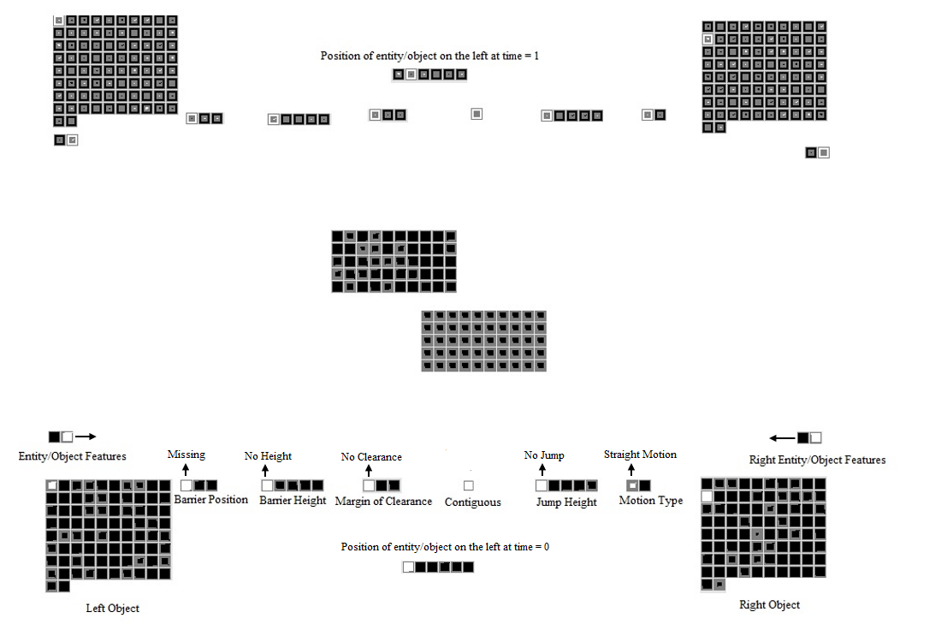
Recurrent Feedback

Slide 3
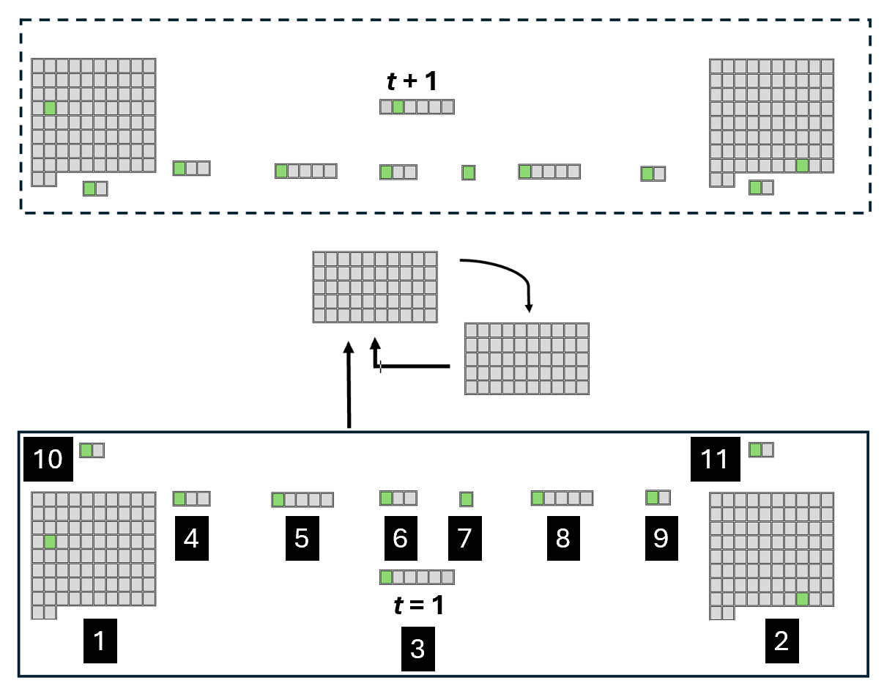
Output layer
Groups | # of Units | Semantic Features of Each Unit
1. Object Left | 80 | Units 1-80: 1-80 individuals
2. Object Right | 80 | Units 1-80: 1-80 individuals
3. Horizontal Position | 6 | Unit 1: Far Left; Unit 2: Left; Unit 3: Center-Left; Unit 4: Center-Right; Unit 5: Right; Unit 6: Far Right
4. Obstacle Horizontal Position | 3 | Unit 1: Absent; Unit 2: Middle; Unit 3: Periphery
5. Obstacle Height | 5 | Unit 1: Absent; Unit 2: Smallest; Unit 3: Small; Unit 4: Large; Unit 5: Largest
6. Arc Apex-Obstacle Gap | 3 | Unit 1: NA; Unit 2: Small; Unit 3: Large
7. Spatial Adjacency | 1 | Unit 1: Spatially Contiguous
8. Arc Peak Height | 5 | Unit 1: NA; Unit 2: Lowest; Unit 3: Low; Unit 4: High; Unit 5: Highest
9. Kinematic Motion Type | 2 | Unit 1: Linear; Unit 2: Arced
10. Surface Property Left | 2 | Unit 1: Typical Animate Features; Unit 2: Typical Inanimate Features
11. Surface Property Right | 2 | Unit 1: Animate-Typical Features; Unit 2: Inanimate-Typical Features
Recurrent Feedback
Input layer
Notes:
Table 1. Input and output groups in ALIAS and the semantic interpretation of their units.

Slide 4
T₁

