Slide 2
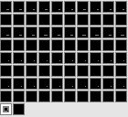
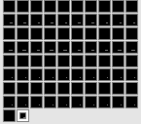
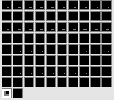
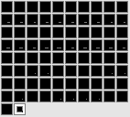




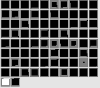
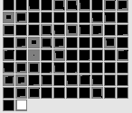
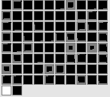
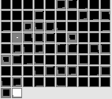
(A) Inconsistent test event
(B) Consistent test event
Horizontal Position at time = 1
Horizontal Position at time = 2
Missing
Absent
No Clearance
Arc Peak Height 4
Arced Path
Missing
No Height
No Clearance
No Arced Motion
Linear Path
Surface Property Left
Surface Property Right
Surface Property Left
Surface Property Right
Obstacle
Horizontal
Spatial Position
Obstacle Height
Arc Apex-Obstacle
Gap
Final
Adjacency
Arc Peak
Height
Kinematic Motion
Type
Obstacle
Horizontal
Spatial Position
Obstacle Height
Arc Apex-Obstacle
Gap
Final
Adjacency
Arc Peak
Height
Kinematic Motion
Type
Horizontal Position at time = 0
Horizontal Position at time = 0
Notes:
Inconsistent left

Slide 3
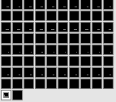
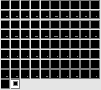
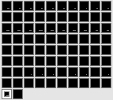
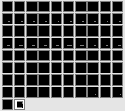




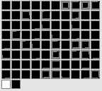
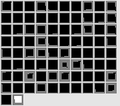
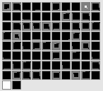
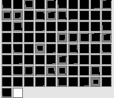
(A) Inconsistent test event
(B) Consistent test event
Horizontal Position at time = 1
Horizontal Position at time = 2
Missing
Absent
No Clearance
Arc Peak Height 4
Arced Path
Missing
No Height
No Clearance
No Arced Motion
Linear Path
Surface Property Left
Surface Property Right
Surface Property Left
Surface Property Right
Obstacle
Horizontal
Spatial Position
Obstacle Height
Arc Apex-Obstacle
Gap
Final
Adjacency
Arc Peak
Height
Kinematic Motion
Type
Obstacle
Horizontal
Spatial Position
Obstacle Height
Arc Apex-Obstacle
Gap
Final
Adjacency
Arc Peak
Height
Kinematic Motion
Type
Horizontal Position at time = 0
Horizontal Position at time = 0

