Slide 2
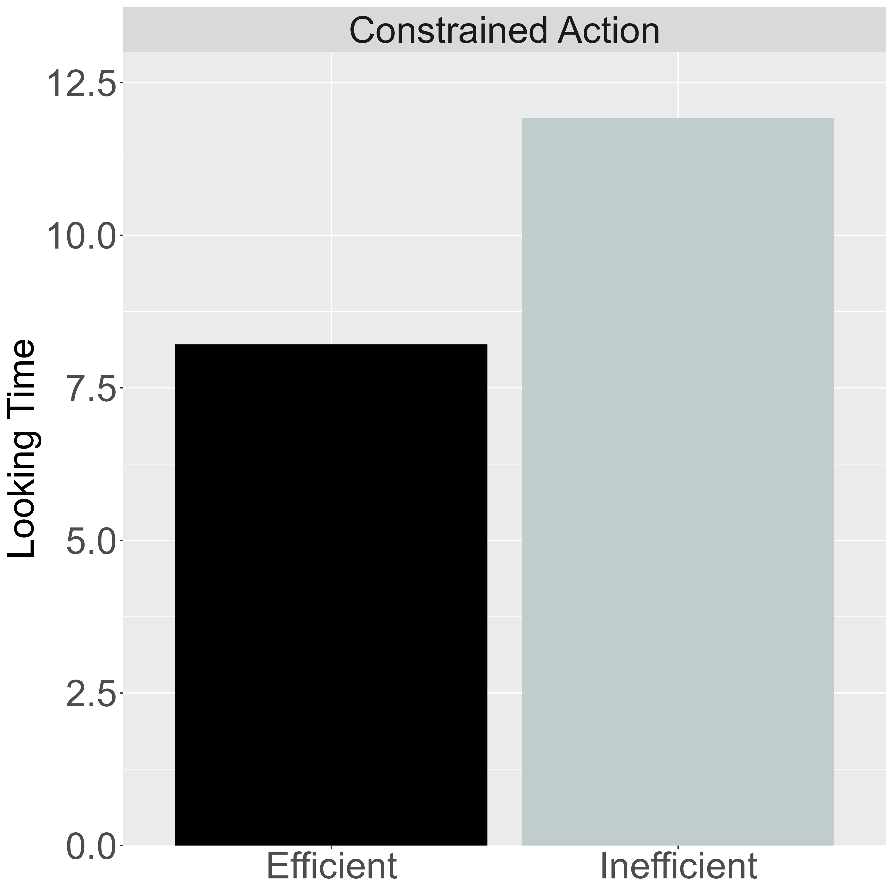
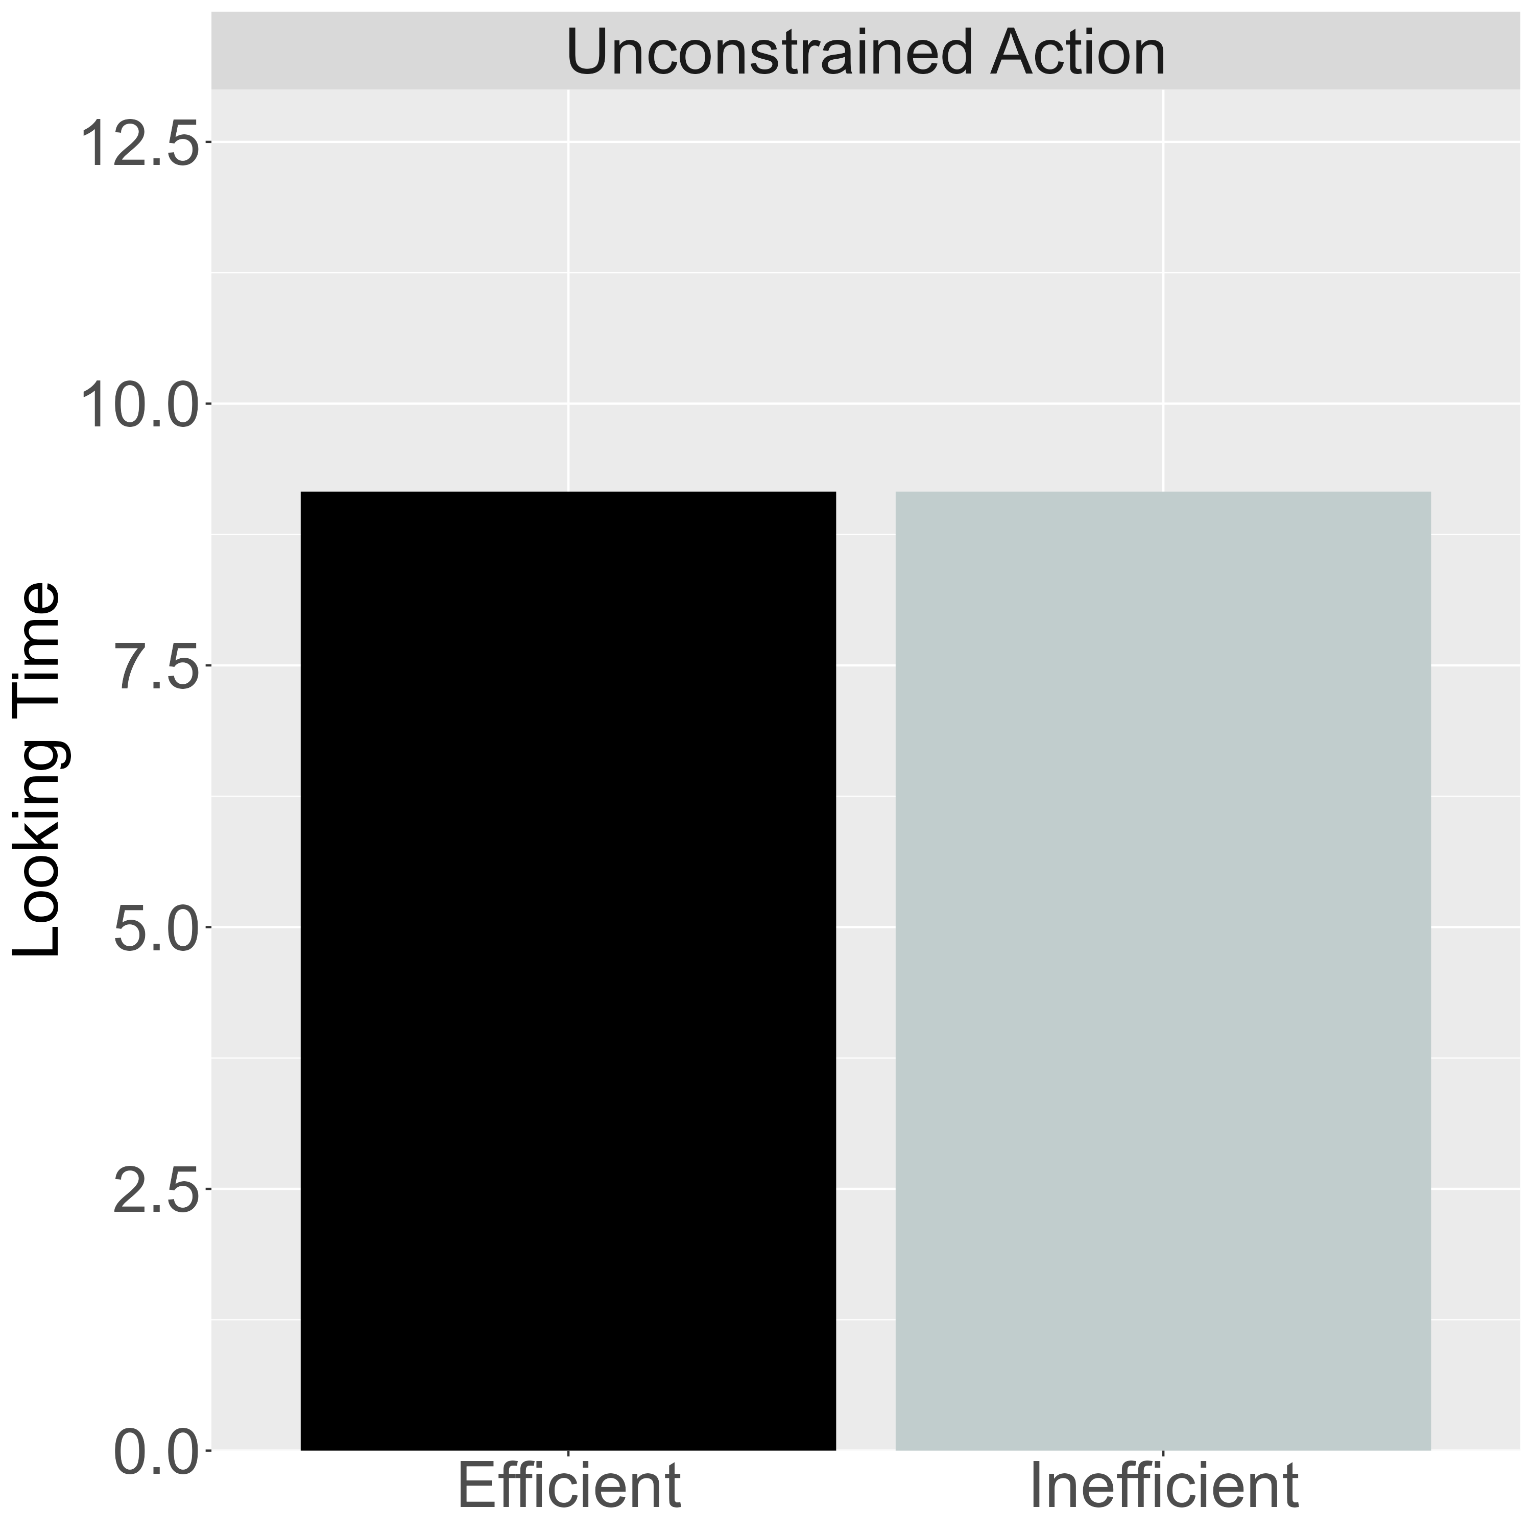
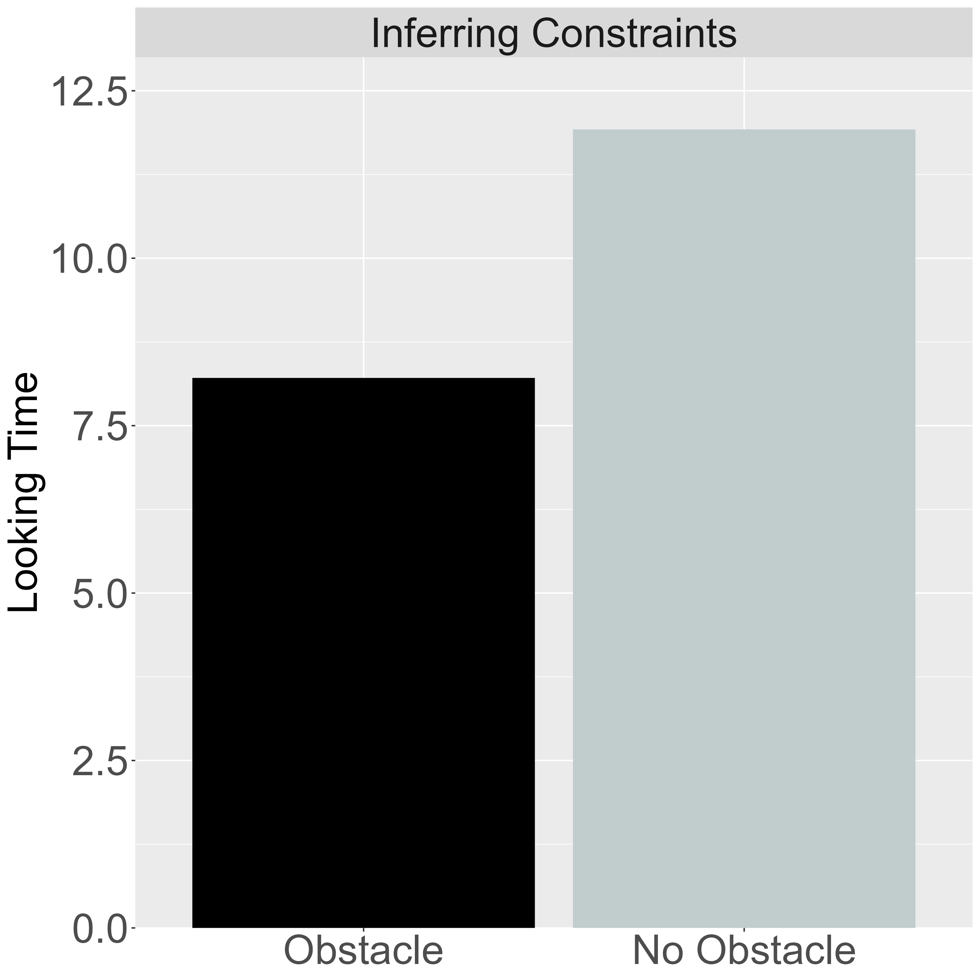
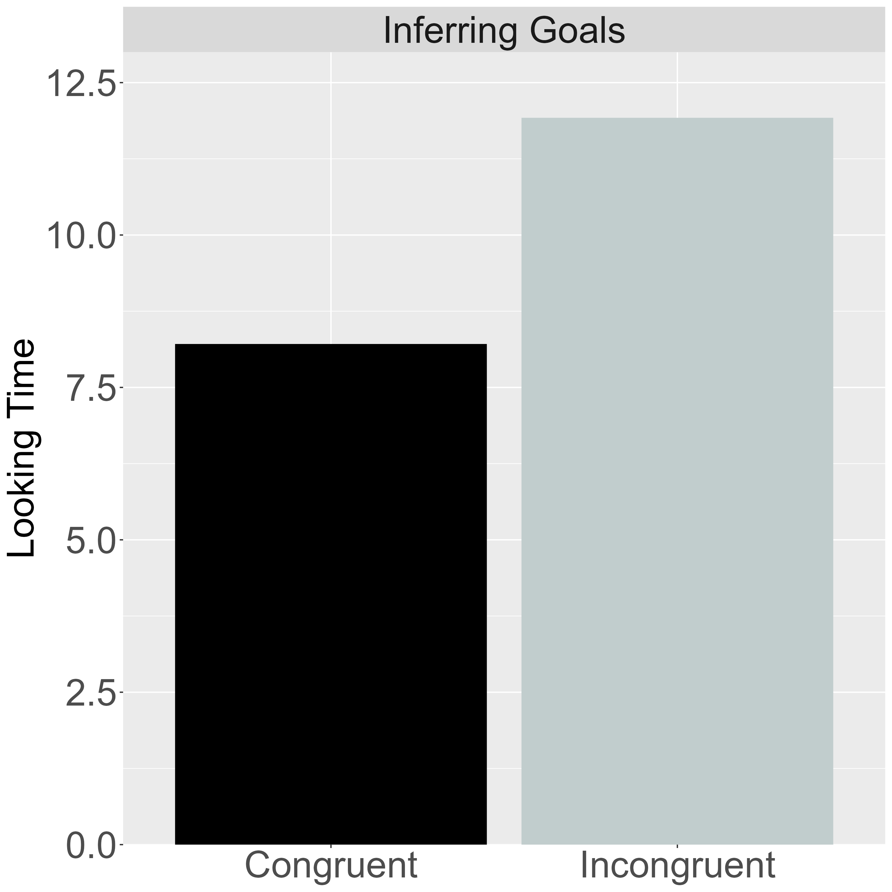
Paradigms Underlying the Five Target Findings
Target Finding 1:
Selective Longer Looking to Inefficient Actions
Target Finding 2:
Independence from Animacy Cues
Target Finding 3:
Bidirectional Inferences about Actions, Goals, and Constraints
Experimental Condition
Control Condition
Experimental Condition
Control Condition
Inferring Constraints Condition
Inferring Goals Condition
Constrained Action Event
Unconstrained Action Event
Constrained Action Event
Unconstrained Action Event

Slide 3
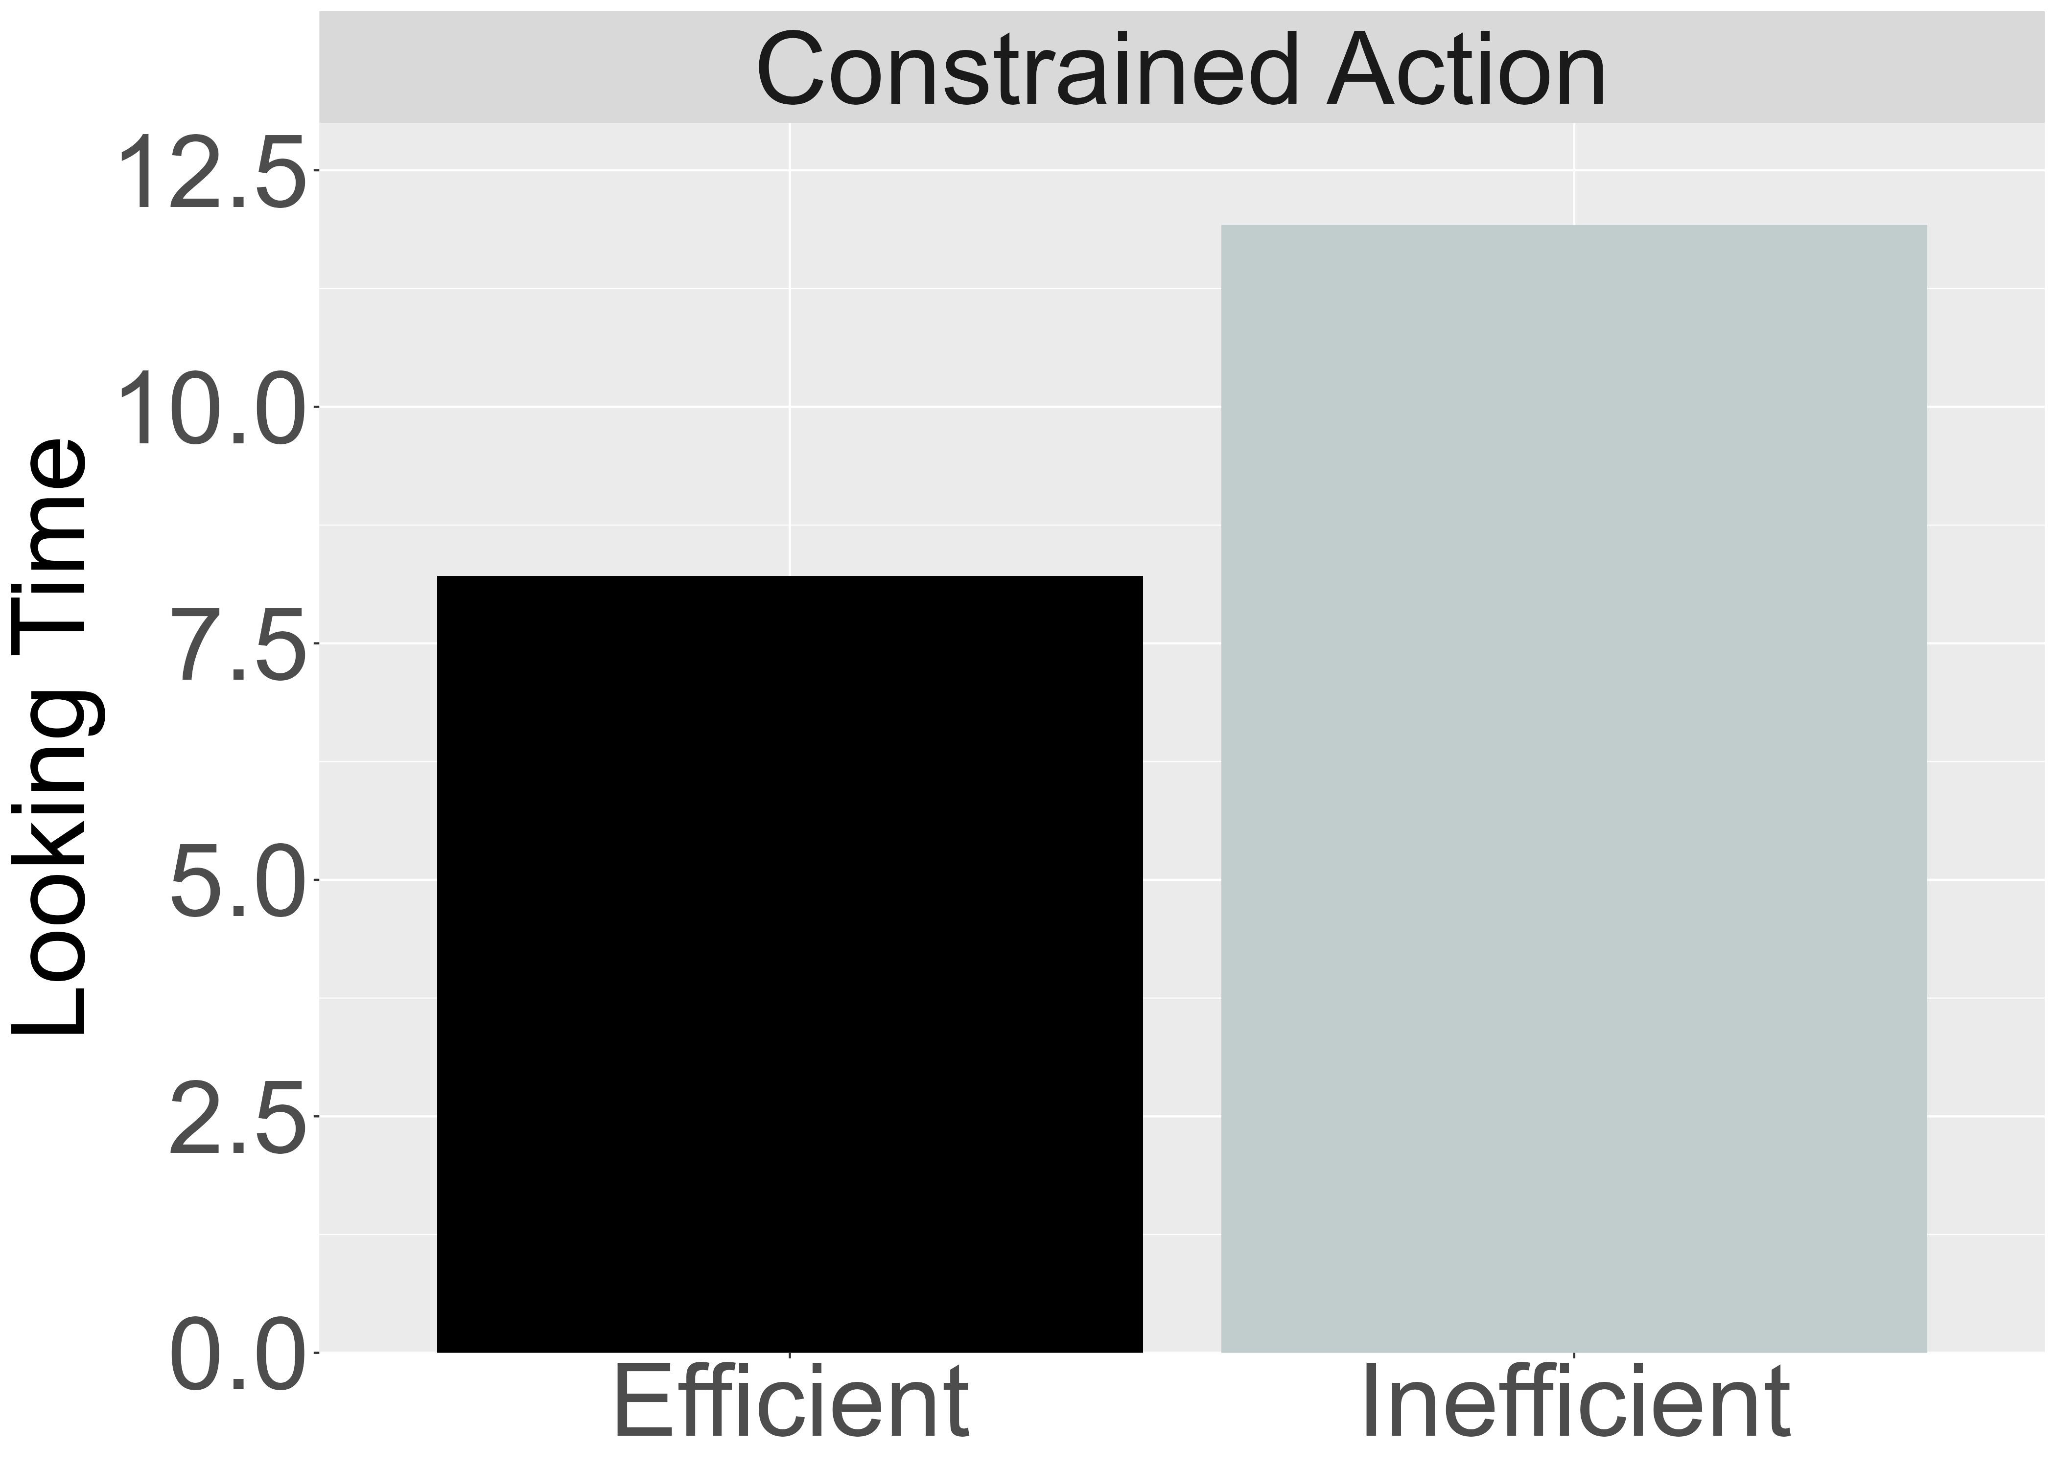
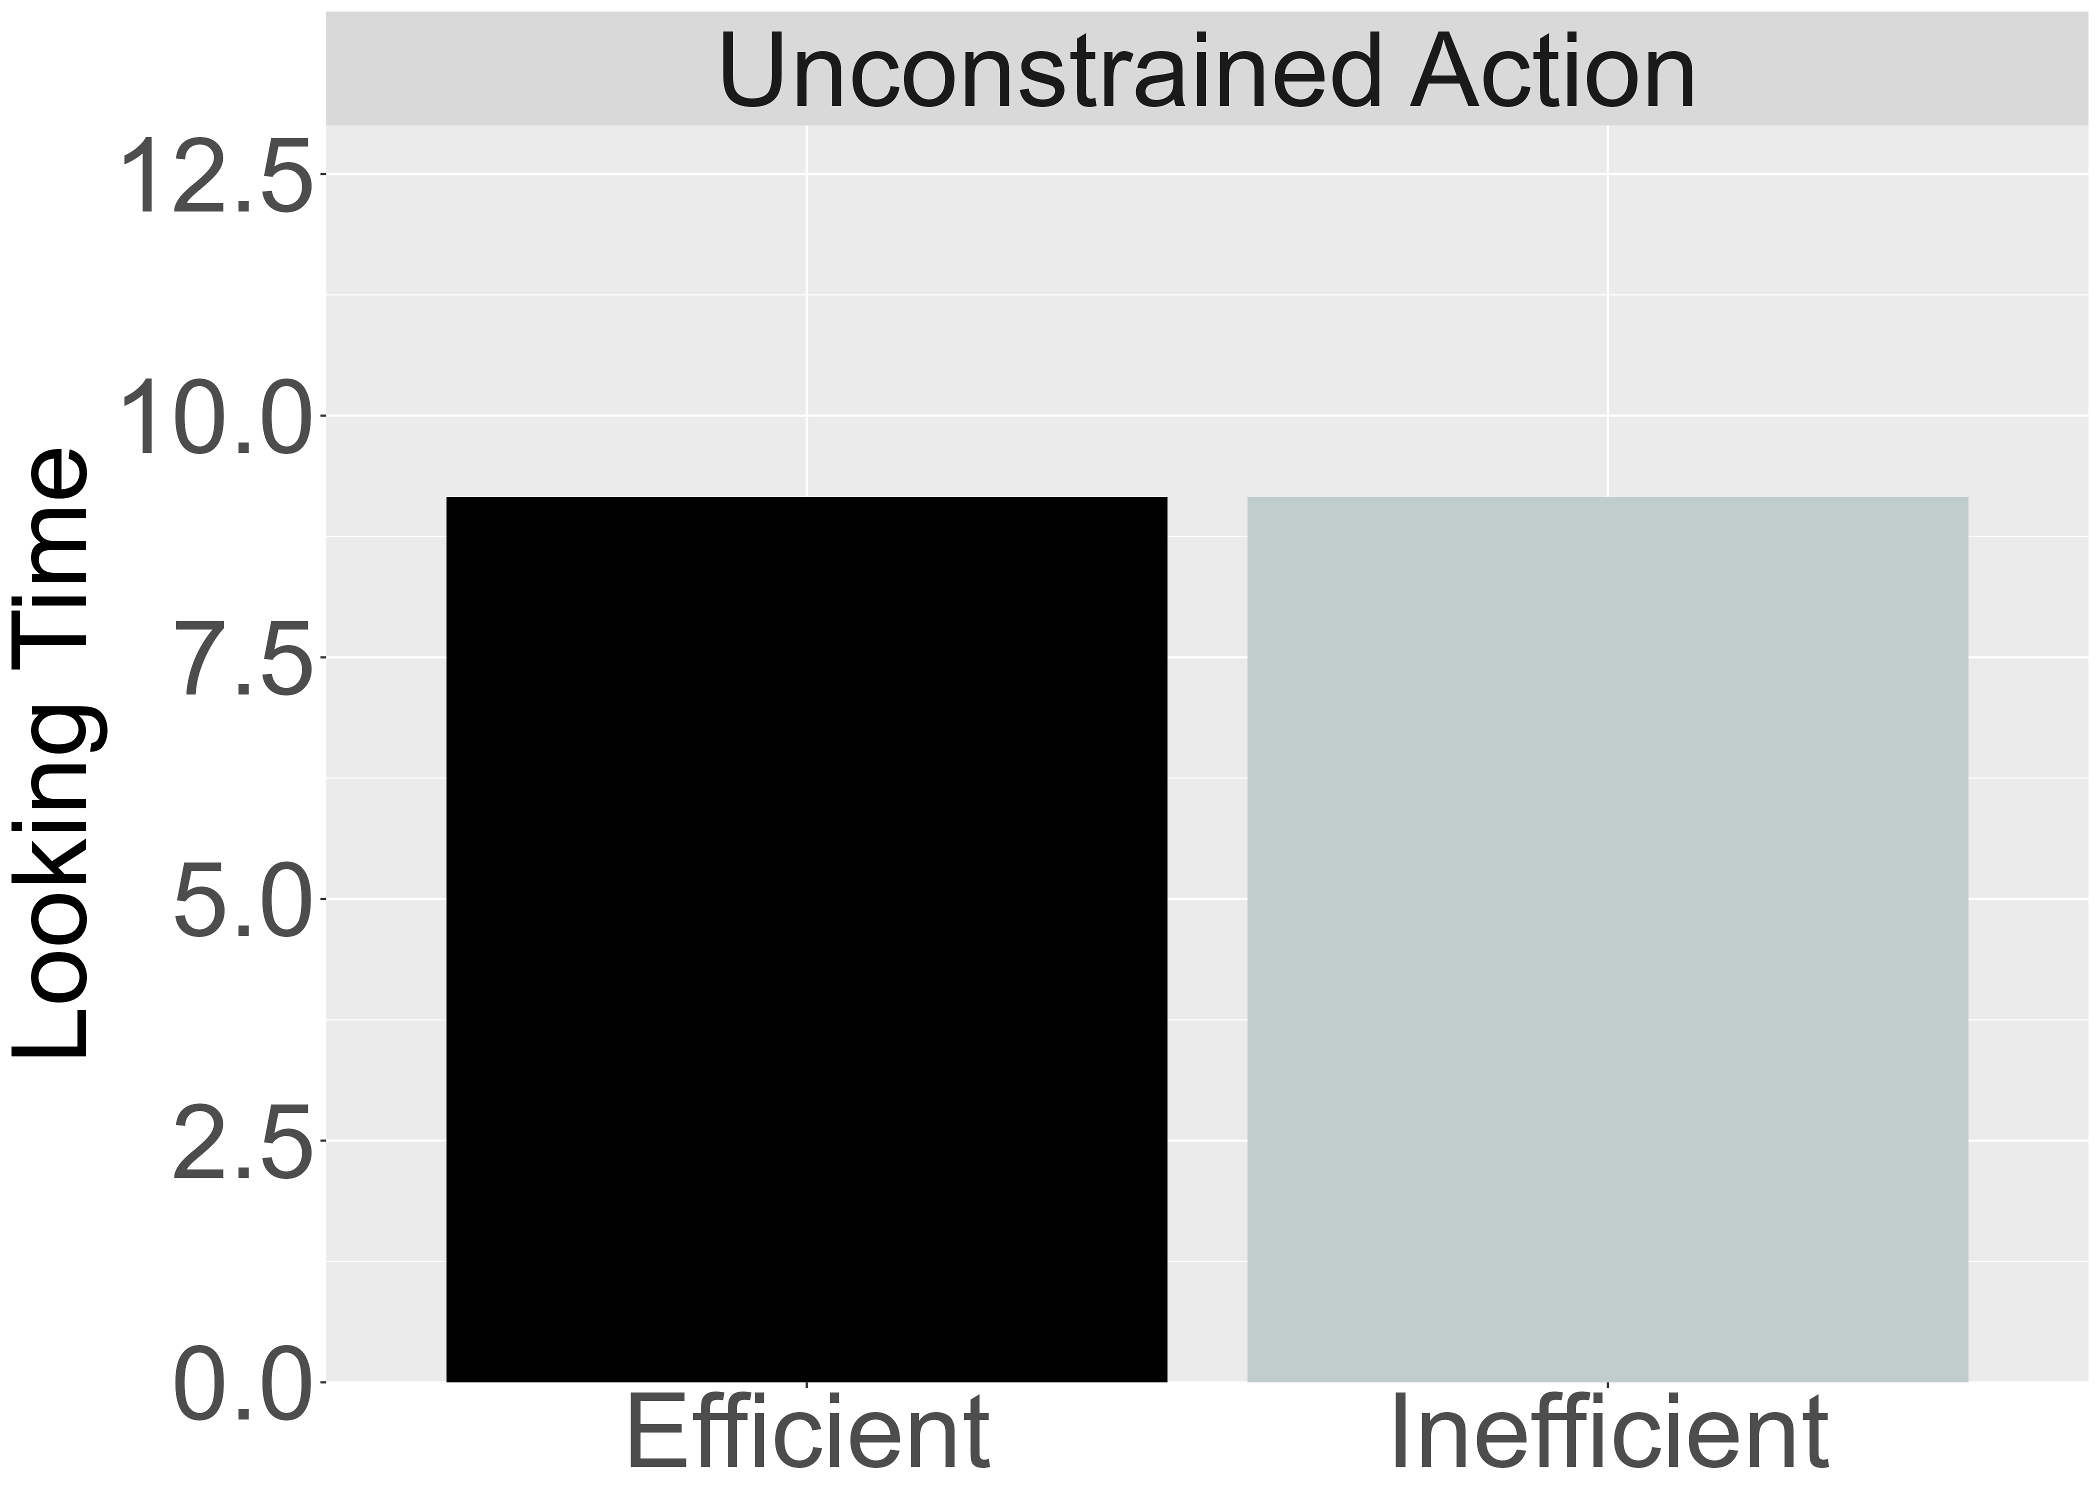

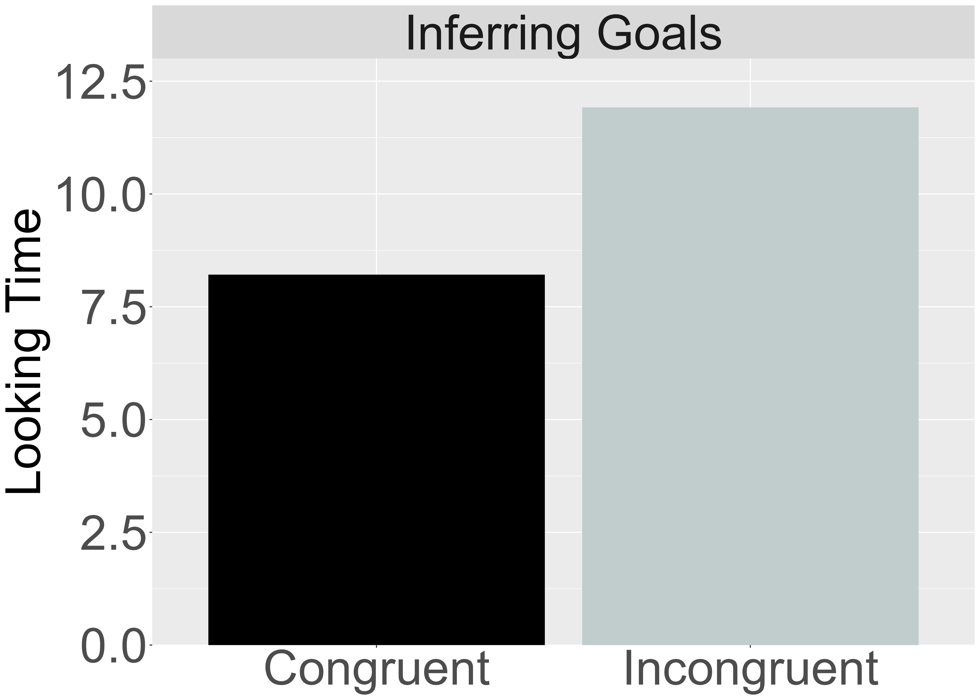
A. Target Finding 2:
B. Target Finding 3:
Independence from Animacy Cues
Bidirectional Inferences about Actions, Goals, and Constraints
Constrained Action
Unconstrained Action
Inferring Constraints
Inferring Goals
Habituation
Habituation
Habituation
Habituation
Test
Test
Test
Test

Slide 4
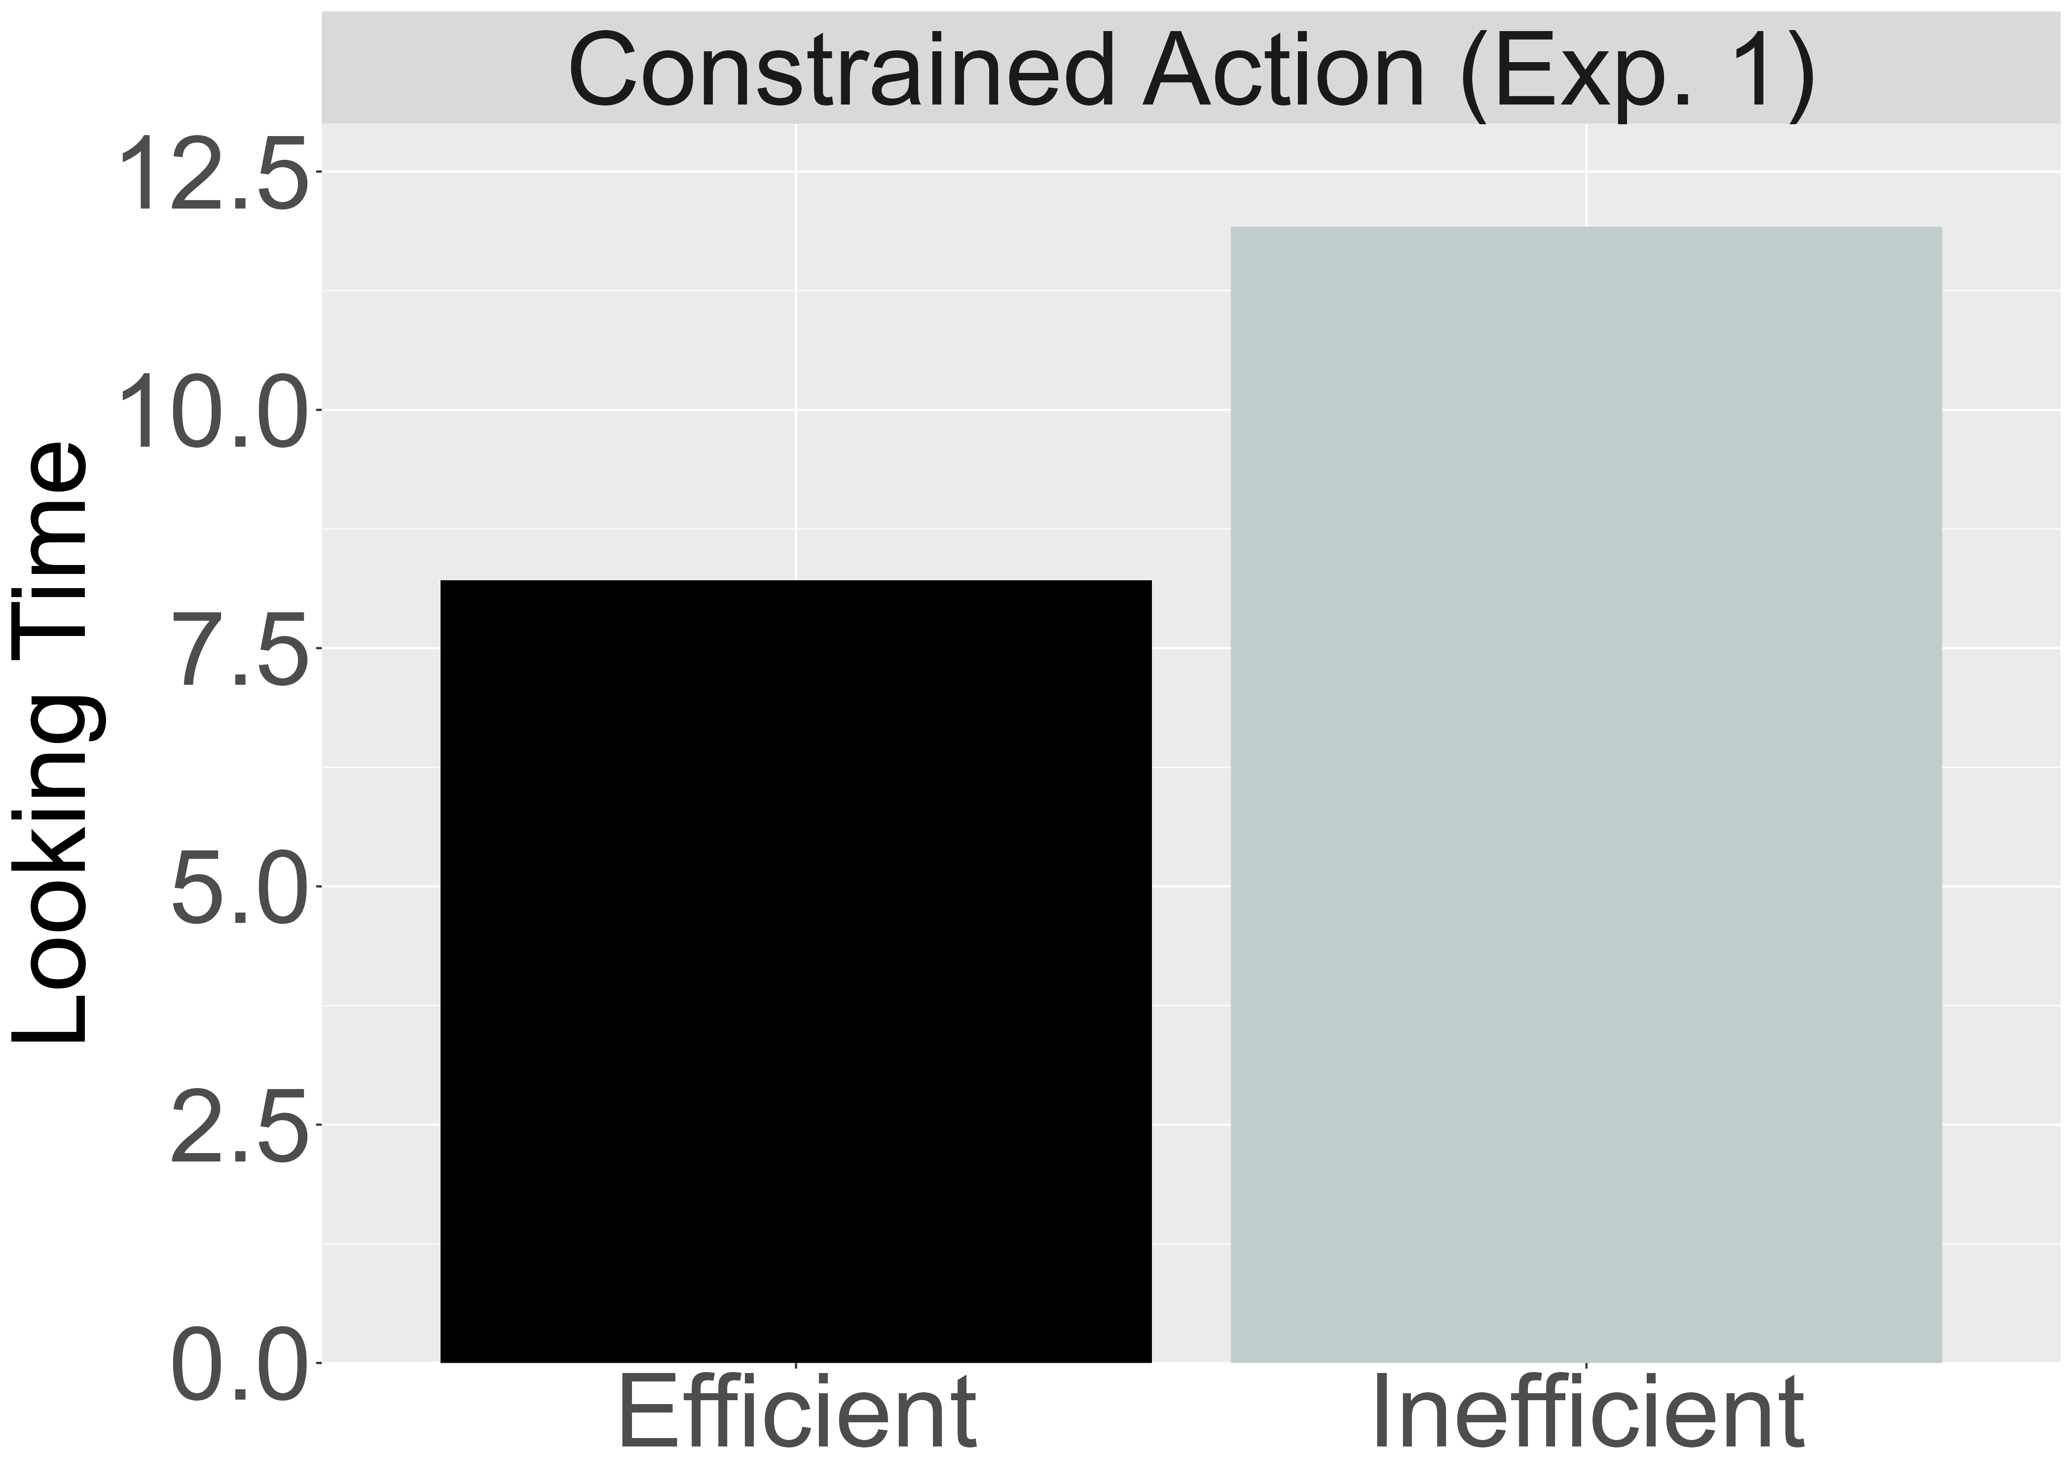
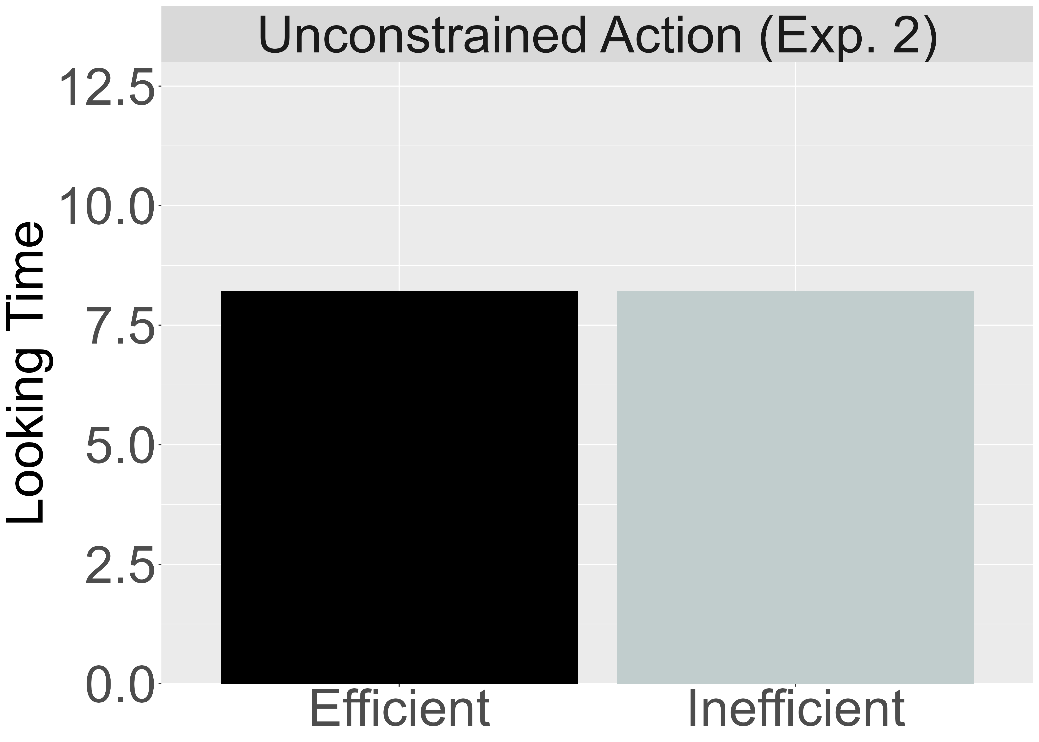


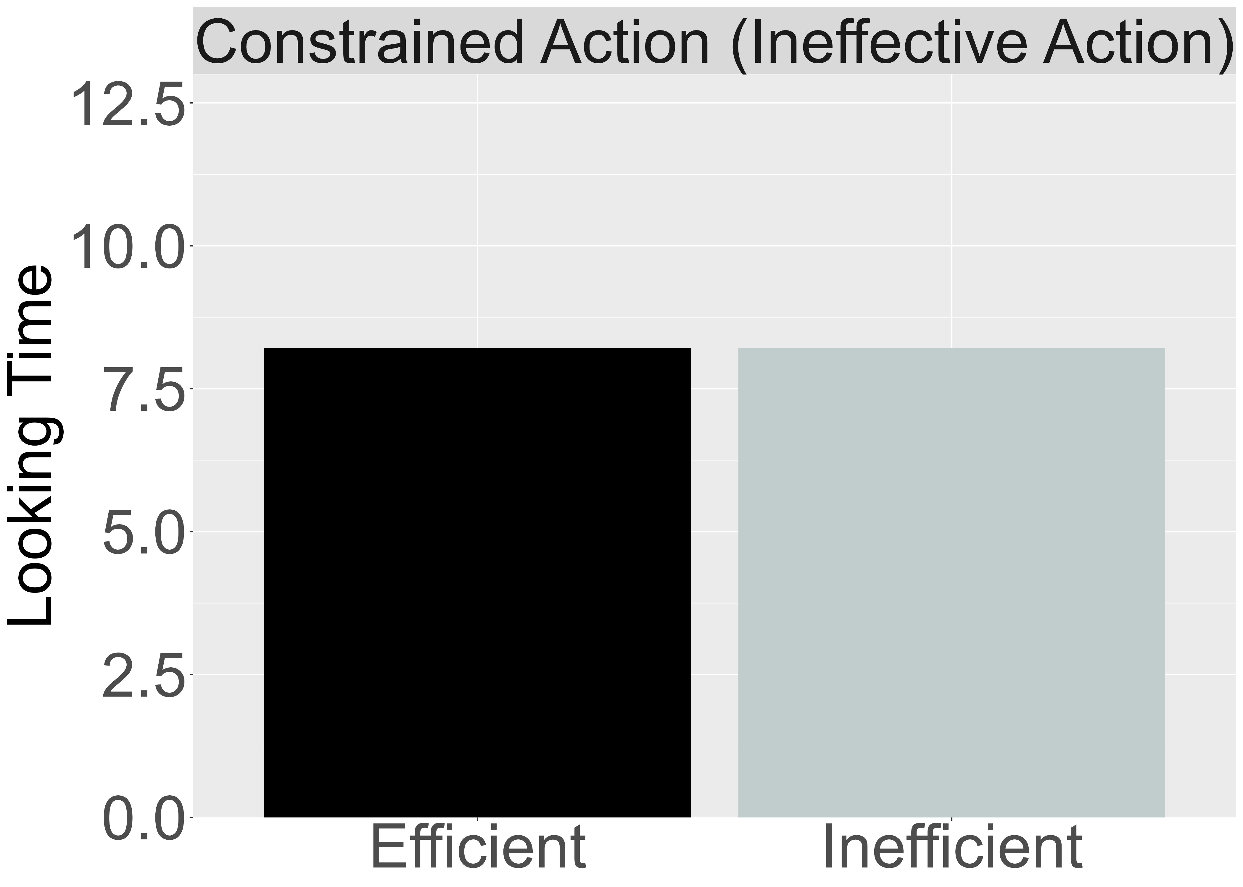

Target Finding 4:
D. Target Finding 5:
Graded Representations of Efficiency
Action efficiency understanding in pre-reaching infants
Constrained Action
Unconstrained Action
Unconstrained Action
Constrained Action
Constrained Action
Unconstrained Action

