Slide 1
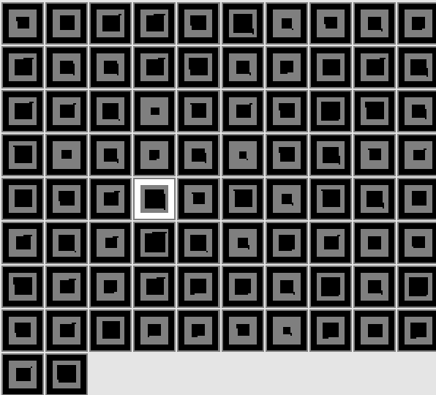
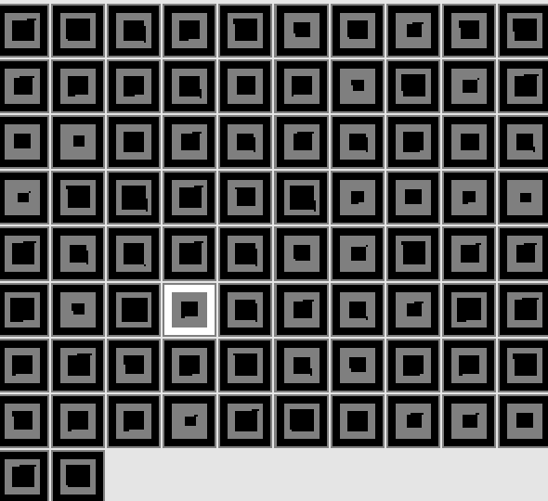







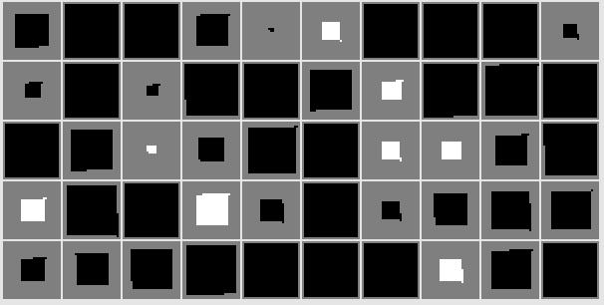

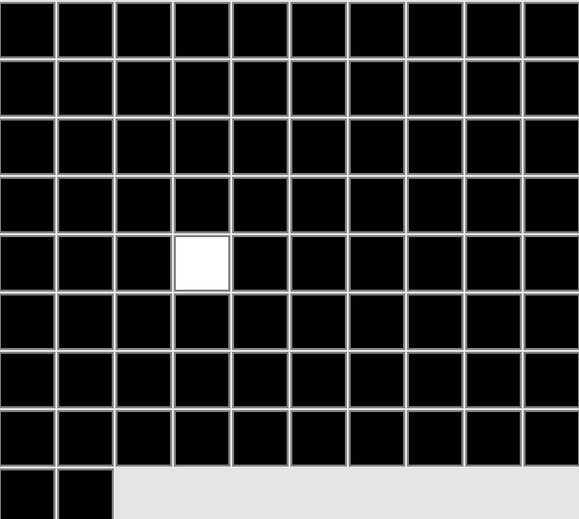



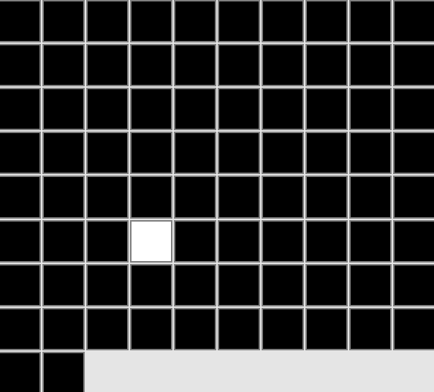
Output Layer
Hidden Layer
Animate Feature
Animate Feature
Left Animate Feature
Middle
Barrier Height 1
Jump Height 1
Curved Motion
Right Animate Feature
Barrier Position
Barrier Height
Contiguous
Jump Height
Motion Type
Object 44
Object 54
Input Layer
Left Object
Right Object

Slide 2
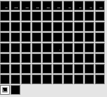
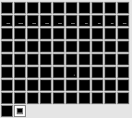

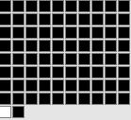
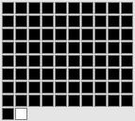
(A) Inconsistent test event
Output Layer
Animate Feature
Animate Feature
Barrier Missing
Barrier Height 0
Contiguous
Jump Height 4
Curved Motion
Input Layer
Object 81
Object 82

Slide 3
(B) Consistent test event
Output Layer
Animate Feature
Animate Feature
Barrier Missing
Barrier Height 0
Contiguous
Jump Height 0 -
Straight Motion
Input Layer
Object 81
Object 82

Slide 4
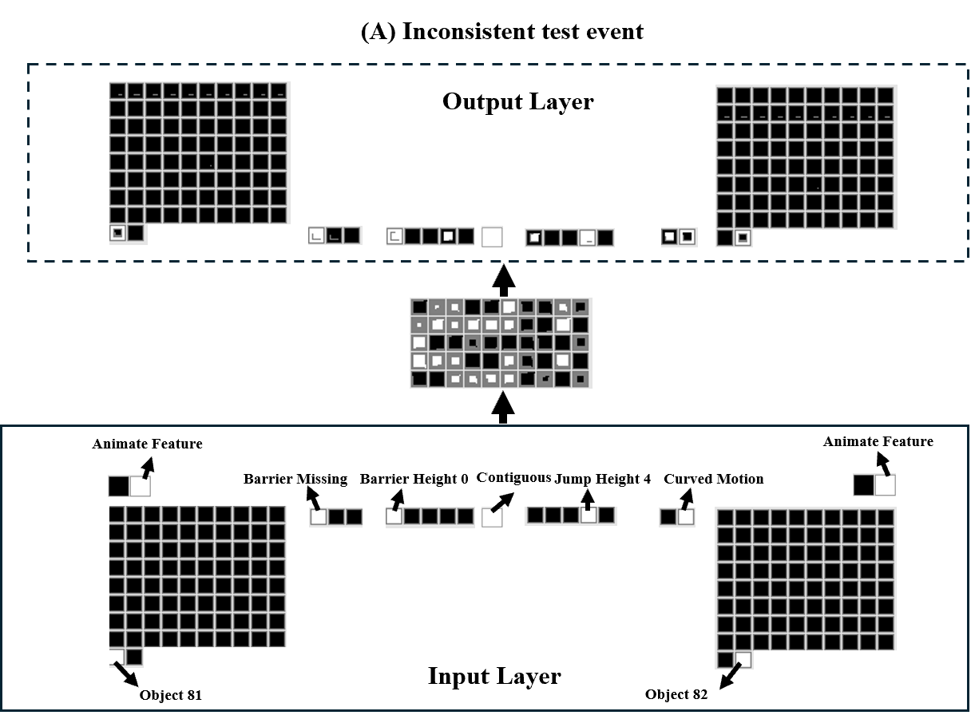
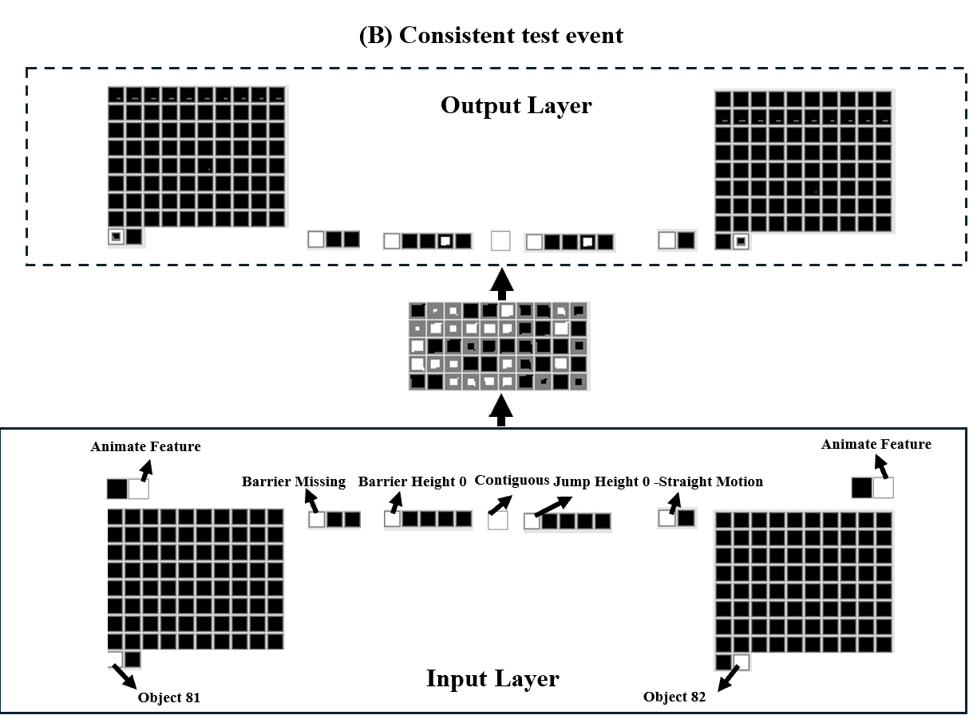
Notes:
Test performance of networks in the Experimental condition

Slide 5
(A) Inconsistent test event
Output Layer
Animate Feature
Animate Feature
Barrier Missing
Barrier Height 0
Contiguous
Jump Height 4
Curved Motion
Input Layer
Object 81
Object 82
Notes:
Control condition

Slide 6
(B) Consistent test event
Output Layer
Animate Feature
Animate Feature
Barrier Missing
Barrier Height 0
Contiguous
Jump Height 0
Straight Motion
Input Layer
Object 81
Object 82

Slide 7
