Slide 2
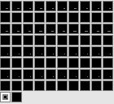
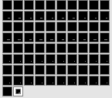
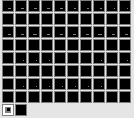
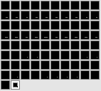




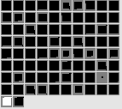
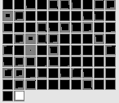
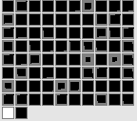
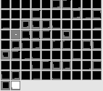
(A) Inconsistent test event
(B) Consistent test event
Position of entity/object on the left at time = 1
Position of entity/object on the left at time = 1
Missing
No Height
No Clearance
Jump Height 4
Curved Motion
Missing
No Height
No Clearance
No Height
Straight Motion
Entity/object features
Entity/object features
Barrier Position
Barrier Height
Margin of clearance
Contiguous
Jump Height
Motion Type
Barrier Position
Barrier Height
Margin of clearance
Contiguous
Jump Height
Motion Type
Position of entity/object on the left at time = 0
Position of entity/object on the left at time = 0
Notes:
Inconsistent left

Slide 3
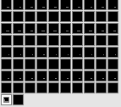
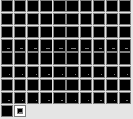
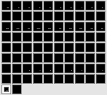
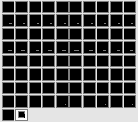




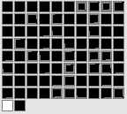
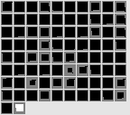
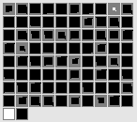
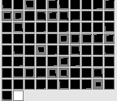
(A) Inconsistent test event
(B) Consistent test event
Missing
No Height
No Clearance
Jump Height 4
Curved Motion
Missing
No Height
No Clearance
No Height
Straight Motion
Entity/object features
Entity/object features
Entity/object features
Entity/object features
Barrier Position
Barrier Height
Margin of clearance
Contiguous
Jump Height
Motion Type
Barrier Position
Barrier Height
Margin of clearance
Contiguous
Jump Height
Motion Type
Position of entity/object on the left at time = 0

