Slide 2
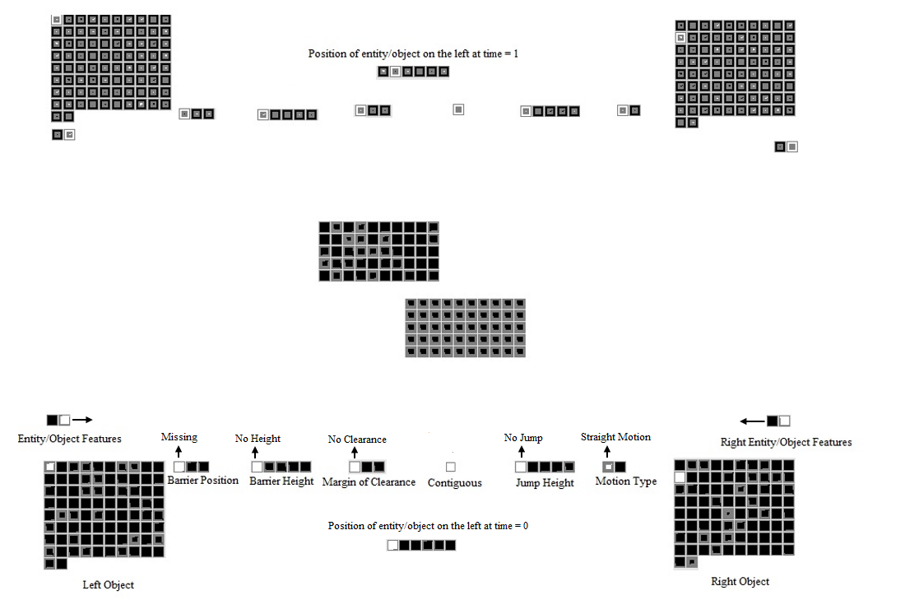
Recurrent Feedback

