Slide 1
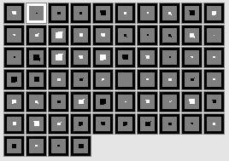
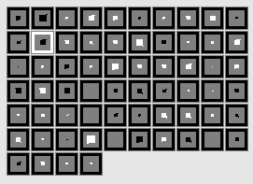






Saliva sharing
Non-saliva sharing
Distressed
Non-distressed
Saliva sharing
Non-saliva sharing
Comforting Action
Distressed Action
Saliva Sharing Action
Saliva sharer
Non-saliva sharer
Saliva sharer
Non-saliva sharer
Saliva sharer
Non-saliva sharer
Saliva sharer
Non-saliva sharer
Saliva Sharing Left Identity
Comforting Left Identity
Saliva Sharing Right Identity
Comforting Right Identity
Food item 1
People Left
People Right

Slide 2
Comforting
Non-comforting
Distressed
Non-distressed
Saliva sharing
Non-saliva sharing
Comforting Action
Distressed Action
Saliva Sharing Action
Saliva sharer
Non-saliva sharer
Comforter
Non-comforter
Saliva sharer
Non-saliva sharer
Comforter
Non-comforter
Saliva Sharing Left Identity
Comforting Left Identity
Saliva Sharing Right Identity
Comforting Right Identity
Food item 1
Person 2
Person 12
People Left
People Right

