Slide 1
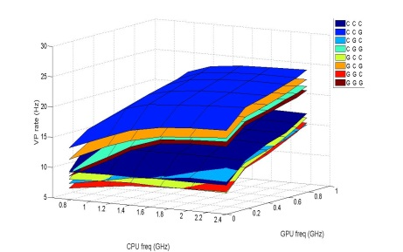
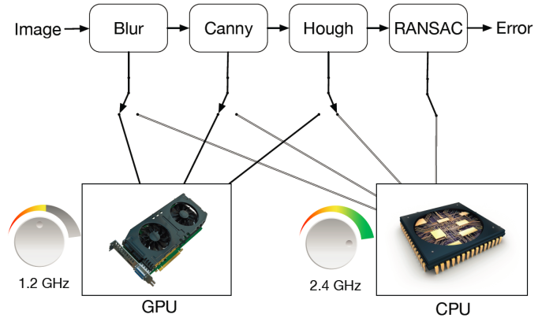
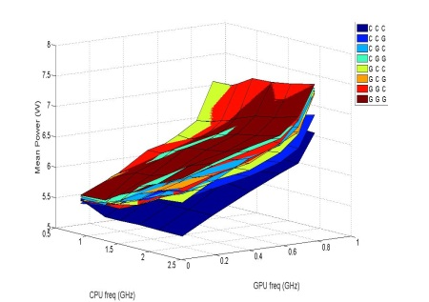




Offline
Online
Supervisor
$$⍺\left(t\right)=f(xv\left(t\right),xm\left(t\right))$$
Profiling
$maxσ,Fc,Fg⍺\left(t\right)T\left(σ,Fc,Fg\right)+(1−$ $⍺\left(t\right)$)/P($σ,Fc,Fg$)
$$σ,Fc,Fg$$
$$xv\left(t\right),xm\left(t\right)$$
Throughput
Vanishing point with hardware optimizations
Image from Camera
Power
Physical System
$$xv\left(t\right),xm\left(t\right)$$
ω(t)
Controller

