Slide 1
Human-Machine Interfaces for Operating a Blimp
Krebs Matthias, Ledergerber Anton
12.06.2012
Internal supervisors:
Javier Alonso Mora, Konrad Rudin

Slide 2
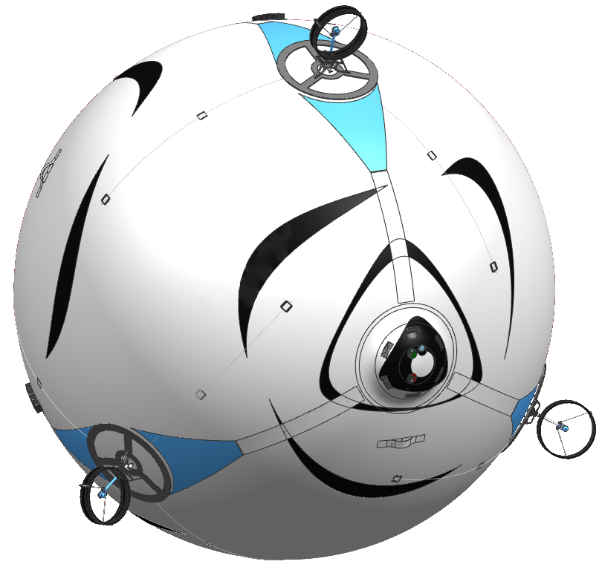
Motivation
Skye‘s unique property: 6 controllable degrees of freedom
Develop a unique HMI and generate Trajectories
Motor Platform
Camera System
Control Unit
Accelerometer Gyroscope Magnetoscope Barometer GPS
Spherical Hull
Filled with Helium
Communication
Xbee 2.4 GHz Fasst WiFi

Slide 3
Bachelor’s Thesis
Overview
Main tasks
Develop Control Modes for 6DoF Motion
Realize HMI
Generate 3D Trajectories
Content
HMI
Trajectories

Slide 4
Control Modes
Definition
Direct
Control
Assisted
Control
Half Automatic Control
w_{x}^{B}
M_{x}^{B}
v_{x}^{I}
w_{x}^{B}
F_{x}^{B}
e_{x}^{B}
e_{x}^{B}
w_{y}^{B}
e_{y}^{B}
e_{x}^{B}
w_{y}^{B}
e_{y}^{B}
F_{y}^{B}
M_{y}^{B}
v_{y}^{I}
e_{y}^{B}
e_{z}^{B}
e_{z}^{B}
e_{z}^{B}
F_{z}^{B}
v_{z}^{I}
w_{z}^{B}
w_{z}^{B}
M_{x}^{B}

Slide 5
Control Modes
Implementation

Slide 6
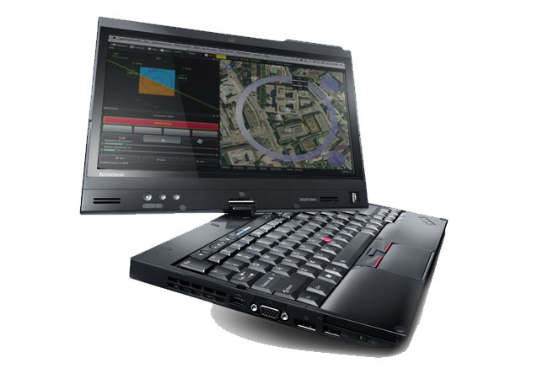
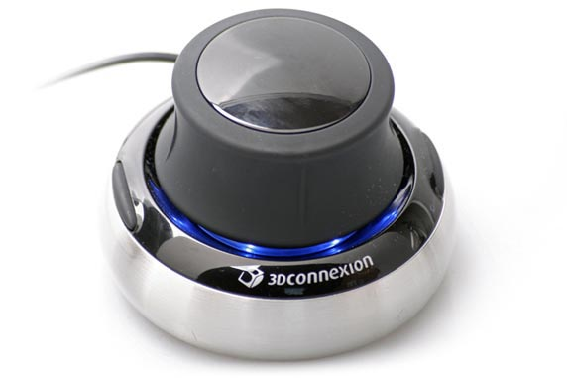
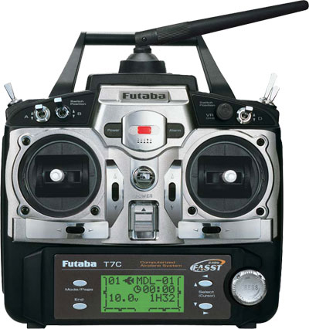
Devices
HMI

Slide 7
GUI
HMI
Widget kurzbeschrieb
Evolution with skye =>Testphase, jede Achse, 3dMouse, Touchinputs, Waypoints

Slide 8
Video
Video in Aktion

Slide 9
Path/Trajectory
Trajectories
Generell, was ist das Ziel von diesem Teil der BA?
Unterschied Path/Trajektorie anhand bekannter Darstellung

Slide 10
Approximation/Interpolation
Trajectories

Slide 11
Spline Degree
Trajectories
-cubic
-quartic
-quintic

Slide 12
Spline Degree, Mot_Alloc
Trajectories
C³ Continuity would be best!
Yet C² seems to be sufficient
Decision
Consider the other effects of the spline degree choice, if quartic has no drawbacks, choose quartic.

Slide 13
Parameterization
Trajectories
The decision of parameterization affect the geometry of the path as well as the properties of the trajectory!

Slide 14
Parameterization
Trajectories
Equally-distant
Chord-distant
Arc-distant
Centripetal

Slide 15
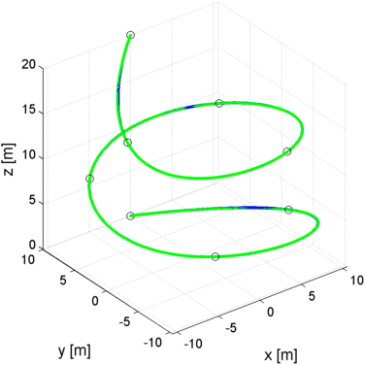
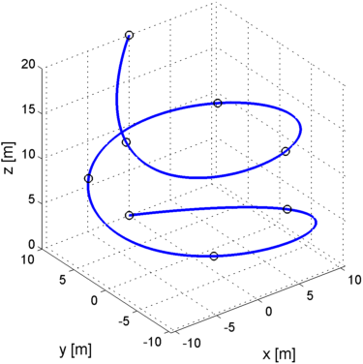
Trajectory-Controllers
Trajectories
Precise path tracking
Low power consumption
Time equivalence (trajectory tracking)
Trajectory
Trajectory and Simulation Trace

Slide 16
Trajectory-Controllers
Trajectories
3 different approaches: Trajectory Following Pure Pursuit Cross Track
(Lookahead) (Closest Point)
Trajectory
Pos Control
Skye
Skye

Slide 17
Trajectory-Controllers
Trajectories
3 different approaches: Trajectory Following Pure Pursuit Cross Track
(Lookahead) (Closest Point)
Trajectory
Vel Control
Skye
Skye

Slide 18
Trajectory-Controllers
Trajectories
3 different approaches: Trajectory Following Pure Pursuit Cross Track
(Lookahead) (Closest Point)
Trajectory
Pos Control
Skye
Skye

Slide 19
Evaluation
Trajectories

Slide 20
>> Backup

