Slide 1
Legend
Main Node
Converter Node
Hardware
ROS Topic
ROS VRPN
Vicon Pose
(x_{vic}, y_{vic}, z_{vic,} ψ_{set})
Coord. Sys. Transform
Vicon Pose in MAVROS C.S.
(x_{map}, y_{map}, z_{map})
Quadrotor
Motor PWM
Pixhawk
Position Setpoint
MAVROS
Dynamics
Fused Pose Data
Visual Odometry
(v_{x}, v_{y}, v_{z})
Pose → Odom.
Pixhawk Pose Estimate
(x, y, z, ϕ, θ, ψ)
Depth and Grayscale Images
Fused Odometry
(v_{x}, v_{y}, v_{z})
Guidance Node
OctoMap
Obstacle Distance
(fused range x 5)
RTAB Map
Ultrasound
(range x 5)
OctoMap → 2D Map
Guidance
SLAM Pose
(x_{map}, y_{map}, z_{map)}
2D Occupancy Grid
IMU
(a_{x-body},a_{y-body},a_{z-body}, p, q, r)
Planning Node
Setpoint Position/Attitude
(x_{set}, y_{set}, z_{set} ϕ_{set}, θ_{set}, ψ_{set})

Slide 2
FLiR
WiFi Dongle
ODROID
Battery (14.8V)
5V
Regulator
14.8 V , .81 A
Guidance
5 V , 4 A
Pixhawk
Power Distribution
5 V , 0.3 A
14.8 V , 2-20 A
Radio Receiver
ESC
14.8 V
Motors

Slide 3
FLiR
I2C (Control)
SPI (Video)
Expansion Board
WiFi Dongle
ODROID
USB 2.0 (#2)
Guidance
USB 3.0 (#0)
USB 2.0 (#1)
Pixhawk
PWM
ESC
Radio Receiver

Slide 4
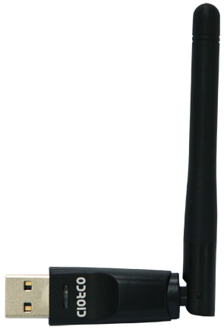
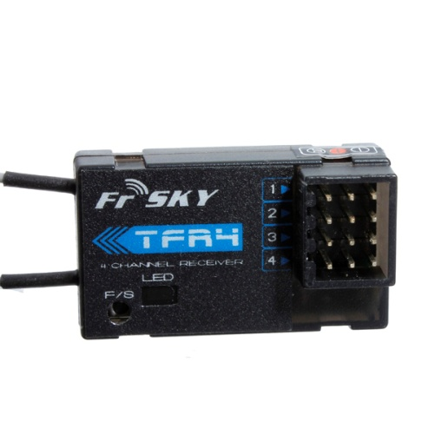
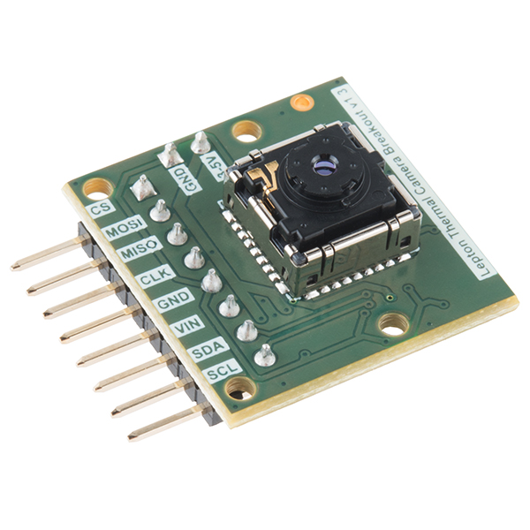
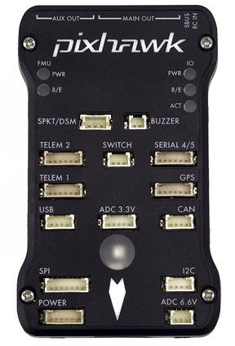
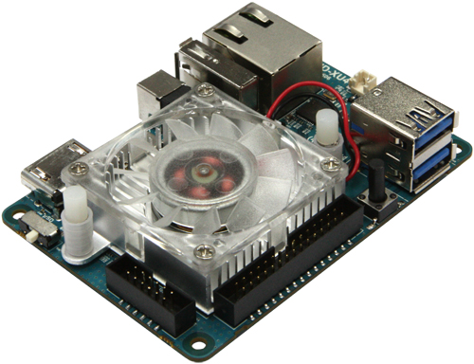

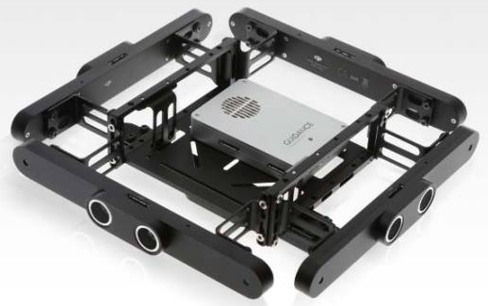
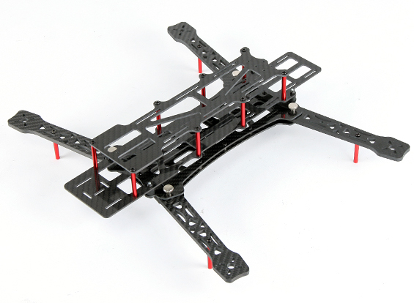
FrSKY TFR4 Radio Receiver
WiFi Adapter
FLiR Sensor
Pixhawk with PX4 Firmware
ODROID XU4
USB Hub
DJI Guidance
Power Distribution Board
ESC/ Motor
Power Module
Aliencopter Bee Quadrotor
Battery
BEC

Slide 5
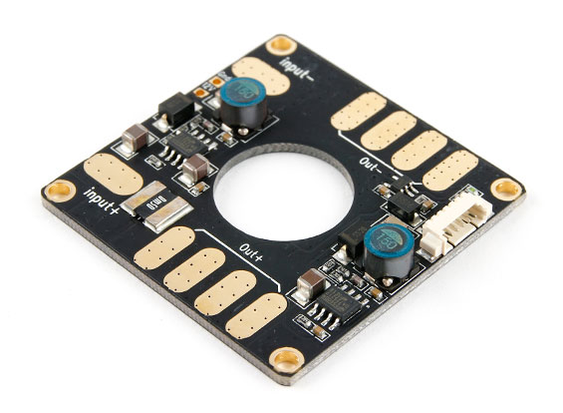
Comms
Power
FrSKY TFR4 Radio Receiver
WiFi Adapter
UART
(RC inputs)
USB 3.0 (#0)
Aliencopter Bee Quadrotor
USB 2.0 (#1)
(Position
Commands)
SPI (video)
I2C (control)
Pixhawk with PX4 Firmware
FLiR Sensor
ODROID XU4
PWM Signals
USB 2.0 (#2)
(odometry & BW images)
ESC/ Motor
Battery (14.8V)
DJI Guidance

Slide 6
Final Architecture
Ground Station
ROS publisher 10Hz
(HW Limited)
DJI Guidance
ROS master
Communicates with onboard flight computer
Data visualization with RVIZ
Provides depth map, grayscale images, and visual odometry for RTAB Map
USB
Pixhawk Autopilot
Odroid XU4
Ubuntu 14.04
Runs RTAB Map
Runs planning algorithms
Runs target ID algorithms
Running PX4 Firmware
Accept position/attitude setpoints from planning algorithm
Runs onboard position controllers
Provides attitude information to target ID algorithms
USB
SSH via WiFi
FLiR Sensor
Provides IR images for human identification
I2C & SPI

